Slide 1
Probability of exceedance tool and additional useful smart tools
Robert Deal
IFPS/GFE Team
WFO Burlington

Slide 2
Motivation
How does a IFPS/GFE centric forecaster provide DSS?
By producing “Forecaster DSS” tools
By improving the forecast, then the message becomes clearer.
Good forecast in, Good Message Out

Slide 3
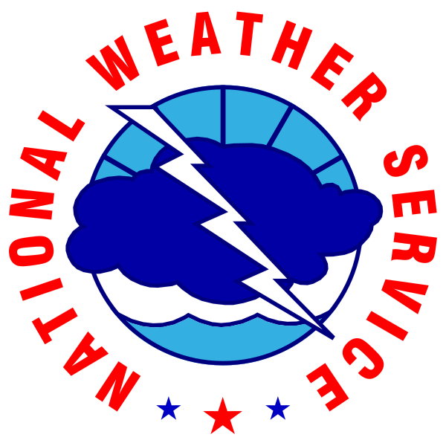
Organization
Probability of Exceedance
Confidence Levels
Hazard Check
Let your forecast dictate your hazards
Local “Ensemble” Smart Tools
PoP/QPF/Sky/Wx/Snow Ratio?

Slide 4
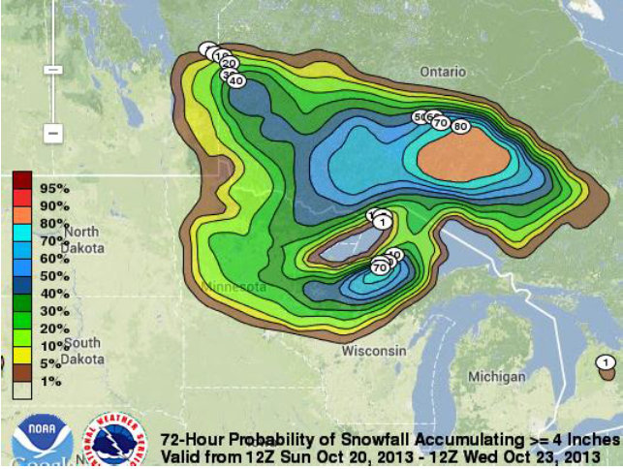
Probability of Exceedance
In a GFE World
We want to be able to answer the question:
How likely is an area going to get at least 1” inch of rain?

Slide 5
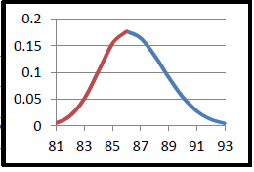
So what is Probability of Exceedance?
Area under a Probability Density Function (PDF) curve (assuming a binomial distribution) of a weather element given a specific threshold.
Simple case - Green Mountain Power calls. They read your forecast and found a high of 86 degrees. However, they make decisions to bring on additional power stations at 86 degrees. They want to know what the likelihood of seeing or exceeding 86 degrees is.
Probability
Consensus Temps
You’re not going to give them a chart like this…I hope!

Slide 6
Give credit where its due
We didn’t write this smart tool.
We did write a wrapper procedure to run the tool.
The author:
Darren Van Cleave (WFO MSO)
Available on the SCP

Slide 7
POE Tool
The output from BC grids can be considered a “calibrated probability”
(like SPC’s SREF page)
Note: Some options not available for BC grids (not running bias corrects on Wind, Sky, QPF and MinRH)
Author: Darren Van Cleave, WFO STO

Slide 8
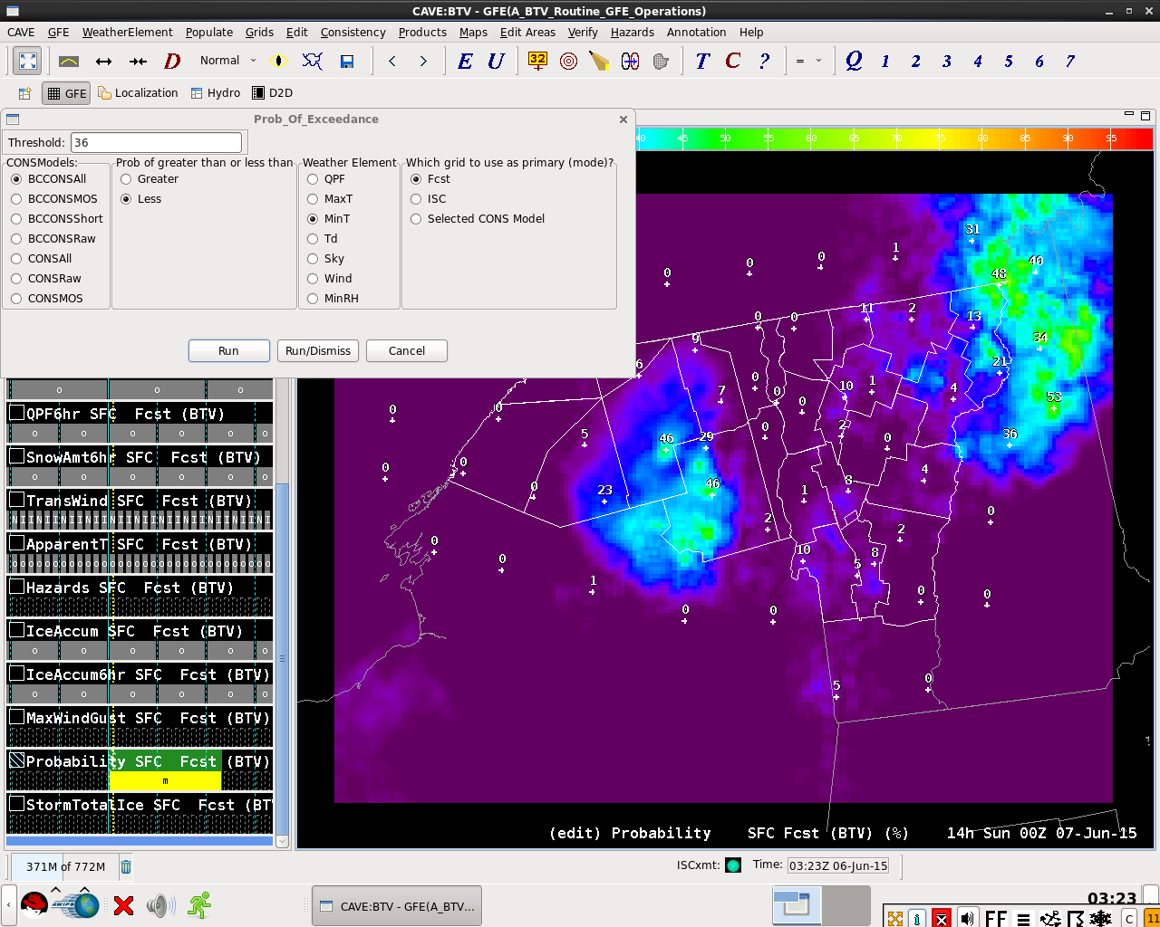

Slide 9
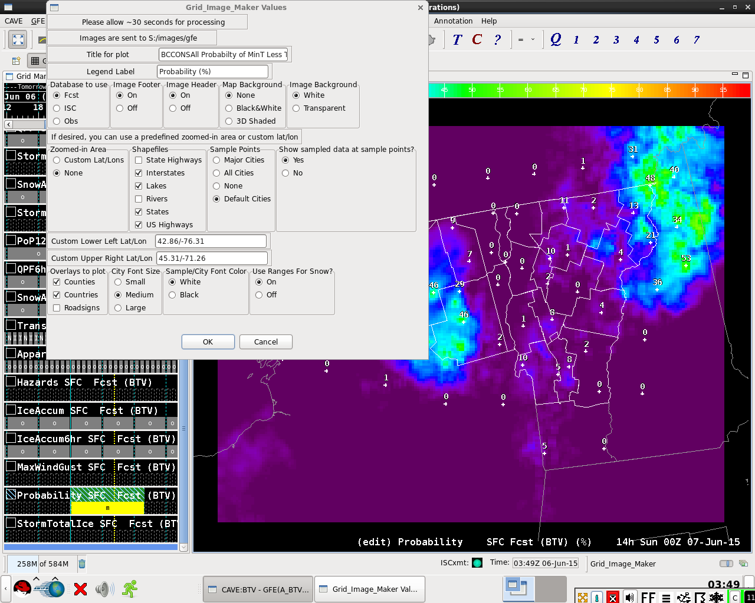
DSS-friendly PoE graphics available thru GridImageMaker!

Slide 10
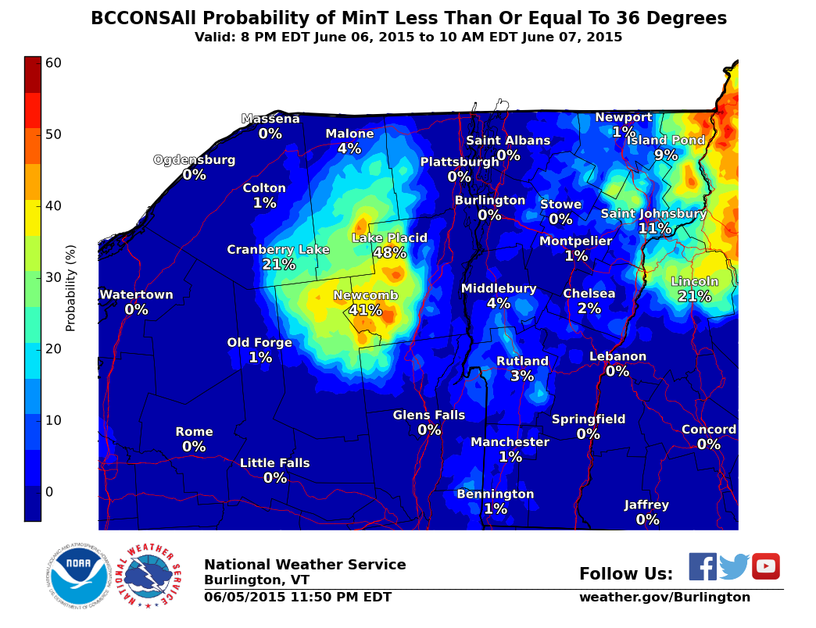

Slide 11
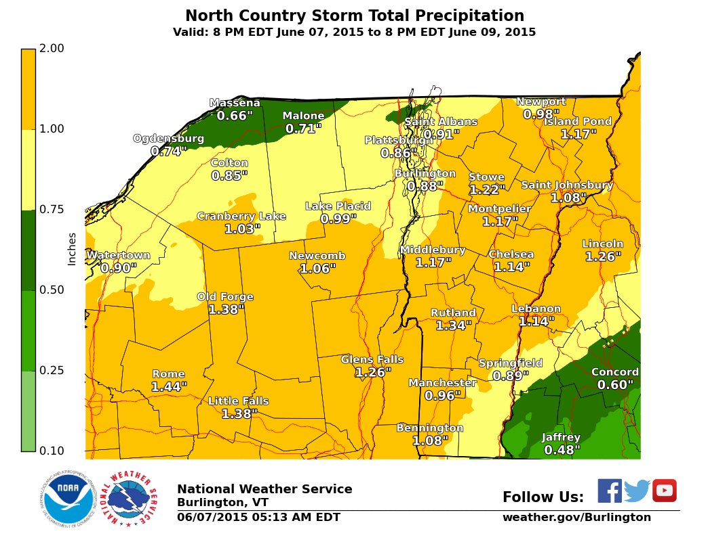
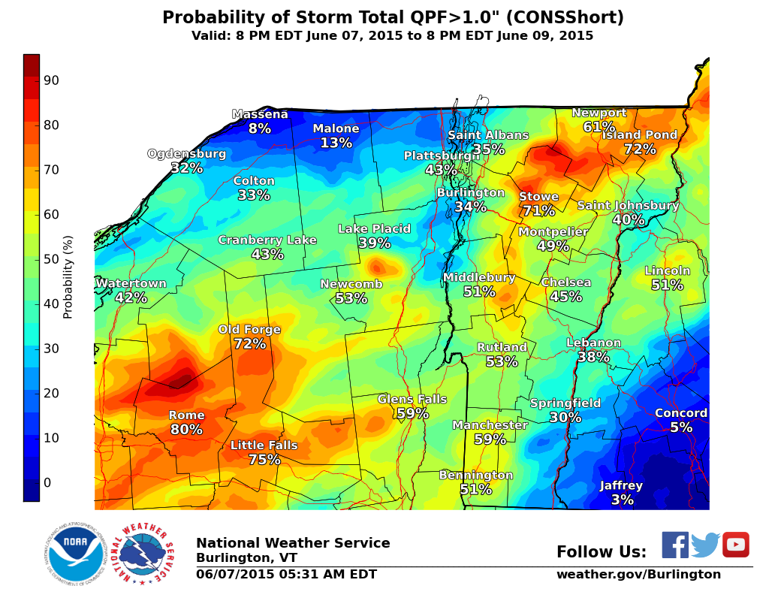
How likely is an area going to get at least
1” inch of rain?

Slide 12
Where we are going
Snow?
We are going to be a test office this winter and will run comparisons events from the WPC Probability Grids and our locally produced Probability Grids

Slide 13
Hazard Check: Let the forecast dictate the Hazards

Slide 14
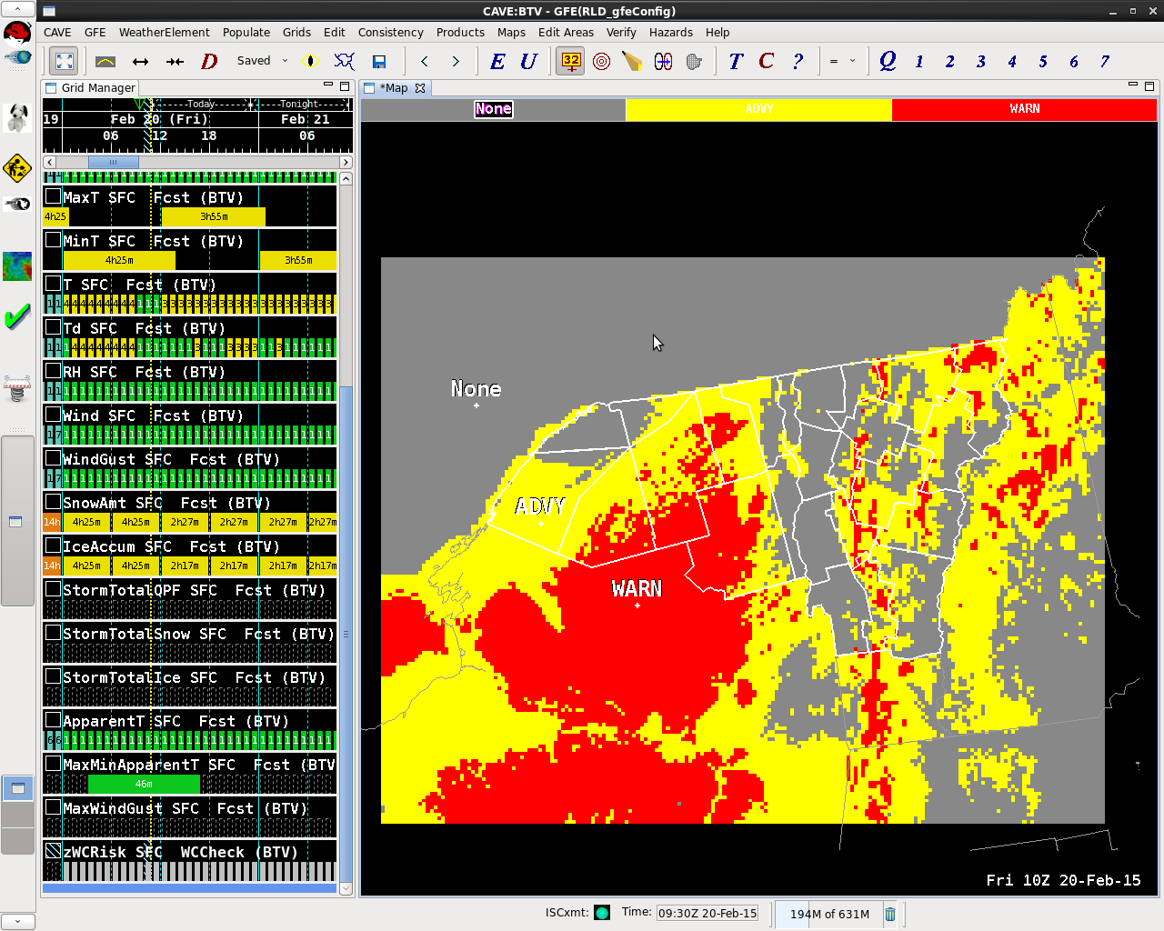
Hazard Check
Used for:
Wind
Wind chill
Frost/Freeze
Heat Index
Fire Weather
Snow WWA
Ice WWA
Best Utilization: Marginal Events/ Crossover Events

Slide 15
HazCheck Gui

Slide 16
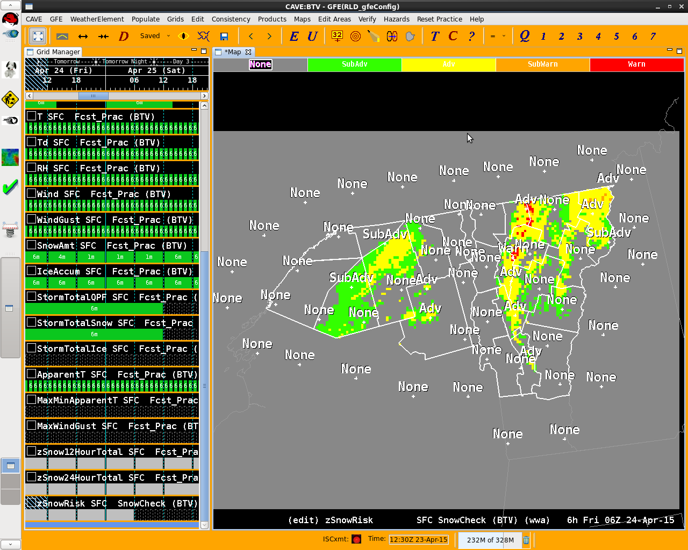
Hazard Check: Snow Ady

Slide 17
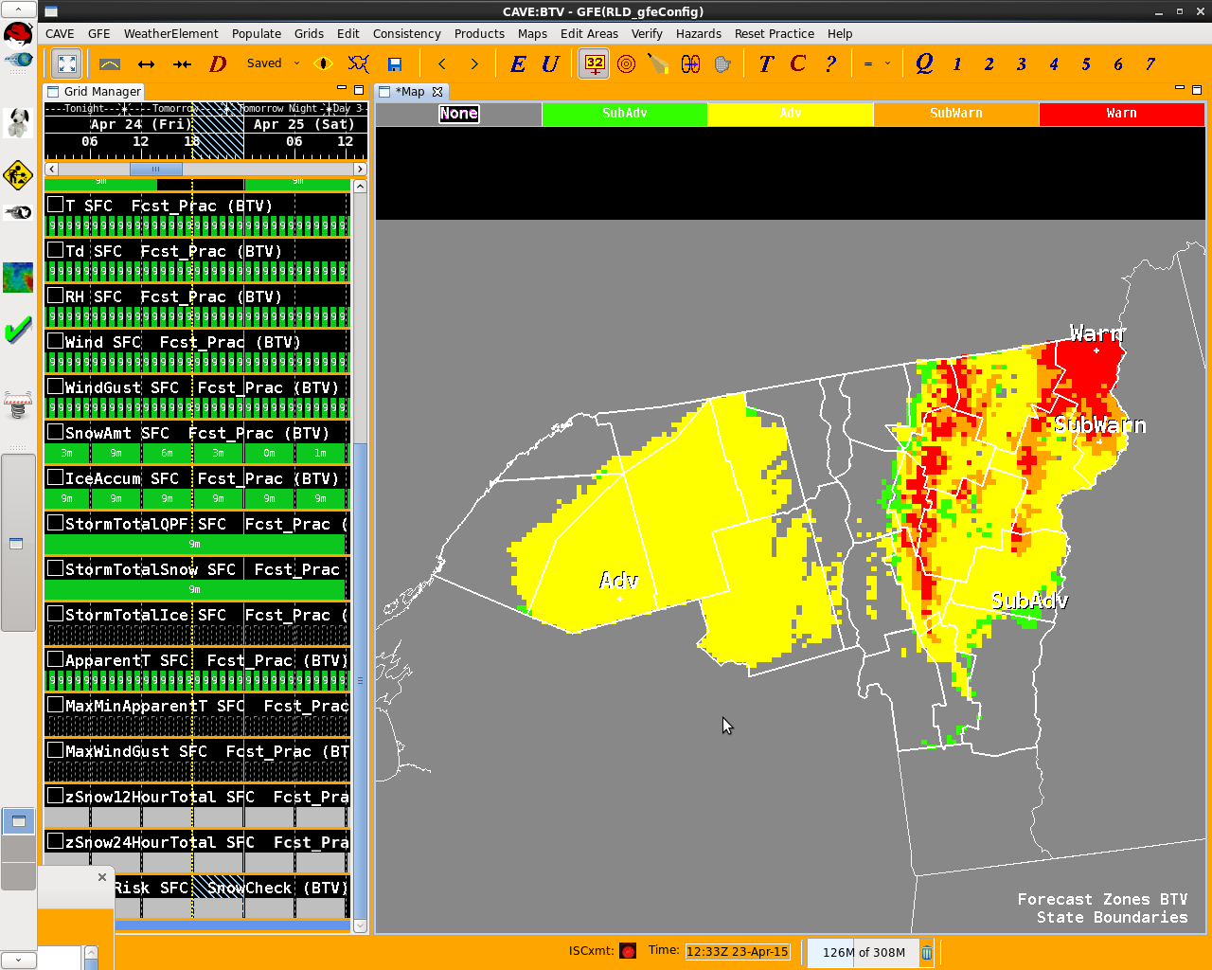
Hazard Check: Snow WWA

Slide 18
HazCheck - Example: 05/04/2015
Fire Weather Concerns:
Local Fire Weather Community asks us to NOT issue Red Flag Warnings for marginal events*
Local Criteria
RH < 30%
Winds Sustained or Frequent Gusts >25 mph
Rainfall < 0.25” in the last X days
Pre-Greenup 5 days
After-Greenup 8 days
*Understand that is not always the case

Slide 19
Forecast RH at 20Z
RH Threshold
> 30%

Slide 20
Forecast Winds at 20z
Wind Threshold
> 25 mph

Slide 21
Forecast Wind Gusts at 20z
Wind Gust
Threshold
> 25 mph

Slide 22
Fire Weather Hazard Check at 20z
RFW Criteria:
Yellow Shading

Slide 23
Frost/Freeze Example
Frost Advisory
During Growing Season
Temps 33-36
Wind 7mph
Skies < 70%
Freeze Warning
Temps <= 32

Slide 26
Frost/Freeze Decision Time
A Frost Advisory would be issued for W Saint Lawrence and the Champlain Valley
A Freeze Warning would be issued for the Adirondacks and the Northeast Kingdom

Slide 27
Hazard Check - Summary
Allows a forecaster to quickly view both spatially and temporarily where gridded forecasts support hazard issuance
Can be run on Local CWA or ISC
Helps determine exact starting/end points for hazard headlines
Useful in crossover advisory-> warning time periods.

Slide 28
Other Additional Useful Smart Tools*
We’ve started using Smart tools to create on the fly ensembles
PoP_fm_Model_Reflectivity
PoP_PercentofModels
PoP_fm_QPFBlender
Sky_fm_ModelClouds
ConvectiveWx
Snow_fm_ModelRatio

Slide 29
Examples
PoP’s
Wx

Slide 30
Debuting this Winter…
The idea is to make a sort of ConsAll grid but all the forecasters to chose the inputs.
The Blend is your Friend!

Slide 31
Questions?

