Slide 1
Implementation and Evaluation Activities at the Environmental Modeling Center
Corey Guastini*, Geoffrey Manikin, Glenn White
Environmental Modeling Center
NCEP/NWS/NOAA
US. Department of Commerce
College Park, MD
*I. M. Systems Group Inc.

Slide 2
Overview
Update on EMC implementations:
RAP/HRRR
NAM
GFS
Future of EMC model suite
About the Model Evaluation Group

Slide 3
RAP and HRRR implementation
Targeted for February 2016

Slide 4
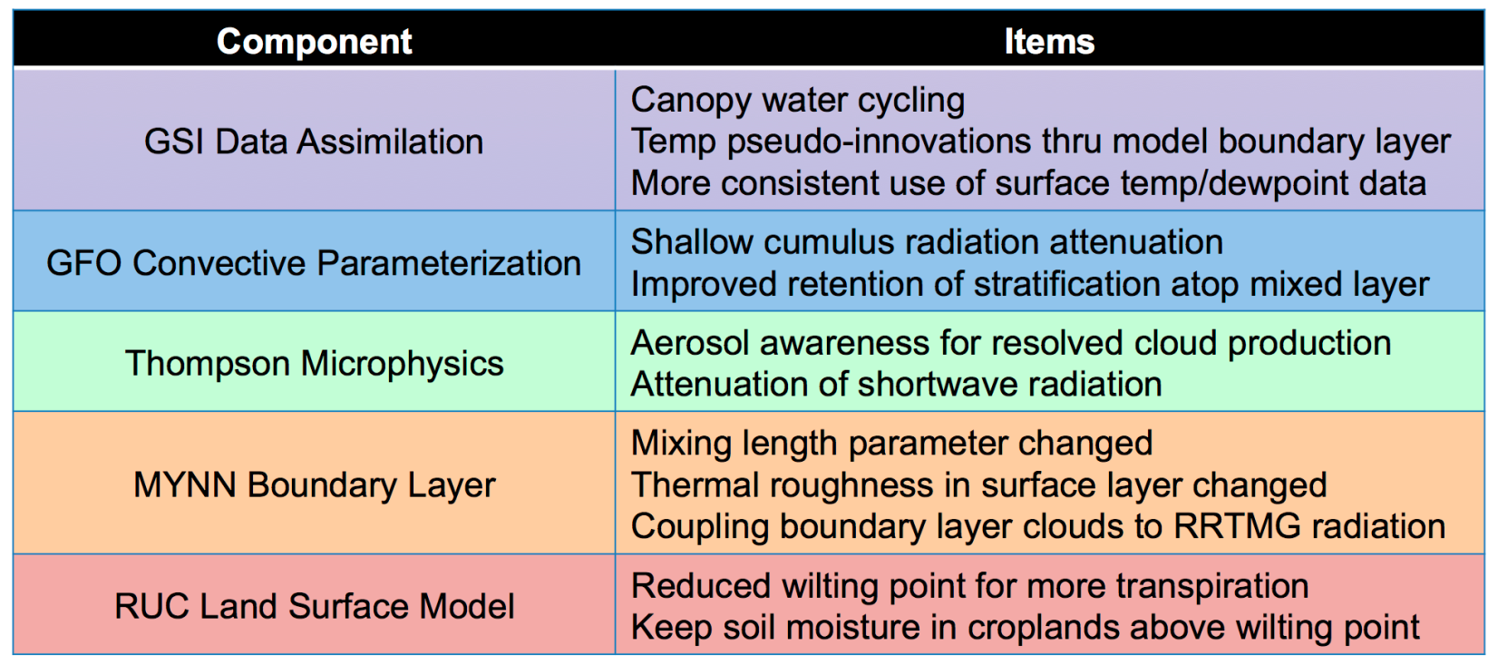
Alleviation of warm/dry bias in RAP and HRRR was a main goal for the upcoming implementation
“Bottom line, we’re reducing the incoming short-wave radiation though better representation of both resolved and unresolved (sub-grid) cloud effects and also promoting a moister/cooler surface and boundary layer through increases/decreases in latent/sensible heat flux from the ground.”
Source: Curtis Alexander

Slide 5
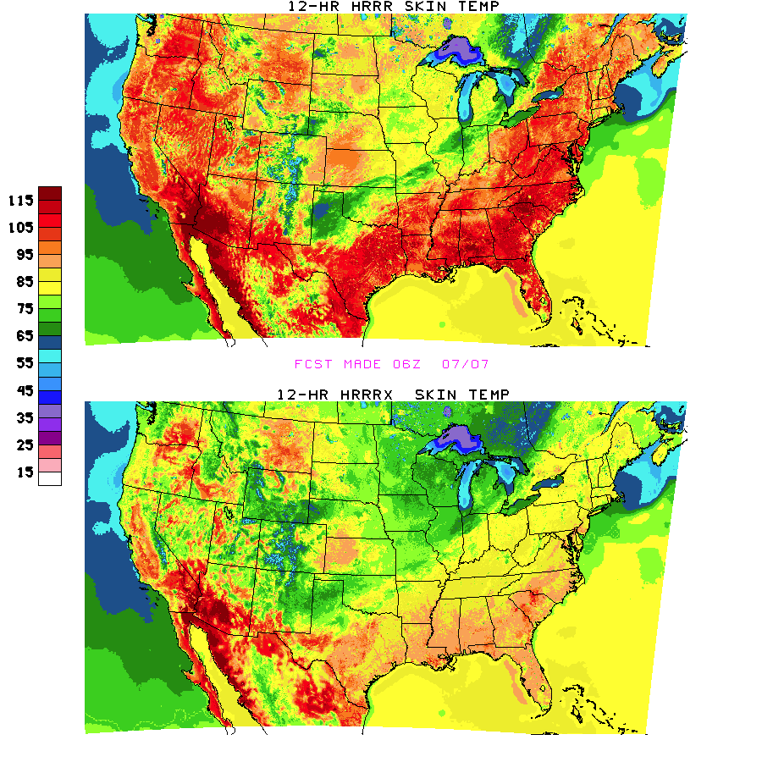
Comparison of HRRR and HRRRX skin temperatures, valid 1800 UTC 7 July 2015
Substantial reduction of skin temperature in parallel HRRR

Slide 6
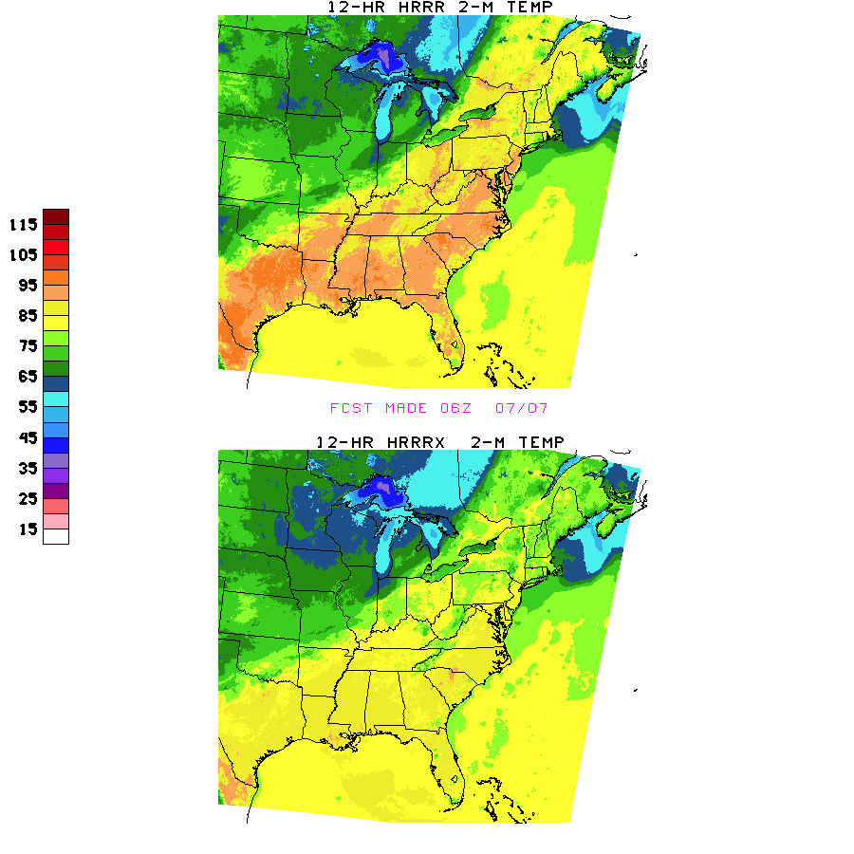
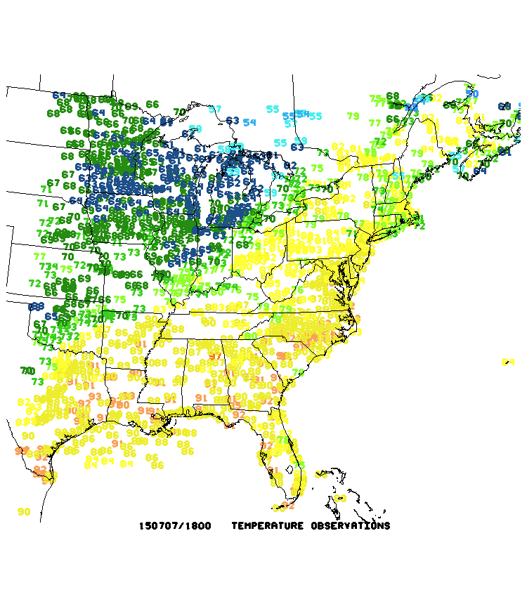
Comparison of HRRR and HRRRX 2-m temperatures, valid 1800 UTC 7 July 2015
Corresponding reduction of 2-m temperature in parallel HRRR
observations

Slide 7
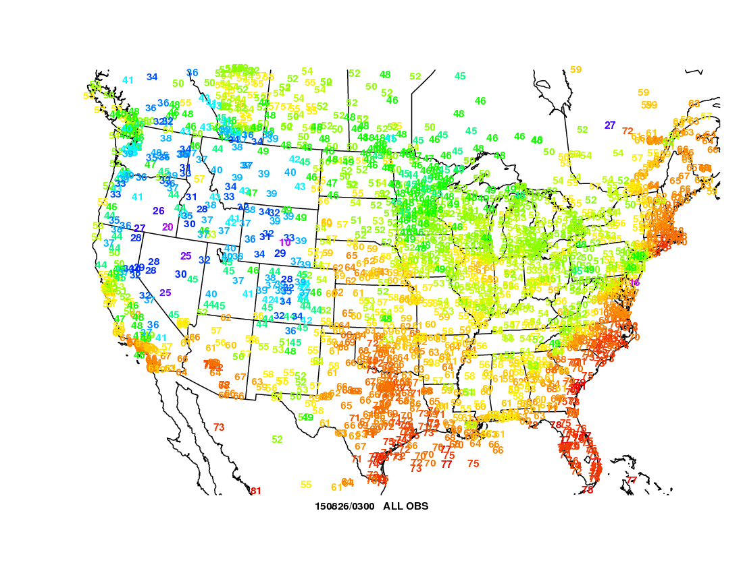
Comparison of RAP and RAPX 2-m dew points, valid 0300 UTC 26 August 2015
Operational RAP much too dry

Slide 8
Comparison of RAP and RAPX surface CAPE, valid 0000 UTC 11 June 2015
area over 5000 J kg⁻¹

Slide 9
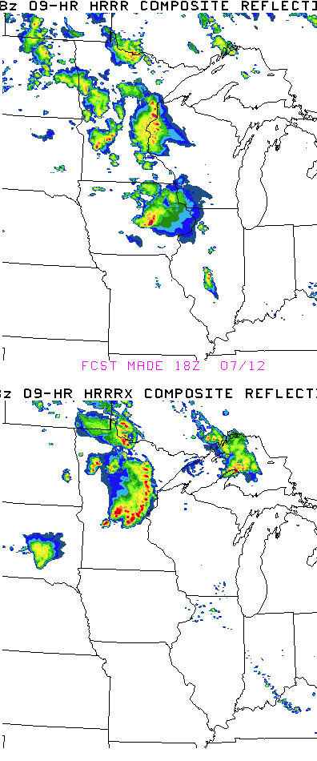
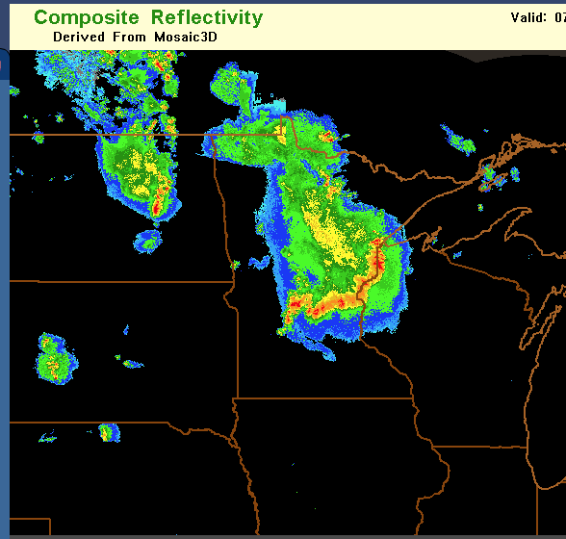
Comparison of HRRR and HRRRX composite reflectivity, valid 0300 UTC 12 July 2015 F09

Slide 10
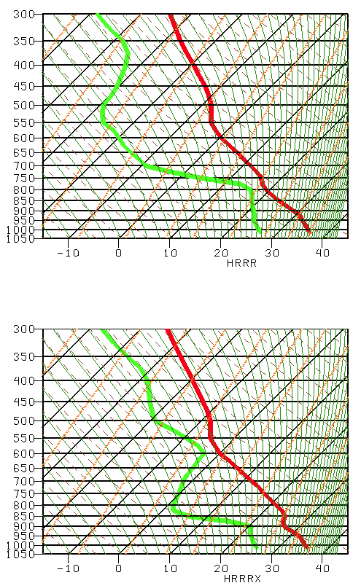
HRRR comparison soundings in extreme southwest MN F00
Operational
Operational HRRR at F00 has a deep mixed PBL with minimal CIN
Parallel
Parallel HRRR has a shallower PBL and substantially more CIN

Slide 11
NAM implementation
Targeted for 2016

Slide 12
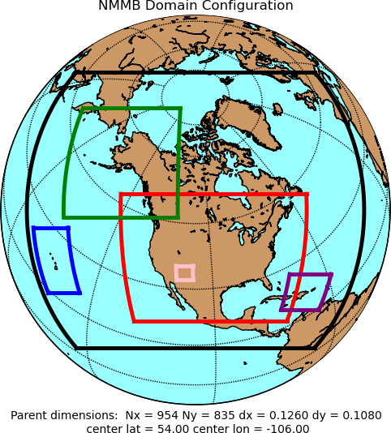
NAM Upgrade for Spring 2016
Resolution changes
CONUS (4 km) and Alaska (6 km) nests → 3km
Sync AK and CONUS On-Demand Fire Weather nests → 1.5 km
Model physics changes
Land-sfc model changes → Address winter Td biases
Adjustment to convection in 12 km NAM → Improve QPF bias
Use of Radar Reflectivity-derived temperature tendencies in model's initialization
Improved short-term forecasts of storms at 3 km
Use AFWA snow depth with envelope adjustment technique
Better specification of snow depth and snow cover (problematic this past winter)
Tropical cyclone relocation
Improved tropical cyclone initialization
3 km
1.5 km
12 km
NAM Rapid Refresh (NAMRR):
Hourly Updates
Cycles 12 km parent domain AND the 3 km CONUS/Alaska nests
Nests are not currently cycled in operations
18 h forecast every hour
First step in construction of a convection-allowing ensemble
HRRR (ARW members) + NAMRR (NMMB members)
Source: Eric Rogers and Jacob Carley

Slide 13
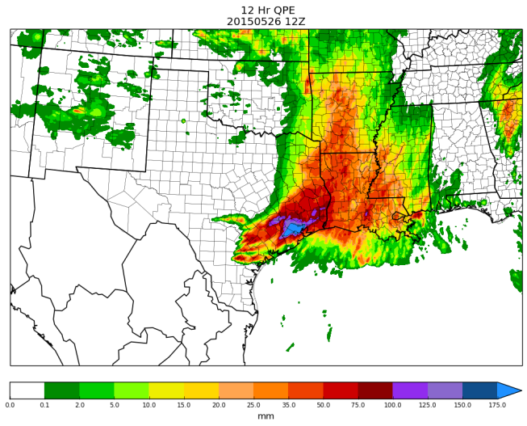
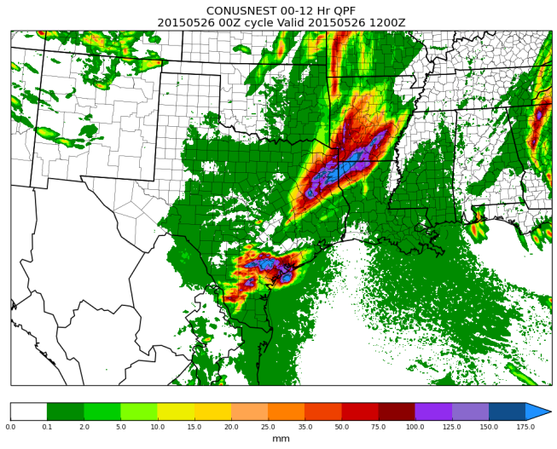
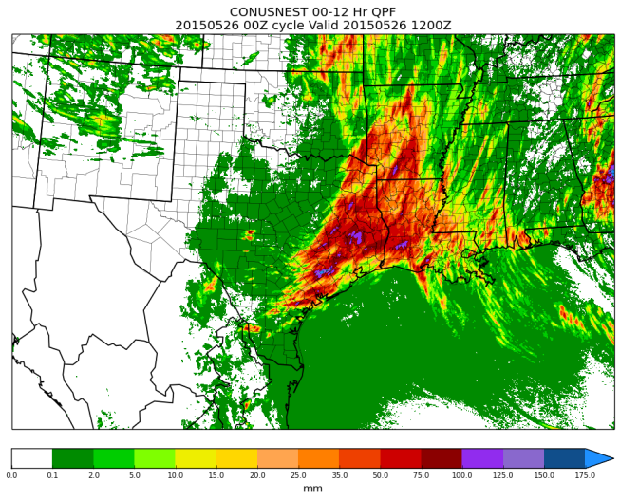
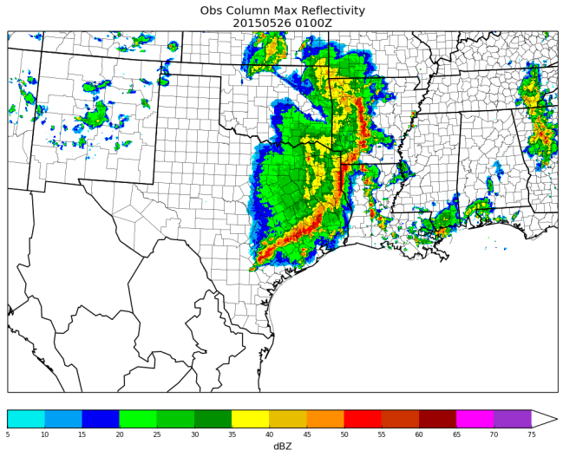
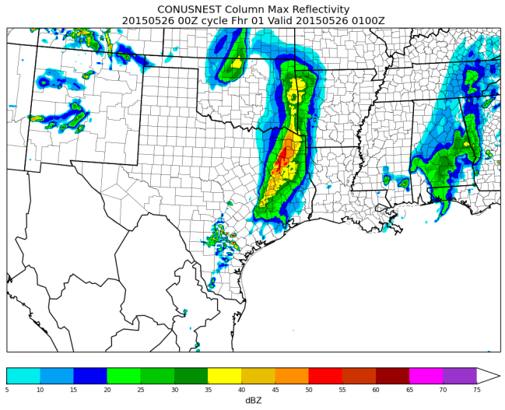
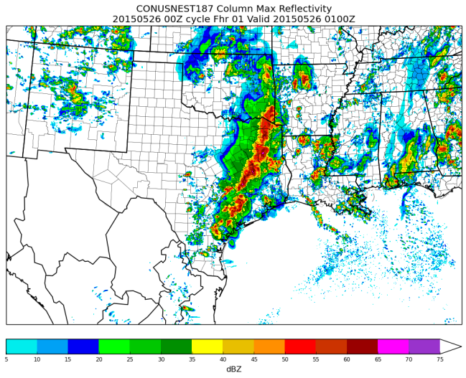
3 km Parallel NAMRR vs Ops 4 km NAM CONUS nest
May 26th, 2015 Extreme Precipitation Event in Houston, TX.
4 km Ops NAM CONUS nest
3 km NAMRR CONUS nest
00-12HR Obs Precip.
00-12HR Forecast Precip.
00-12HR Forecast Precip.
4 km Ops NAM CONUS nest
3 km NAMRR CONUS nest
01Z Obs Composite dBZ
1HR Forecast Composite dBZ
1HR Forecast Composite dBZ
NAMRR CONUS nest forecast is significantly better
Use of radar reflectivity in analysis
Use of a data assimilation cycle for the CONUS nest

Slide 14
GFS implementation
Targeted for 2016
Verification:
http://www.emc.ncep.noaa.gov/gmb/wd20rt/vsdb/pr4dev/
Not quite a frozen system

Slide 15
Some of the Likely changes
4-D hybrid ensemble variational analysis
Utilize ozone cross covariances
Reduce tropospheric localization length scales
Increase ensemble weight
Remove additive error inflation
Observations
Radiances
Upgrade to CRTM v2.2.1
Assimilate all-sky AMSU-A Radiances
Monitor AVHRR radiances
Modify thinning/weight in time
SATWND observation changes
Assimilate AVHRR winds
Monitor VIIRS winds
Aircraft observation changes
Bias correct aircraft data
Assimilate aircraft moisture data
Forecast model
Semi-implicit upgrade
Reduces noise
Changes to evaporation and roughness length parameters over grassland/cropland
Increase evaporation
Reduce low-level wind speed
Convective gravity wave upgrade
Limits extreme effects
Main new feature
Source: Mark Iredell

Slide 16
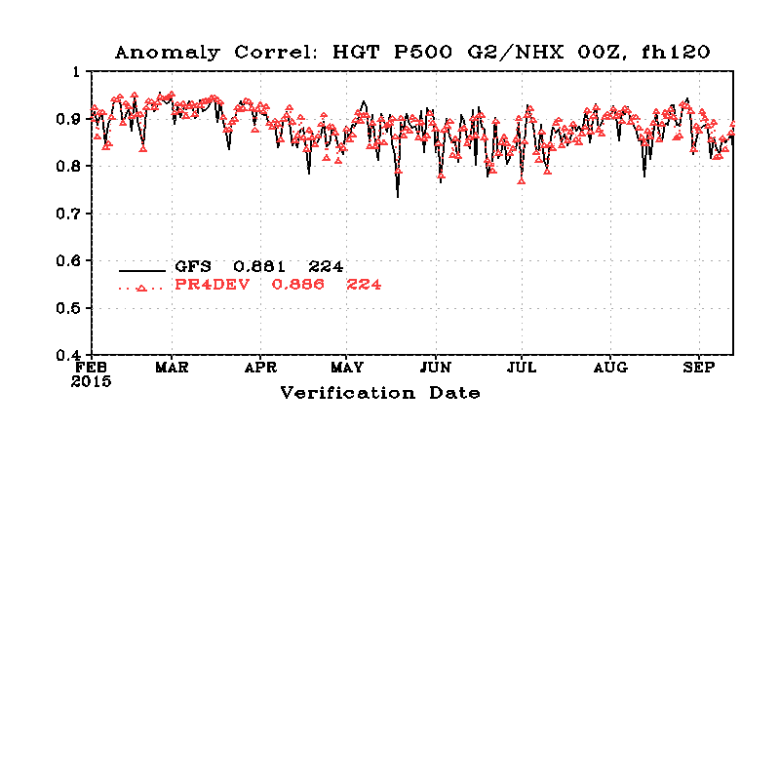
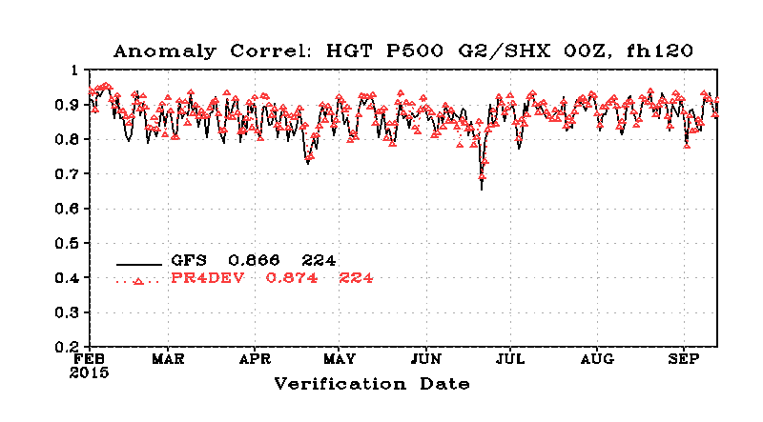
Parallel GFS doing better than operational by the measure of F120 500-hPa anomaly correlation in both hemispheres
Source: Fanglin Yang’s verification page

Slide 17
Northern Hemisphere, statistically significant improvement out to F120
Southern Hemisphere, statistically significant improvement out to F144
Source: Fanglin Yang’s verification page

Slide 18
Future of model suite

Slide 19
Future 3-tier regional ensemble system
(SREF & HREF & SSEF)
1. Continental scale | 2. Regional scale | 3. Local scale
~9-12km North America WRF-ARW, NEMS-NMMB Parametrized physics SREF | ~3km CONUS, Alaska, HI, PR WRF-ARW & NEMS-NMMB Convection-allowing physics HREF | ~1km Placeable or storm-following WRF-ARW & NEMS-NMMB Cloud-resolving physics SSEF
“Standard-Resolution Ensemble Forecast” 6-? members Hourly update run to 18-24hr | “High-Resolution Ensemble Forecast” 6-? members hourly update run to 18-24hr | “Storm-Scale Ensemble Forecast” hourly update run to 18-24hr
SREF “Standard-Resolution Ensemble Forecast” | HREF “High-Resolution Ensemble Forecast”
26 members 6 hourly runs to 84-96hr | ? members 6 hourly extended from 18-24hr to 48-60hr
?
Is there a need?
Source: Geoff DiMego
Notes:
I’ve tweaked this slide

Slide 20
Future 3-tier regional ensemble system
(SREF & HREF & SSEF)
1. Continental scale | 2. Regional scale | 3. Local scale
~9-12km North America WRF-ARW, NEMS-NMMB Parametrized physics SREF | ~3km CONUS, Alaska, HI, PR WRF-ARW & NEMS-NMMB Convection-allowing physics HREF | ~1km Placeable or storm-following WRF-ARW & NEMS-NMMB Cloud-resolving physics SSEF
“Standard-Resolution Ensemble Forecast” 6-? members Hourly update run to 18-24hr | “High-Resolution Ensemble Forecast” 6-? members hourly update run to 18-24hr | “Storm-Scale Ensemble Forecast” hourly update run to 18-24hr
SREF “Standard-Resolution Ensemble Forecast” | HREF “High-Resolution Ensemble Forecast”
26 members 6 hourly runs to 84-96hr | ? members 6 hourly extended from 18-24hr to 48-60hr
?
Is there sufficient need?
?
Is there a need?
Source: Geoff DiMego
Notes:
I’ve tweaked this slide

Slide 21
Model Evaluation Group (MEG)

Slide 22
Model Evaluation Group (MEG)
proven entity with 3 years of enhancing communication among EMC and the field
Weekly synoptic briefing of model performance
Organized evaluation of EMC parallels and experiments
Critical feedback to developers
Updates users regarding model changes and issues
Listens to users’ feedback
Rapidly generates critical case studies (e.g. 2012 Mid-Atlantic derecho, 2013 El Reno tornado/OKC flooding, 2015 PHL-NYC snow forecast bust, Superstorm Sandy….)

Slide 23
2012:
In late spring 2012, Geoff Manikin noted late afternoon moist bias in GFS (especially over Midwest)
Associated cold bias seen in summer—most evident in hot air masses
EMC aware of the issue by the time forecasters noticed and implemented correction in late summer 2012
Dashed: 12-h model forecasts , Solid: observed

Slide 24
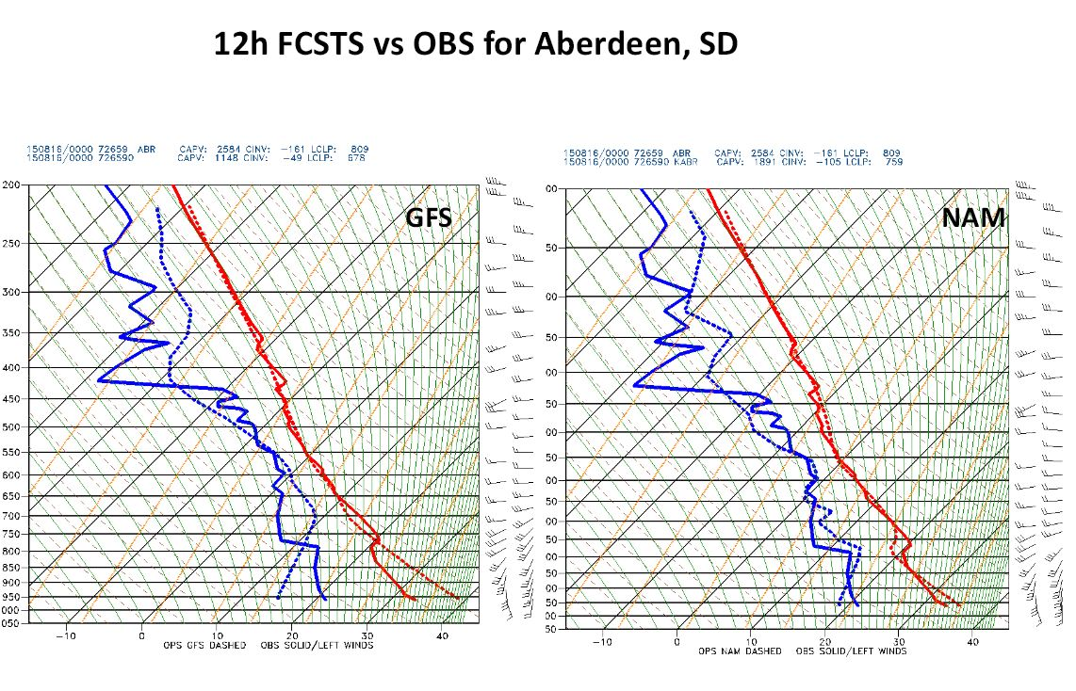
This summer:
Pronounced warm/dry bias in the GFS noticed and brought to EMC’s attention by many users
Land surface team responded quickly with tests changing land surface parameters:
rsmin for grassland from 45 to 20
rsmin for cropland from 45 to 20
roughness length for cropland from 3.5cm to 12.5cm
Last year an EMC model evaluation group was formed; weekly EMC synoptic evaluations are held. The group noted a late afternoon moist bias in the GFS (especially over the mid west US); an associated cold bias became evident as summer arrived since the problem was most evident in hot air masses. EMC was aware of issue by the time forecasters noticed it and were able to implement a correction in early September.
Last year an EMC model evaluation group was formed; weekly EMC synoptic evaluations are held. The group noted a late afternoon moist bias in the GFS (especially over the mid west US); an associated cold bias became evident as summer arrived since the problem was most evident in hot air masses. EMC was aware of issue by the time forecasters noticed it and were able to implement a correction in early September.

Slide 25
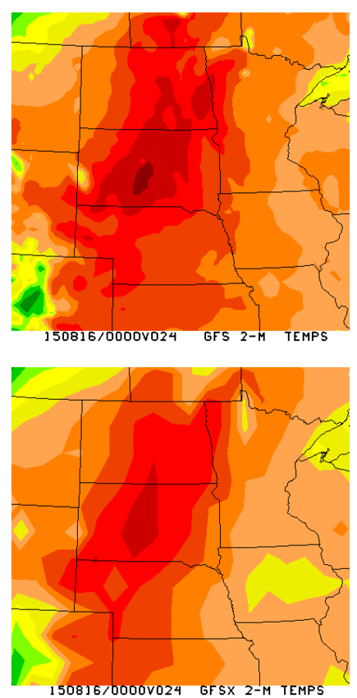
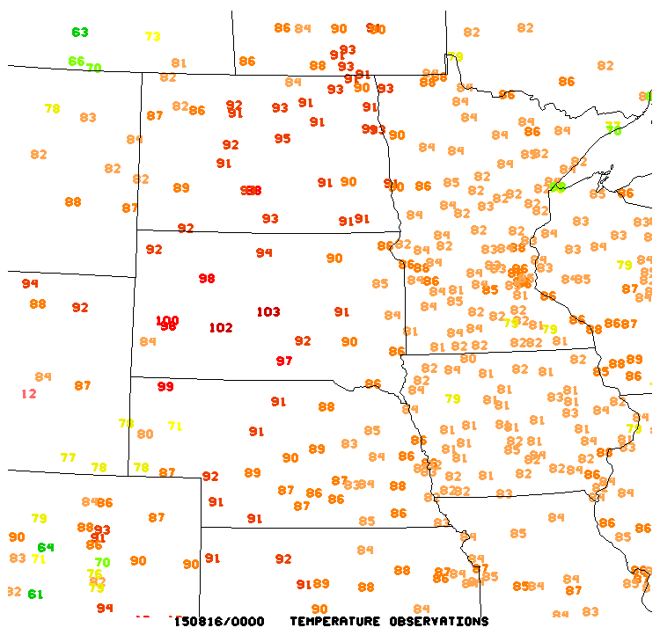
2m T 24-hr forecasts valid 00z 8/16
Temperature decrease in tests

Slide 26
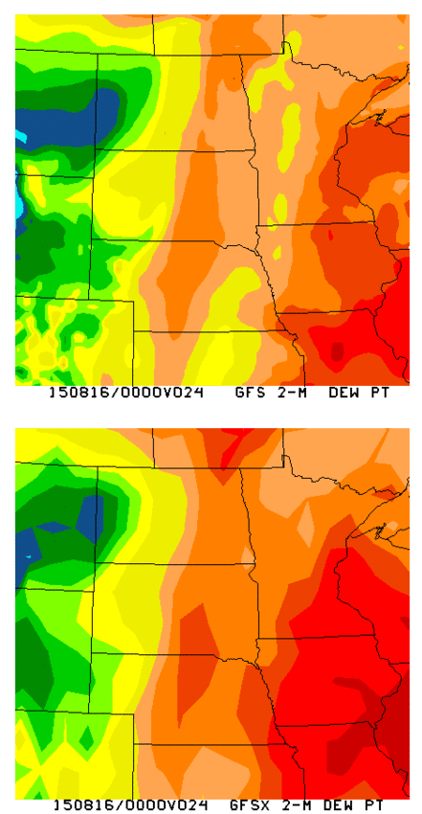
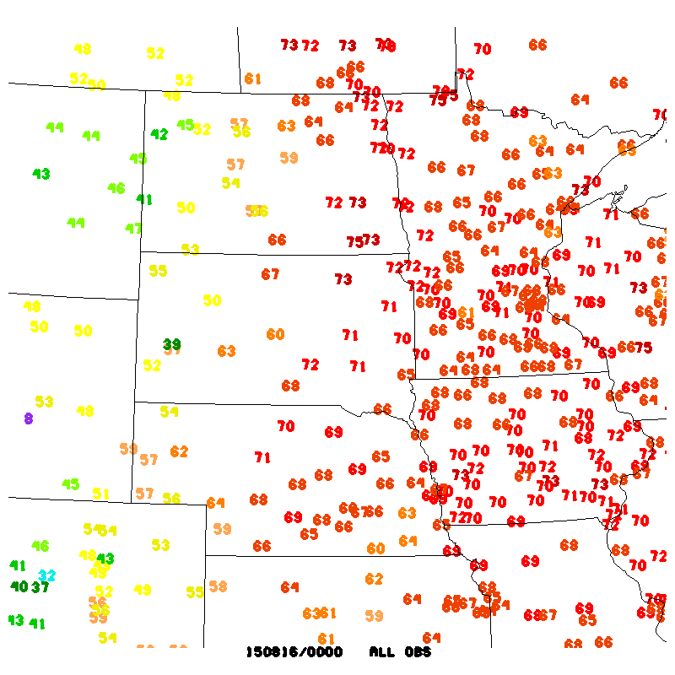
2m Td 24-hr forecasts valid 00z 8/16
Dew point increase in tests

Slide 27
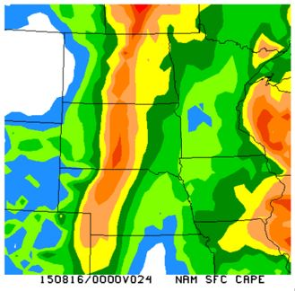
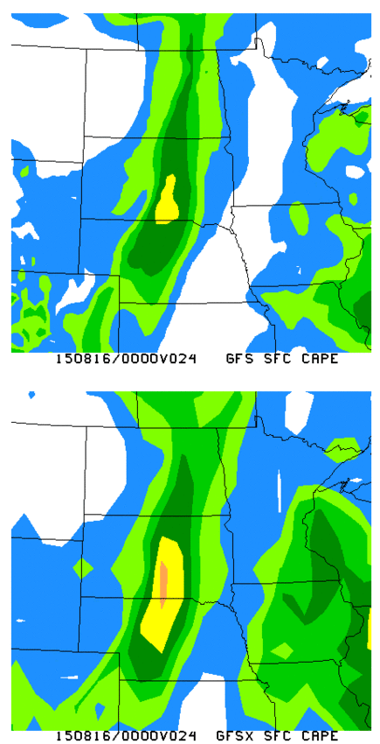
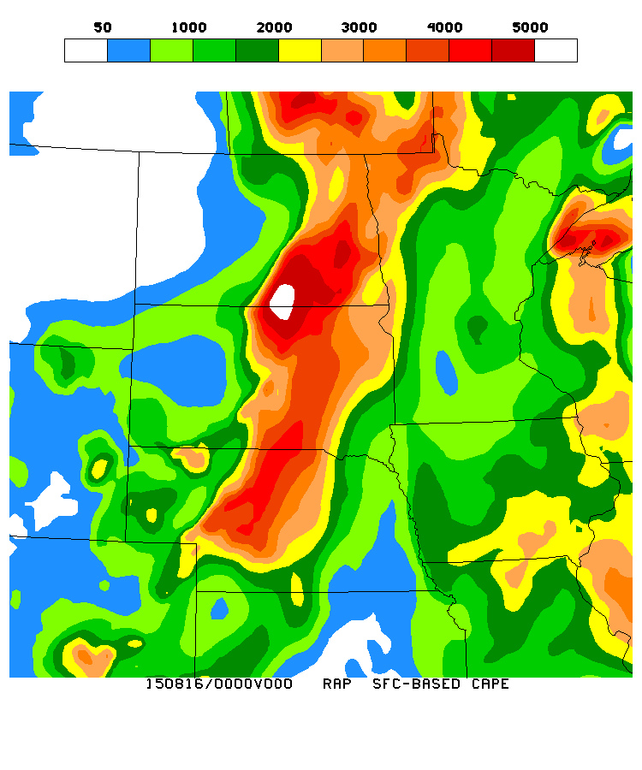
Surface CAPE forecasts (J kg⁻¹)
NAM
Operational GFS
Test GFS
RAP analysis
Marginal CAPE increase in tests

Slide 28
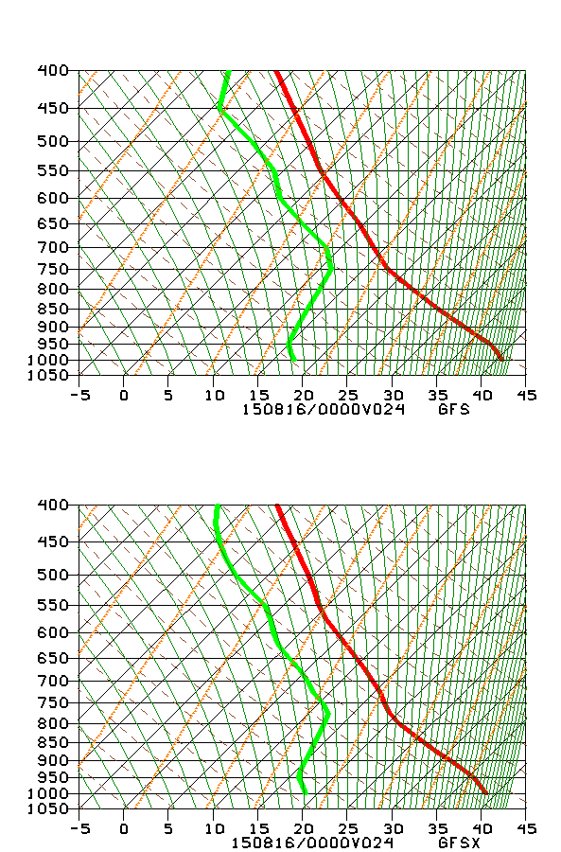
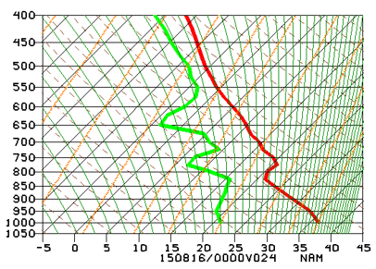
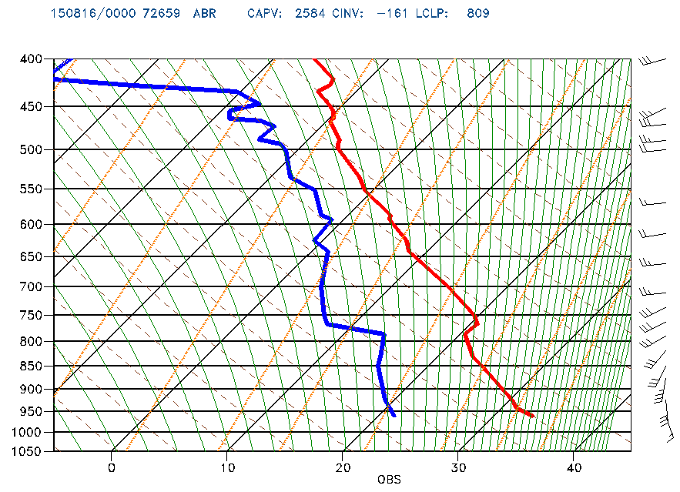
Sounding comparisons
NAM F24
Ops GFS F24
Test GFS F24
Observed
capping inversion
Test GFS still missing a lot of the boundary layer structure

Slide 29
EMC recommends joint projects with SOOs and DOHs:
Convection-permitting ensemble
Global models
Communications and dissemination
Visitors program between EMC and the rest of the NWS
EMC’s Model Evaluation Group (MEG) center of joint activity

Slide 30
Field comments from SOO/DOH workshop
Establish VLab forum for increased communication
Create easy access information about models and parallels
Send modelers to field and vice versa
Get parallel data in AWIPS

Slide 31
MEG meetings Thursdays 11:30 AM EST
Presentations available to anyone with a noaa.gov email address at:
https://drive.google.com/drive/folders/0BySqFAN_J6G4cWdpNzBRMkM4ZVE
Webinars thanks to Southern Region
Everyone welcome
More info or forecast issues:
Glenn.White@noaa.gov
Geoffrey.Manikin@noaa.gov
Corey.Guastini@noaa.gov

Slide 32
Extra

Slide 33
GEFS implementation
Currently in parallel

Slide 34
GEFS Configuration
 | V10.0.0 (OPR) | V11.0.0 (PARA)
GFS Model | Euler, 2012 | Semi-Lagrangian, 2015
Resolution 0-192 h | T254 (52km) L42 (hybrid) | T_{L}574 (34km) L64 (hybrid)
Resolution 192-384 h | T190 (70km) L42 (hybrid) | T_{L}382 (52km) L64 (hybrid)
Computational Cost | 84 nodes (+ post process) | 300 nodes 1st segment 250 nodes 2nd segment
Execution time | 55 min | 35 min 1st segment 25 min 2nd segment
Output resolution | 1^{O} x 1^{O} | 0.5^{O} x 0.5^{O} for 0-8 days 1^{O} x 1^{O} the rest
Output frequency | 6h | 3h the first 8 days; 6h the rest
Yuejian Zhu

Slide 35
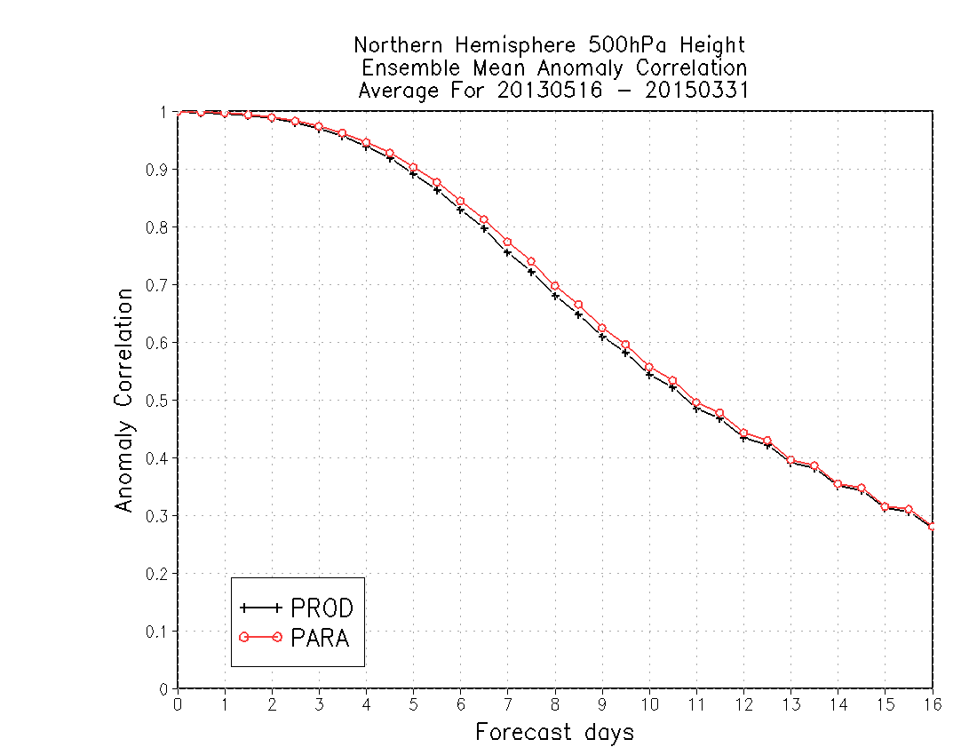
685 cases
77%
2% improvement of 7-day forecast AC score
75%
9.20d
9.52d
About 8 hours improvement of skillful forecast

Slide 36
SREF implementation
Currently in parallel

Slide 37
Jun Du

Slide 38
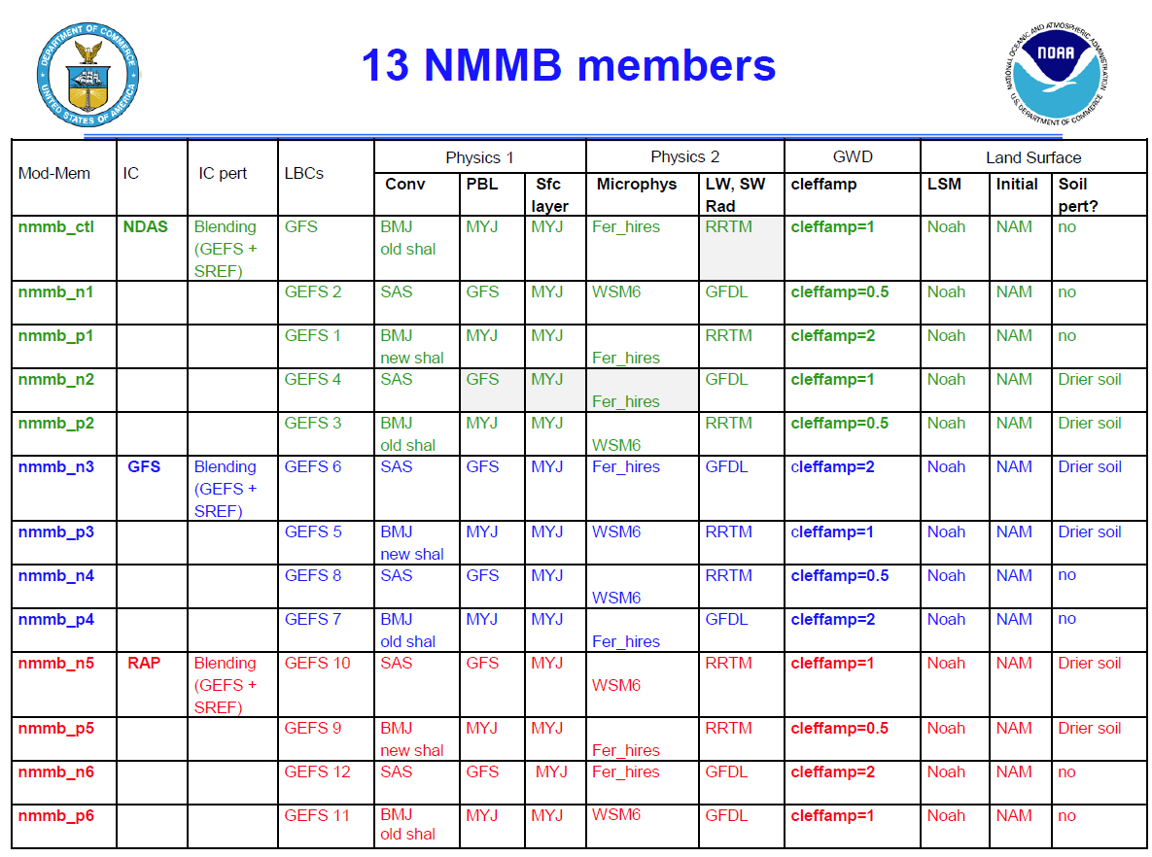
Jun Du

Slide 39
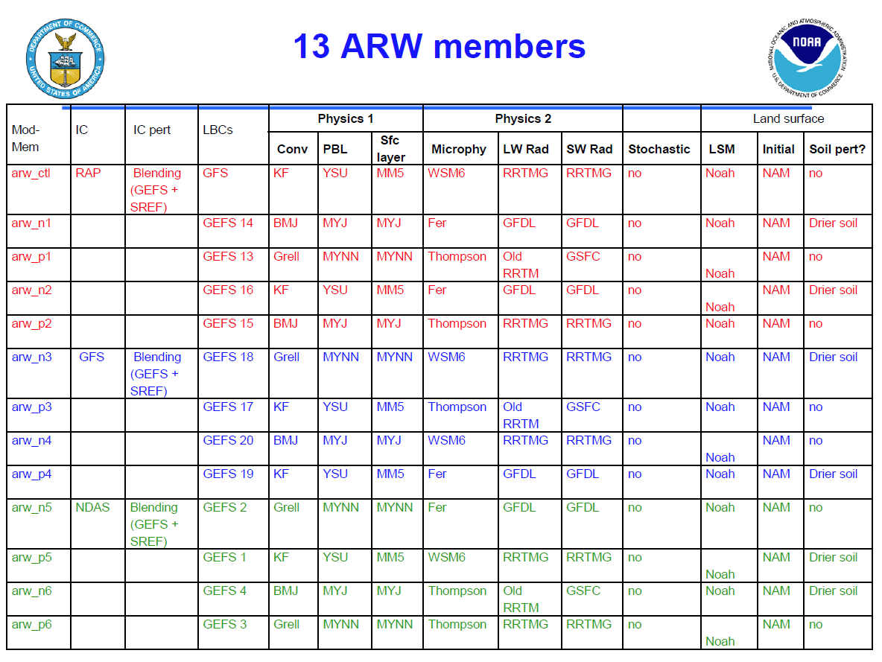
Jun Du

Slide 40
Jun Du

Slide 41
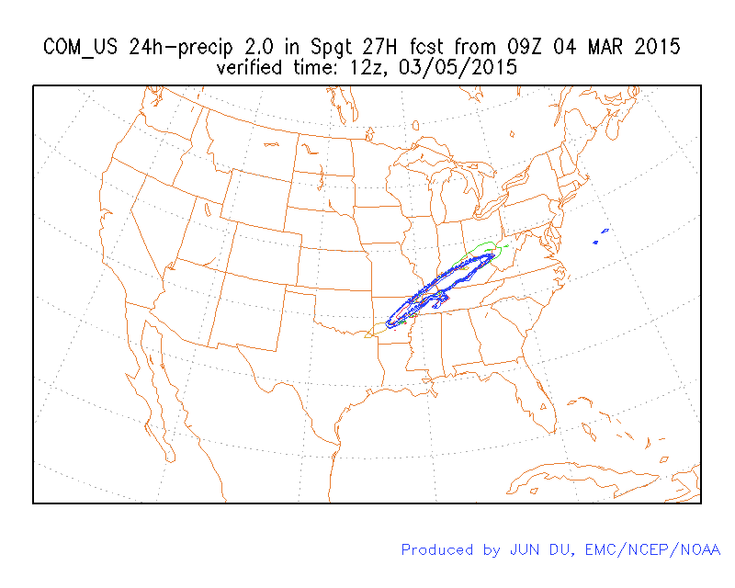
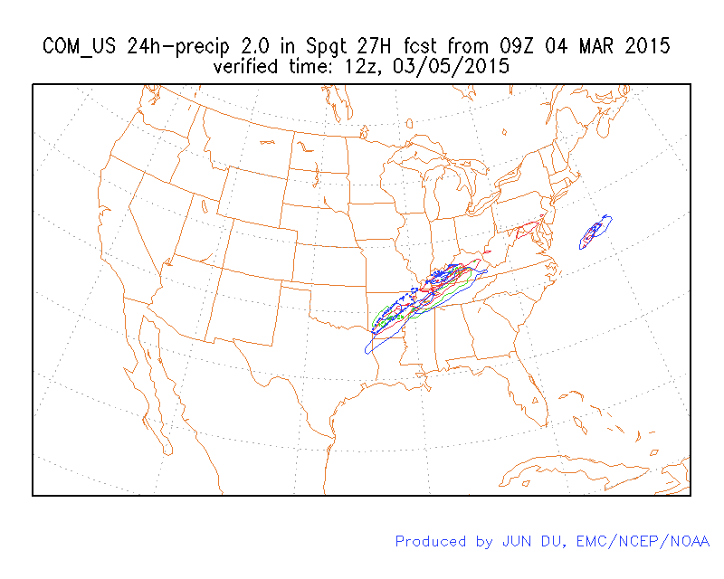
Operational
Parallel
Jun Du

Slide 42
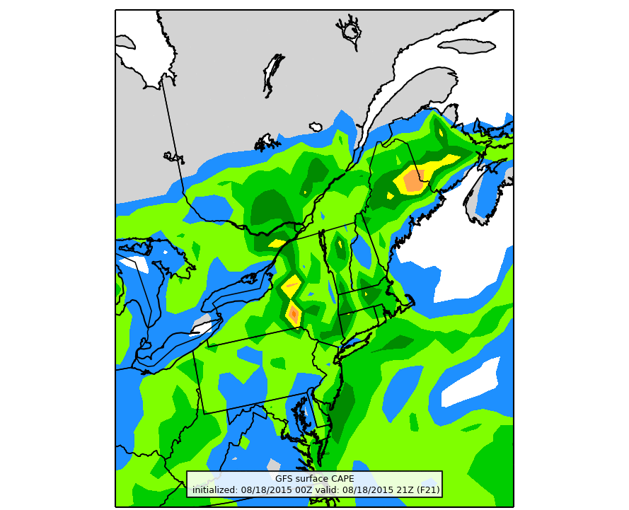
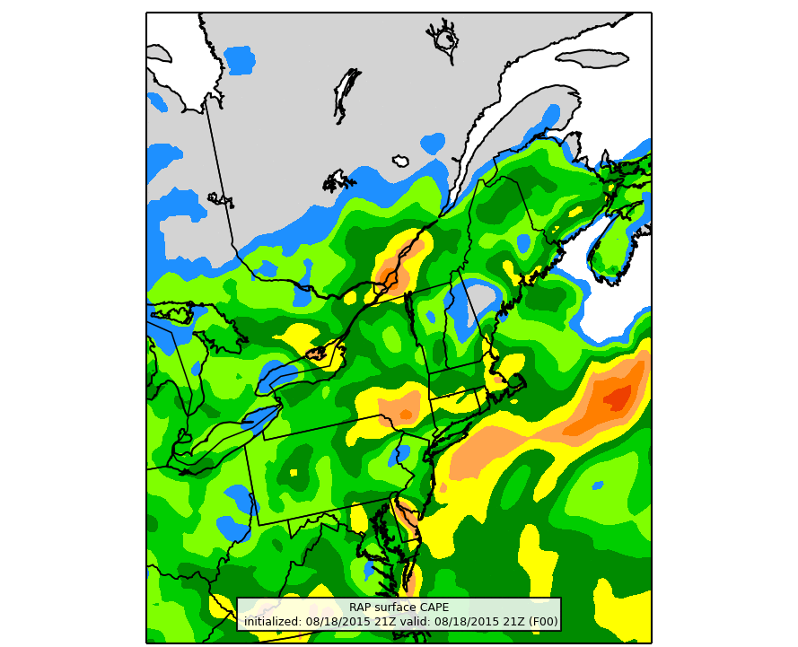
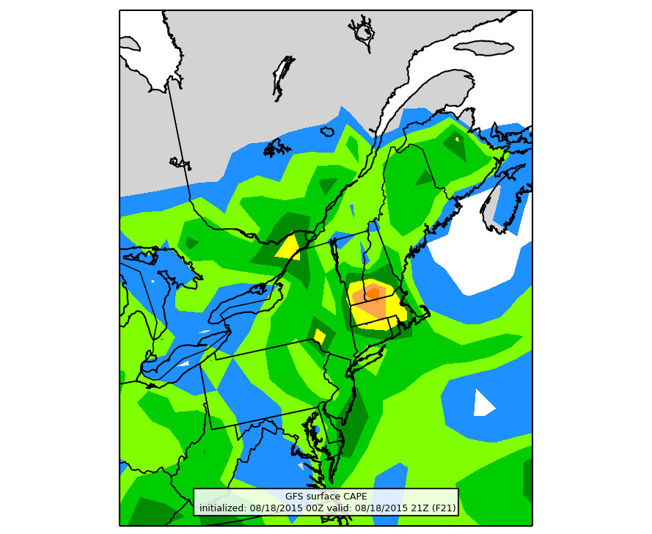
GFS
RAP analysis
2100 UTC 18 August CAPE
F21
Test GFS

Slide 43
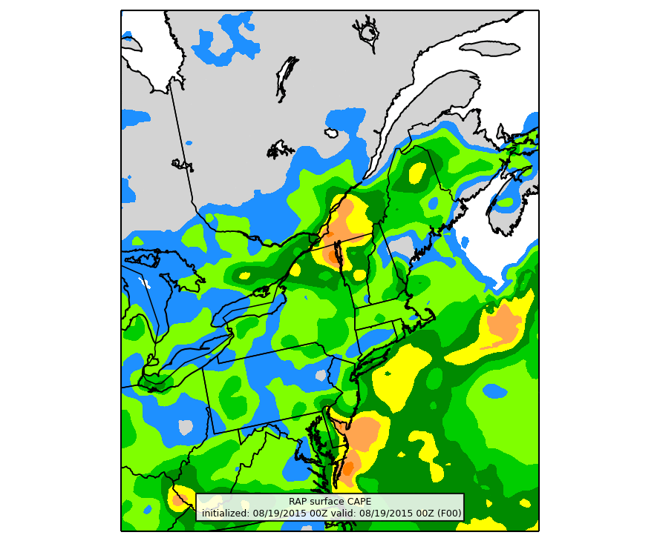
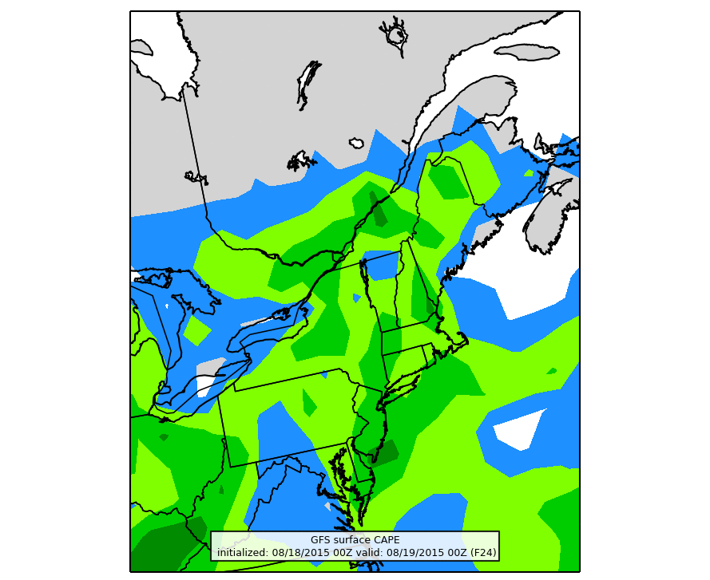
GFS
RAP analysis
0000 UTC 19 August CAPE
F24
Test GFS

