Slide 1
Zdr/Kdp Behavior in Potentially Tornadic Storms
Michael L. Jurewicz, Sr. and Michael Evans
Binghamton, NY
and
Christopher M. Gitro
Pleasant Hill, MO
Wfo bgm sub-regional workshop
September 23, 2015

Slide 2
Outline
Previous Research
Study Results
Recent Supercell Example
Preliminary Conclusions / Future Work

Slide 3
Previous Research

Slide 4
Drop Size Sorting / Zdr Arc
From Romine, et. al, 2008
From Kumjian and Ryzhkov, 2009
* Enhanced Kdp (blue) gets displaced left of enhanced Zdr (orange) via preferential size sorting
* Conceptual schematic of differing hydrometeor descents and Zdr arcing

Slide 5
Conceptual Model (Kumjian, et al. 2011)

Slide 6
Results of Northeastern U.S. Study

Slide 7
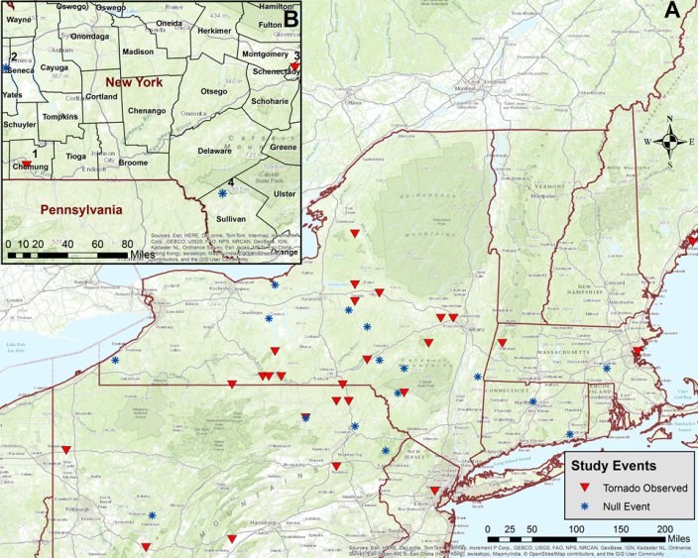
Event Cases: 42 total 26 Tornadic and 16 non-tornadic

Slide 8
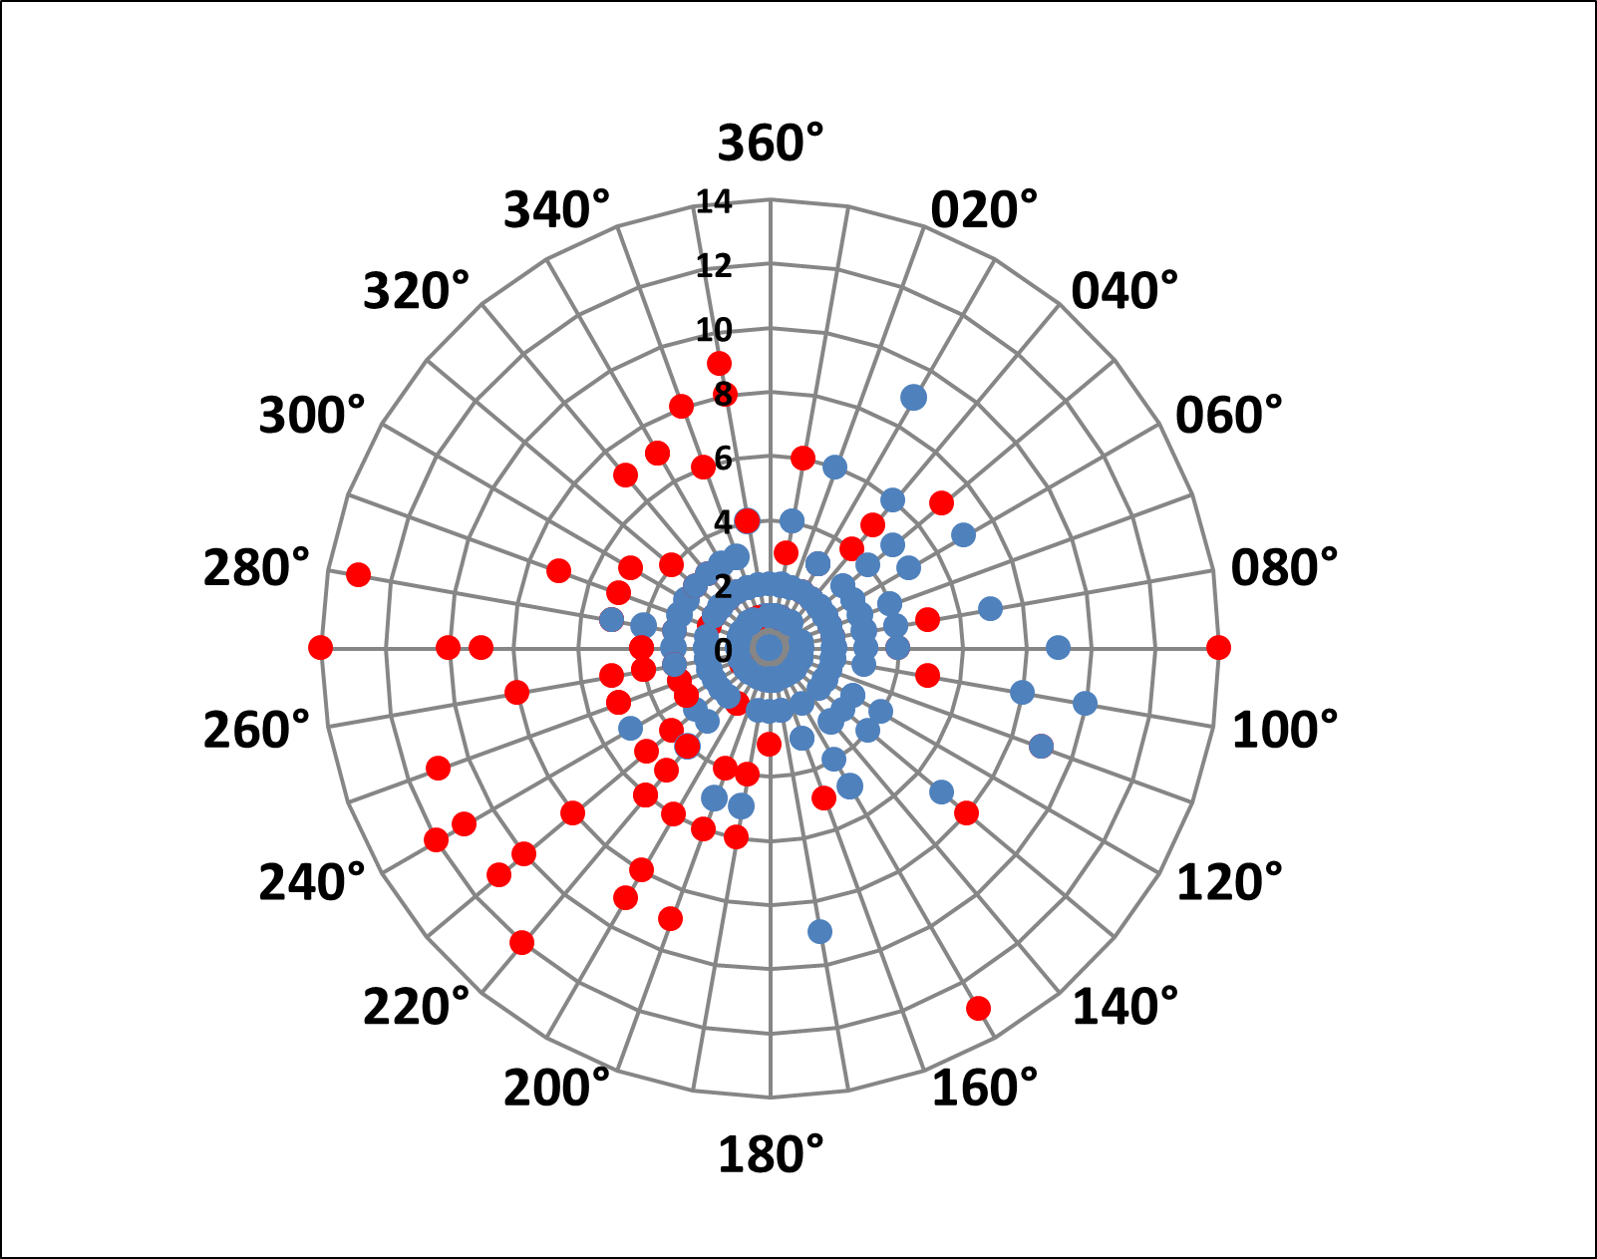
Polar Plot of Kdp maxima (red for tornadic storms and blue for non-tornadic storms) versus Zdr maxima (center point)
* All 42 storms in the database represented
* Note the typically much larger horizontal separation for tornadic storms (red)
* For the non-tornadic storms (blue), little separation was typically seen (data points tightly clustered around the center of the plot)

Slide 9
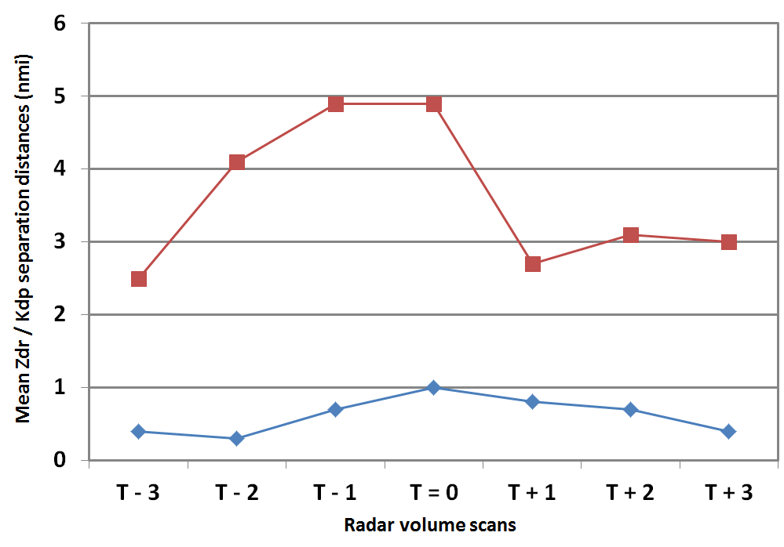
Horizontal Separations (nmi, y-axis) of Zdr and Kdp maxima over time
* Looking at +/- 3 volume scans from T=0
* T=0 is either the time of initial tornado touchdown or tornado warning issuance (null events)
* Note the large differences in separation magnitude between T-2 and T=0
* Separation distances for tornado events:
2.5 - 5 nmi (4-8 km)
* Separation distances for non-tornado events:
0.5 - 1 nmi (1-2 km)

Slide 10
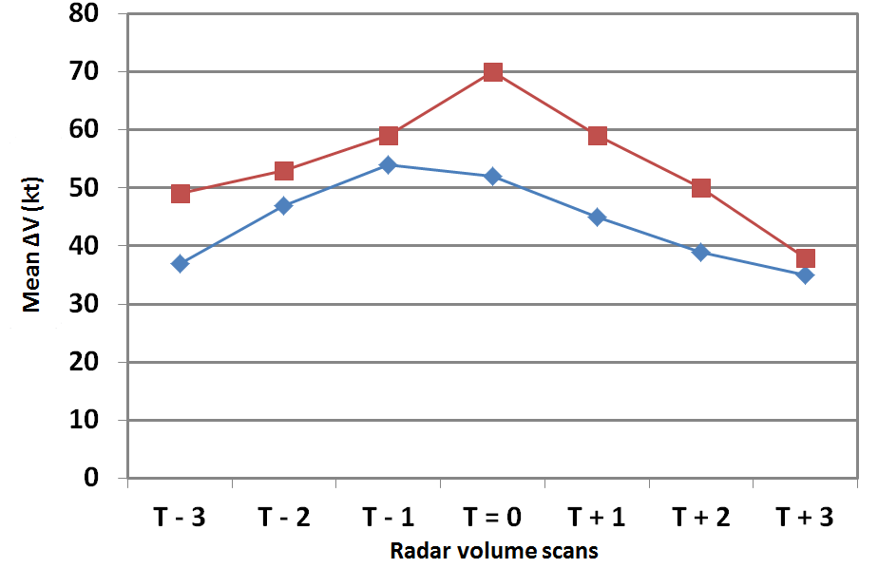
Trends of Maximum Gate-Gate Shear (kt, y-axis (Storm Relative Motion)) over time
* Once again, looking at +/- 3 volume scans from T=0
* T=0 is either the time of initial tornado touchdown or tornado warning issuance (null events)
* Rotational velocity couplet seems to spike in intensity near T=0 for tornadic storms and T-1 for non-tornadic storms
* Tornado events: mean ∆V: 70 kts
* Non-tornado events: mean ∆V: 54 kts
Note: ∆V =
│max_{inbound}│+ │max_{outbound}│

Slide 11
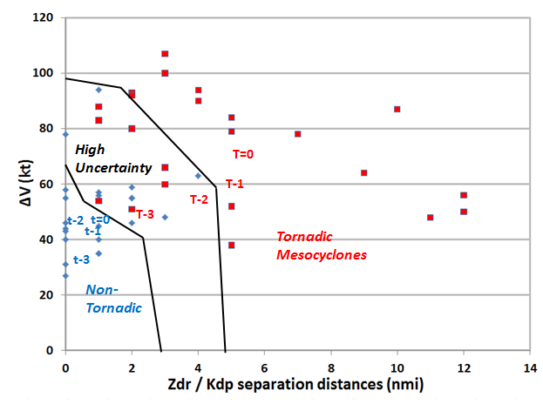
Updated nomogram based on 42 events in present study
* Lower-tropospheric ∆V vs. Zdr/Kdp horizontal separation distances
* Improved ability to discriminate between tornadic and non-tornadic storms, when newer dual-polarization and more traditional velocity techniques are both considered

Slide 12
Supercell Example

Slide 13
Zdr Arc Development (Slide 1)
Z at 1923z (t-3)
Zdr at 1923z (t-3)

Slide 14
Zdr Arc Development (Slide 2)
Z at 1928z (t-2)
Zdr at 1928z (t-2)
* Zdr magnitudes increased in the Zdr arc region between t-3 and t-2

Slide 15
Zdr/Kdp Separation (Slide 1)
Zdr at 1923z (t-3)
Kdp at 1923z (t-3)
Zdr Max

Slide 16
Zdr/Kdp Separation (Slide 2)
Zdr at 1928z (t-2)
Kdp at 1928z (t-2)
Zdr Max
* Zdr surges ahead of Kdp max between t-3 and t-2

Slide 17
RFD/Hook Echo (Slide 1)
Z at 1928z (t-2)
Zdr at 1928z (t-2)
Hook Echo Region

Slide 18
RFD/Hook Echo (Slide 2)
Z at 1933z (t-1)
Zdr at 1933z (t-1)
Hook Echo Region
* Zdr decreases in the hook echo region between t-2 and t-1

Slide 19
RFD/Hook Echo (Slide 3)
Cross-section axis
V x-s at 1933z (t-1)
*RFD region

Slide 20
RFD/Hook Echo (Slide 4)
V x-s at 1933z (t-1)
Zdr x-s at 1933z (t-1)
* Zdr minima in RFD region

Slide 21
RFD/Hook Echo (Slide 5)
V x-s at 1933z (t-1)
Kdp x-s at 1933z (t-1)
* Kdp maxima in RFD region

Slide 22
Conclusions/Future Work

Slide 23
Main Take Home Points
Reliable indicators just prior to tornadogenesis, especially for supercells (typically t-3 to t-1, and often before you see “bright and tight” couplet):
Zdr maxima surges ahead of Kdp maxima, with increasing horizontal separations (Kdp lags back to the west)
Zdr flare up in the arc/inflow region
Zdr decrease in the hook echo region
Higher Kdp gates becoming more prevalent in the RFD region (downward transport ?)
Warmer more buoyant RFD’s ?
Cursory evidence suggests tornadic QLCS development could be somewhat different
Higher Zdr gates noted S-SE of tornadic vortex
Cooler drier RFD’s still sufficient for tornadogenesis ?
Zdr arc development seems less important
Reliable indicators just prior to tornado dissipation, or for non-tornadic storms:
Relatively low Zdr and/or decreasing Zdr in the inflow/arc region
Zdr becoming more spread out/homogeneous across the storm cell
Tornado undercutting ?
Less Zdr/Kdp maxima separation over time

Slide 24
Future Work
Publish results
Near-future submission to W&F
Develop methods to make Zdr/Kdp signatures easier to recognize in real-time
Better visualization needed in operational setting
Better color curves for Zdr (4-5+ db) and Kdp (2-3+ deg/km)
Future WDTB/academia collaboration likely
Continue to evaluate these processes in coming convective seasons

Slide 25
Questions ?

