Slide 1


Short-Wave Troughs in the Great Lakes Region and their Impacts on Lake-Effect Snow Bands
Zachary S. Bruick¹, Nicholas D. Metz², and Emily W. Ott²
¹Valparaiso University
²Hobart and William Smith Colleges
E-mail: nmetz@hws.edu
Binghamton Workshop
Support Provided By: NSF AGS-1258548 and REU Supplements
23 September 2015

Slide 2
Purpose
Goal:
Determine the frequency of short-wave troughs in the Great Lakes region and the influence that synoptic- and mesoscale shortwaves have on
lake-effect snow bands
  The large-scale dynamics can complement lake boundary layer environment leading to change in position and snowfall of snow band
  Not an initial OWLeS project objective; however while in the field saw first-hand the difficulty these interactions posed in the forecasting process

Slide 3
Background/Motivation
Very limited reference in the literature on the impacts of short-wave troughs on lake-effect snow events
  Niziol (1987) states, “the existence of a secondary trough embedded in large-scale flow has been shown to enhance lake effect snow activity”
Differential cyclonic vorticity advection (CVA) ahead of a short-wave trough can produce forcing for ascent and atmospheric destabilization
  Boundary-layer inversion heights can increase ahead of a
  short-wave trough

Slide 4
Part I:
Climatology of
Short-Wave Troughs in the Great Lakes Region

Slide 5
Methodology
Short-wave trough criteria
  Visible curvature in the 500-hPa height and wind fields
  Vorticity maximum of at least 18 × 10⁻⁵ s⁻¹
  located within the curvature
  Maximum curvature width of 1500 Km
  (e.g., Tuttle and Davis 2013)
  Minimum duration of 6 hours (three consecutive 3-hr periods)
  in the Great Lakes region
Over eight cold seasons
(October–March of 2007/2008 – 2014/2015)
698 unique short-wave troughs were identified

Slide 6
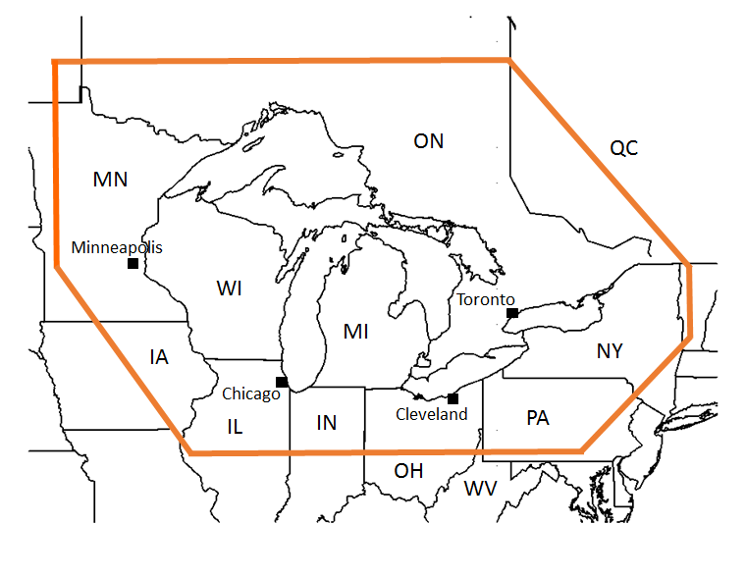
Great Lakes Region
Pettersen and Calabrese (1959), Bates et al (1994), Cortinas (2000), and Payer et al. (2011)

Slide 7
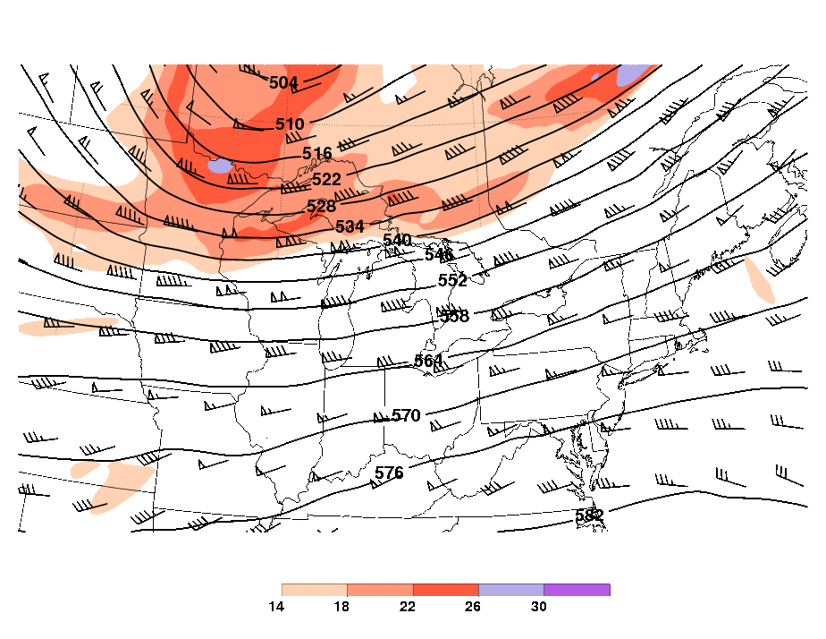
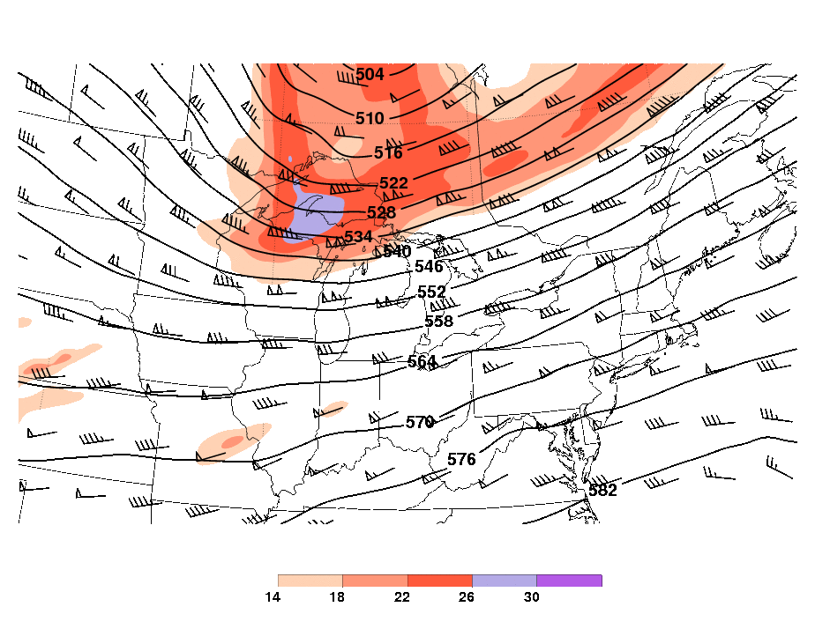
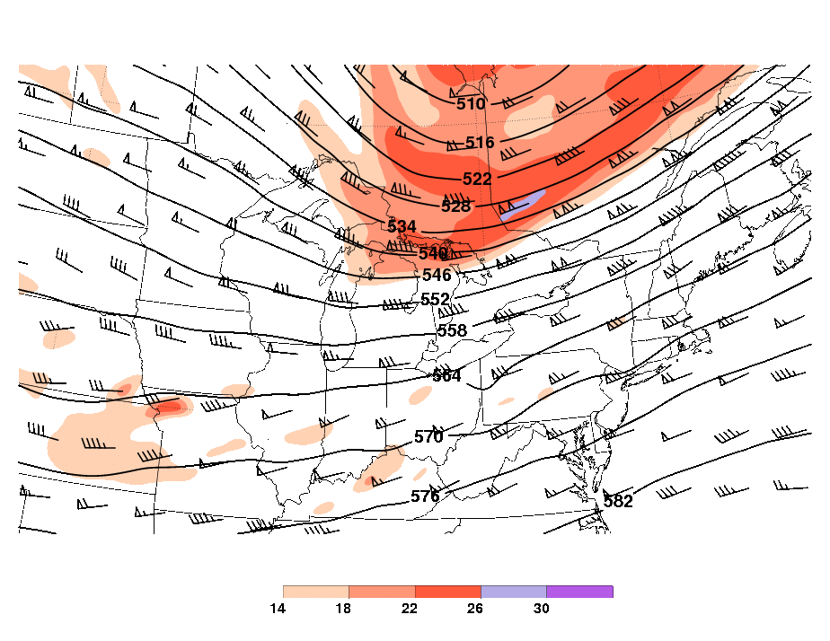
Type A: From West (247.5°– 292.5°)
0600 UTC
1200 UTC
1800 UTC
1 December 2014

Slide 8
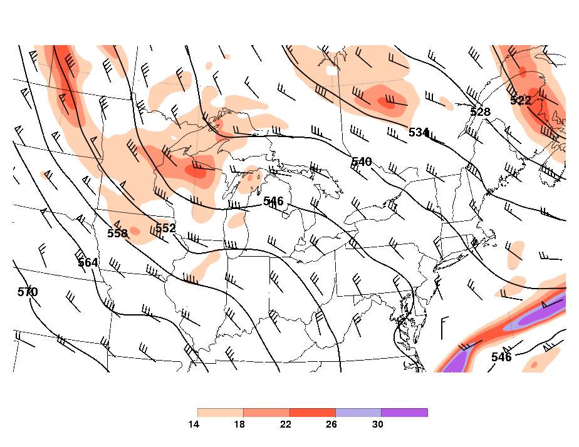
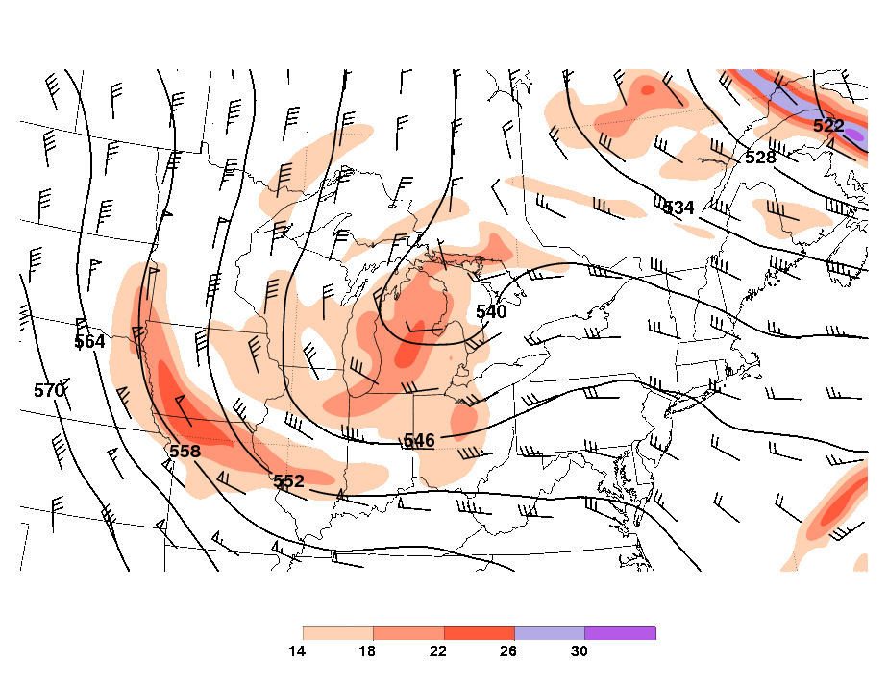
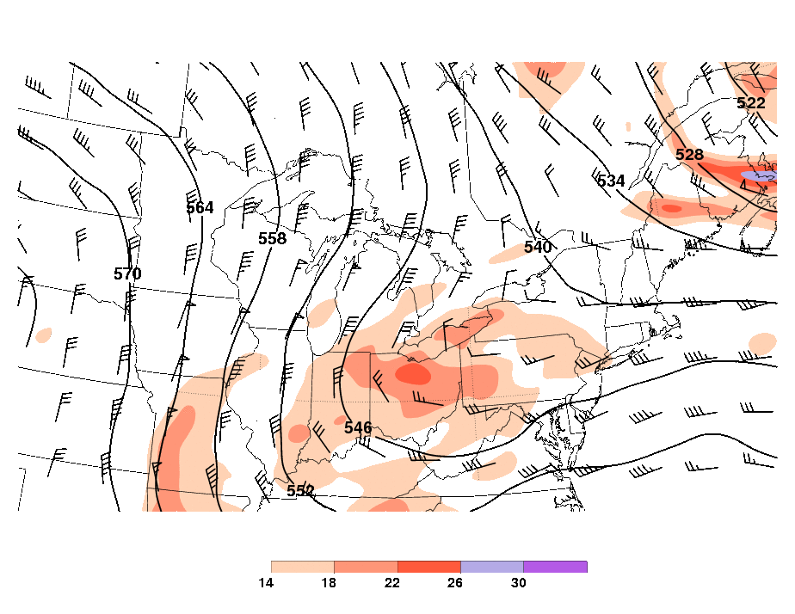
Type B: From Northwest (292.5°– 337.5°)
0300 UTC
1500 UTC
0300 UTC
11–12 January 2010

Slide 9
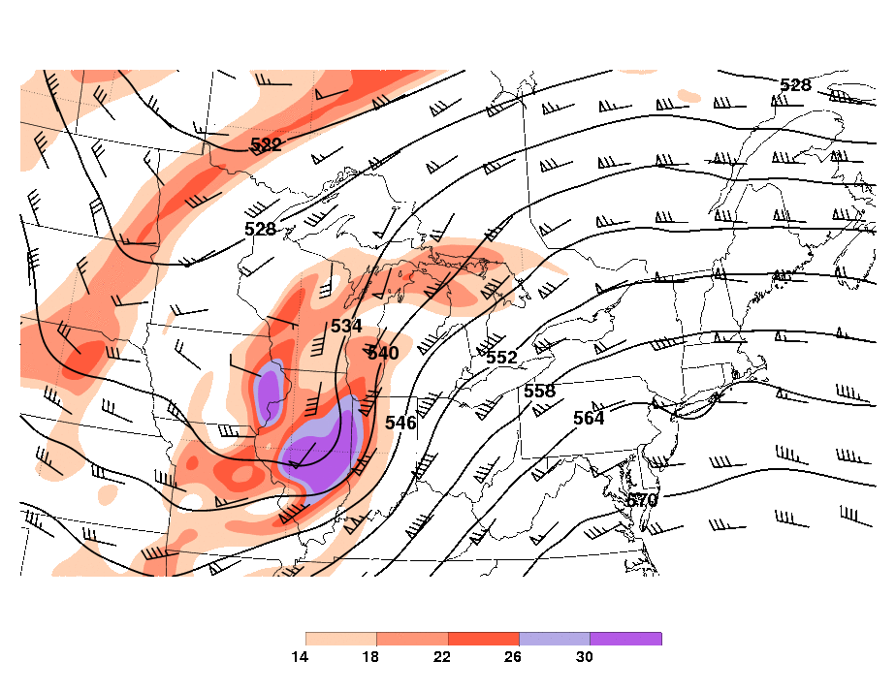
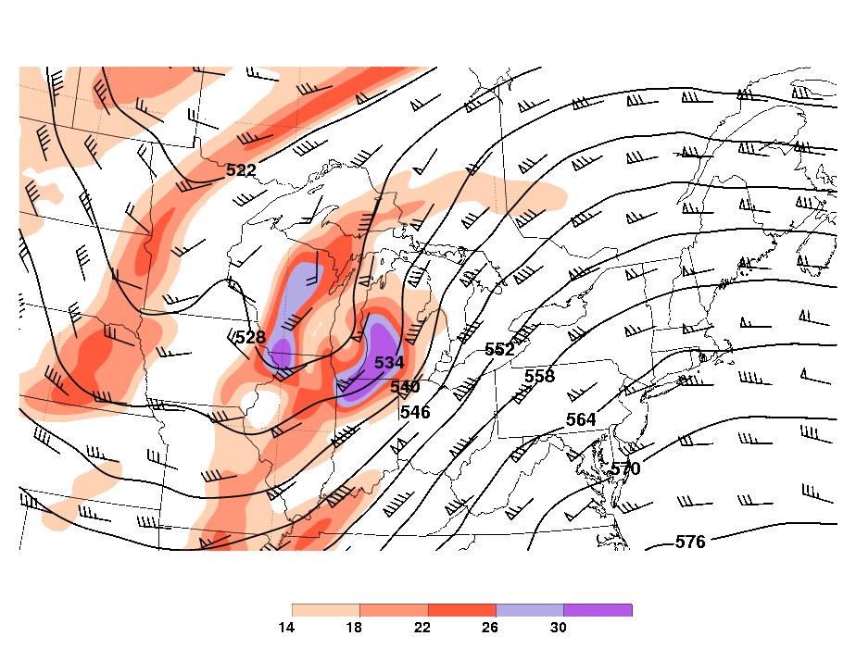
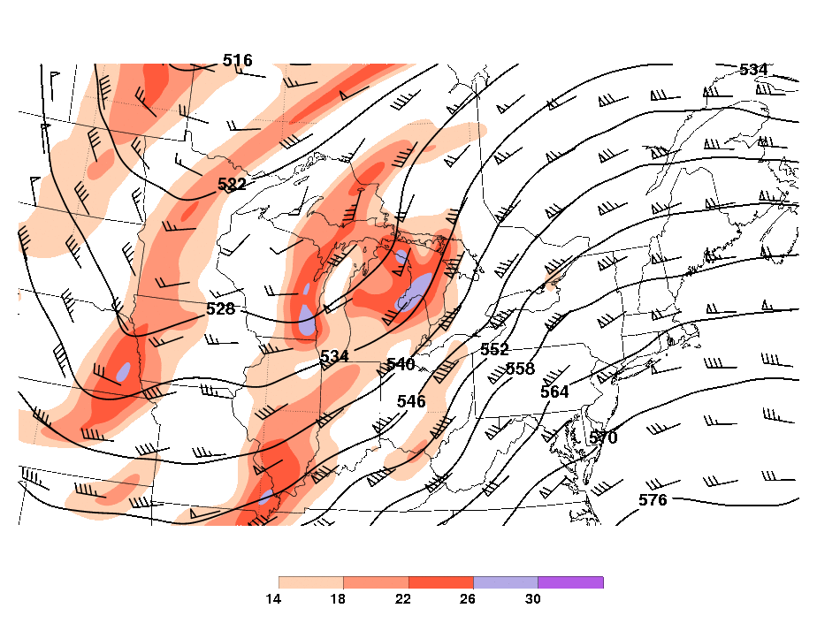
Type C: From Southwest (212.5°–247.5°)
1800 UTC
2100 UTC
0000 UTC
17–18 February 2008

Slide 10
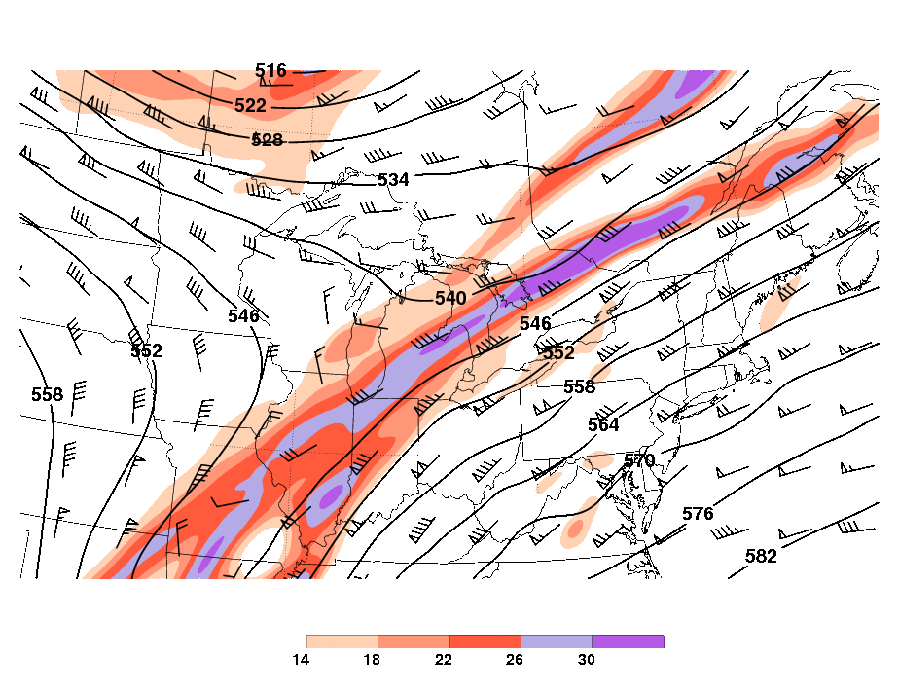
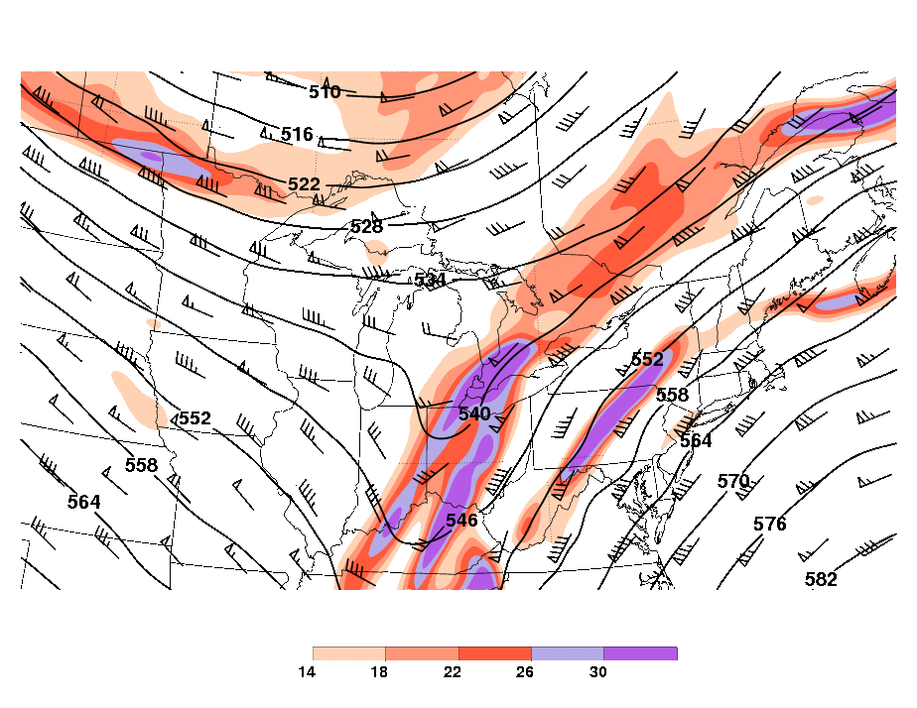
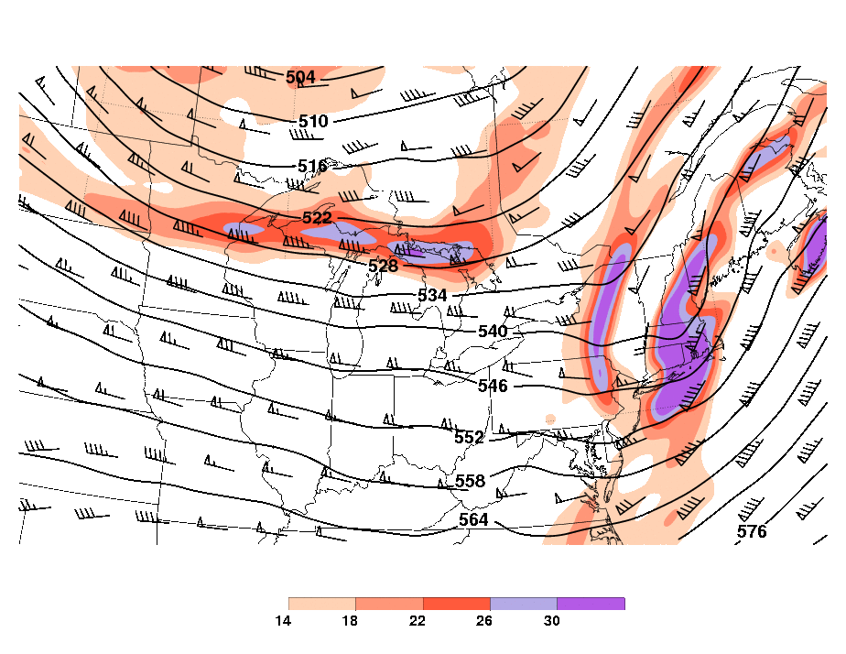
Type D: Rounding Long-Wave Trough
0900 UTC
2100 UTC
0900 UTC
7–8 December 2011

Slide 11
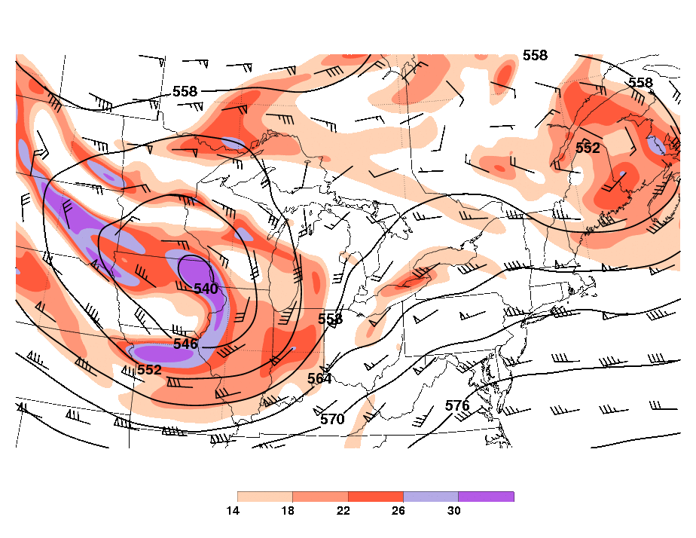
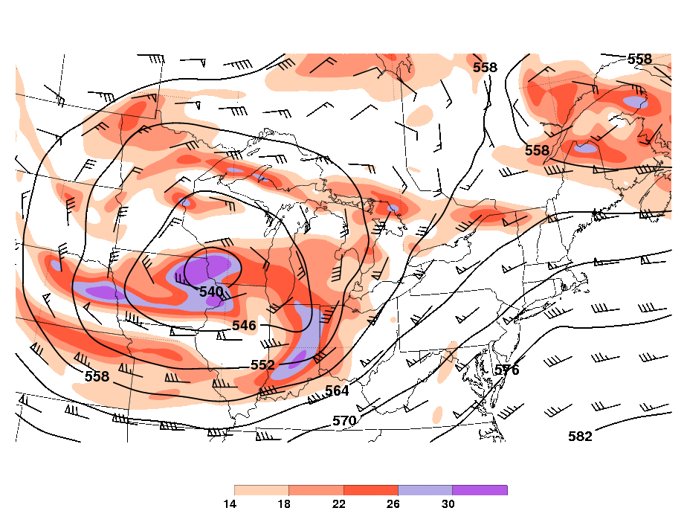
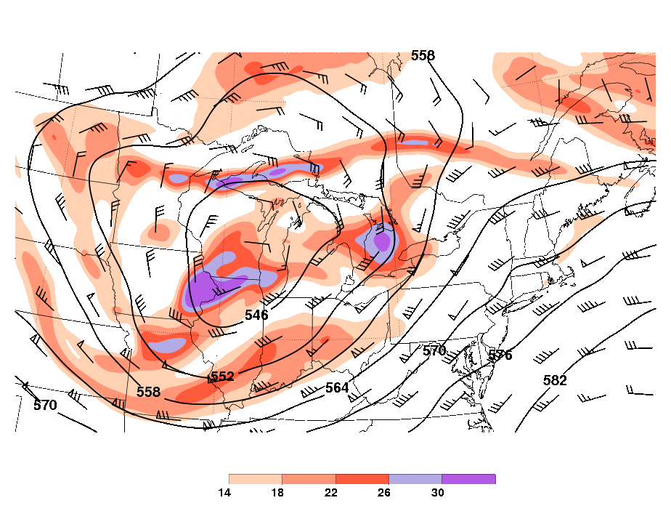
Type E: Cutoff Low
1500 UTC
2100 UTC
0300 UTC
2–3 October 2009

Slide 12
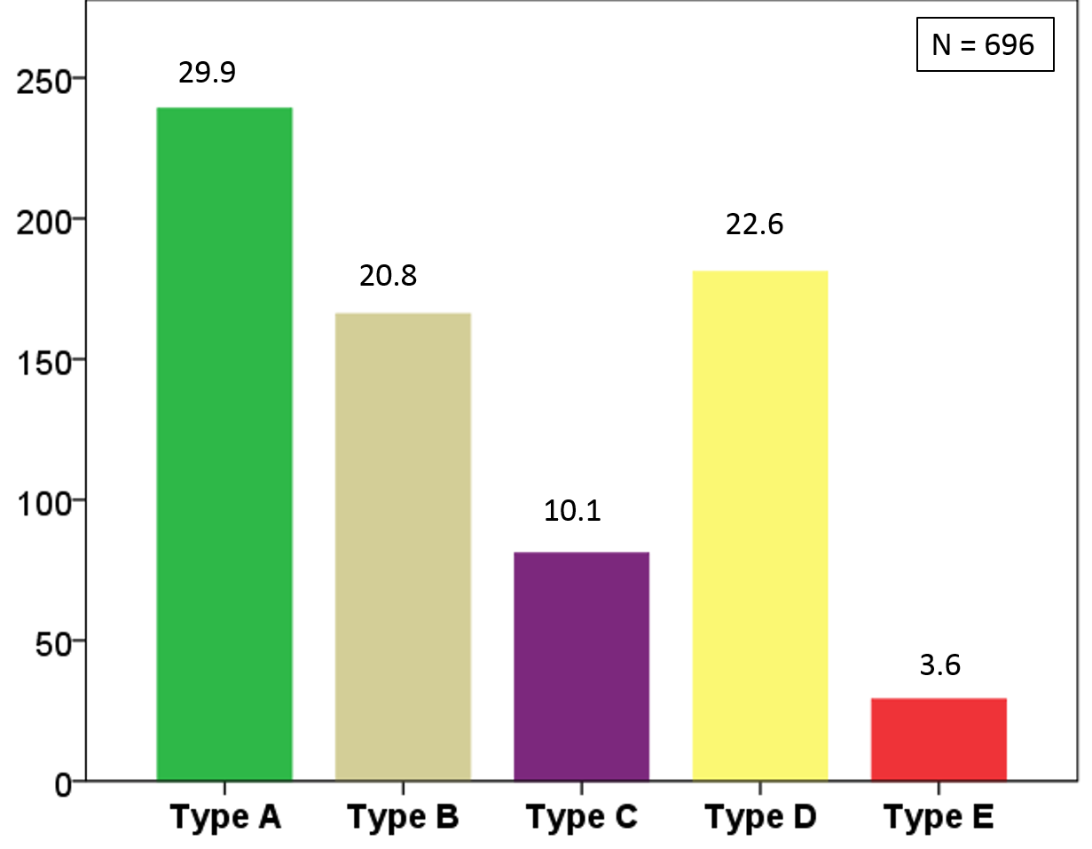
Short-Wave Troughs by Type
Average Per Year Shown Above Each Bar

Slide 13
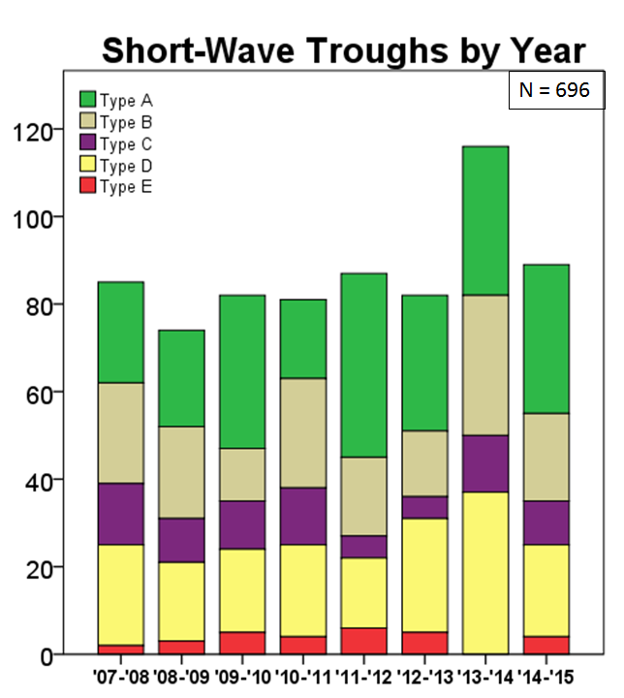
Short-Wave Troughs by Year

Slide 14
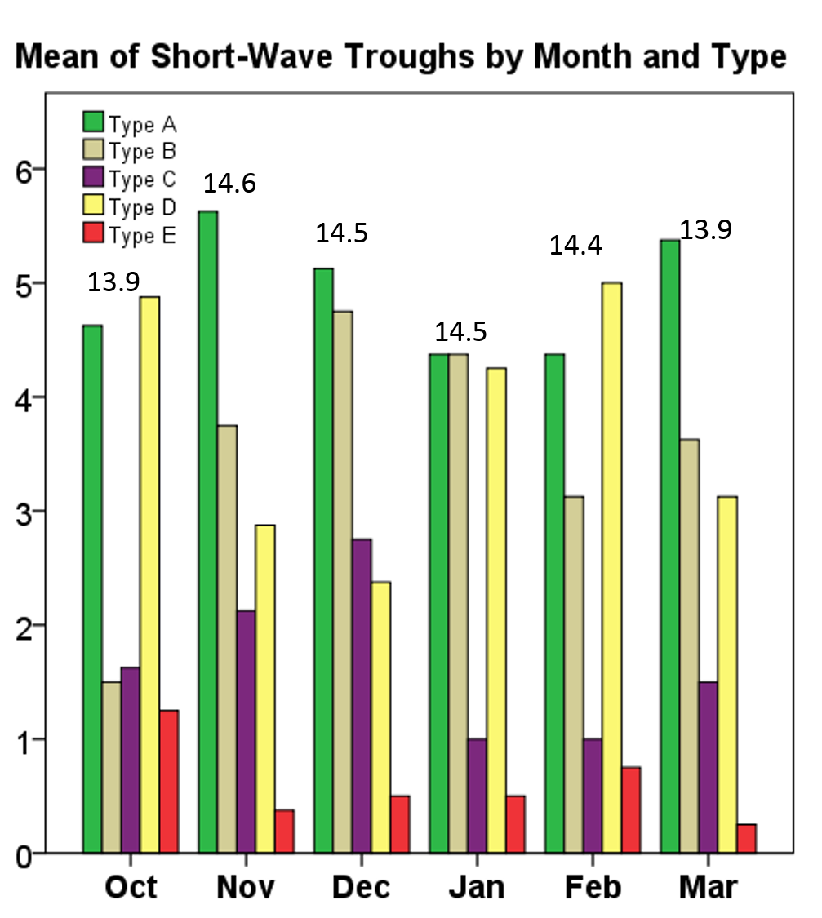
Mean Short-Wave Troughs by Month
Average Per Month Shown Above Each Bar

Slide 15
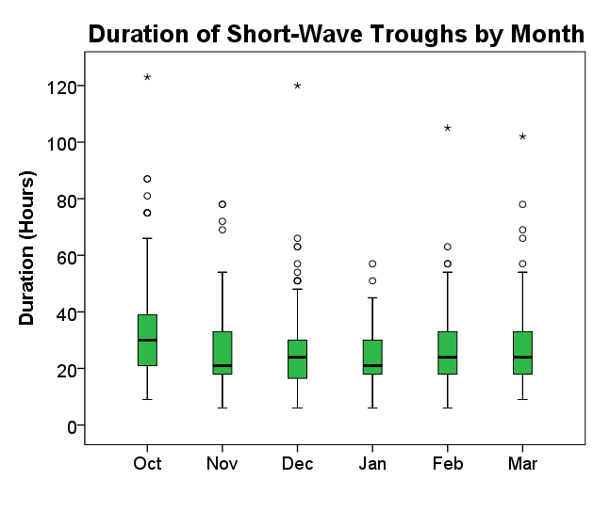
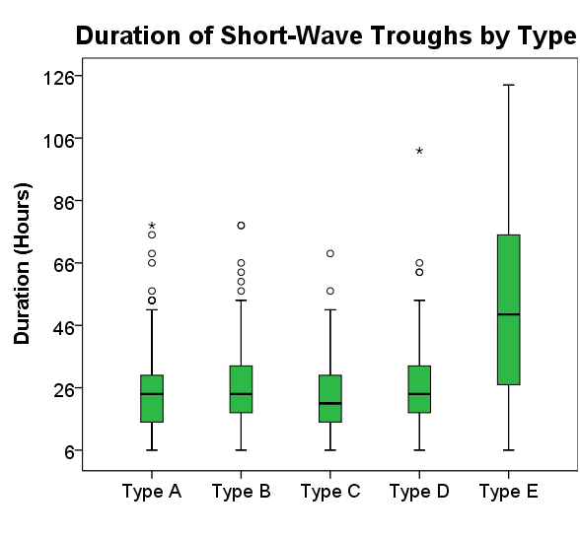
Short-Wave Trough Duration
n = 696
n = 696

Slide 16
Conclusions – Part I
Summary
Type A (from West) short-wave troughs occur most frequently in this eight-year climatology
November through February had similar frequencies of short-wave troughs while October and March had somewhat fewer cases
Most cold seasons had 81–90 short-wave troughs but there was inter-annual variability of up to 50%
Type E (cut-off Low) had the greatest median duration in the Great Lakes Region (49.5 hours) while the overall median duration was 24 hours.

Slide 17
Part II:
Climatology of
Shortwave Trough Interactions with
Lake Ontario Type 1
Lake-Effect Bands

Slide 18
Methodology
Identified Lake Ontario Type 1 lake-effect bands during cold seasons (October–March of 2007/2008 – 2014/2015) using WSR-88D radar data from Buffalo and Montague
Information collected from 3-hrs before short-wave trough, during trough passage, and 3-hrs after:
  Lake-effect Snow Band Orientation
  Meridional Position
  Maximum Intensity
  Inland Extent

Slide 19
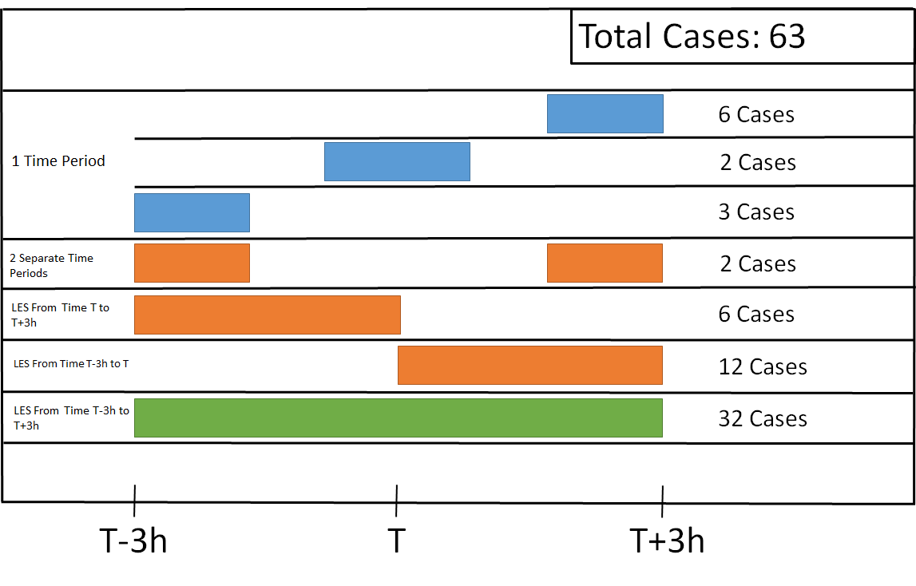
Type 1 Bands
LES From Time
T-3h to T
LES From Time
T to T+3h
63 events over eight cold seasons – 32 of which had snow during all three times evaluated

Slide 20
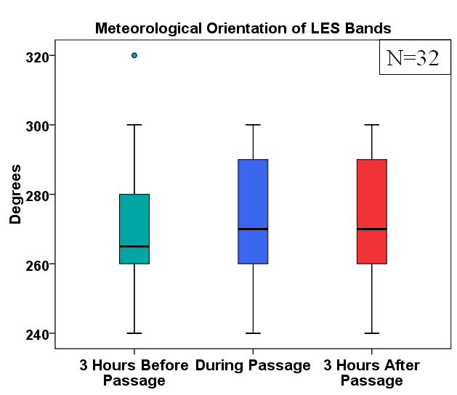
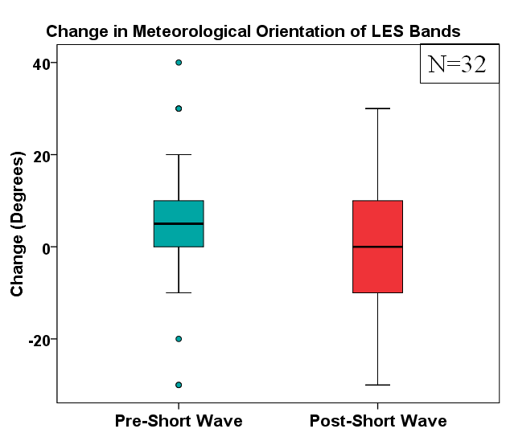
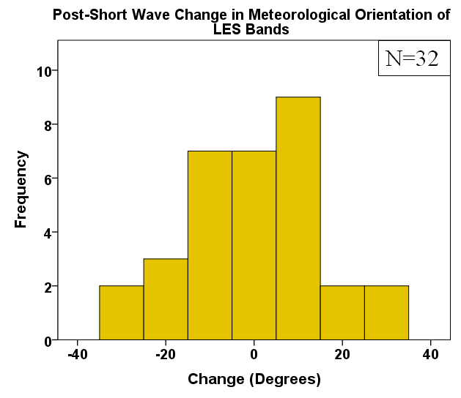
Orientation
12
13
Band Orientation
Change in Band Orientation
Post Short-Wave Change in Orientation

Slide 21
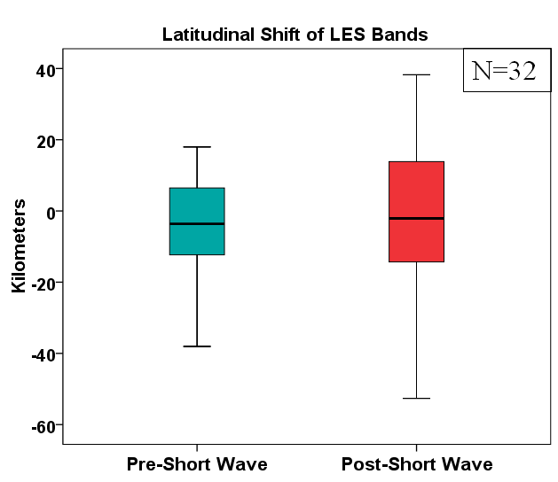
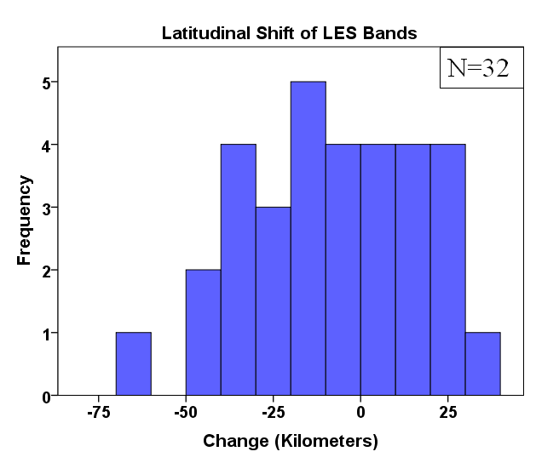
Meridional Position
Change in Band Latitude
Total Latitudinal Shift in Band

Slide 22
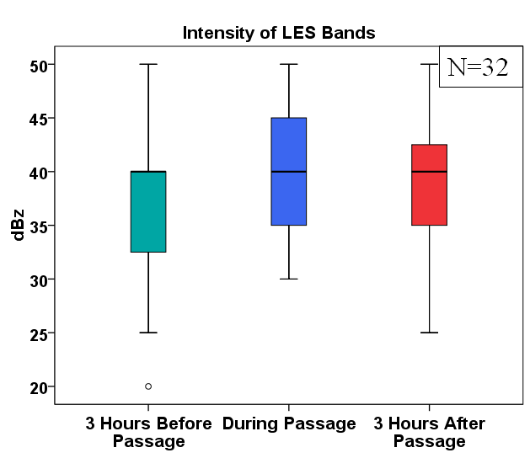
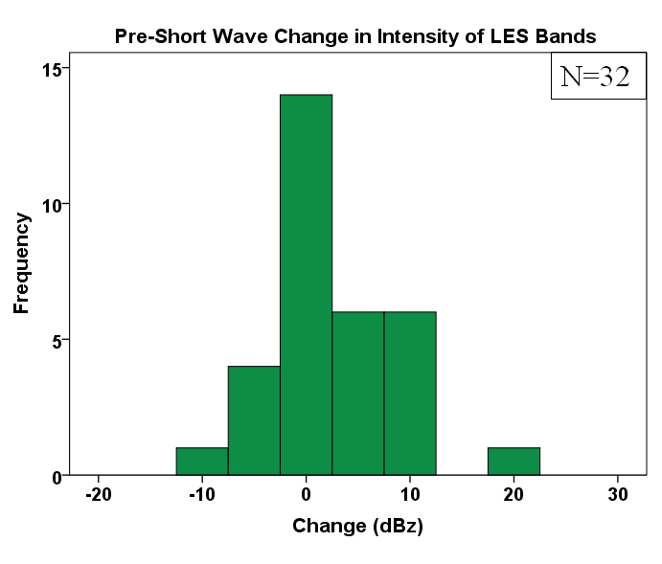
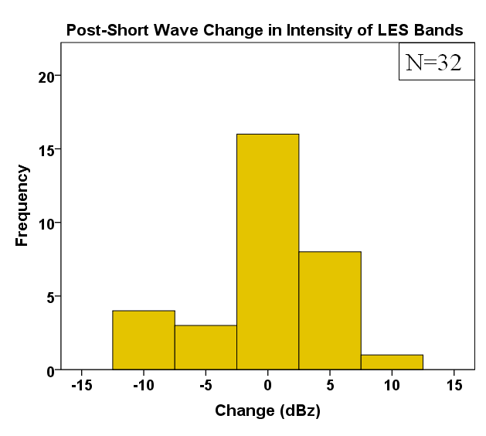
Maximum Intensity
Band Intensity
Pre Short-Wave Change in Intensity
Post Short-Wave Change in Intensity

Slide 23
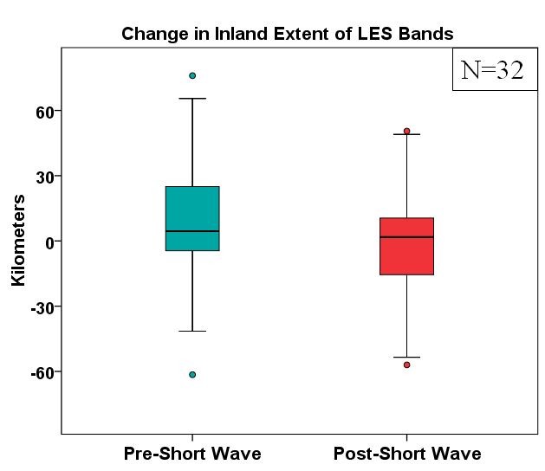
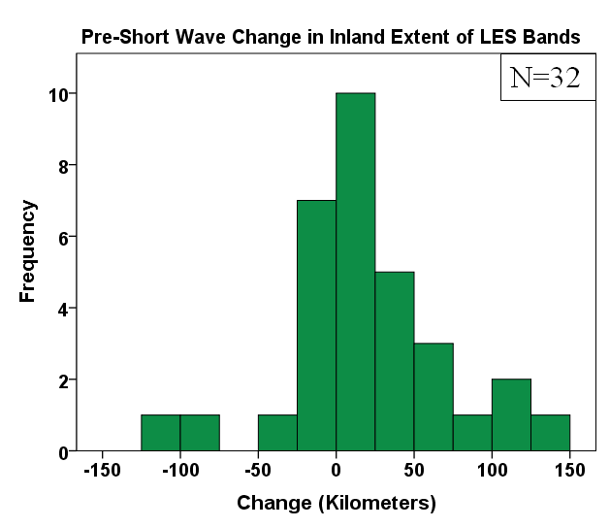
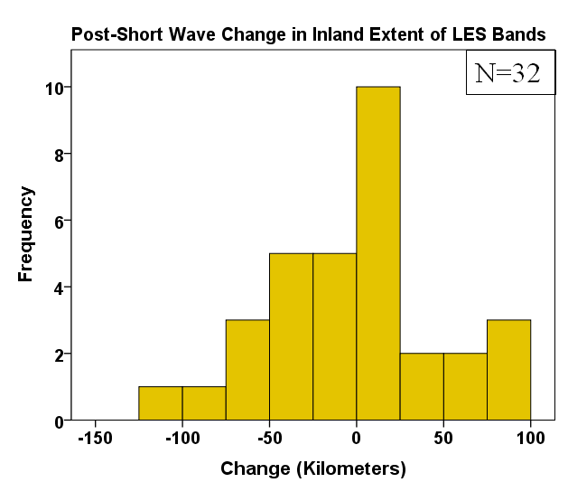
Inland Extent
Change in Inland Extent
Pre Short-Wave Change in Inland Extent
Post Short-Wave Change in Inland Extent

Slide 24
Conclusions – Part II
As a short-wave trough APPROACHS an established
Type 1 lake-effect band typical changes involve a(n):
  Clockwise rotation in orientation
  Southward shift in position
  Intensification of maximum radar reflectivity
  Increase in inland extent
As a short-wave trough PASSES an established
Type 1 lake-effect band changes are more varied

