Slide 1
Dendritic Growth Zones in Lake-effect, Lake-enhanced & Synoptic Snowstorms
Kelley Murphy
Earth & Atmospheric Sciences Department
State University of New York at Oneonta Photo of snow crystals collected by Univ. of Utah during the Ontario Winter Lake-effect Systems (OWLeS) project
Stephen VanHoesen
Department of Geoscience
Hobart & William Smith Colleges
Neil Laird
Department of Geoscience
Hobart & William Smith Colleges
Nick Metz
Department of Geoscience
Hobart & William Smith Colleges
This research was conducted during the 2015 undergraduate summer research
program at Hobart & William Smith (HWS) Colleges. Funding for this project was
provided by the National Science Foundation and the HWS Provost's Office.

Slide 2
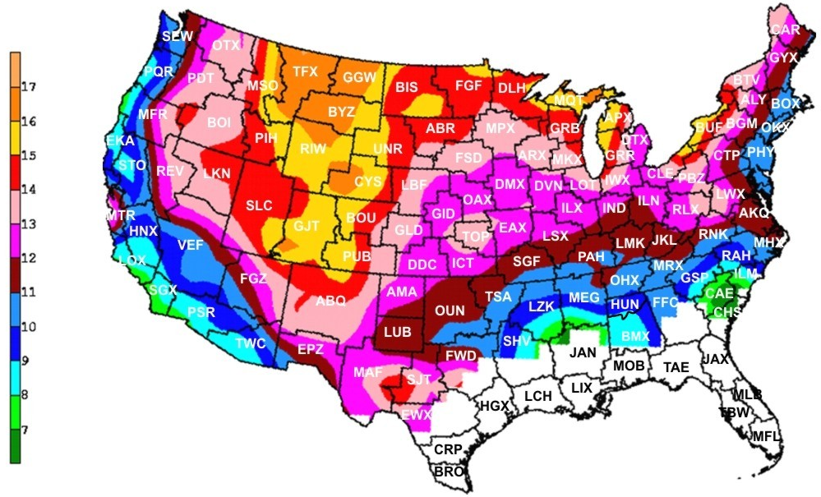
INTRODUCTION: Snow-to-Liquid Ratio Climatology
From Baxter, A. A., C. E. Graves, J. T. Moore, 2005: A Climatology of Snow-to-Liquid Ratio for the Contiguous United States. Wea. Forecasting, 20, 729–744.

Slide 3
INTRODUCTION: Forecasting Snowfall
NWP models do a better job at indicating the temporal and spatial distribution of forcing for precipitation, than they do forecasting the actual QPF
During big snowfalls, much of the snow falls within a small time window
From an impact standpoint, forecasting these brief periods of intense snowfall are as important (and maybe more important) than forecasting the total amounts
From Mahoney, Waldstreicher, and Niziol, 2003: Using Bufkit to Visualize Precipitation Amount and Type. Warning Decision Training Branch Presentation. Winter Weather Workshop

Slide 4
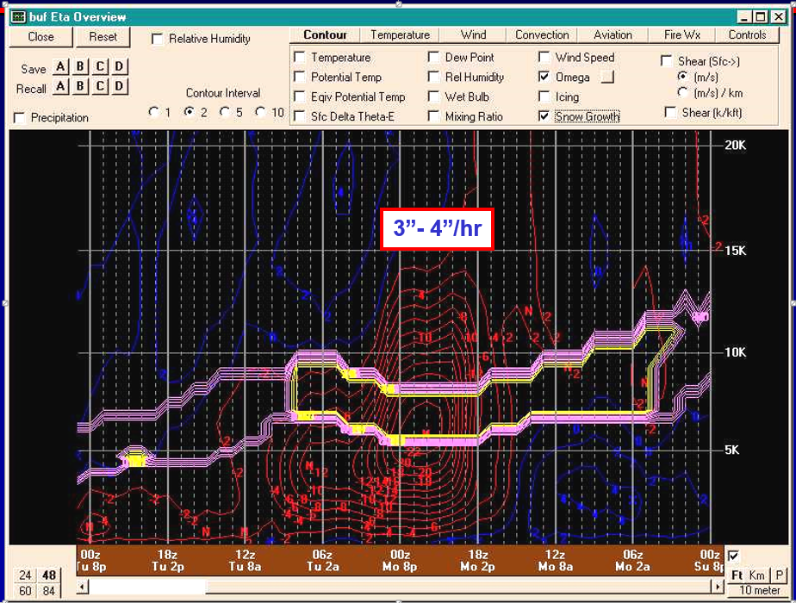
INTRODUCTION: Forecasted Omega & Dendritic Growth Intersection
From Mahoney, Waldstreicher, and Niziol, 2003: Using Bufkit to Visualize Precipitation Amount and Type. Warning Decision Training Branch Presentation. Winter Weather Workshop

Slide 5
INTRODUCTION: Ice Crystal relation to Temperature & Supersaturation
Dendritic Ice Crystal Growth most often occurring with:
Temperature Range
-12°C to -18°C
Supersaturation w.r.t. Ice
> 8%
From Nakaya, U., (1954): Snow Crystals: Natural and Artificial

Slide 6
RESEARCH OBJECTIVES & METHODS
Objective:
Understand the characteristics of dendritic growth zones (DGZs) associated with different types of snowfall events
Data & Methods:
Buffalo, NY region
October – March of 2010/2011 through 2014/2015 (5 cold seasons)
Identify Snowfall events
22 – 02 UTC & 10 – 14 UTC (4-hr periods centered on 00 & 12 UTC soundings)
Region within 167 km (100 mi) radius from KBUF
SNODAS hourly snowfall product; > trace LWE snowfall (NOHRSC)
Archived surface, upper-air analyses, & lake temperatures (UCAR; CSU; GLERL)
Archived KBUF WSR-88D radar data (NCDC)
DGZ analyses
653 archived KBUF 00 UTC & 12 UTC soundings (Univ. Wyoming)
SPSS statistical software

Slide 7
METHODS: Lake-effect, Lake-enhanced, & Synoptic
LAKE-EFFECT
18 Nov 2014
12 UTC
LAKE-ENHANCED
17 Dec 2014
12 UTC
SYNOPTIC
6 Dec 2014
12 UTC
LAKE-EFFECT: temperature difference of about 13°C or greater between the lake surface and 850 hPa. ex: cold front passes through the region w/ cold air moving over warm lake, leading to precipitation bands
LAKE-ENHANCED: lake-effect band within synoptic precipitation
SYNOPTIC: solely synoptic cyclone moving through the region or a passing front w/ precipitation ahead of or along front, precipitation is usually more wide-spread

Slide 8
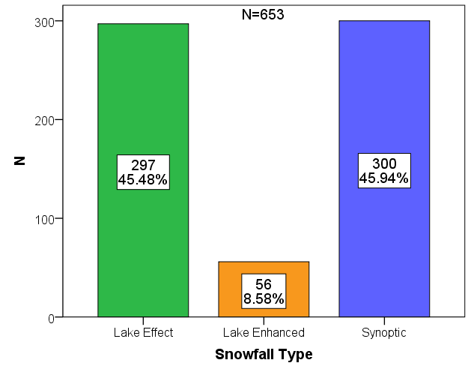
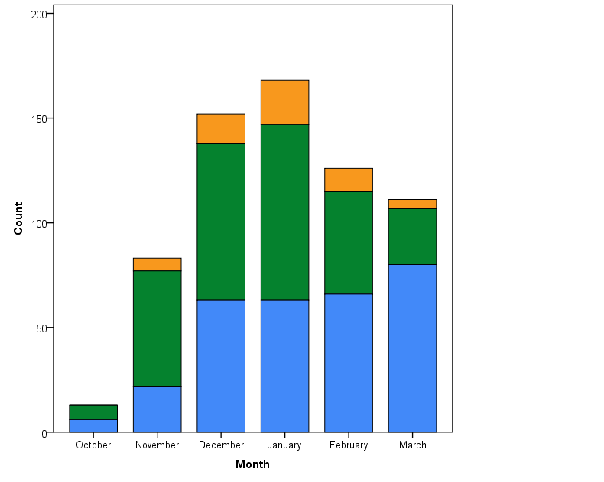
METHODS: Lake-effect, Lake-enhanced, & Synoptic
297
45.5%
300
45.9%
56
8.6%

Slide 9
METHODS: Dendritic Growth Zone (defined by T: -12°C to -18°C)
400
500
600
700
800
900
1000
KBUF 7 December 2013 12 UTC
DGZ-b
DGZ-a
Pressure (hPa)
-18°C
-12°C
-40 -30 -20 -10 0 10
Temperature (°C)

Slide 10
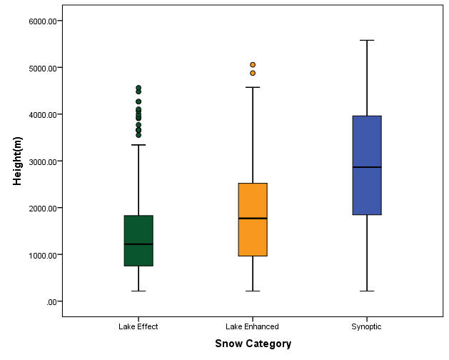
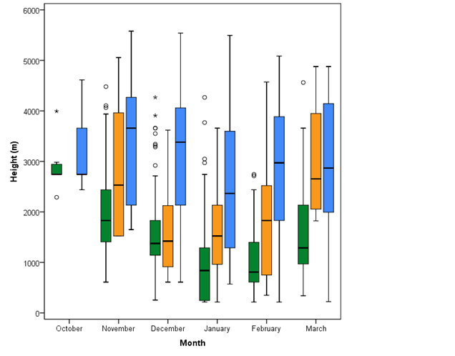
RESULTS: Base Height of DGZs
N=653

Slide 11
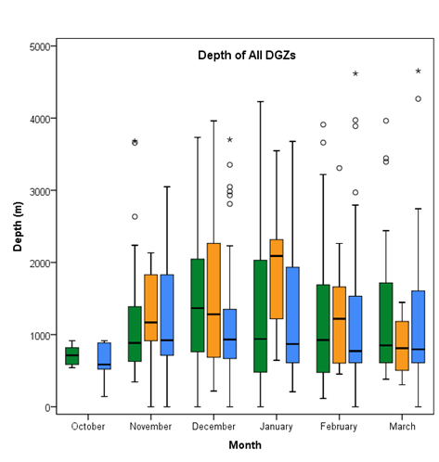
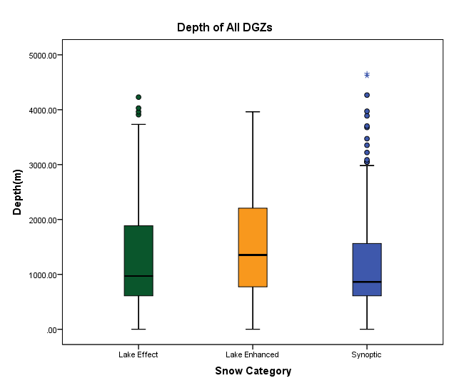
RESULTS: Depth of DGZs
N=653

Slide 12
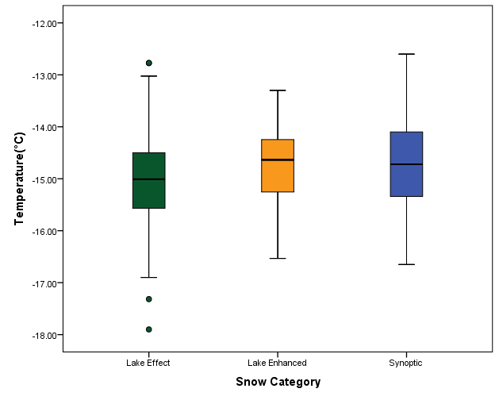
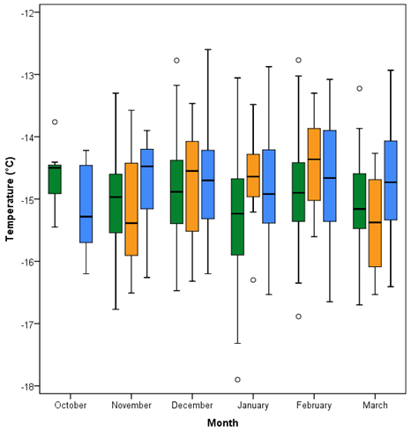
RESULTS: Mean Temperature within DGZs
N=653

Slide 13
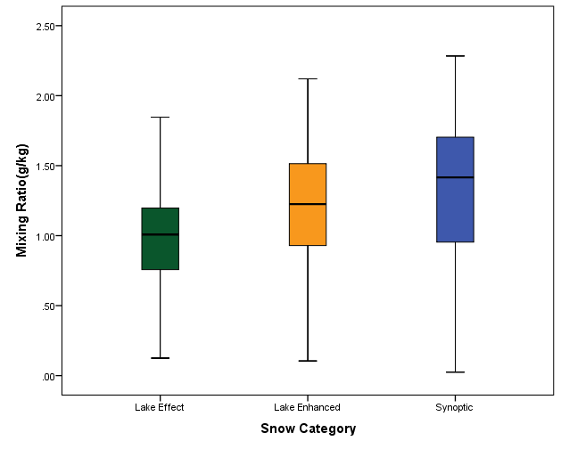
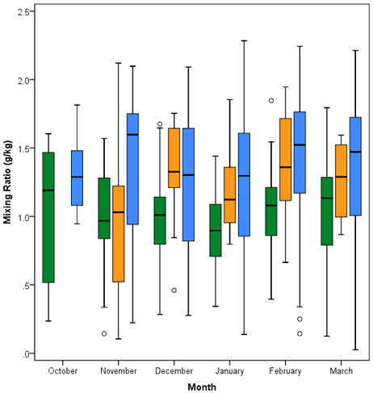
RESULTS: Mean Mixing Ratio in DGZs
N=653

Slide 14
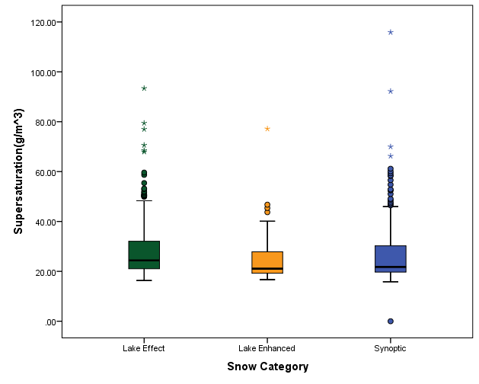
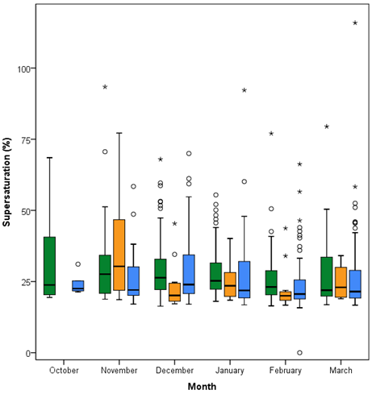
RESULTS: Mean Supersaturation (Ice) in DGZs
N=653

Slide 15
SUMMARY
Lake Effect
DGZs reflect a dry environment with the passing of a cold front, high supersaturation values, and a short distance for dendrites to fall to the surface (low DGZ base height)
Could indicate that lake-effect storms have the largest potential for rapid snowfall accumulation
Lake Enhanced
DGZs reflect the greatest potential for dendritic growth (largest depth). Moisture, temperature, and supersaturation values fall between those of lake-effect and synoptic storms.
Synoptic
DGZs reflect a moist environment with largest distances from the surface to DGZ base. Supersaturation is consistently lower than lake-effect DGZs.
Seasonality
During the “peak” months of the cold season, DGZ base height drops and the variability of layer depth increases
Supersaturation values for all snow events generally decreases across the cold season

