Slide 1
Northeast Severe Convection: High-Impact and Low-Impact Events
Matthew Vaughan, Brian Tang, and Lance Bosart
Department of Atmospheric and Environmental Sciences
University at Albany/SUNY
Albany, NY 12222
WFO BGM Sub-Regional Workshop
Huron Campus
Endicott, NY
23 September2015
Supported by the NOAA Collaborative Science,
Technology and Applied Research Program (NA13NWS4680004)
Notes:
DOUBLE check

Slide 2
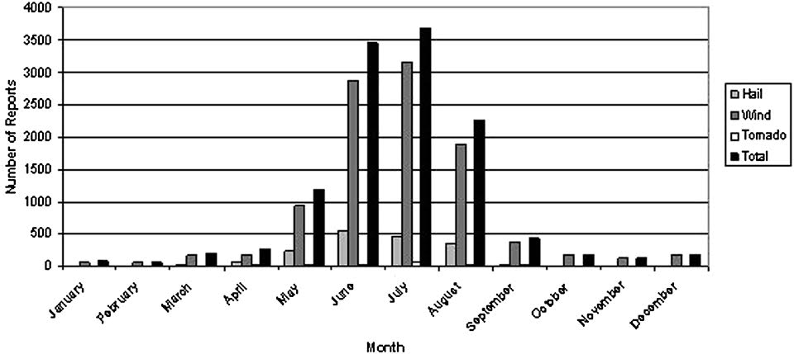
Motivation
Severe weather in the Northeast a topic of recent research
Hurlbut and Cohen (2014) conducted a proxy sounding study on events of varying severity
Significant discriminators:
850–500-hPa and 700–500-hPa lapse rates
Downdraft CAPE (DCAPE)
Mixed-layer CIN
Hurlbut and Cohen (2014)

Slide 3
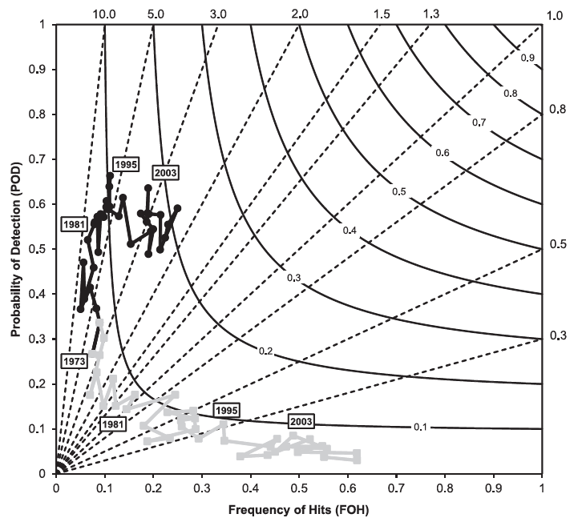
Motivation
Hitchens and Brooks (2012) verified SPC day-1 slight risk convective outlooks over CONUS
Found increased forecast performance with time
Black line represents slight risk performance. Source: Hitchens and Brooks(2014)

Slide 4
Motivation
Is there an opportunity to combine the strategies of these two studies?
Launched a CSTAR-supported Master’s thesis studying high-impact severe weather in environments with poor predictive skill
Notes:
Line up bullets CHECK

Slide 5
Methodology

Slide 6
Methodology
Create Northeast domain to evaluate forecast skill
Plot SPC convective outlook contours over the domain
Evaluate slight contours with storm reports
Similar method used in Hitchens and Brooks (2012)
Include high-impact events without slight risk outlooks to have a fair representation of forecast skill
Notes:
Titles to Red. Red lines to blue

Slide 7
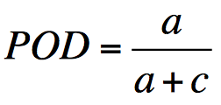
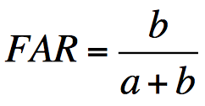
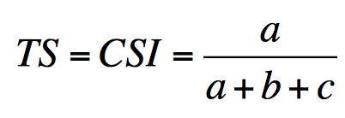
Methodology: Evaluation
Contingency Table | Observed Y | Observed N
Forecast (Y) | Hit (A) | False Alarm (B)
Forecast (N) | Miss (C) | Correct null (D)
0 ≤ POD ≤ 1, best score: POD = 1, best score ≠ perfect forecast
0 ≤ FAR ≤ 1, best score: FAR = 0, best score ≠ perfect forecast
0 ≤ TS ≤ 1, best score: TS = 1, best score = perfect forecast
Notes:
Make a note on title position

Slide 8
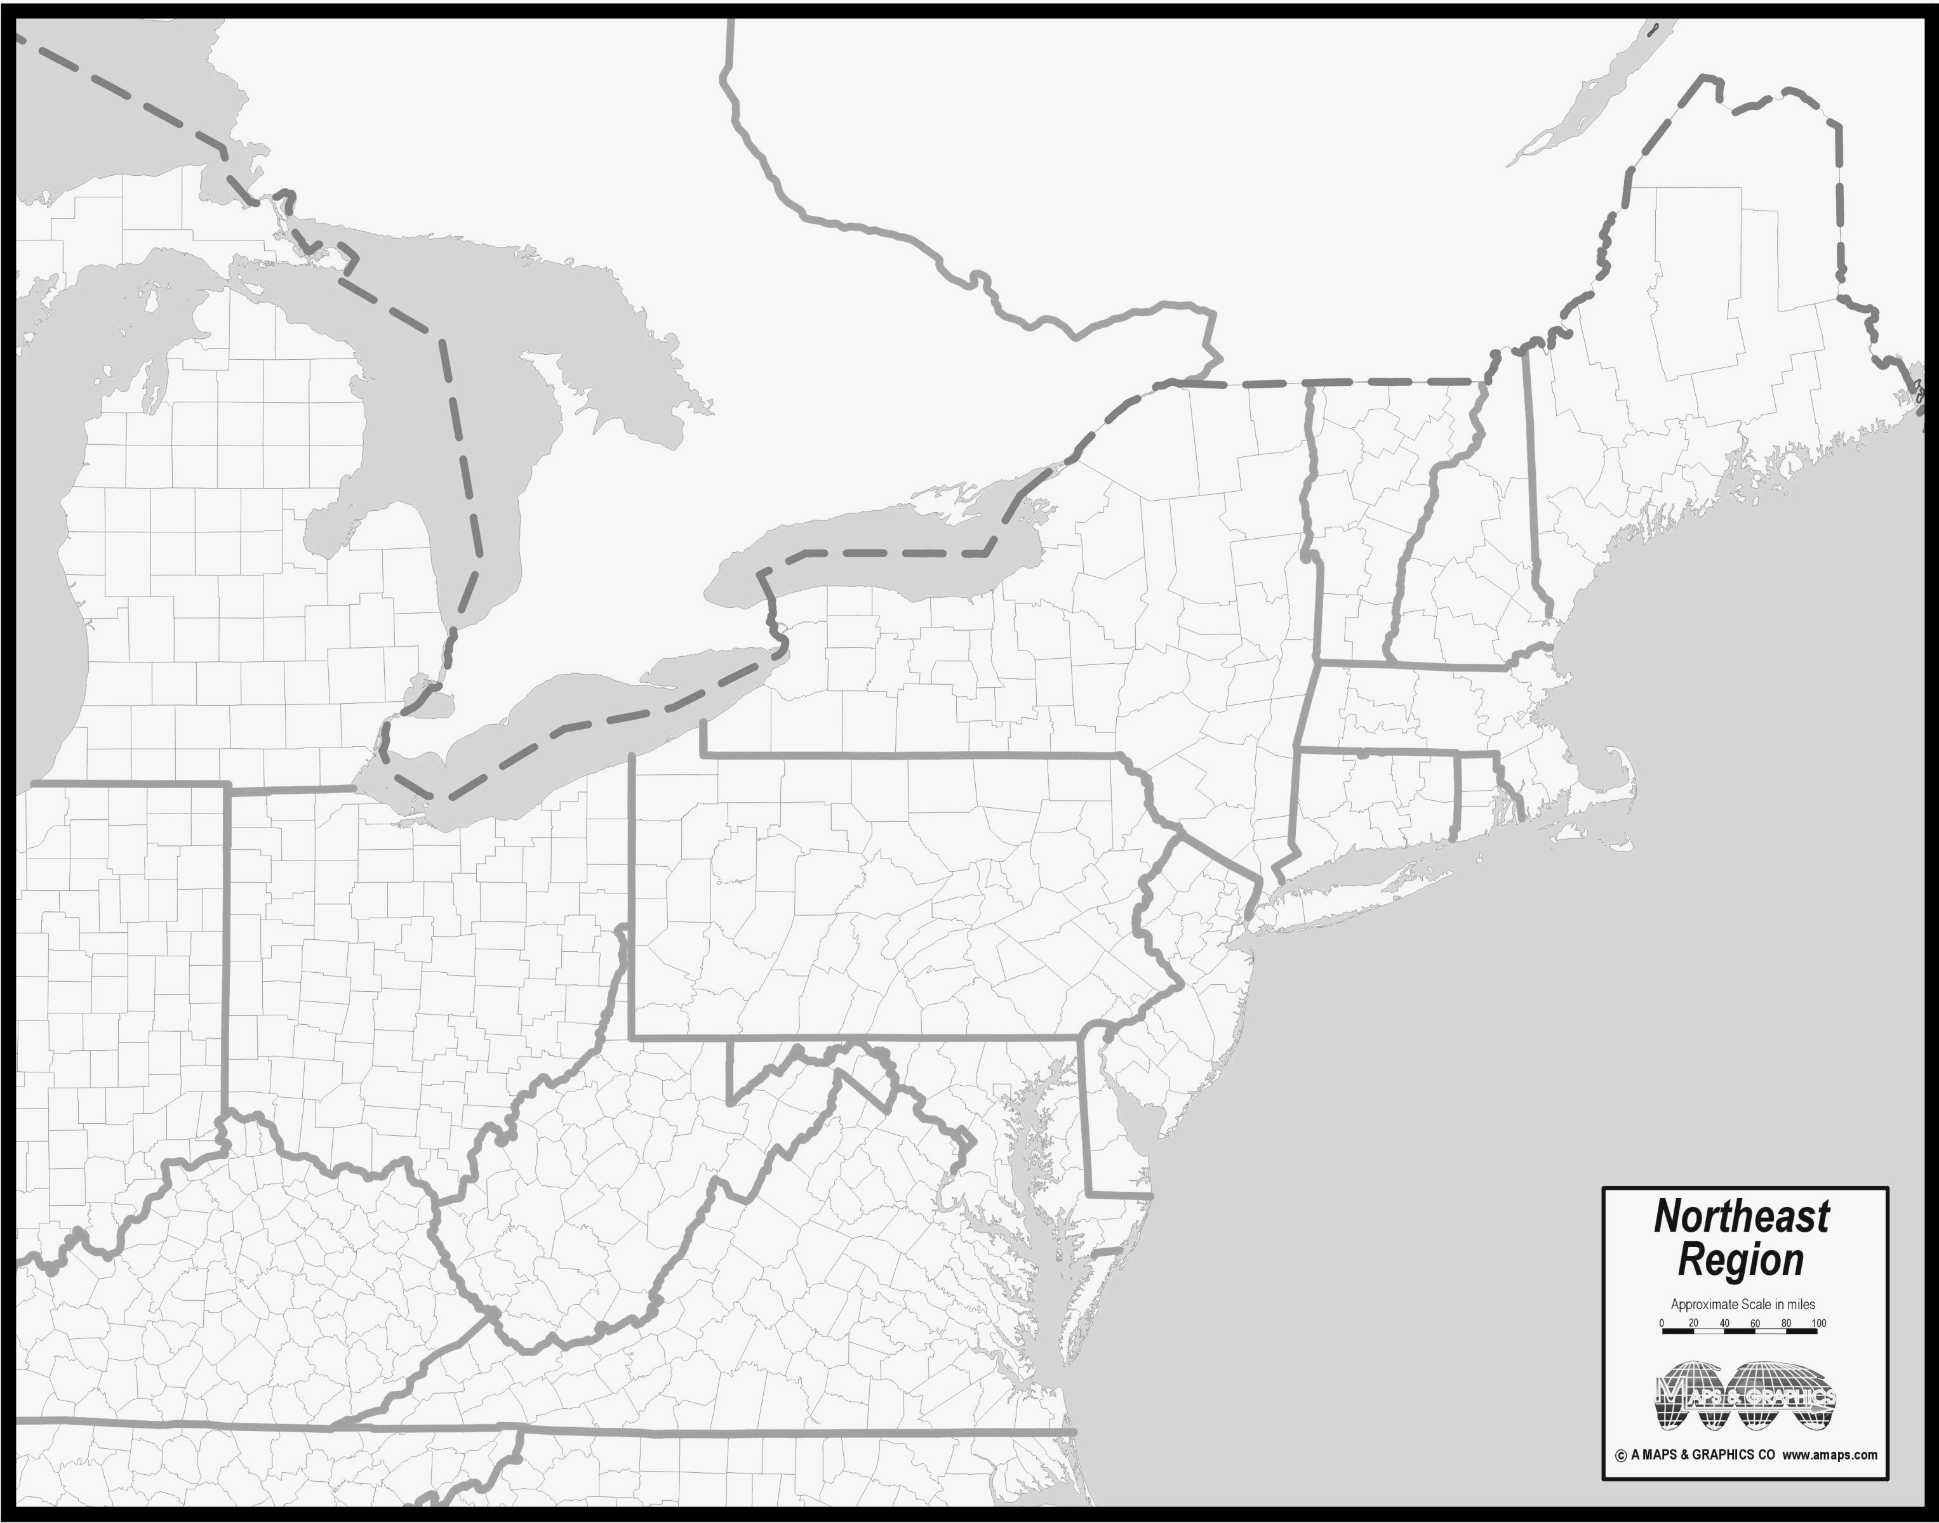
Northeast Domain
Courtesy of amaps.com
Notes:
Construct cartoon for slight risk evaluation method.
Choose cases to illustrate problem.
Move Venn Diagrams up into methodology section.

Slide 9
Northeast Domain
Here
Courtesy of amaps.com
Notes:
Construct cartoon for slight risk evaluation method.
Choose cases to illustrate problem.
Move Venn Diagrams up into methodology section.

Slide 10
Algorithm Example
Slight Risk
Issued: 0600 UTC
Valid: 1200–1200 UTC
40 km
Notes:
Construct cartoon for slight risk evaluation method.
Choose cases to illustrate problem.
Move Venn Diagrams up into methodology section.

Slide 11
Algorithm Example
40 km
Severe
report
Notes:
Construct cartoon for slight risk evaluation method.
Choose cases to illustrate problem.
Move Venn Diagrams up into methodology section.

Slide 12
Algorithm Example
Area of influence
40 km
40 km
Severe
report
Notes:
Look for consistency in capitalization
Choose cases to illustrate problem.
Move Venn Diagrams up into methodology section.

Slide 13
Algorithm Example
40 km
Notes:
Look for hyphen vs. em-dash/en-dash
Choose cases to illustrate problem.
Move Venn Diagrams up into methodology section.

Slide 14
Algorithm Example
40 km
Miss ☹
Notes:
Construct cartoon for slight risk evaluation method.
Choose cases to illustrate problem.
Move Venn Diagrams up into methodology section.

Slide 15
Algorithm Example
40 km
Miss ☹
Correct Hit ☺
Notes:
Construct cartoon for slight risk evaluation method.
Choose cases to illustrate problem.
Move Venn Diagrams up into methodology section.

Slide 16
Algorithm Example
40 km
Miss ☹
Correct Hit ☺
False Alarm 😐
Notes:
Construct cartoon for slight risk evaluation method.
Choose cases to illustrate problem.
Move Venn Diagrams up into methodology section.

Slide 17
Database Criteria
For inclusion in the 1980–2013 dataset, an event must meet at least 1 of 2 criteria:
Have a slight risk contour within the NE domain
Have a sufficiently high impact to warrant inclusion
How do we define “high impact”?
Notes:
For the CONUS dataset, you need either a SLIGHT contour or at least 20 reports for an event to be included. For inclusion in the Northeast Dataset, at least part of a SLIGHT risk area must be within the domain depicted on the previous slide or at least 20 reports within the same domain.

Slide 18
Northeast Severe Report Trend
Notes:
For the CONUS dataset, you need either a SLIGHT contour or at least 20 reports for an event to be included. For inclusion in the Northeast Dataset, at least part of a SLIGHT risk area must be within the domain depicted on the previous slide or at least 20 reports within the same domain.

Slide 19
Northeast Report Trend
55th percentile linear regression
Notes:
Shift slides up and bolded axes.

Slide 20
Northeast Report Trend
55th percentile linear regression
Notes:
Shift slides up and bolded axes.

Slide 21
Northeast Report Trend
High impact!
Notes:
Shift slides up and bolded axes.

Slide 22
variability of high impact events

Slide 23
Annual Variability
Notes:
Add in parenthetical reminder for low POD

Slide 24
Monthly Variability
Notes:
Add in parenthetical reminder for low POD

Slide 25
But what about low(er)-impact events?

Slide 26
Northeast Severe Report Trend
Notes:
For the CONUS dataset, you need either a SLIGHT contour or at least 20 reports for an event to be included. For inclusion in the Northeast Dataset, at least part of a SLIGHT risk area must be within the domain depicted on the previous slide or at least 20 reports within the same domain.

Slide 27
Northeast Severe Report Trend
55th percentile linear regression
45th percentile linear regression
Notes:
For the CONUS dataset, you need either a SLIGHT contour or at least 20 reports for an event to be included. For inclusion in the Northeast Dataset, at least part of a SLIGHT risk area must be within the domain depicted on the previous slide or at least 20 reports within the same domain.

Slide 28
Northeast Severe Report Trend
Strong Slight
Weak Slight
Notes:
For the CONUS dataset, you need either a SLIGHT contour or at least 20 reports for an event to be included. For inclusion in the Northeast Dataset, at least part of a SLIGHT risk area must be within the domain depicted on the previous slide or at least 20 reports within the same domain.

Slide 29
Types of Slight Risk Events
WS
Weak Slight
SS
Strong Slight
Weak Slight Events
Slight risk present
Severe report coverage below 45th percentile
Strong Slight Events
Slight risk present
Severe report coverage above 55th percentile
Notes:
Have only two circles and no overlap. Address hyphens in high impact

Slide 30
Event-Centered Composites

Slide 31
Event-Centered Composites
0.5° NCEP Climate Forecast System Reanalysis (CFSR)
Morning (1200 UTC) data for mid-level flow conditions
Afternoon (1800 UTC) data for convective parameter analysis
Composited April–September events to focus on warm season
All events centered at point of maximum report density
Used Hurlbut and Cohen (2014) results to guide analysis
Notes:
Type 1 event composites (1200z for these slides) are centered on the gridpoint of maximum report count per 1 degree of latitude-longitude (i.e. report density). If an event has several maximum densities of the same magnitude, the case was not included. Type 2 event composites are centered at the centroid of the largest slight risk area in the Northeast domain for a given event.

Slide 32
Event-Centered Composites
Most-Unstable CAPE
850–500-hPa Lapse Rate
Arithmetic mean and 95% confidence interval shown. Additional median significance tests support results.

Slide 33
Event-Centered Composites
Downdraft CAPE
Lowest 150-hPa Mean RH
Arithmetic mean and 95% confidence interval shown. Additional median significance tests support results.

Slide 34
Let’s Digest this a little…

Slide 35
Event-Centered Composites
500-hPa Flow for High-Impact Events
Threat Score for High-Impact Events
Arithmetic mean and 95% confidence interval shown.

Slide 36
Event-Centered Composites
Mid-level Flow Distribution
Majority of slight risk events occur under westerly flow
Do the previous statistics hold for each flow regime?
Notes:
Ditto for this slide

Slide 37
Event-Centered Composites
Mid-level Flow Distribution
Majority of slight risk events occur under westerly flow
Do the previous statistics hold for each flow regime?
Notes:
Ditto for this slide

Slide 38
Southwesterly Flow Regime
Most-Unstable CAPE
850–500-hPa Lapse Rate
Arithmetic mean and 95% confidence interval shown. Additional median significance tests support results.

Slide 39
Southwesterly Flow Regime
Downdraft CAPE
Lowest 150-hPa Mean RH
Arithmetic mean and 95% confidence interval shown. Additional median significance tests support results.

Slide 40
Southwesterly Flow Regime
Downdraft CAPE
Lowest 150-hPa Mean RH
Doh!
Arithmetic mean and 95% confidence interval shown. Additional median significance tests support results.

Slide 41
What does this actually look like?

Slide 42
Weak Slight vs. Strong Slight
Weak Slight
1200 UTC 250 hPa
Strong Slight
250-hPa geopotential height (m, black contours), 250-hPa winds (knots, shaded every 20 knots starting at 50 knots, and barbed). Red dot signifies event center.
Notes:
Title format. Check caption exponentiation

Slide 43
Weak Slight vs. Strong Slight
Weak Slight
1800 UTC 250 hPa
Strong Slight
250-hPa geopotential height (m, black contours), 250-hPa winds (knots, shaded every 20 knots starting at 50 knots, and barbed). Red dot signifies event center.
Notes:
Title format. Check caption exponentiation

Slide 44
Weak Slight vs. Strong Slight
Weak Slight
1200 UTC 500 hPa
Strong Slight
500-hPa geopotential height (m, black contours), 500-hPa winds (knots, barbed), 500-hPa relative vorticity (×10⁻⁵ s⁻¹, shaded every 2×10⁻⁵ s⁻¹). Red dot signifies event center.
Notes:
Title format. Check caption exponentiation

Slide 45
Weak Slight vs. Strong Slight
Weak Slight
1200 UTC MUCAPE & Shear
Strong Slight
850–500-hPa lapse rate (K/km, black contours every .5 K from 6 K/km), 1000–500-hPa shear (knots, barbed), most-unstable CAPE(J/kg, shaded every 250 J/kg). Red dot signifies event center.
Notes:
Title format. Check caption exponentiation

Slide 46
Weak Slight vs. Strong Slight
Weak Slight
1800 UTC MUCAPE & Shear
Strong Slight
850–500-hPa lapse rate (K/km, black contours every .5 K from 6 K/km), 1000–500-hPa shear (knots, barbed), most-unstable CAPE(J/kg, shaded every 250 J/kg). Red dot signifies event center.
Notes:
Title format. Check caption exponentiation

Slide 47
Composite Summary and Key Points
NE high-impact events
Peak in July and warm season. Skew towards Spring
Most common under Westerly and Southwesterly conditions
NE strong slight days and weak slight days
Results support findings of Hurlbut and Cohen (2014)
MUCAPE, DCAPE, 850–500-hPa lapse rate, and lowest 150 hPa layer-averaged RH are found to be helpful discriminators
Southwesterly (strong and weak) slight risk days
Subtle differences include
Shallower, more progressive trough for weak case composite
Faster flow aloft in strong cases, enhanced advection
Upstream lapse rate plume evident in strong case composite
Notes:
CAPITALIZATION. Hyphens for modification only.

Slide 48
FIN
Matthew Vaughan
Email: mvaughan@albany.edu

Slide 49
Type 1 (Low POD)
Notes:
Composites are binned according to 500 hPa flow over the composite point. N is the number of Type 1 events per flow direction (i.e. sample size). Since Type 1 events are in the lowest 25th percentile of events that have 20+ reports, we infer from the bar graph that NW-ly, W-ly, and SW-ly cases follow climatology pretty closely with 25-30% of 20+ cases falling into the Type 1 category. The rarer S-ly, and N-ly cases have a higher occurrence rate than climatology, however the sample size is small. From the pie chart, we see that most Type 1 events have 500 hPa flow out of the west.

Slide 50
Threat Scores by Midlevel Flow
High shear ≥ 31 knots
High MUCAPE ≥ 662 J/kg
Low shear cases have more type 1 events than “good” forecast events
Notes:
Ditto for this slide

Slide 51
MUCAPE-Shear Phase Space
Low Shear, High CAPE (LSHC)
High Shear, High CAPE (HSHC)
High Shear, Low CAPE (HSLC)
Low Shear, Low CAPE (LSLC)
Notes:
Black dot at Center.
Make axes bigger
Black dot at center.
Bigger and better defined axes

Slide 52
MUCAPE-Shear Phase Space
LSHC
HSHC
31 knots
662 J/kg
LSLC
HSLC
Notes:
Black dot at Center.
Make axes bigger
Black dot at center.
Bigger and better defined axes

Slide 53
MUCAPE-Shear Phase Space
LSHC
HSHC
662
LSLC
HSLC
31
Notes:
Black dot at Center. Move 31 and 662 to axes.
Make axes bigger
Black dot at center.
Bigger and better defined axes

Slide 54
MUCAPE-Shear Phase Space
LSHC
HSHC
662
LSLC
HSLC
31
Notes:
Black dot at Center.
Make axes bigger
Black dot at center.
Bigger and better defined axes

Slide 55
MUCAPE-Shear Phase Space
LSHC
HSHC
662
LSLC
HSLC
31
Notes:
Black dot at Center.
Make axes bigger
Black dot at center.
Bigger and better defined axes

Slide 56
CFSR Convective Parameter Results
High shear ≥ 31 knots
High MUCAPE ≥ 662 J/kg
Low shear cases have more type 1 events than “good” forecast events
Notes:
Ditto for this slide

Slide 57
CFSR Convective Parameter Results
High shear ≥ 31 knots
Low shear < 31 knots
High-impact cases with low shear have a lower median threat score than cases with high shear.
Notes:
Change greater that to gt. and equal to

Slide 58
Example Case

Slide 59
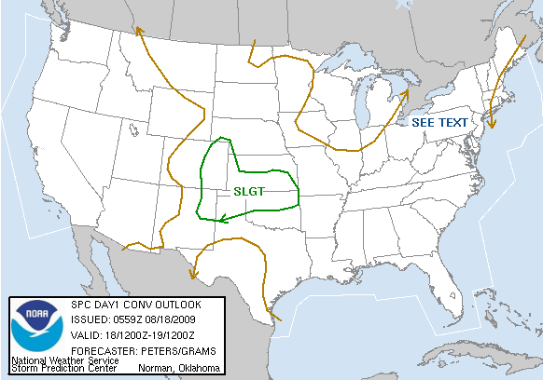
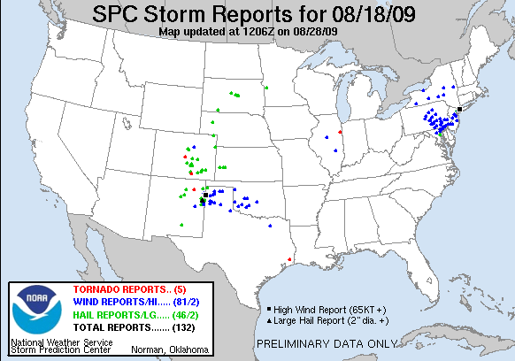
18 August 2009 Severe Wind Event (LSHC)
Type 1 under-predicted storm affecting the NE.
SPC issued “See Text” for NE
Notes:
Be consistent with acronyms

Slide 60
Synoptic Overview
250 hPa
250-hPa geopotential height (m, black contours), 250-hPa winds (knots, shaded and barbed), divergence (× 10⁻⁵ s⁻¹, red contours)
Notes:
Title format. Check caption exponentiation

Slide 61
Synoptic Overview
500 hPa
500-hPa geopotential height (m, black contours), 500-hPa winds (knots, barbed), 500-hPa relative vorticity (×10⁻⁵ s⁻¹, shaded)

Slide 62
Synoptic Overview
CAPE & shear
700–500-hPa lapse rate (K/km, black contours), 1000–500-hPa shear (knots, barbed), surface-based CAPE(J/kg, shaded)
Notes:
FORMAT FORMAT FORMAT. Exponentials and capitalizations. Make barbs a different color and bold. Remove words

Slide 63
Morning Sounding: Convective Initiation
MLCAPE: 1948 J/kg
MLCIN: -167 J/kg
6-km shear: 12 kt
DCAPE: 510 J/kg
Notes:
Think about just one sounding for CI locations. Look at abbreviations and correct them in Titles

Slide 64
Morning Sounding: Severe Report Location
MLCAPE: 2192 J/kg
MLCIN: -233 J/kg
6-km shear: 12 kt
DCAPE: 1294 J/kg
Notes:
Crop out Hodo and down for clarity

Slide 65
WAL Sounding Climatology
DCAPE: 1294 J/kg

Slide 66
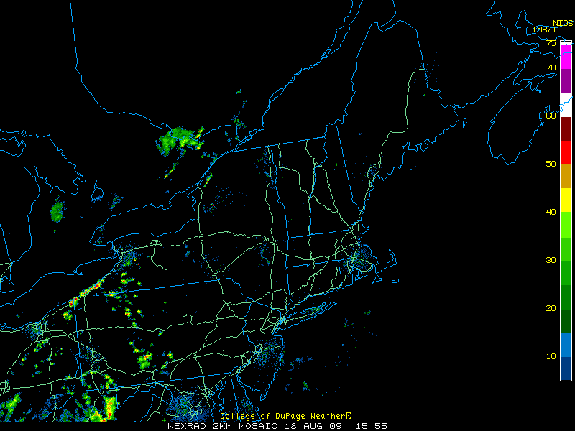
Radar 1600 UTC 18 Aug
Notes:
Over the great Lakes instead of off the coast.
Just radar image lead off

Slide 67
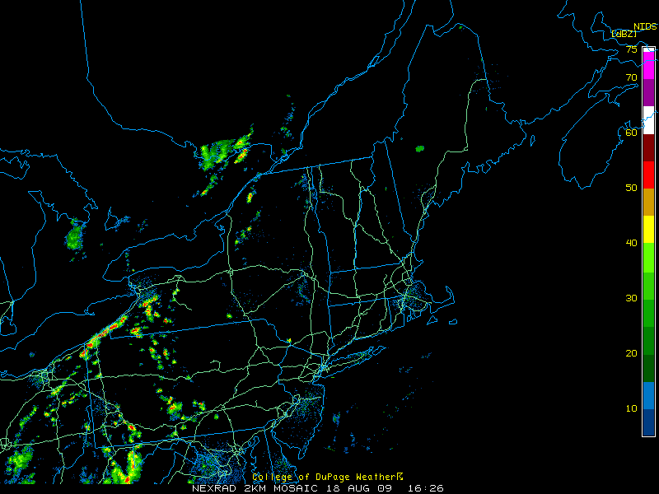
Radar 1630 UTC 18 Aug
Notes:
Over the great Lakes instead of off the coast.
Just radar image lead off

Slide 68
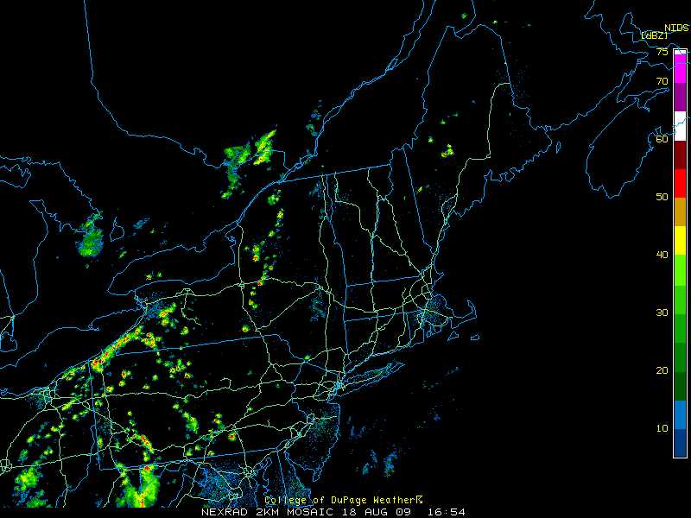
Radar 1700 UTC 18 Aug
Notes:
Over the great Lakes instead of off the coast.
Just radar image lead off

Slide 69
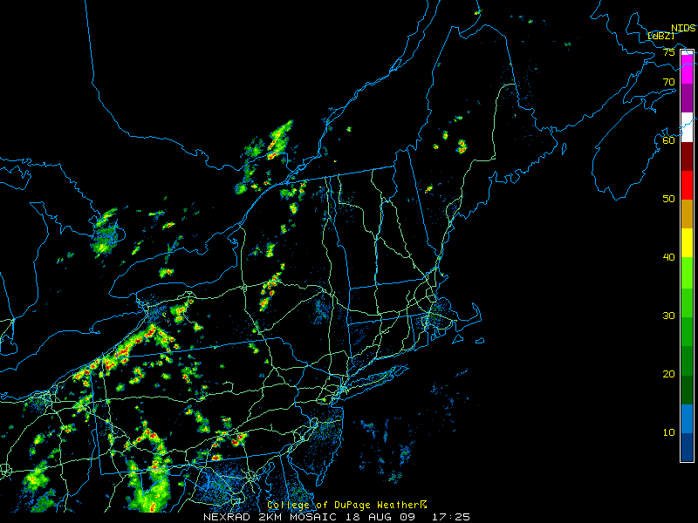
Radar 1730 UTC 18 Aug
Notes:
Over the great Lakes instead of off the coast.
Just radar image lead off

Slide 70
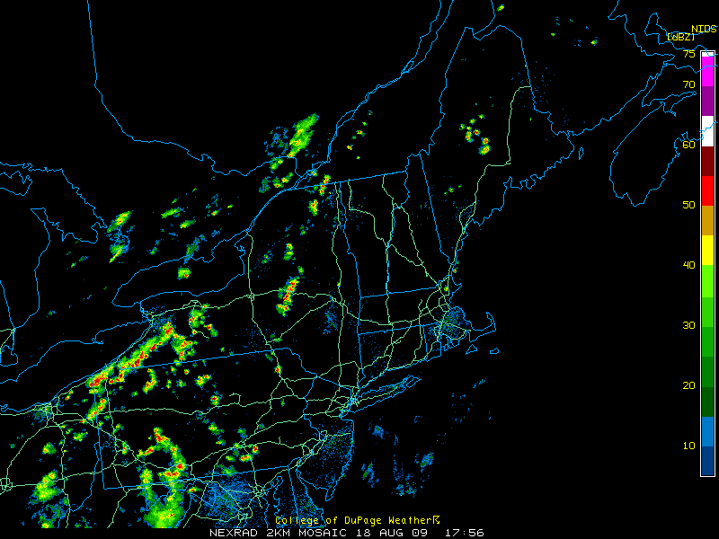
Radar 1800 UTC 18 Aug
Notes:
Over the great Lakes instead of off the coast.
Just radar image lead off

Slide 71
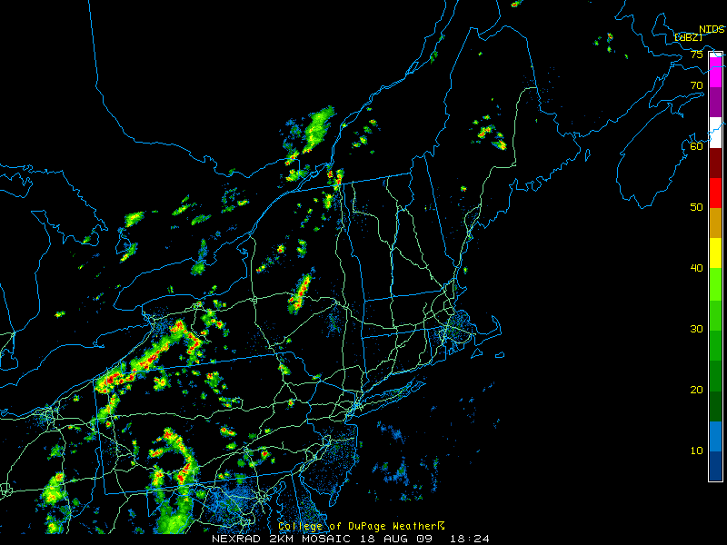
Radar 1830 UTC 18 Aug
Notes:
Over the great Lakes instead of off the coast.
Just radar image lead off

Slide 72
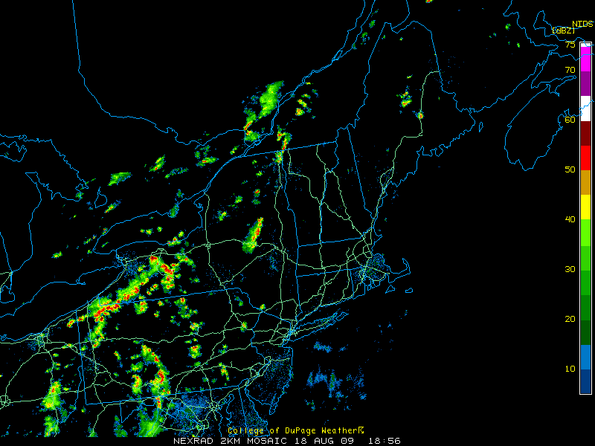
Radar 1900 UTC 18 Aug
Notes:
Over the great Lakes instead of off the coast.
Just radar image lead off

Slide 73
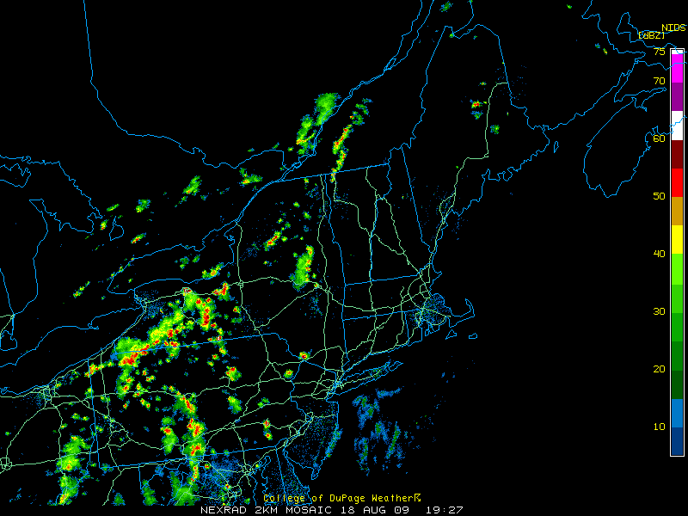
Radar 1930 UTC 18 Aug

Slide 74
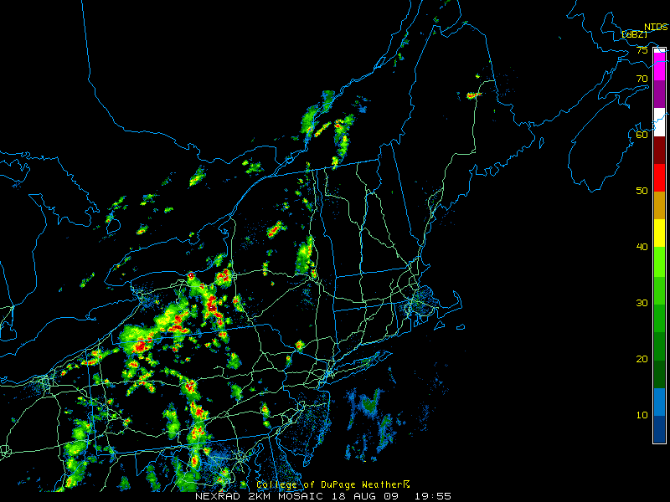
Radar 2000 UTC 18 Aug

Slide 75
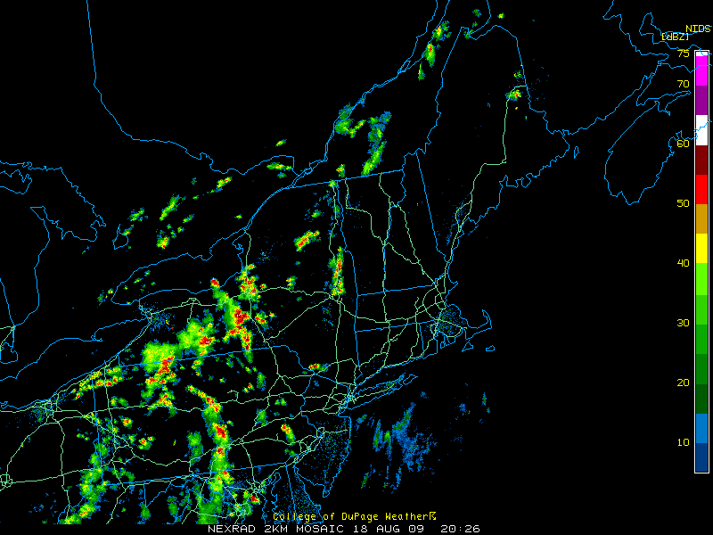
Radar 2030 UTC 18 Aug
Source: UCAR

Slide 76
Radar 2100 UTC 18 Aug

Slide 77
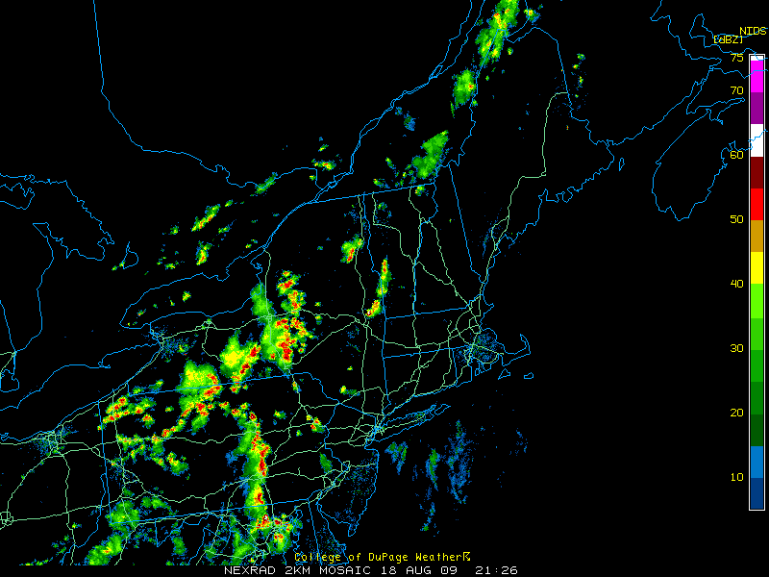
Radar 2130 UTC 18 Aug

Slide 78
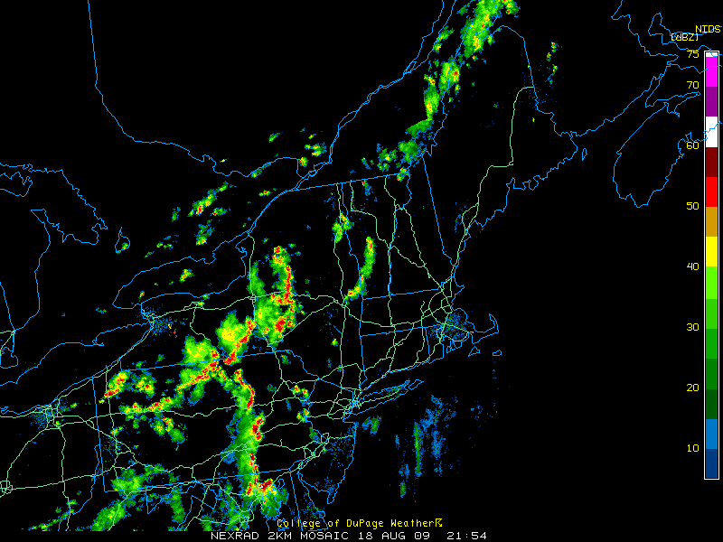
Radar 2200 UTC 18 Aug

Slide 79
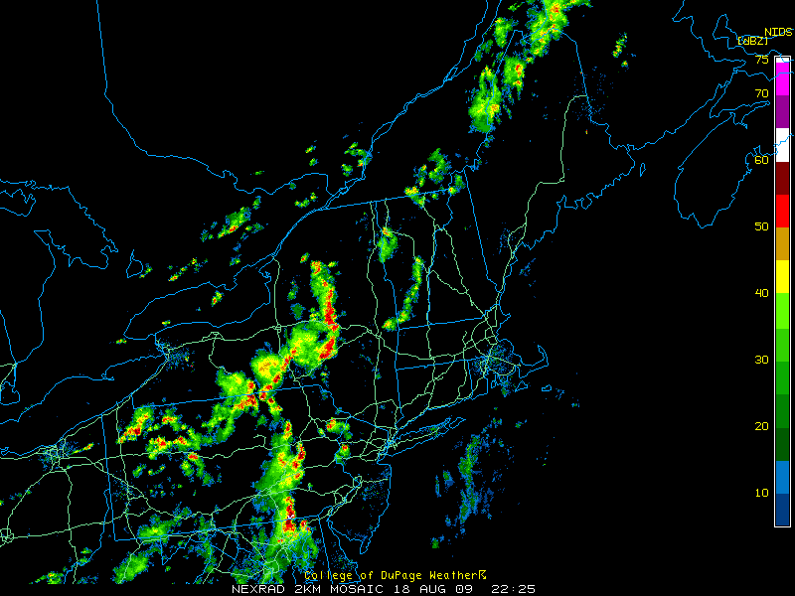
Radar 2230 UTC 18 Aug

Slide 80
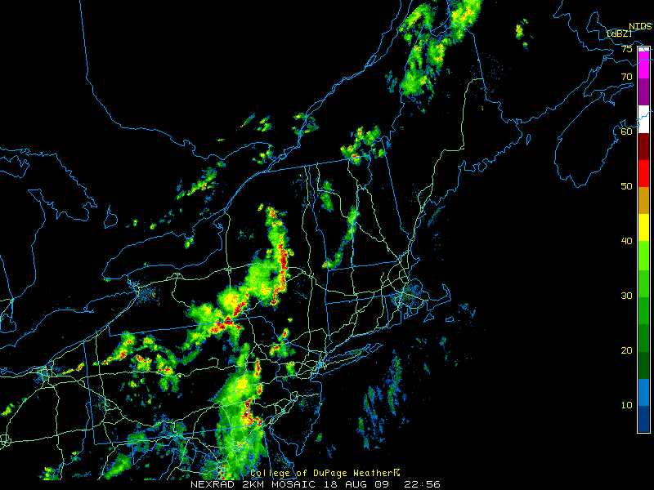
Radar 2300 UTC 18 Aug

Slide 81
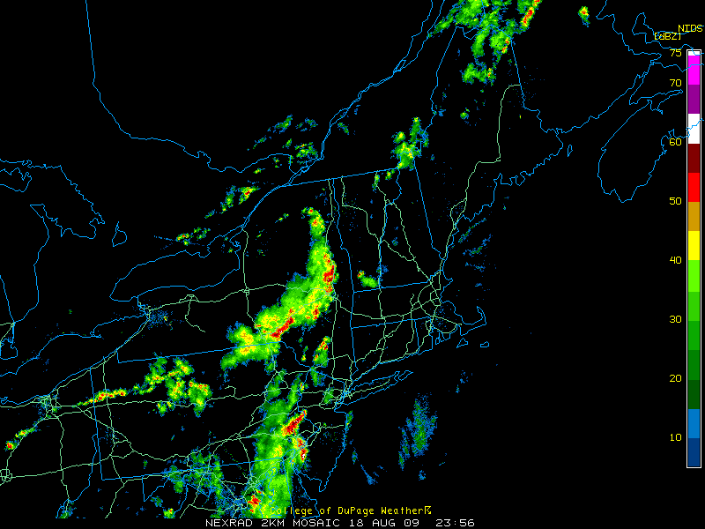
Radar 0000 UTC 19 Aug

Slide 82
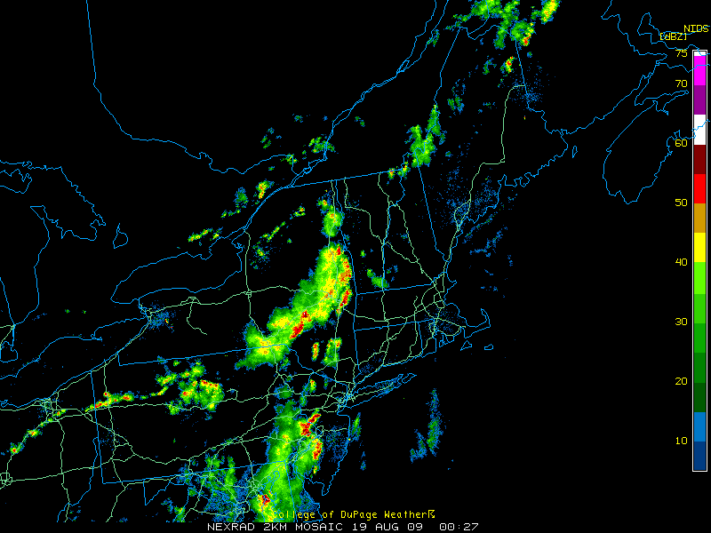
Radar 0030 UTC 19 Aug

Slide 83
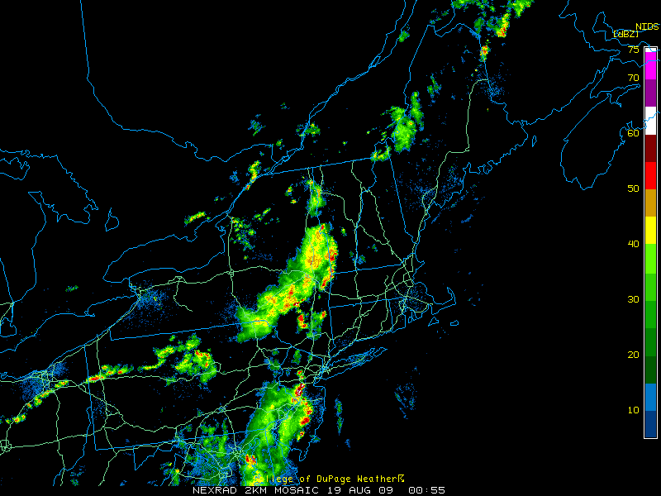
Radar 0100 UTC 19 Aug

Slide 84
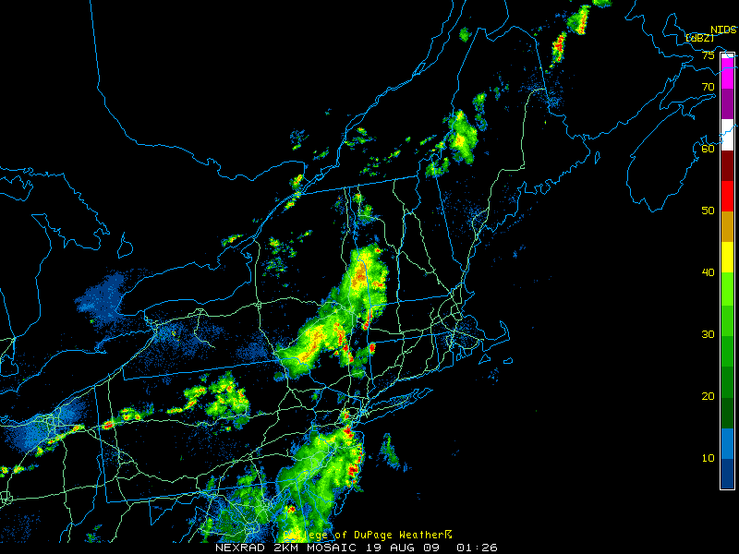
Radar 0130 UTC 19 Aug

Slide 85
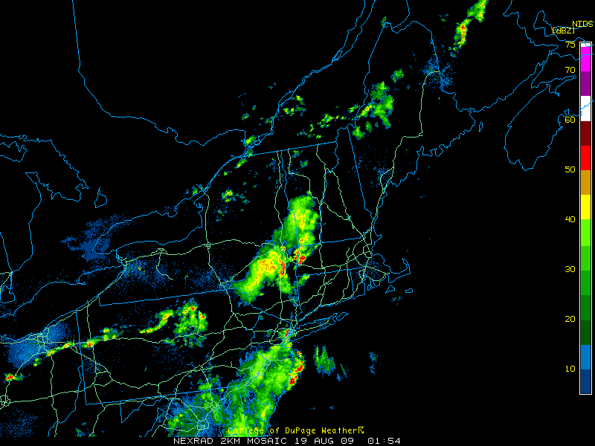
Radar 0200 UTC 19 Aug

Slide 86
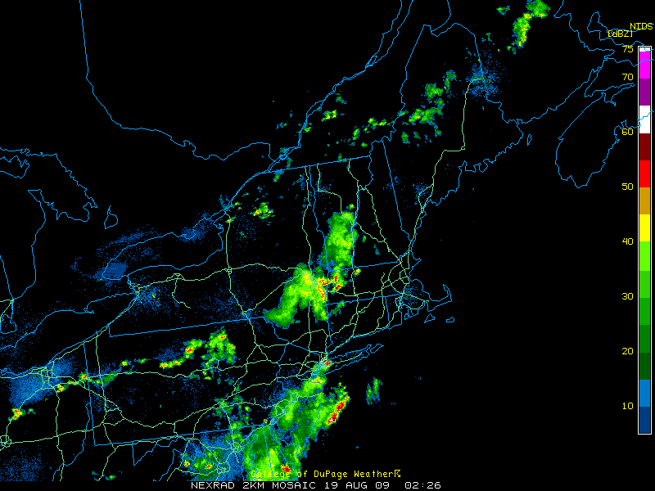
Radar 0230 UTC 19 Aug

Slide 87
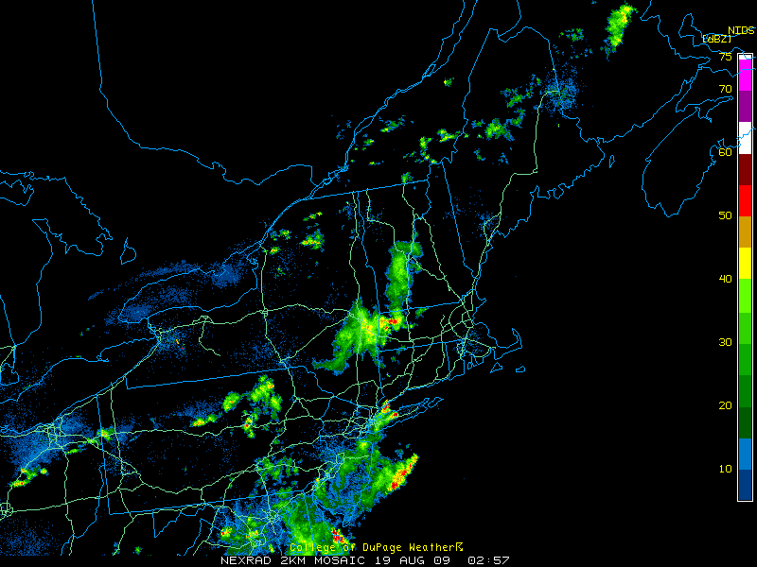
Radar 0300 UTC 19 Aug

Slide 88
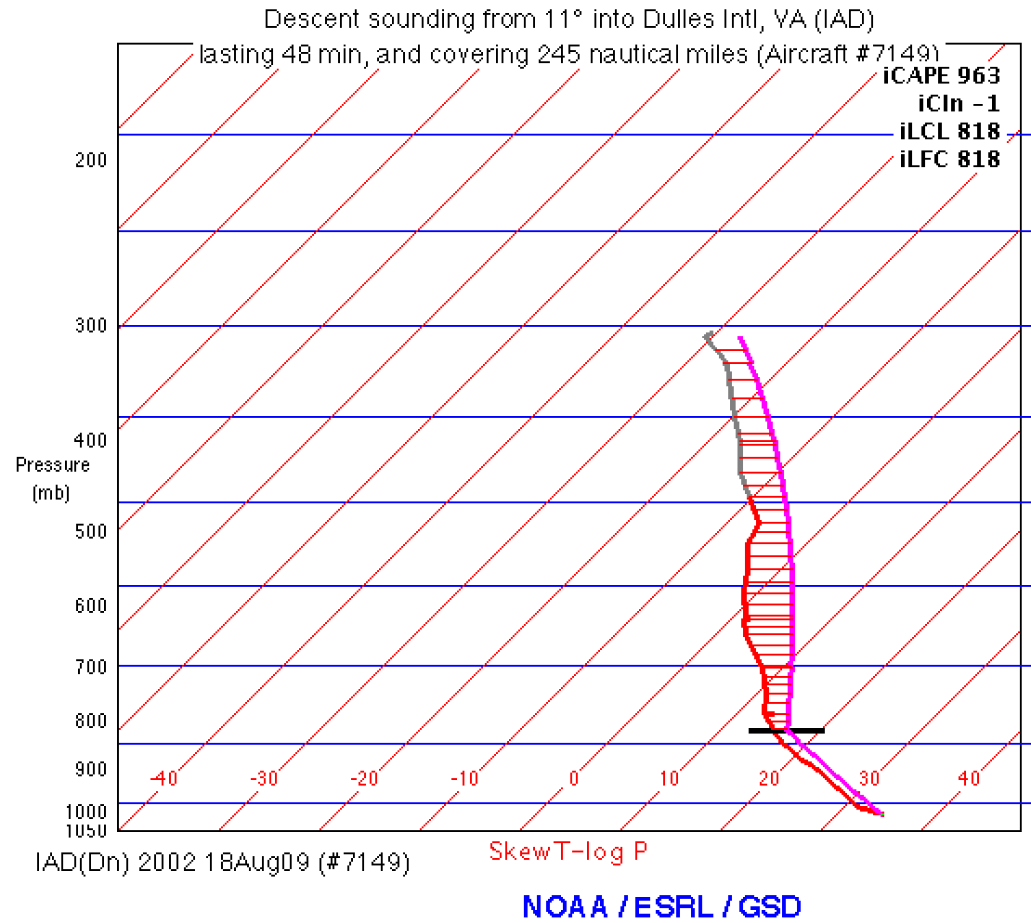
Radar 2000 UTC 18 Aug

Slide 89
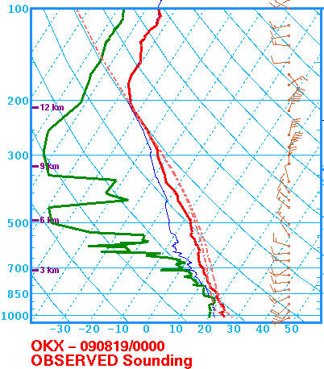
Radar 0000 UTC 19 Aug
DCAPE: 1199 J/kg

Slide 90
Case Summary
Low Shear High CAPE (LSHC) event.
Weak synoptically forced environment
Orography and lake boundaries critical in convective initiation
Convective initiation environment differed from environment to the east where most severe reports occurred.
Type 1 LSHC cases often feature storms propagating into environments with higher PBL heights and greater DCAPE
In the absence of strong low-to-mid level flow and large vertical wind shear, enhanced evaporative cooling likely contributed to severe wind threat

Slide 91
Composite Summary and Key Points
NE high-impact events
Peak in July and warm season. Skew towards Spring
Most common under Westerly and Southwesterly conditions
NE strong slight days and weak slight days
Results support findings of Hurlbut and Cohen (2014)
MUCAPE, DCAPE, 850–500-hPa lapse rate, and lowest 150 hPa layer-averaged RH are found to be helpful discriminators
Southwesterly (strong and weak) slight risk days
Subtle differences include
Shallower, more progressive trough for weak case composite
Faster flow aloft in strong cases, enhanced advection
Upstream lapse rate plume evident in strong case composite
Notes:
CAPITALIZATION. Hyphens for modification only.

Slide 92
Types of Slight Risk Events
WS
Weak Slight
SS
Strong Slight
Weak Slight Events
Slight risk
Report coverage below 45th percentile
Strong Slight Events
Slight risk
Report coverage above 55th percentile
Notes:
Have only two circles and no overlap. Address hyphens in high impact

Slide 93
Type 2 (High FAR) Example
Reports captured = 2 Reports missed = 0
POD = 1 FAR = .986 TS = .014

Slide 94
Type 1 (Low POD)
Notes:
Composites are binned according to 500 hPa flow over the composite point. N is the number of Type 1 events per flow direction (i.e. sample size). Since Type 1 events are in the lowest 25th percentile of events that have 20+ reports, we infer from the bar graph that NW-ly, W-ly, and SW-ly cases follow climatology pretty closely with 25-30% of 20+ cases falling into the Type 1 category. The rarer S-ly, and N-ly cases have a higher occurrence rate than climatology, however the sample size is small. From the pie chart, we see that most Type 1 events have 500 hPa flow out of the west.

Slide 95
Morning Sounding in ALB

Slide 96
Morning Sounding in IAD

