Slide 1
Integrating GFE, MPE, Site-Specific and Hydroview into WFO Operations
Steve DiRienzo
Senior Service Hydrologist
National Weather Service
WFO Albany, NY

Slide 2
GFE, MPE, Site-Specific and Hydroview in WFO Operations
This presentation was originally given at the Hydro Program Manager’s Conference in 2007 in Kansas City
This presentation is a subset of our local training package available for staff on WFO ALY intranet since 2007

Slide 3
Overview – ALY Best Practices
Convey Importance of Hydrology to Staff
Include Hydrologic Discussion in every issuance of Area Forecast Discussion (AFD)
Hydrologic discussion information obtained from RFCs, NOHRSC and USGS, etc.
4. Site Specific forecasts as guidance for writing hydrologic discussion when NERFC closed.

Slide 4
Overview – Best Practices
Quality Control MPE Data
Be proactive with proper Z/R relationship.
Develop local Guidance on Headwater Guidance
8. Quality control AHPS web pages.

Slide 5
Overview – Best Practices
9. Hydroview has many uses. Incorporate it into operations

Slide 6
Best Practice 1: Convey Importance of Hydrology to Staff
Hydrologic disasters happen here often – flooding has big impact (80% of Federal Disaster Declarations are for flooding or drought)
Hydrologic disaster examples
Terrain/Relief play a major role

Slide 7
Hydrology – Big Impact at WFO ALY
March 1977 – Green Island Bridge Collapse (Hudson River)
April 1987 – I-90 Bridge Collapse (Schoharie Creek)
January 1996 – Rain and Rapid Snow Melt – Widespread Major to Record Flooding
April/June 2005 - Catskill Record Flooding (rain + snowmelt) and I-87 Washout (Flash Flood)
June 2006 – Record Flooding on Upper Mohawk River (I-90, railroads and Erie/Mohawk Canal shut down)

Slide 8
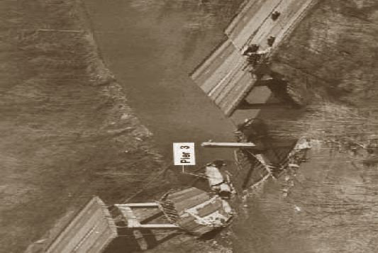
I-90 bridge collapse on Schoharie Creek, April 5, 1987
Courtesy of Sid Brown, Schenectady Gazette.

Slide 9
I-87 (Northway) Washout June 2005

Slide 10
Canajoharie, NY - June 2006

Slide 11
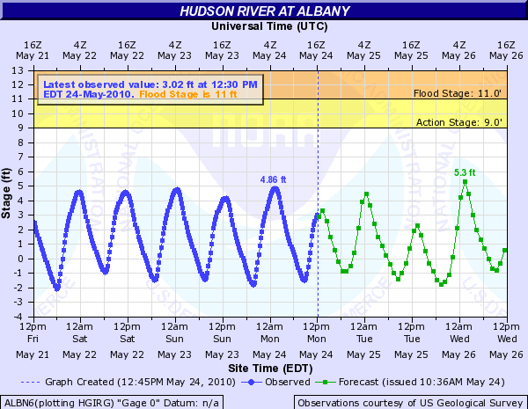
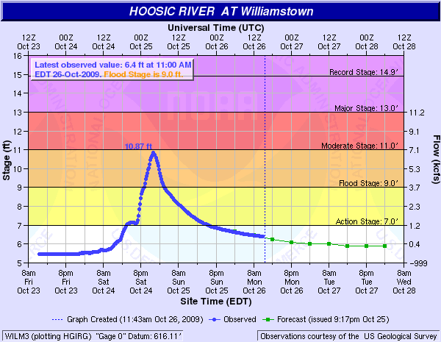
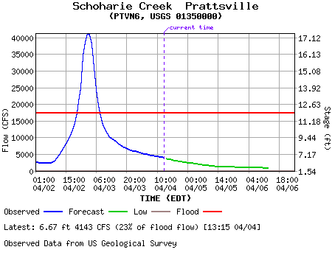
Terrain/Relief a Major Factor in WFO ALY Hydrology

Slide 12
Terrain Effects
Deep snow pack can accumulate in mountains even with no snow on ground here at Albany or other valley locations
Strong 925mb wind flow will cause upslope enhancement of precipitation: SE wind in Catskills, W wind in Adirondacks for lake effect snow
Fast responding rivers

Slide 13
Terrain Influence on SWE

Slide 14
Best Practice 2: Include Hydro Discussion in each issuance of AFD
In 2005 we decided to include Hydrology Discussion in every issuance of Area Forecast Discussion (AFD)
Staff remains aware of current hydrologic conditions and forecast QPF, river response, FFG, snowpack, etc (Situational Awareness).

Slide 15
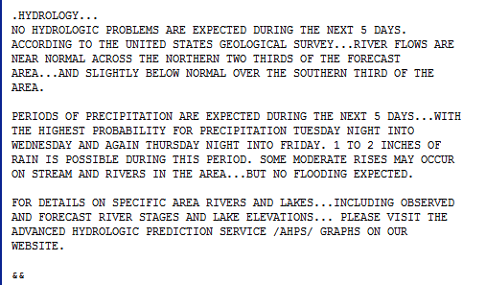
Example Hydro Discussion
Can simply say: “Please refer to latest Winter/Spring Flood Potential Outlook (ESFALY) for details”.

Slide 16
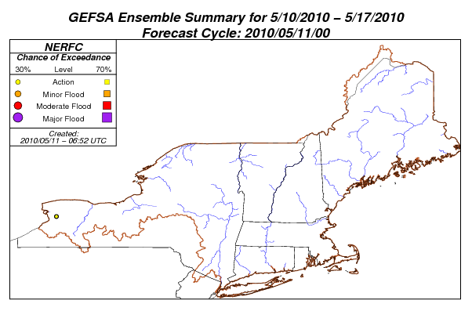
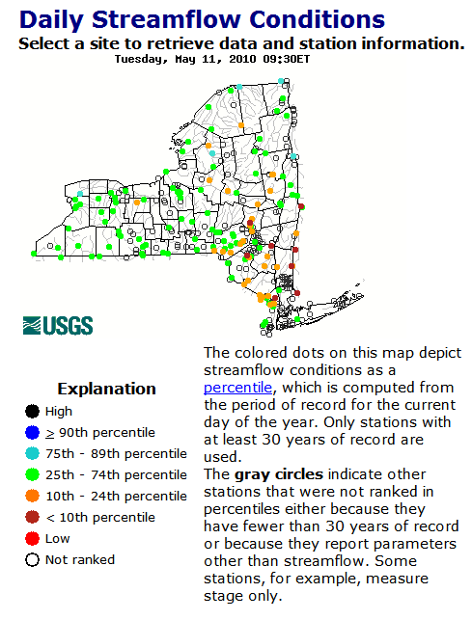
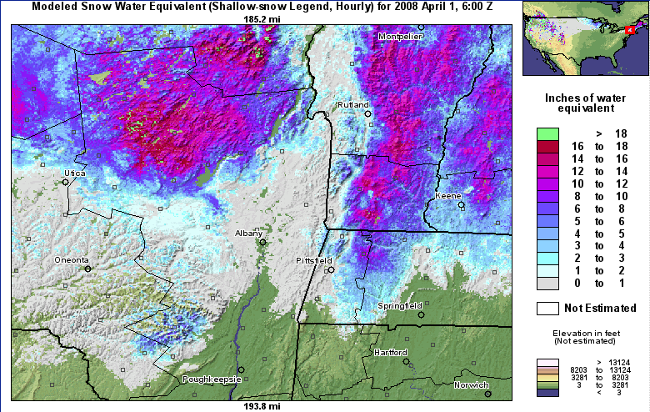
Best Practice 3: Include NERFC, NOHRSC and USGS Information in Hydro Discussion

Slide 17
Best Practice 4: Site Specific forecasts as guidance for hydrologic discussion when NERFC closed.
After adding Hydro discussion to AFD, Forecasters complained of old hydro guidance on midnight shift.
Set up Site Specific to forecast all headwater points and GFE Formatter to send QPF to SSHP.
Basis for Hydrologic Discussion in AFD and FLWs when NERFC is Closed

Slide 18
Basin Outlines in GFE

Slide 19
Example GFE Hydro Edit Area FLVC3
FLVC3

Slide 20
Hourly QPF Formatter – WRKRR2

Slide 21
RR2ALY – Hourly QPF to 72 Hours
Generated from QPF in GFE Grids.

Slide 22
Forecast Data in SSHP – Basis for Hydrologic Discussion in AFD and FLWs When NERFC Closed
Fcst Precip
Forecast River Stage
Observed River Stage

Slide 23
Future GFE Hydrologic Formatter Additions
Add Snowmelt Grid to GFE…hopefully receive snowmelt grids from NERFC or NOHRSC
Compute Rain + Snow Melt from GFE
Formatter Launcher choices: Rain, snow melt only or rain + snow melt

Slide 24
Best Practice 5: Quality Control MPE Data
Site Specific Hydrologic Predictor Uses MPE Data so Need to Quality Control MPE Data
Quality rain gage data will improve radar bias adjustment as well as river stage forecasts
Sometimes have to remove AP from radar data.

Slide 25
Available 1-Hr Rain Gages
Need to include gauges from outside CWA for consistent radar bias adjustments and consistent MPE precipitation estimates.

Slide 26
MPE Radar Coverage
ALY HSA covered by six radars. Lowest slice of from each radar used.

Slide 27
Individual Radar Coverage Issues With Lowest Slice
Sometimes looking at a higher slice or neighboring radar might be better than lowest slice due to beam blockage. Beam blockage causes precipitation under estimation.

Slide 28
Best Practice 6: Be proactive with proper Z/R relationship
WFO ALY uses 3 Z/R Relationships:
Convective Default (Z-R): 300/1.4
Tropical (Z-R): 250/1.2
Cool Season-Stratiform (Z-R): 130/2.0
Tropical Z-R in tropical rain situations (i.e. tropical remnants or very moist summertime air mass).
Cool Season-Stratiform Z-R relationship from roughly NOV-MAR, unless unseasonably mild air masses with convection occur during winter then switch to 300/1.4.

Slide 29
Site Specific Uses Gridded Headwater Guidance From RFC

Slide 30
Best Practice 7: Guidance on Headwater Guidance
Local Site Specific points may have “Bogus Default Value” = 5 reported for FFH in SSHP
Rough rule of thumb is to use 2.0 for FFH value from 1 November to 30 April (leaf off period) unless NERFC guidance is lower. Then use NERFC number.
For late summer dry conditions (no widespread rain for a couple of weeks) use around 4 inches.

Slide 31
Guidance on Headwater Guidance
For high intensity rain and melt on frozen ground you may have to use the threshold runoff number for the basin FFH.
Remember: The FFH value you use can not be lower than the basin threshold runoff otherwise the threshold runoff value is used by the model.

Slide 32
Best Practice 8: Quality control AHPS web pages.
AHPS is the Public Access to our river observations/forecasts/warnings
Shift checklist requires that AHPS pages are working and that data looks good

Slide 33
Albany AHPS Page
http://water.weather.gov/ahps2/index.php?wfo=aly

Slide 34
Best Practice 9: Incorporate Hydroview into operations.
Hydroview has many uses…
Examples follow:

Slide 35
Time Series Control – Predefined Group Mode
“OVERVIEW” Group: Use to QC forecasts from NERFC before sending RVD. Eight Pages. Use PgUp or PGDown to cycle through group.

Slide 36
Point Data Control Preset: Latest Temperature
“Hydroview useful for more than just rivers…

Slide 37
Point Data Control Preset: Peak Winds

Slide 38
Review – ALY Best Practices
80 % of federal disaster declarations are hydrology related…so…Convey Importance of Hydrology to Staff
Include Hydrologic Discussion in every issuance of Area Forecast Discussion (AFD)
Hydrologic discussion information obtained from RFCs, NOHRSC and USGS…situational awareness
Site Specific forecasts as guidance for writing hydrologic discussion when NERFC closed.

Slide 39
Review – Best Practices
Quality Control MPE Data
Be proactive with proper Z/R relationship.
Develop local Guidance on Headwater Guidance
8. Shift checklist requires each shift to quality control AHPS web pages.

Slide 40
Review – Best Practices
9. Hydroview has many uses. Incorporate it into operations

Slide 41
The End
Questions?
Steve DiRienzo
Senior Service Hydrologist
National Weather Service Forecast Office
251 Fuller Rd, Suite B-300
Albany, NY 12203
(518) 435-9571 x234
www.weather.gov/aly

