Slide 1
Verification of Flash Flood Warnings
Brent MacAloney
Meteorologist, Performance Branch
Silver Spring, MD

Slide 2
On Tap Today….
Historical Flash Flood Verification
Developing a scheme for storm-based flash flood warnings
How storm-based warnings are verified
Upcoming changes to verification
Next-Generation Storm Data Program

Slide 3
Historical Flash Flood Verification
Verification data back to 1986
Verifying events from storm data
GPRA metric until FY10
County-based verification
One report in warned county, regardless of if in polygon verifies warning

Slide 4
County-based Verification
unwarned
unwarned
unwarned
unwarned
unwarned

Slide 5
Developing Storm-based FFW Verification
NWS begins issuing storm-based warnings in October 2007 for SVR, TOR, FFW, and SMW products
Needed way to measure performance since county-based methodology no longer applied.
Team formed to develop new performance metrics
Met in Boulder in December 2005

Slide 6
How Storm-based FFWs are Verified
Information used from warning products
Beginning date / time (VTEC)
Ending date / time (VTEC)
Forecast office
Action Code (NEW or EXT)
Event Tracking Number (ETN)
Area from latitude/longitude

Slide 7
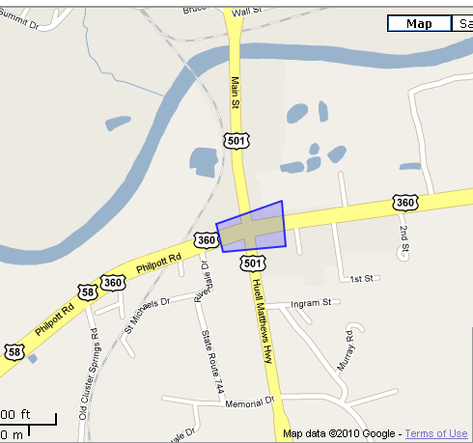
How Storm-based FFWs are Verified
Information used from events
Beginning date / time
Ending date / time
Forecast office
Area from latitude/longitude points outlining flooded area

Slide 8
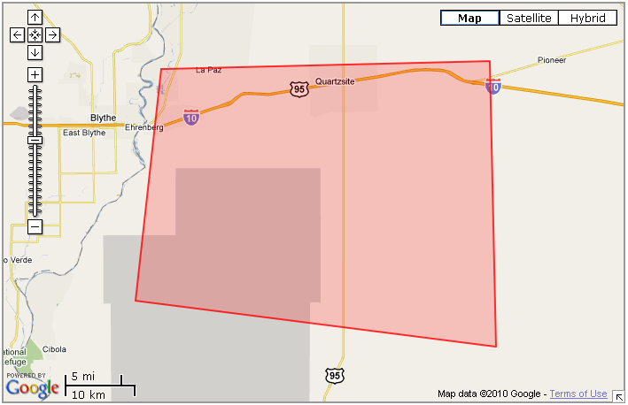
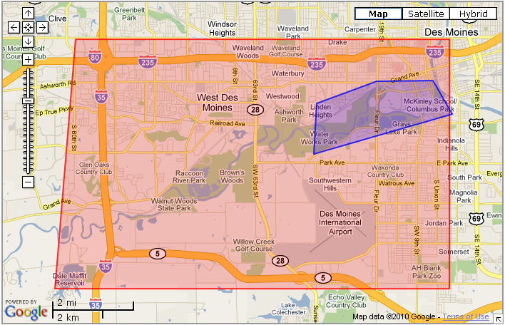
How Storm-based FFWs are Verified
First step: Check if the warning verified
Did a flash flood event occur within the area and time of the warning?
Yes, warning is verified.
No, warning is unverified
UNVERIFIED
VERIFIED

Slide 9
How Storm-based FFWs are Verified
Second step: Calculate percent of event warned (PEW)
Was there a flash flood warning valid for the area and time in which the event occurred?
Yes, event is fully warned, PEW = 1
Partially, event is partially warned, PEW between 0 - 1
No, event is unwarned, PEW = 0

Slide 10
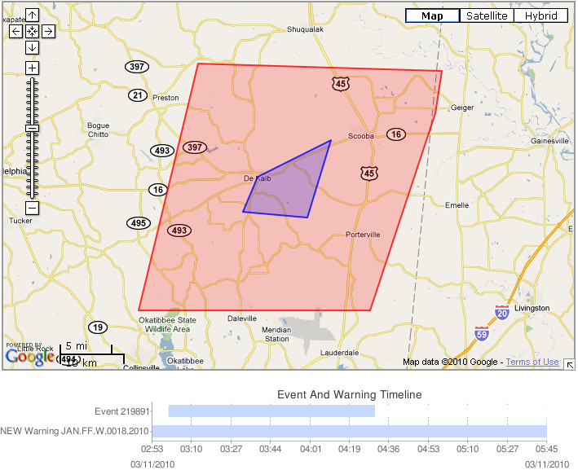
Event fully warned in time and area

Slide 11
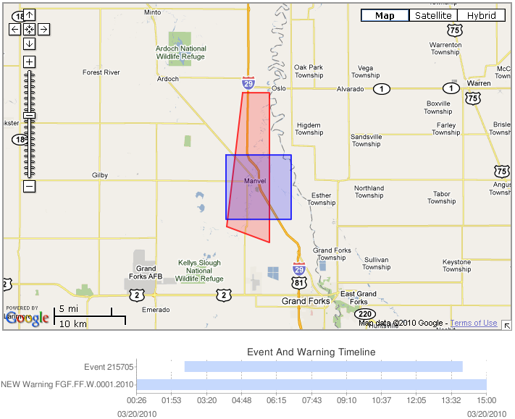
Event partially warned in time and area

Slide 12
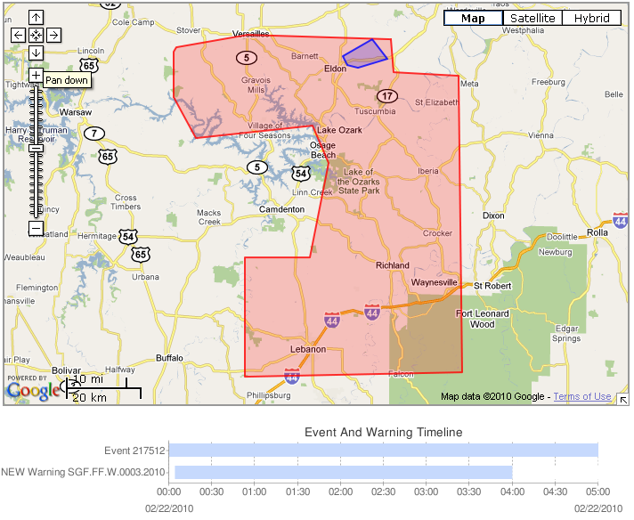
Event partially warned in time and area

Slide 13
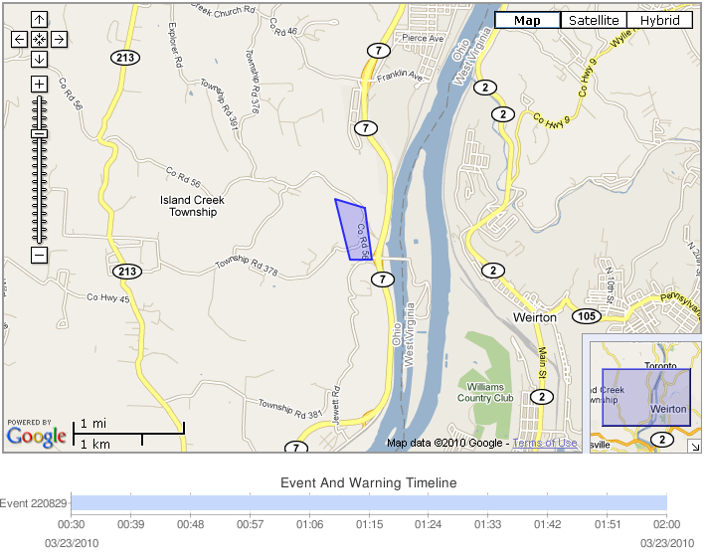
Event not warned in time and/or area

Slide 14
How Storm-based FFWs are Verified
Third step: Calculate event maximum event lead time
Was there a flash flood warning valid any area of the event at the time in which the event occurred?
Yes, lead time > 0
No, lead time = 0
Note: Maximum event lead time calculation does not take into account how much of event was covered by a warning.

Slide 15
Event with maximum event lead time > 0
Maximum event lead time = 7 minutes

Slide 16
Event with maximum event lead time > 0
Maximum event lead time = 119 minutes

Slide 17
Event with no maximum event lead time
Maximum event lead time = 0 minutes

Slide 18
How Storm-based FFWs are Verified
Fourth step: Calculate event area weighted lead time
Was there a flash flood warning valid at the time in which the event occurred?
Yes
Did the warning cover the entire area of the event?
Yes, lead time > 0
No, deduction taken on lead time for area not warned
No, lead time = 0

Slide 19
Event with area weighted lead time > 0
Area weighted lead time = 7 minutes

Slide 20
Event with area weighted lead time > 0
Area weighted lead time = 69 minutes

Slide 21
Event with no area weighted lead time
Area weighted lead time = 0 minutes

Slide 22
Difference between area weighted and maximum event lead times
Area LT = 69 minutes
Max LT = 119 minutes
Which best shows our
performance?

Slide 23
Storm-based Flash Flood Verification
Verification data back to October 2007
Verifying events from storm data
GPRA metric since FY10

Slide 24
Changes to Verification
Storm data currently being modernized
Beginning with data in October 2010
Changes will impact verification of flash floods

Slide 25
Change to how events are entered
Problem – “Events in storm data are broken into county-based segments.

Slide 26
Change to how events are entered
Solution – Eliminate the need to enter events into county-based events
All county-based events will be able to be entered “as they occurred” and won’t have to be broken up into county-based segments.
Biggest impact to tornado, hail, thunderstorm wind, flash flood and flood

Slide 27
Change to how events are entered
Benefit of eliminating county-boundaries:
More accurate reporting of events
Easier entry into storm data
Saves a lot of entry time

Slide 28
Thank you for your time! Feel free to contact me….
Brent MacAloney
E-mail: Brent.MacAloney@noaa.gov
Phone: 301-713-0090 x135

