Slide 1
The August 21, 2009 Chelsea, VT Flash Flood Case Study and Radar Considerations Eastern Region Flash Flood Conference June 2 2010
Greg Hanson
WFO BTV
802-922-9139
gregory.hanson@noaa.gov

Slide 2
Overview
Meteorological background and event summary
Radar Considerations
FFMP and HPE recap
Notes:
On August 21, 2009 heavy rainfall produced flash floods in portions of east central and southeast Vermont. A stalled frontal boundary provided a focus for convection, and deep subtropical moisture was in place. Precipitable water values were around 2 inches, roughly double the normal amount. Thunderstorms produced 4 inches of rain in 2 hours, and flooded Chelsea Village in Vermont. While flash flooding is not uncommon in Vermont, further study is warranted based on the geographic placement of the storms and the resulting radar sampling issues. We found that the High Resolution Precipitation Estimator (HPE) required further configuration to be fully effective in FFMP (Flash Flood Monitoring and Prediction). For offices in complex terrain, missing radar bin files derived from radar climatology should be optimized and included in FFMP processing. This presentation will examine the meteorological conditions leading up to the flash flood event, radar beam blockage issues, and range effects that created challenges for the warning process. A comparison of various radar products used as input to the Flash Flood Monitoring and Prediction (FFMP) will be presented.

Slide 3
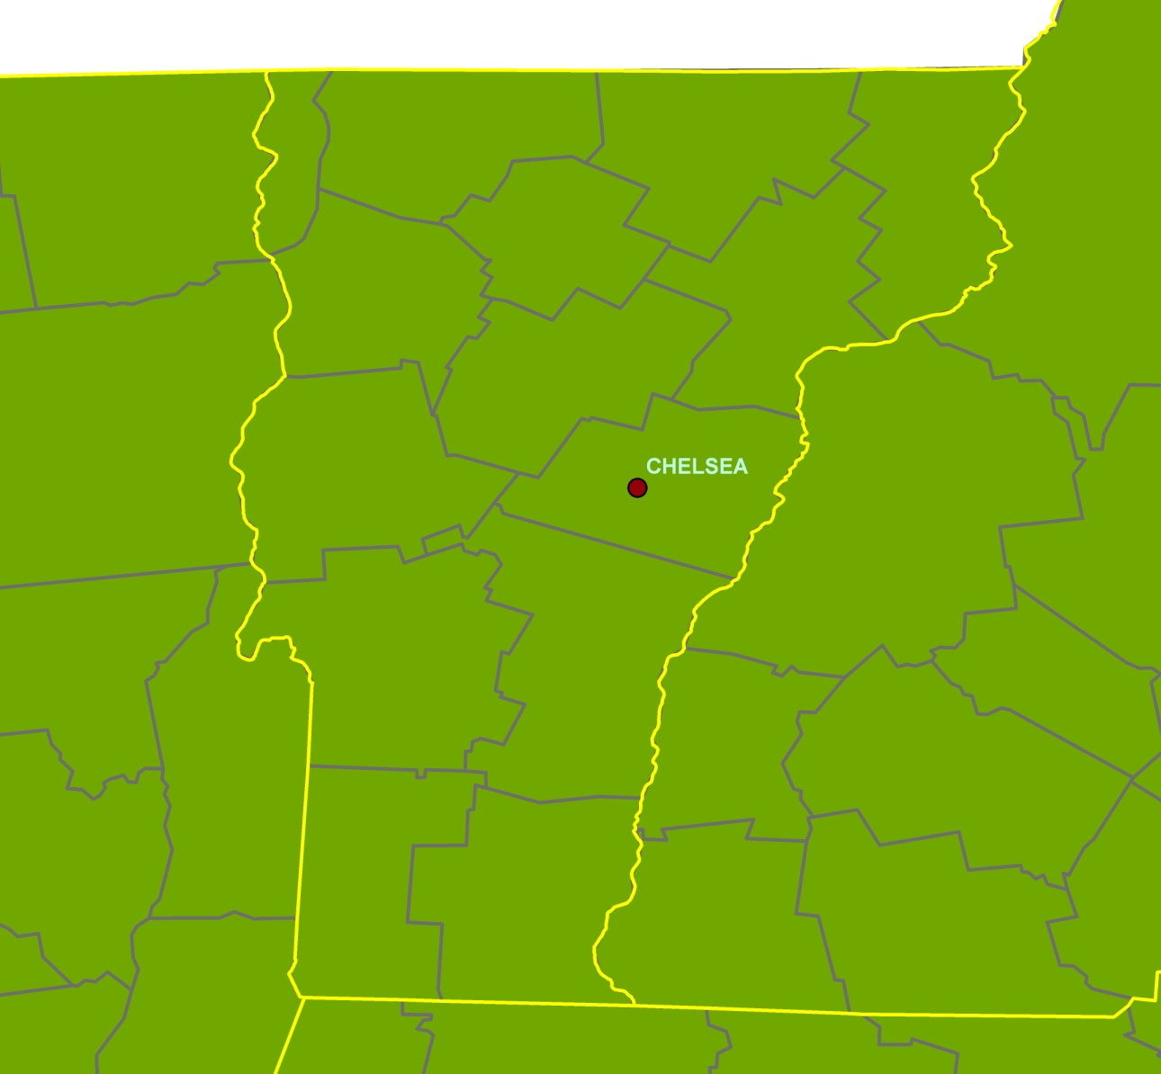
Chelsea Flash Flood
1st Branch White River
Steep Terrain
Notes:
The village of Chelsea VT was the hardest hit of the flood event. Chelsea lies in the White River drainage along the First Branch of the White. The elevation of Chelsea is approximately 800 feet, sharply rising to 1500 to 2000 ft mountains in the surrounding area.

Slide 4
Surface Analysis Valid 1800 UTC 21 Aug 2009
L
L
>70° F
Dew Point
Notes:
Surface analysis for 1800 UTC 21 Aug 2009. A warm front had lifted north of the region in to Quebec, with an occluded surface low to the northwest of the area and an approaching cold front moving through the great lakes region. Surface dewpoints across all of Vermont were in the low 70s.

Slide 5
500 HPa 12 UTC NAM80 valid 1800 UTC 21 Aug 2009
Notes:
500 HPa height and vorticity from the 1200 UTC NAM80. A deep full latitude trough was situated to the west with a series of vigorous shortwave troughs moving through. Flow over Vermont was from the southwest and weakly diffluent. The NAM80 depicted a weak vort max moving over the area around 1800 UTC, which was at the beginning of the heavy rainfall. The GFS40 (not shown) also depicted a similar feature.

Slide 6
300 HPa Jet Stream Winds 12 UTC NAM80 valid 1800 UTC 21 Aug 2009
100 KT
Notes:
The NAM80 depicted a 100 kt jet max to the west of the region, although Vermont remained outside the favored right entrance and left exit regions of the jet. As with the 500 HPa flow, the 300 HPa flow was weakly diffluent over Vermont.

Slide 7
300 HPa Divergence 12 UTC NAM80 valid 1800 UTC 21 Aug 2009
Notes:
300 HPa divergence field from the NAM 80 indicates area of divergence associated with diffluent flow.

Slide 8
BUFKIT Sounding NAM Valid 2000 UTC 21 Aug 2009
Precipitable Water over 2”
Saturated to 11 km
Warm coalescence layer > 3 km
MBE Velocity <10 kts
Notes:
BUFKIT NAM forecast sounding valid 2000 UTC depicts heavy rain model forecast sounding with MBE velocity less than 10 kts, warm rain coalescence depth of almost 4 km, and a nearly saturated column from the surface through 11 km.

Slide 9
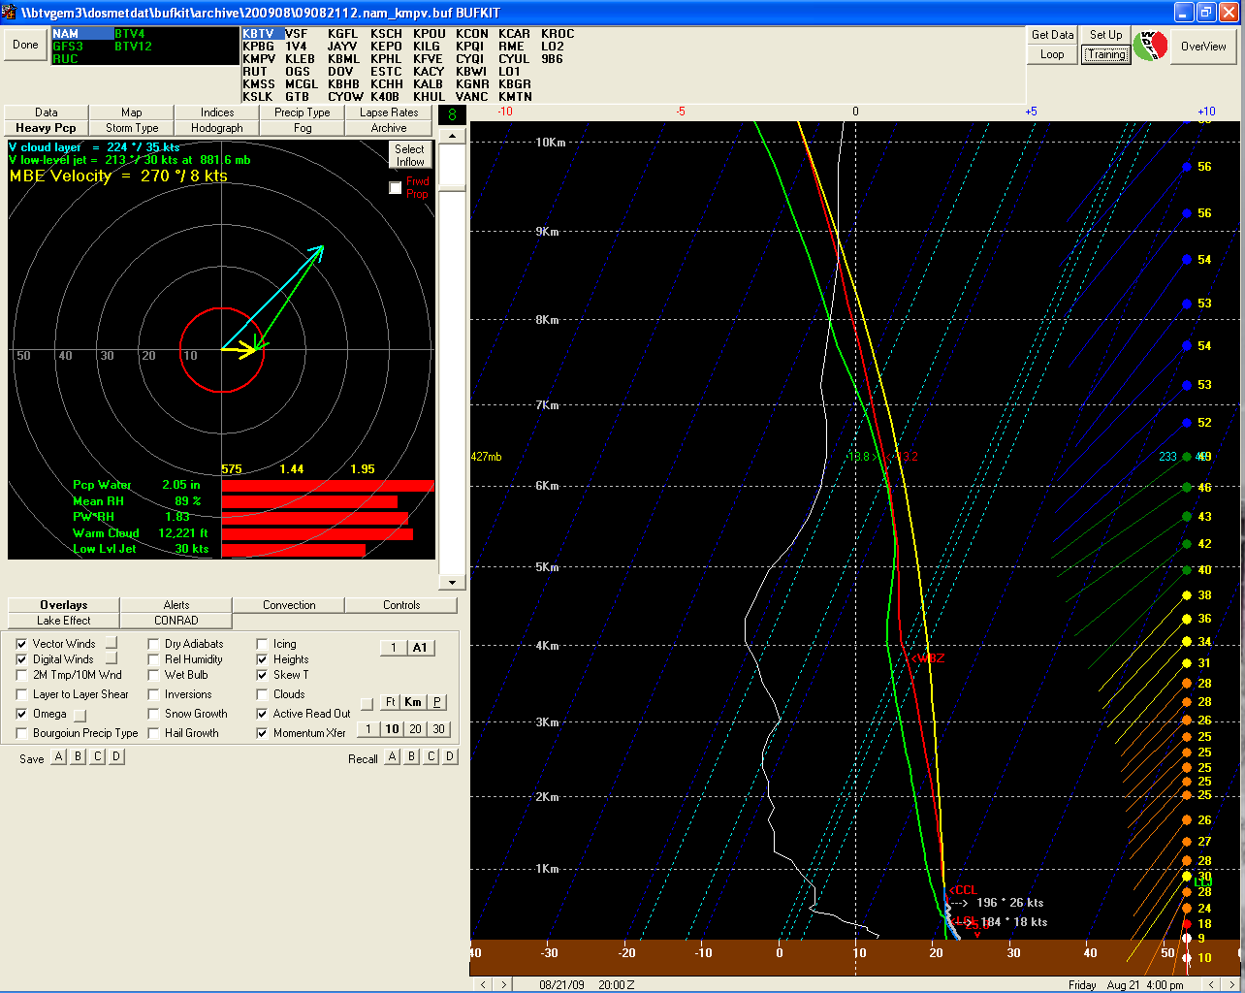
“Tall Skinny CAPE”
NCAPE 0.06
Warm Coalescence
Depth >4 km

Slide 10
Result: excessive rainfall
Three to four inches in a couple hours
Notes:
Storm Total Precipitation, for the Aug 21 2009 event, shows more representative precipitation estimates from KGYX than KCXX. Another example from the same event, not shown, similarly depicts better estimates from Albany’s KENX radar than KCXX in southeast Vermont.

Slide 11
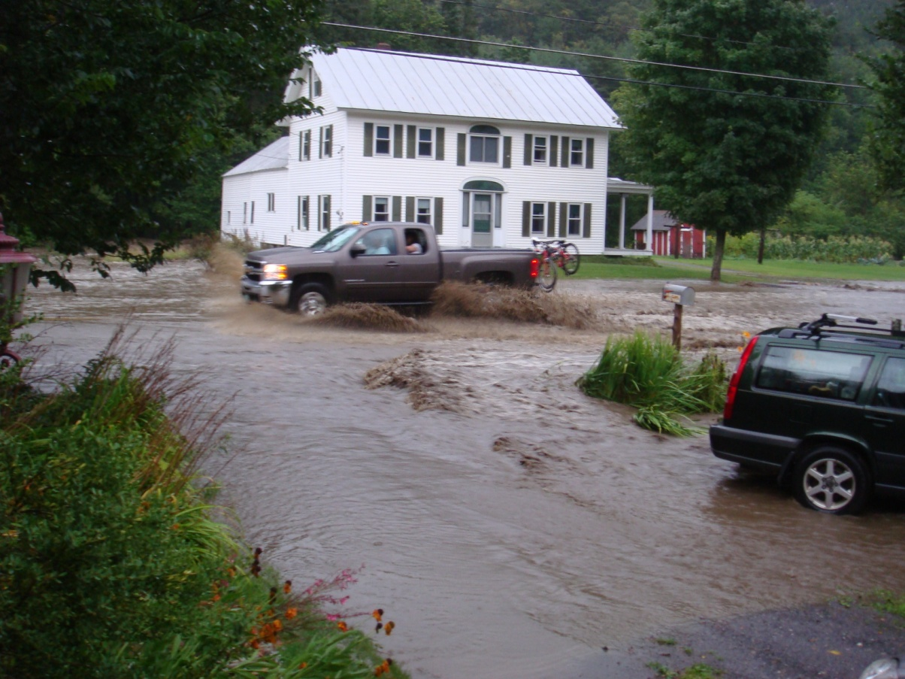
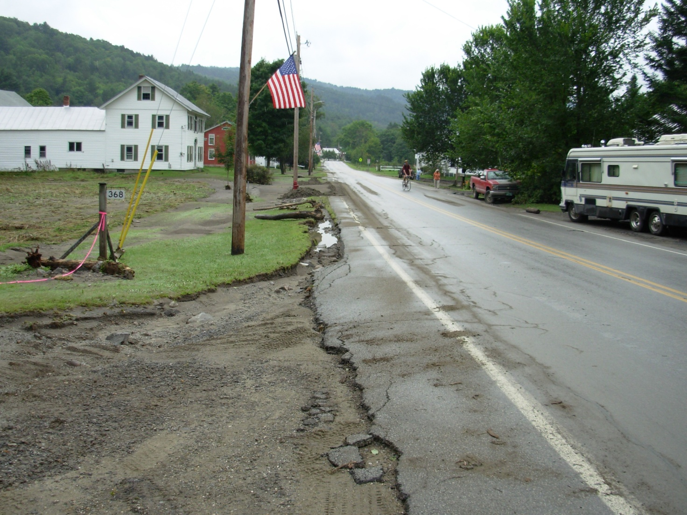
Flash Flooding in Chelsea

Slide 12
Overview
Meteorological background and event summary
Radar Considerations
FFMP and HPE recap
Notes:
Moving on to Radar Considerations

Slide 13
KCXX vs KGYX STP
KCXX
KGYX
KCXX STP underestimated, despite closer to radar
KGYX better estimate, even when double the distance
Notes:
Storm Total Precipitation, for the Aug 21 2009 event, shows more representative precipitation estimates from KGYX than KCXX. Another example from the same event, not shown, similarly depicts better estimates from Albany’s KENX radar than KCXX in southeast Vermont.

Slide 14
KCXX Hybrid Scan
WFO BTV’s primary radar
2.4° elevation inside white lines
1.5° elevation outside white lines
Altitude of 12,700 ft near Chelsea VT at 2.4°
0.5
1.5
2.4
1.5
2.4
1.5
0.5
1.5
2.4
Notes:
This graphic depicts the elevation angles used in the KCXX radar Hybrid Scan used in precipitation estimates. There is significant beam blockage east of the radar. Much of the state of Vermont is blocked at the 0.5 degree angle, forcing the use of 1.5 degrees where indicated. Inside the wedges delineated by the white lines, the radar beam is blocked at 1.5 degrees as well, forcing the use of 2.4 degree elevation. In some locations, such as Chelsea, the use of the 2.4 degree beam means radar sampling for precipitation is made at a very high altitude, despite being relatively close to the radar.

Slide 15
KGYX Hybrid Scan
0.5° elevation
Altitude 11,400 ft near Chelsea VT at 0.5°
Available in FFMP since OB8.3
HPE
KGYX
Notes:
KGYX experiences no blockage to the west, and despite being much farther away than KCXX, it still samples at the lower elevation angle. However at this range the beam from KGYX is much wider as well, which may lead to underestimation due to beam filling issues. Even with beam filling problems it is still thought that KGYX offers a superior vantage point for eastern Vermont over KCXX.

Slide 16
KCXX/KGYX Hybrid Scan Comparison
KGYX 0.5° provides 1 kft lower altitude precip estimate than KCXX 2.4°
KCXX used by HPE Default setting
KCXX
2.4º
KGYX
0.5º
Chelsea VT
51 mi
110 mi
Notes:
This cross sectional graphic depicts the comparison of radar sampling over Chelsea VT from the 2.4 degree slice from KCXX versus the KGYX 0.5 degree KGYX.

Slide 17
Overview
Meteorological background and event summary
Radar Considerations
FFMP and HPE
Notes:
Configuring and optimizing HPE for FFMP.

Slide 18
FFMP/HPE Recap
With OB 8.3, FFMP became FFMPA
High resolution Precip Estimator (HPE)
Integrates data from multiple radars in one FFMP display
How does HPE know what radar to use?

Slide 19
HPE Default Setting
HPE populated from radar with the lowest altitude at 0.5°
In other words, whichever radar is closest
In flat terrain, this logic is OK.
Hybrid Scan uses 0.5°
Notes:
The default setting for radar data used in HPE is for any given point, data is used from the radar with the lowest beam altitude at 0.5 degrees. This essentially uses data from the closest radar available. For flat terrain this logic is OK, as the radar hybrid scan uses the 0.5 degree slice, and it makes sense to use data from the closest radar. Problems begin if you are in complex terrain, and the hybrid scan used by your radar is using higher elevation data. In those cases, the decision for which radar to use is based on the height of the 0.5 degree slice, even though the hybrid scan does not use the 0.5 degree slice for that point.

Slide 20
HPE In Complex Terrain
Hybrid Scan in complex terrain uses up to 2.4°
Alternate radar selection method needed
“misbin” file designates radar data source
based on radar climatology
Notes:
The default setting for radar data used in HPE is for any given point, data is used from the radar with the lowest beam altitude at 0.5 degrees. This essentially uses data from the closest radar available. For flat terrain this logic is OK, as the radar hybrid scan uses the 0.5 degree slice, and it makes sense to use data from the closest radar. Problems begin if you are in complex terrain, and the hybrid scan used by your radar is using higher elevation data. In those cases, the decision for which radar to use is based on the height of the 0.5 degree slice, even though the hybrid scan does not use the 0.5 degree slice for that point. View a map of your misbin file in MPE editor, under “Base Fields”, “Radar Coverage Field”.

Slide 21
How misbin files are made
RFC runs RadClim
Radar Climatology identifies areas with degraded precip estimates
misbin files created for each radar
1 = good data bin
0 = use someone else
Notes:
NWS Hydrology lab has an ongoing project to objectively define radar data "quality" through an automated process of analyzing DPAs and a reference precip field - this would take out the subjectivity. This will be reported out within a year (by Oct 2010).

Slide 22
Turning misbin ON
To enable the use of misbin:
As user oper, edit /awips/hydroapps/.Apps_defaults_site
add the line:
hpe_load_misbin : ON
Notes:
Only change the token in .Apps_default_site

Slide 23
Optimize misbin/Radar Coverage Maps
Radclim data shows good data from both radars
Tiebreaker is to use nearest radar (KCXX).
KGYX more desirable
KCXX (red) uses 1.5°
KGYX (blue) uses 0.5°
Notes:
The next two slides show examples of optimization of the HPE radar coverage map based on the misbin files. The default maps show the KCXX radar coverage in red, KGYX in blue, and KENX in green. In the circled area, there is a spike of KCXX radar coverage all the way to the Vermont/New Hampshire border. Although the RADCLIM program indicated this is acceptable data, we preferred to use KGYX radar data in the circled area. The reason: KGYX hybrid scan uses the 0.5 degree slice, while the KCXX hybrid scan uses 1.5 and 2.4 degree elevations.

Slide 24
Hybrid Scan/misbin example
Worked with NERFC to edit misbin
Removed spike of KCXX radar data
KGYX data used instead
Notes:
Working with NERFC to re-run the misbin generation program, the coverage from the KGYX radar was extended west, and KGYX is now used in the Connecticut River Valley when HPE is loaded in FFMP. A significant area of missing data still exists (upper right, black area), where beam blockage for KGYX (Mount Washington) and KCXX (Mount Mansfield) prevents good sampling. Rather than give the forecasters bad data and a falls sense of security, we chose to leave this field missing. When HPE is used in FFMP, basins in the missing data area will be blank, and the basin table will show “M” for those basins.

Slide 25
Suggested Actions for Service Hydrologists in Eastern Region
If complex terrain & hybrid scan uses elevations above 0.5, consider turning on the misbin token!
misbin token off:
HPE Data choice will be based on altitude of 0.5º elevation
Hybrid scan may be using higher elevation
misbin token on:
Check Radar Coverage Field in MPE Editor.
Optimize radar selection working with RFC
Note missing data areas
may degrade FFMP estimates if basins partially missing
Entire basin may be set to missing if no radar data available

Slide 26
Summary
Meteorological precursor conditions in place for flash flooding
Radar sampling issues complicated heavy rainfall identification
Localization of misbin parameters should help FFMP operations for 2010 convective season.

Slide 27
Summary
Misbin token determines radar data used in FFMP HPE field.
Default setting is misbin=off.
Precip estimates used from the radar with the lowest altitude at 0.5°.
Limitation: for complex terrain, 0.5° logic overlooks Hybrid Scan, beam blockage, other precip estimate degradation

Slide 28
Summary
For misbin token set to ON
In HPE, for each bin, decision for which radar’s precip estimates is based on misbin files for each radar
For overlapping radars
misbin file for both has “1” in same HPE bin
0.5° rule determines radar used.

Slide 29
Acknowledgements
David Riley, WHFS Support
Mark Glaudemans, WHFS Support
Tom Filiaggi, FFMP
Dave Kitzmiller, Hydromet Group, OHD HL
Dave Miller, AWIPS HPE/HPN Software Development and Integration Lead, OHD/HSEB
Jeff Ouellet, NERFC

Slide 30
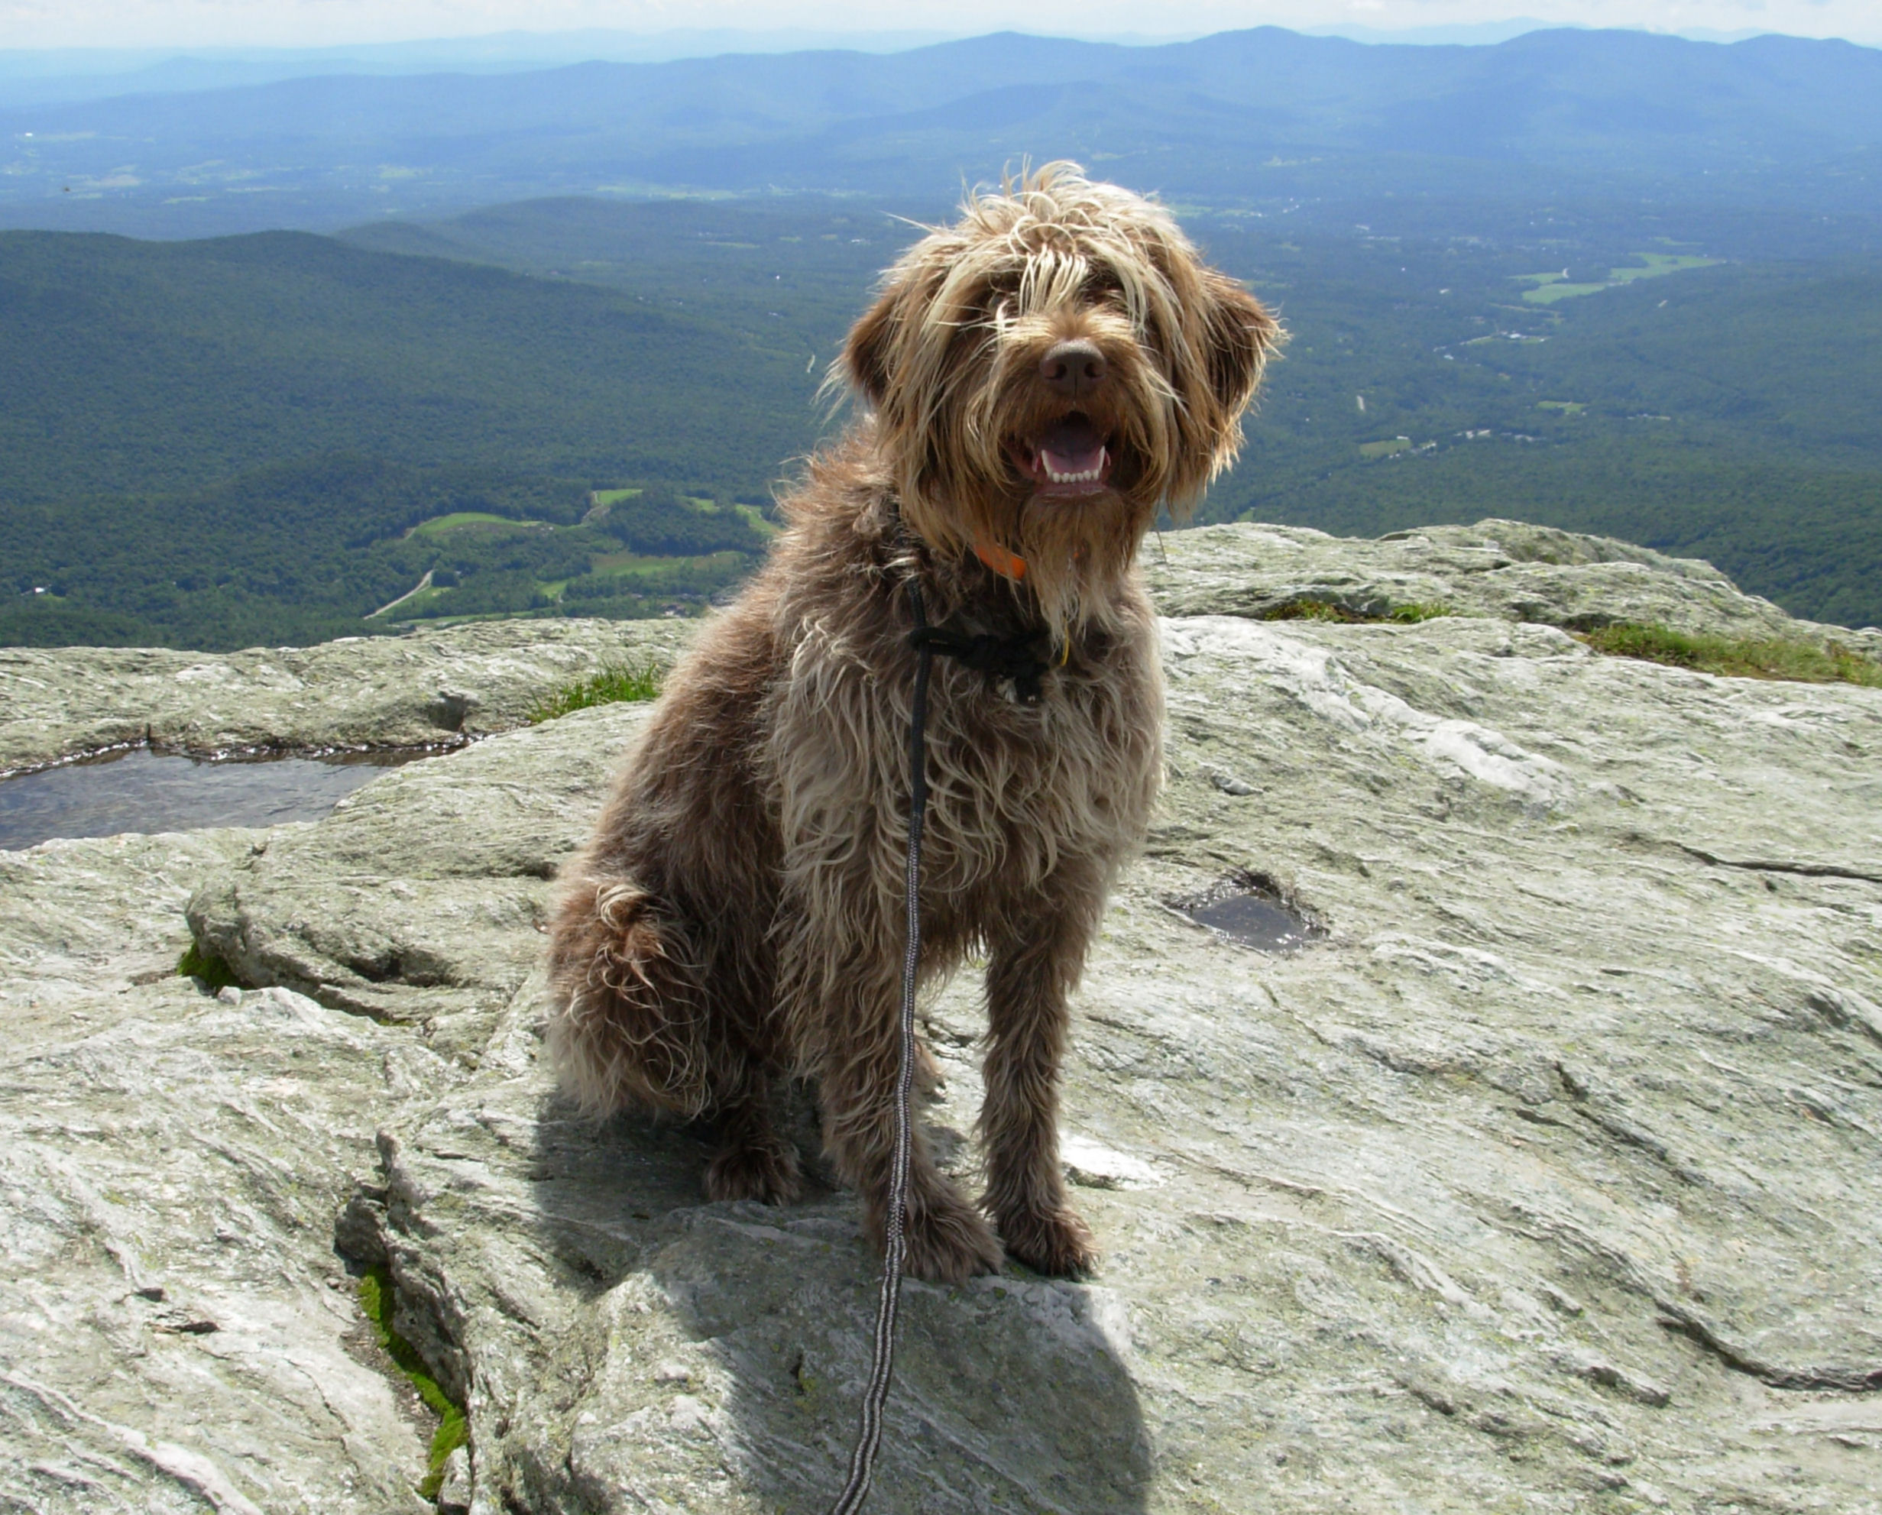
Questions?

