Slide 1
SSHP
(Site Specific Headwater Predictor)
How to Better use SSHP
ER Flash Flood Workshop
June 2-4, 2010
Jeff Myers
NOAA/NWS/Ohio River Forecast Center
Jim Noel
NOAA/NWS/Ohio River Forecast Center

Slide 2
Outline
SSHP Overview
MPE/Rainfall Input Critical for SSHP
Q2 in MPE and using it in SSHP
Different MPE Field Estimates and Unit Hydrographs

Slide 3
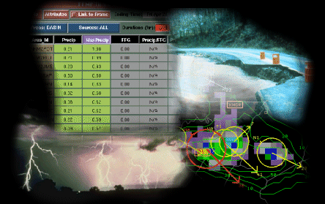

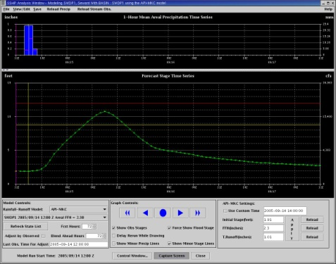
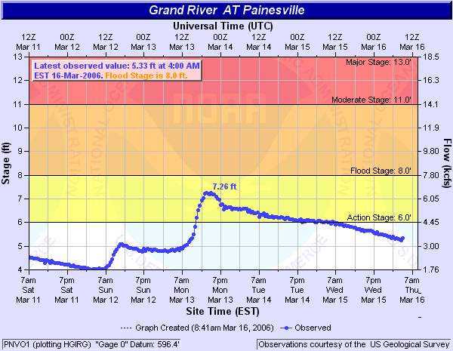
Where does SSHP fall within the NOAA/NWS Hydrologic Services
Hydrologic
Forecast
Services
WFO Flash Flood Monitor
and Prediction
RFC NWSRFS/ESP/Probabilistic
WFO Site Specific Flood and Flash Flood
Application
AHPS
Notes:
The SSHP is the WFO application that complements the RFC’s NWSRFS system for small headwater basins to provide a complete hydrologic forecast service suite.

Slide 4
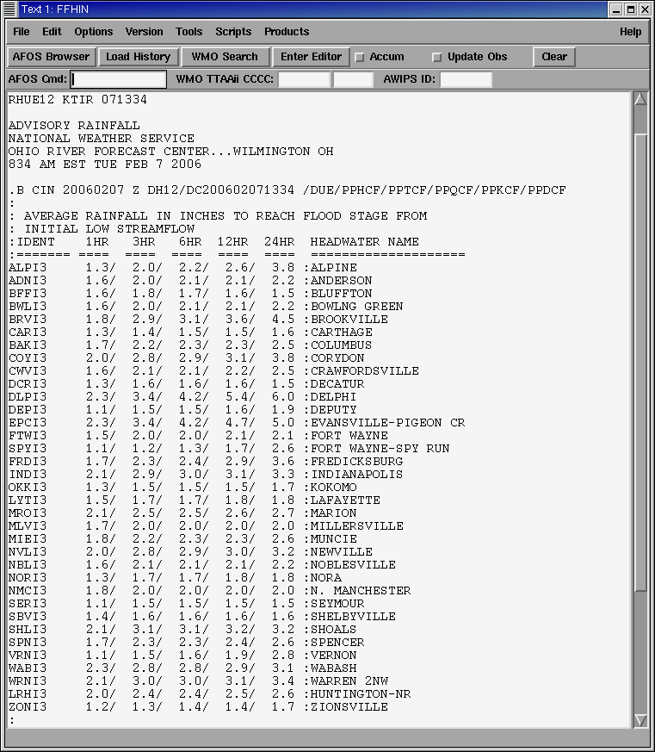
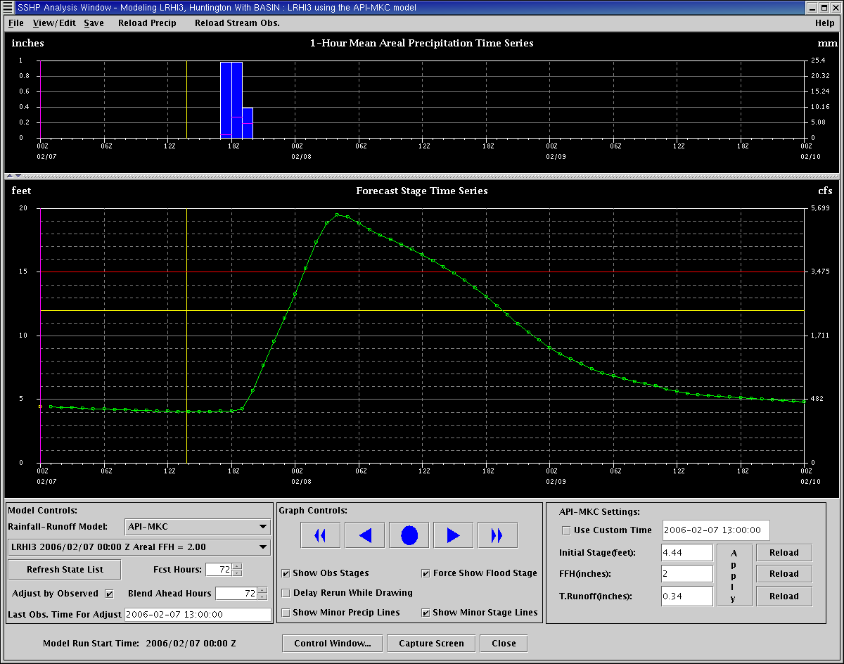
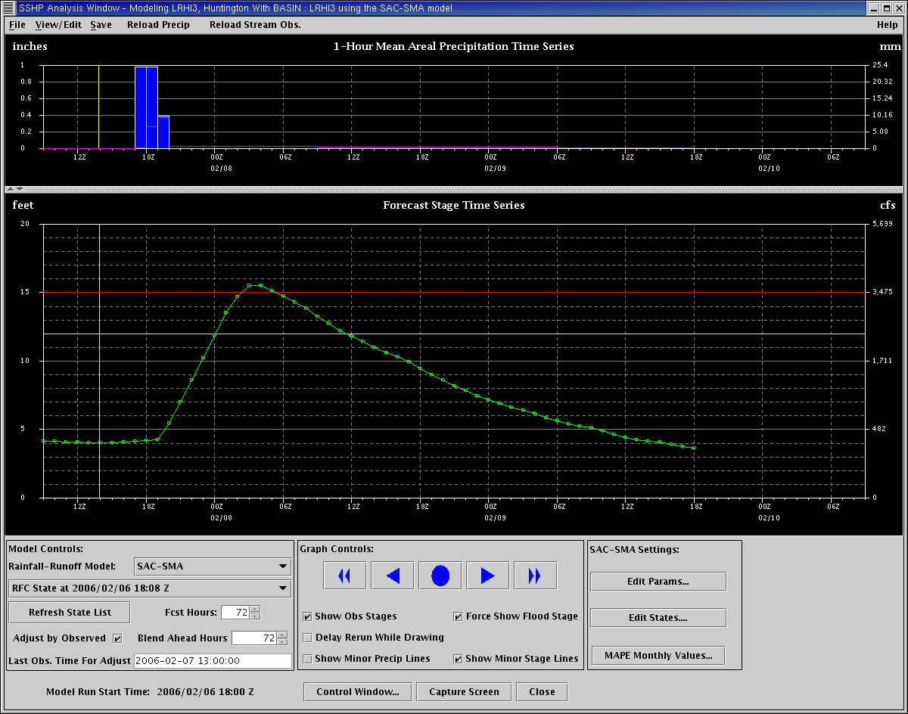
Site Specific Model
Recent Historic Overview
Headwater Tables
SSHP API-MKC
SSHP SAC-SMA
Notes:
We have moved from the headwater tables prior to 2004 to the SSHP API-MKC version as a first step SSHP in 2004 and 2005 and in Dec of 2005 through Feb 2006 we transitioned to the SSHP SAC-SMA version so we could be fully on one model.

Slide 5

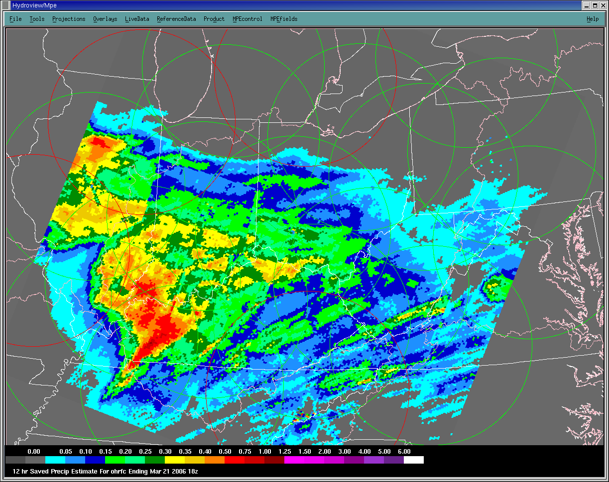
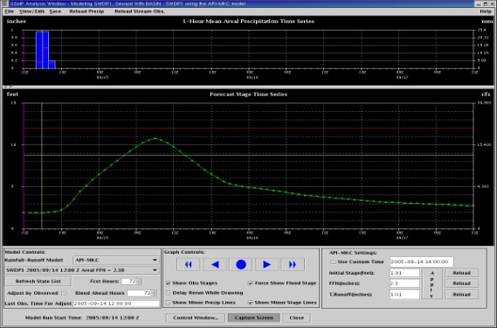
Rainfall QC Most Important Factor for WFOs Using SSHP SAC-SMA
Radar Data
Rain Gage Data
HydroView/MPE Estimates
WFO Site Specific
Notes:
The SSHP is the WFO application that complements the RFC NWSRFS system for small headwater basins to provide a complete hydrologic forecast service suite.

Slide 6
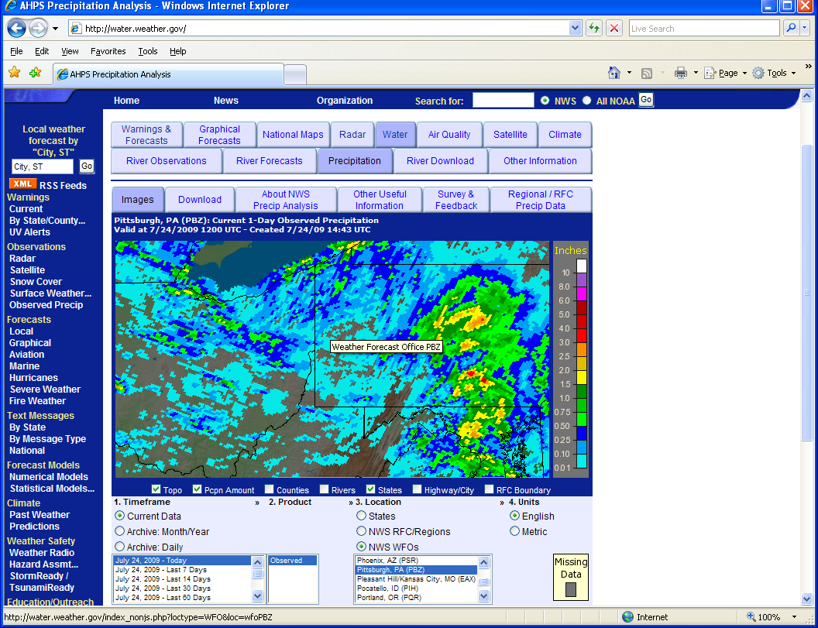
MPE
Multi-sensor Precipitation Estimates. Currently uses radar and gages.
Quality of the radar and gages is the most important thing.
Generated hourly at the WFO and RFC.
Data is usually not QC’d at WFOs but is at the RFC
Uses Hydrologic Rainfall Analysis Project (HRAP) format at 4x4 km resolution

Slide 7
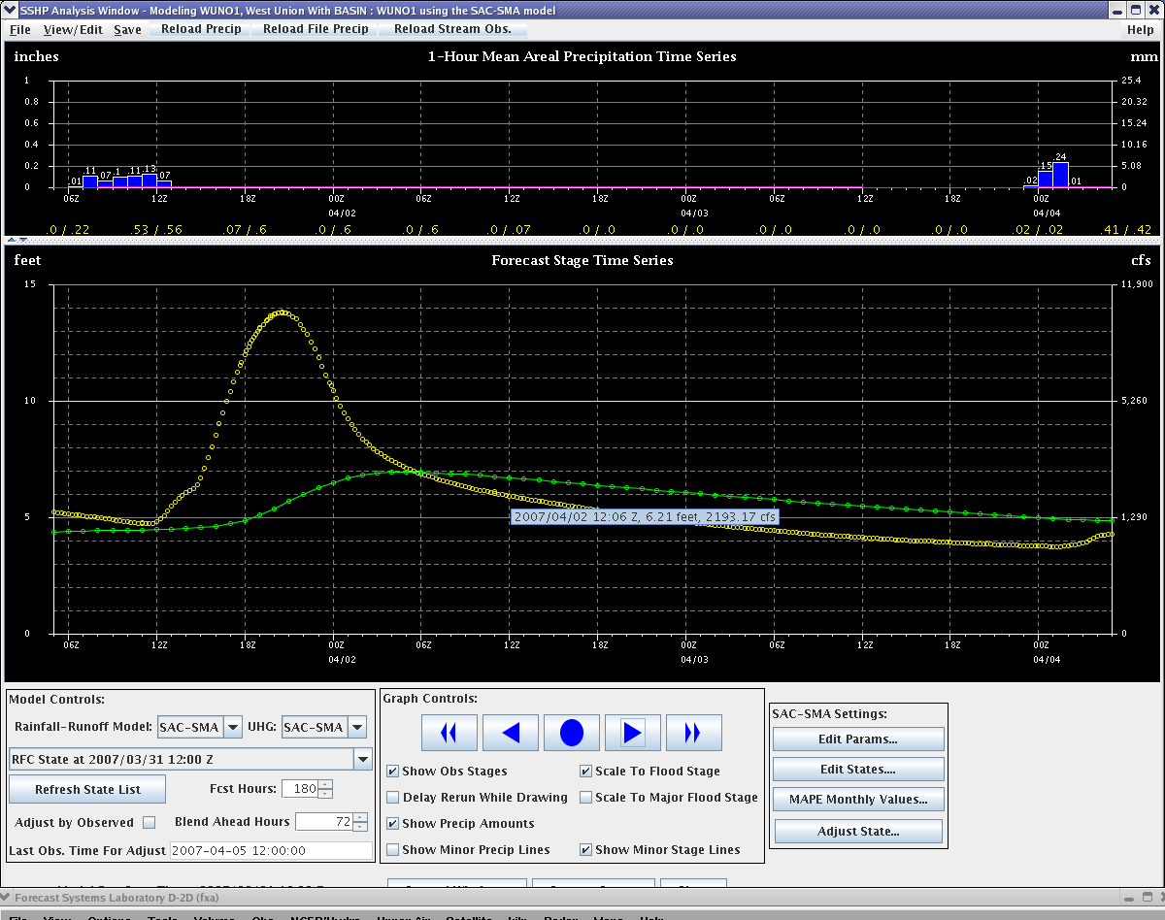
Site Specific Model – SACSMA – WUNO1
Notes:
Incorrect rainfall of 0.60 inches. Graph shows the result of poor precip estimates.

Slide 8
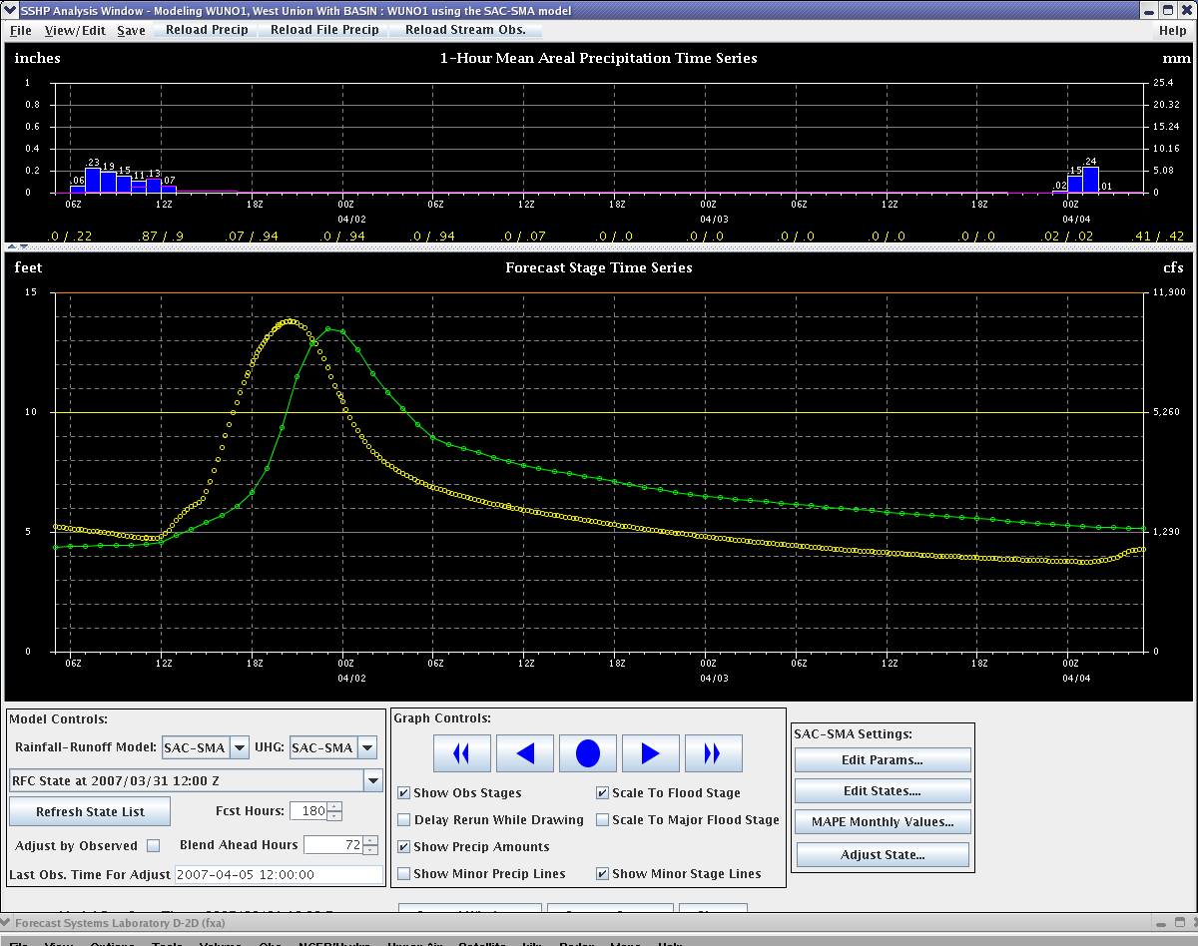
Site Specific Model – SACSMA – WUNO1
Notes:
Correct rainfall of about 1 inches. Unit hydrograph change could improve the trace. Leads into Q2…

Slide 9

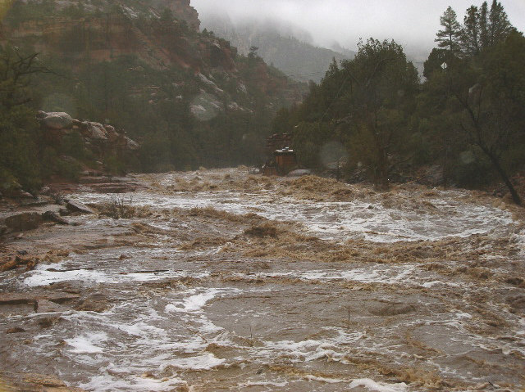
What is Q2?
Our goals is to have as many tools as possible to make the best QPE as possible. Why?
Arizona, 2005

Slide 10
What is Q2?
Q2: “A paradigm shift”
Accurate rain rate estimation (~7%) can be achieved only after the proper underlying physical process is identified and the associated R-Z relationship is used.
(Lee and Zawadzki, JAM 2005)
Create multi-radar CONUS hybrid scan reflectivity
Determine underlying physical processes
  http://www.nssl.noaa.gov/projects/q2/tutorial/3dderived.php
Apply differential Z-Rs pixel by pixel
  Convective, stratiform, snow
  Warm rain (tropical); added in August 2007
Remove clutter
Notes:
Final 2 properties listed are likely the most important.

Slide 11
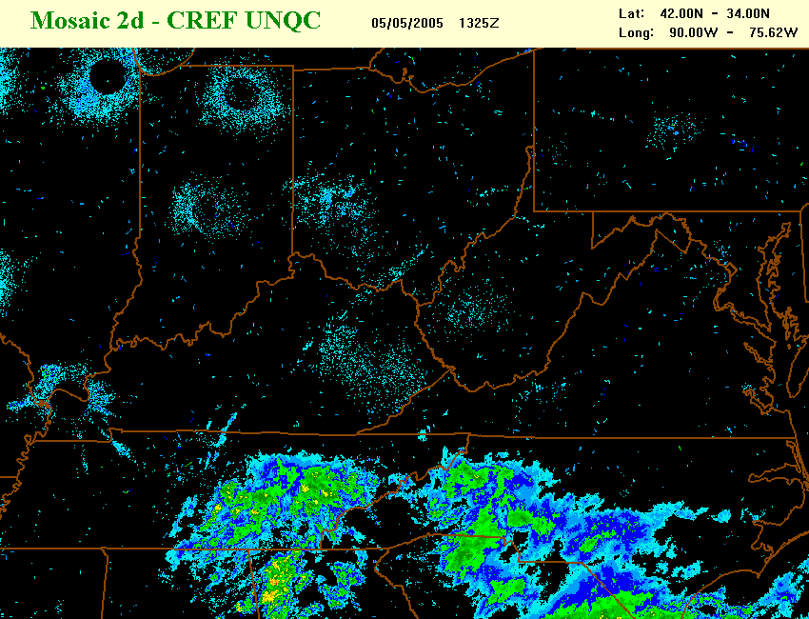
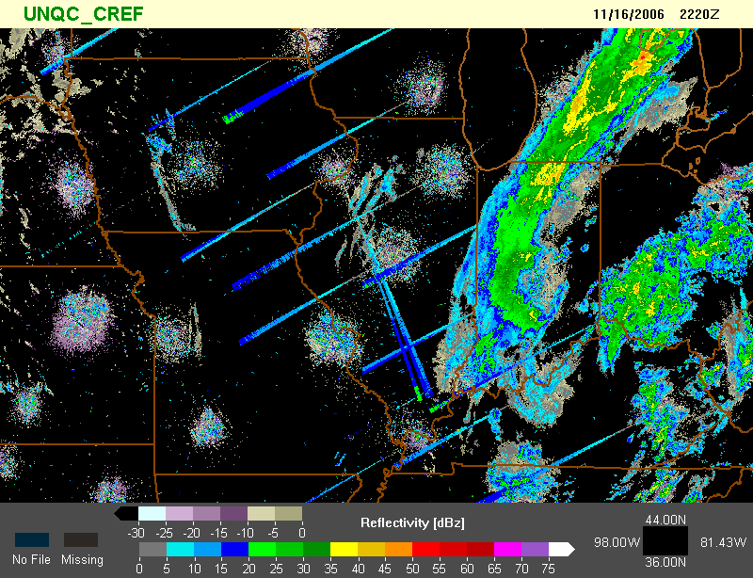
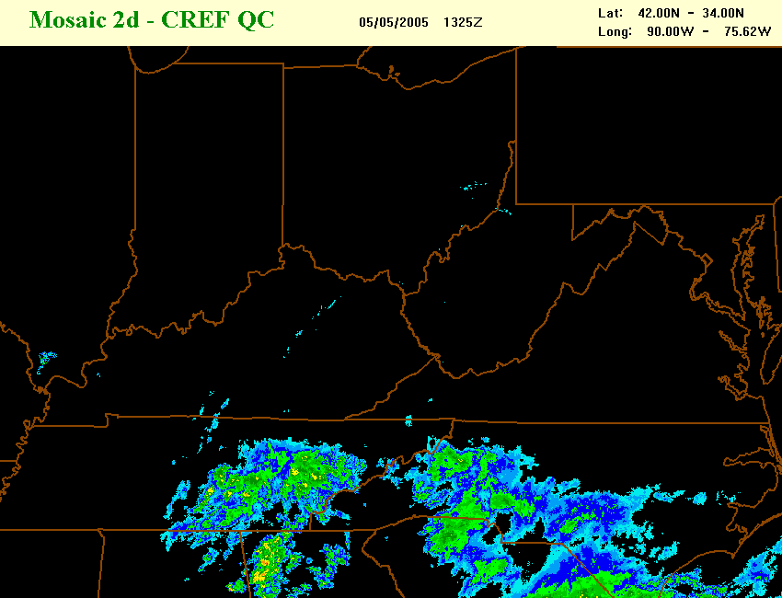
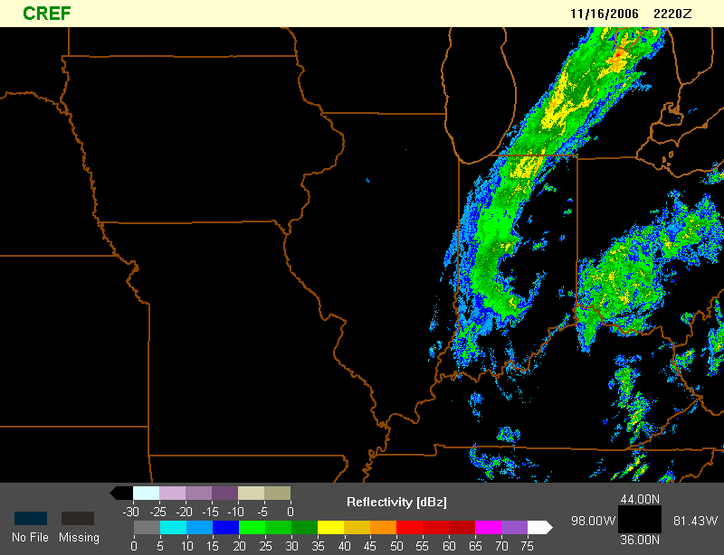
Speckle & Sun beam filters
Notes:
Pre-processing example

Slide 12
Comparison of MPE and Q2
MPE
  DPA file from 88-D
    Reflectivity pushed through precipitation algorithm at RPG
    Impacts from invoked clutter suppression
    Dependent on single Z/R relationship assigned to entire radar sweep
  AP/bright banding/hail contamination carried through DPA file into raw rainfall estimates
    Requires manual QC by NWS forecasters to remove/adjust
  Biases radar estimates against rain gauges
  Precipitation estimates limited to 230 km in DPA file (further reduced by radar climatologies)
Q2
  Hybrid Scan Reflectivity
    All processing occurs at NSSL, not radar sites
    No impact from invoked clutter suppression
    Dynamic Z/R relationship assignment (potential for sectorizing within radar sweep)
  AP/bright banding/hail contamination significantly removed through NSSL auto-processes
    Ingest of environmental parameters and model data to adjust estimates
  Currently does not bias against rain gauges (just beginning this phase) with input from OHRFC/WGRFC
  Precipitation estimates over entire 460 km radar sweep
Notes:
Lots of words to say Q2 is better than other un-QC’d MPE fields.

Slide 13
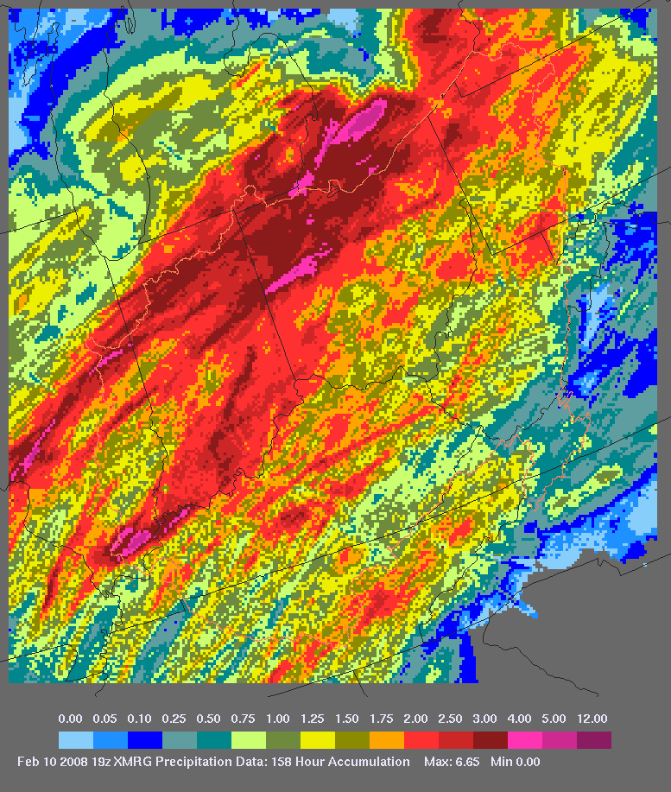
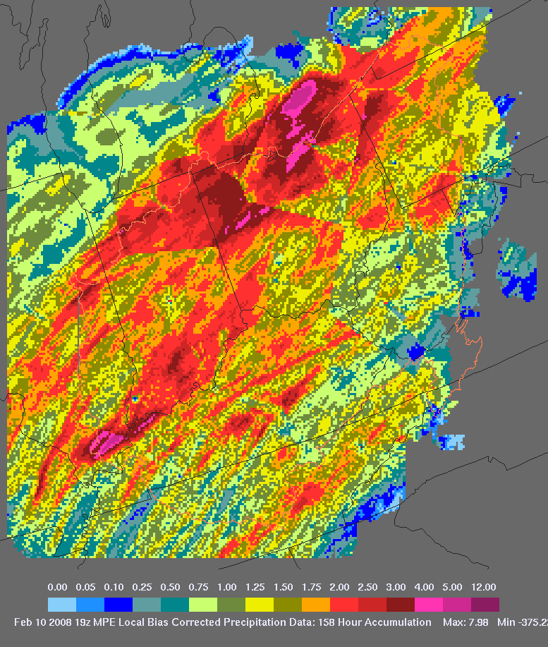
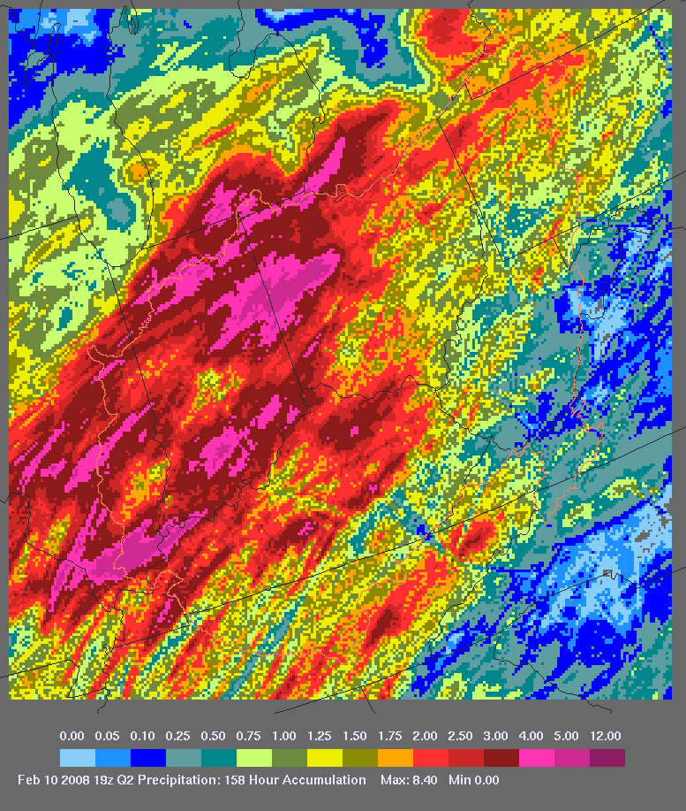
Comparison of MPE and Q2
MPE Best Estimate
MPE LMOSAIC
Q2
Feb 4-5, 2008 Flood

Slide 14
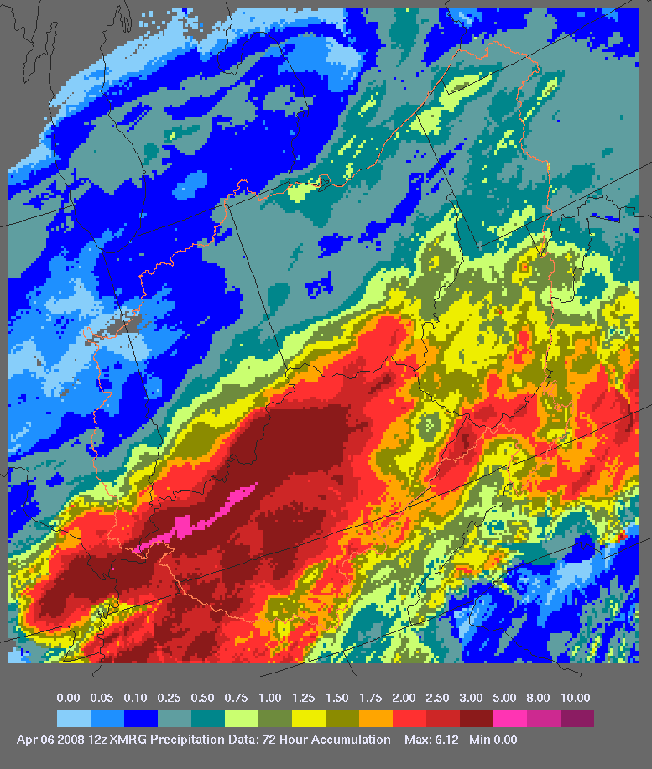
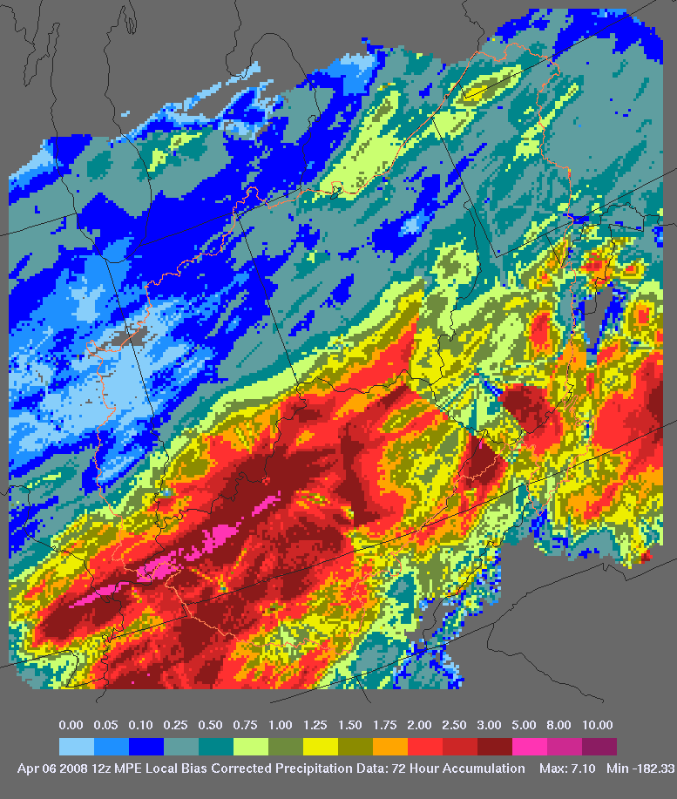
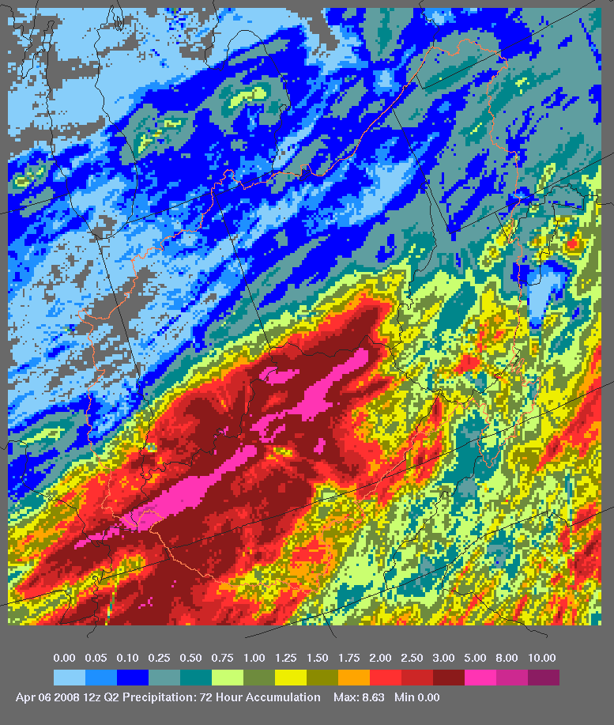
Comparison of MPE and Q2
MPE Best Estimate
MPE LMOSAIC
Q2
April 5, 2008 Flood

Slide 15
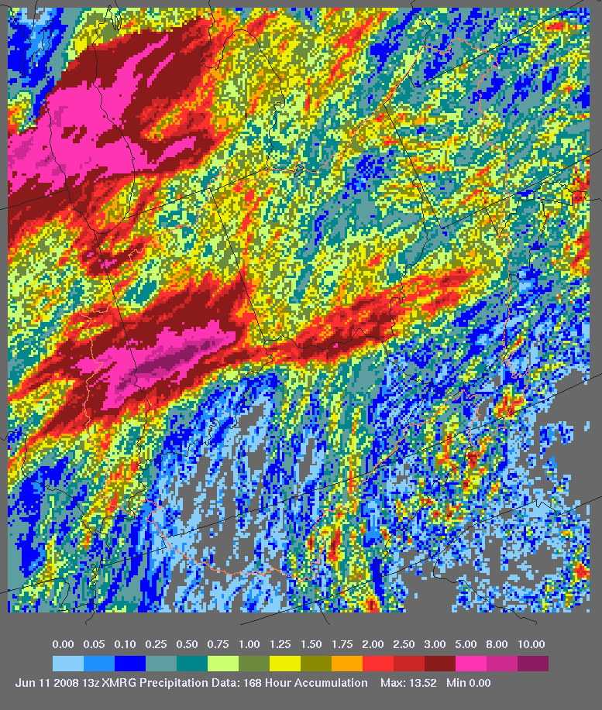
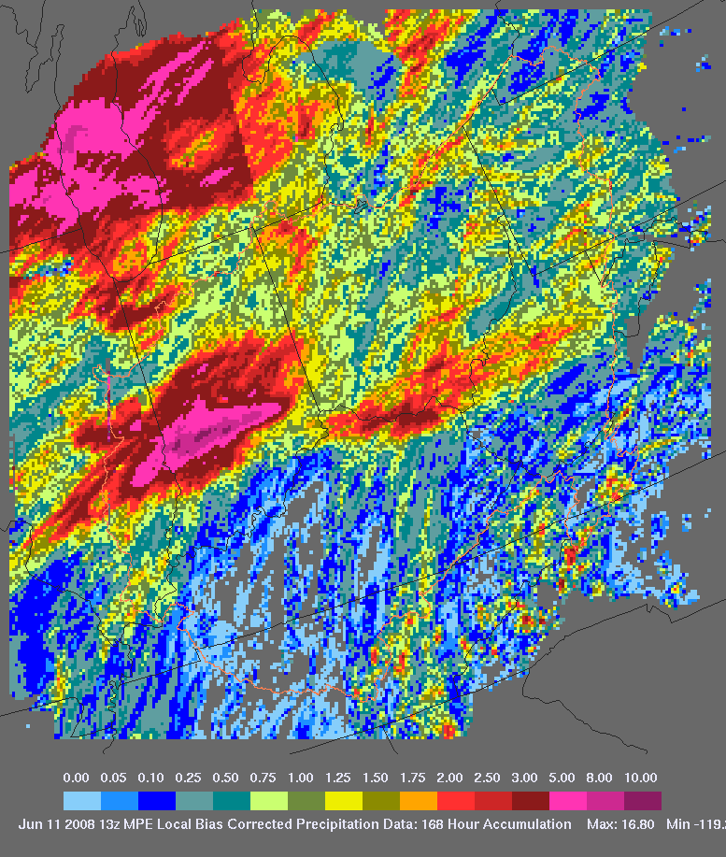
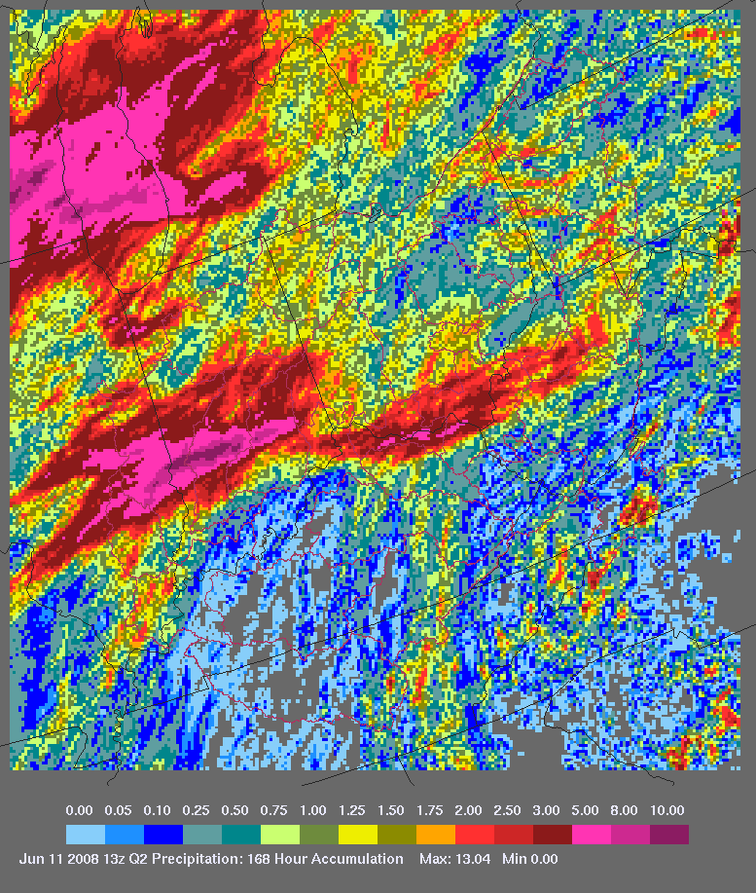
Comparison of MPE and Q2
MPE Best Estimate
MPE LMOSAIC
Q2
June 10, 2008 Flood

Slide 16
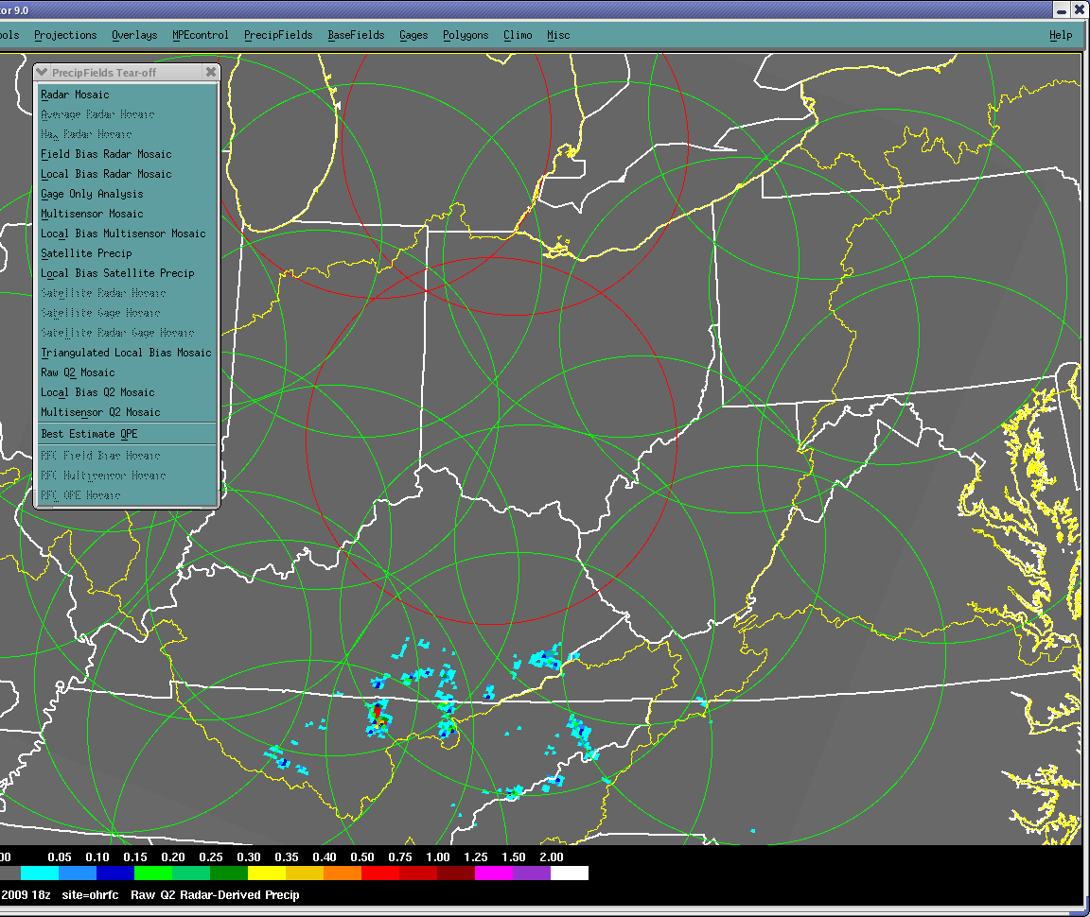
Q2 in MPE
RFCs have Raw Q2 and Local Bias Q2 and Multisensor Q2 as additional fields under PrecipFields.
OHRFC use Local Bias Q2 as default auto Best Estimate.
This can be pushed to WFOs via cron and manually (WFO PBZ/ILN)
WFOs need to do minor WHFS/MPE Configuration. We will send instructions.
Can be select under RFC QPE Mosaic
sshp_map_qpe_to_use: MIXED #can use RFCONLY here
mpe_generate_list : RFCMOSAIC
mpe_qpe_fieldtype: LMOSAIC

Slide 17
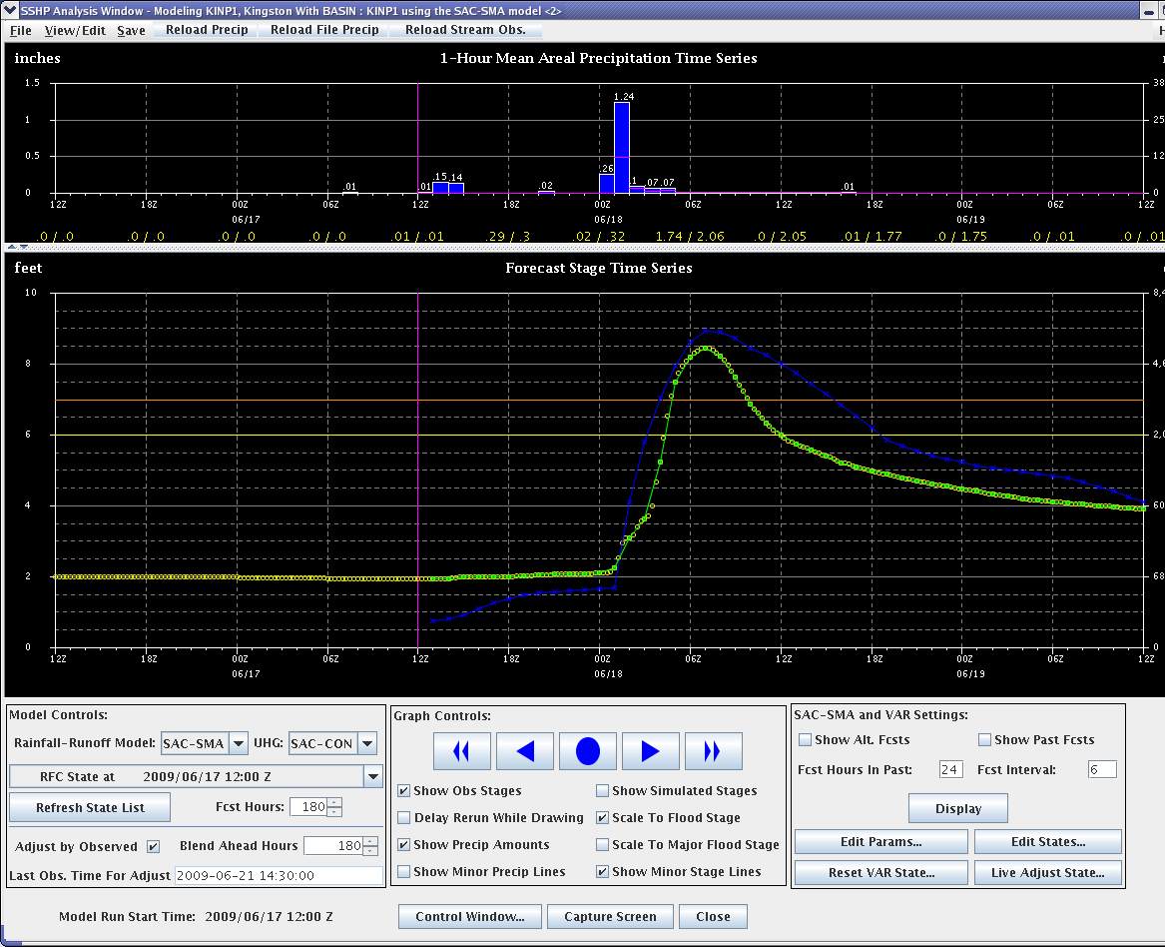
SSHP Analysis Window
SSHP Analysis Window
  Time increments are 1 hour
  Precipitation values are in Inches (left-hand scale) and Millimeters (right-hand scale)
  6 and 24 hour running precipitation total
  Orange horizontal line is Flood Stage
  Yellow horizontal line is Alert Stage
In the 1 hour Mean Areal Precipitation Time Series window (upper pane)
  The Dark Blue vertical blocks denote estimated and forecast precipitation amounts
In the Forecast Stage Time Series window (lower pane)
  The Green curve is actual observed stage data
  Dark Blue curve is resultant forecast data curve
Model Controls
  Rainfall-Runoff Model: SAC-SMA (Default )
  UHG (Unit Hydrograph) SAC-CON (Convective)
SAC-SMA (Stratiform)

Slide 18
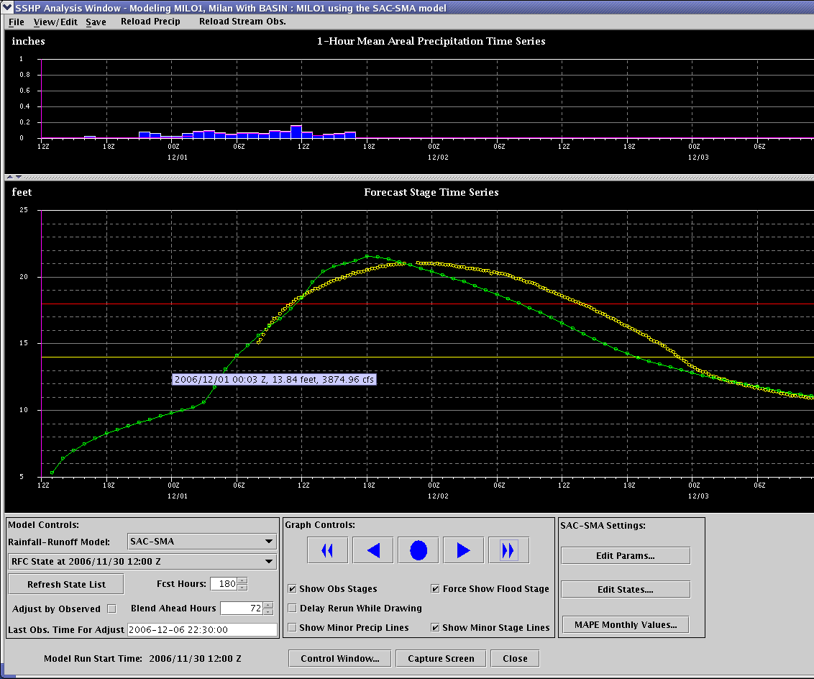
Site Specific Model – SACSMA – MILO1
Notes:
Major flood well forecast with good rainfall estimates at MILO1.

Slide 19
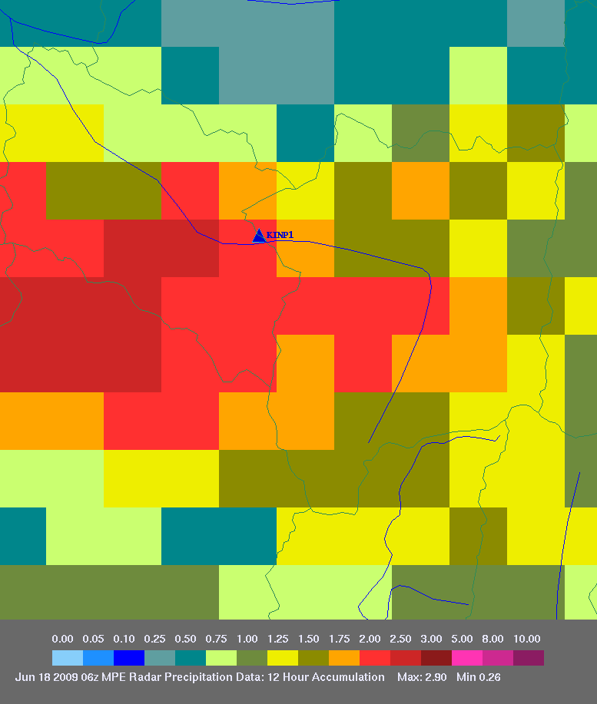
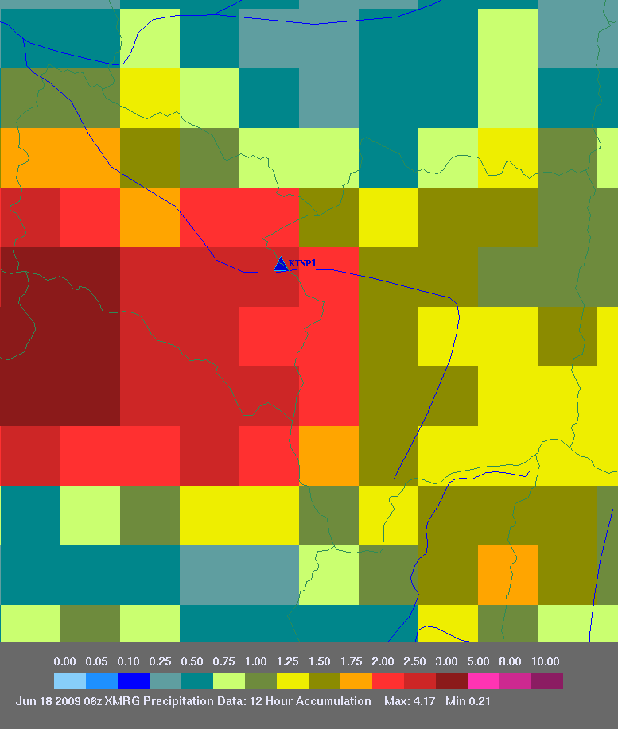
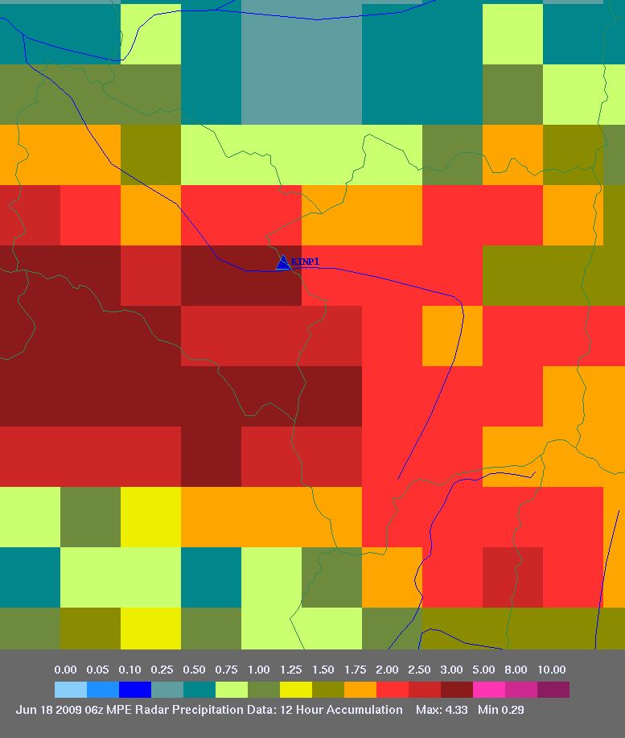
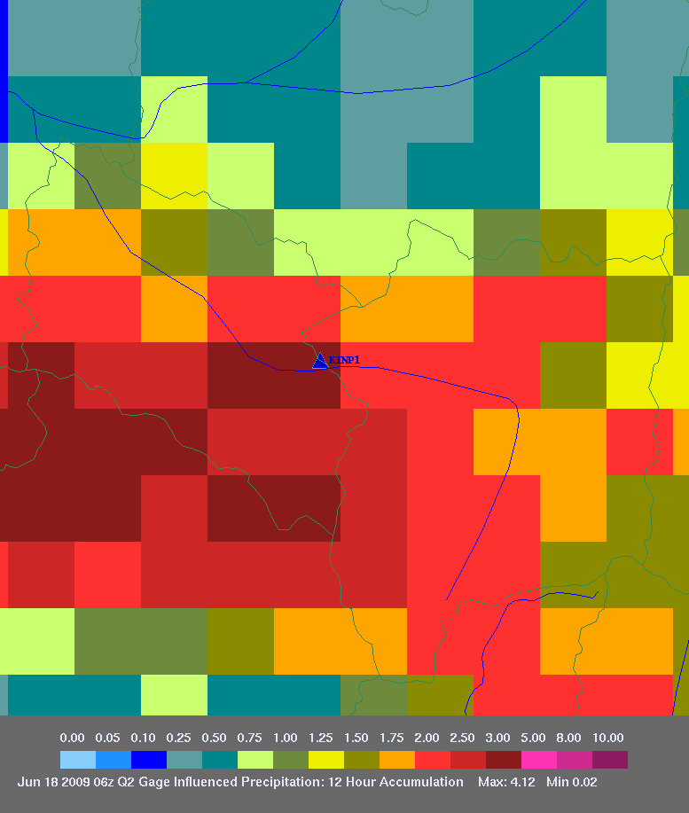
MPE comparisons
Kingston, PA (KINP1)
June 18, 2009
XMRG quality controlled
Radar only
1.58”
1.81”
Q2 gage adjusted
Q2
2.06”
2.00”

Slide 20
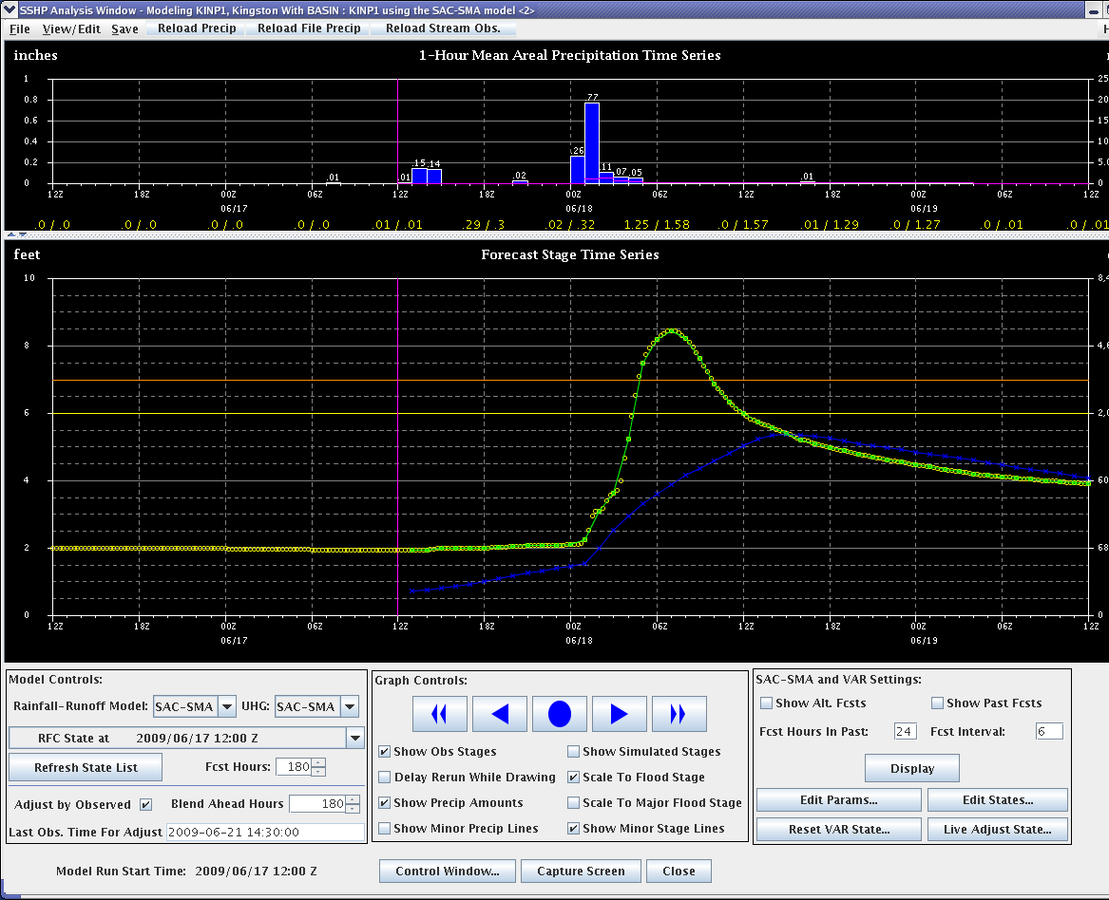
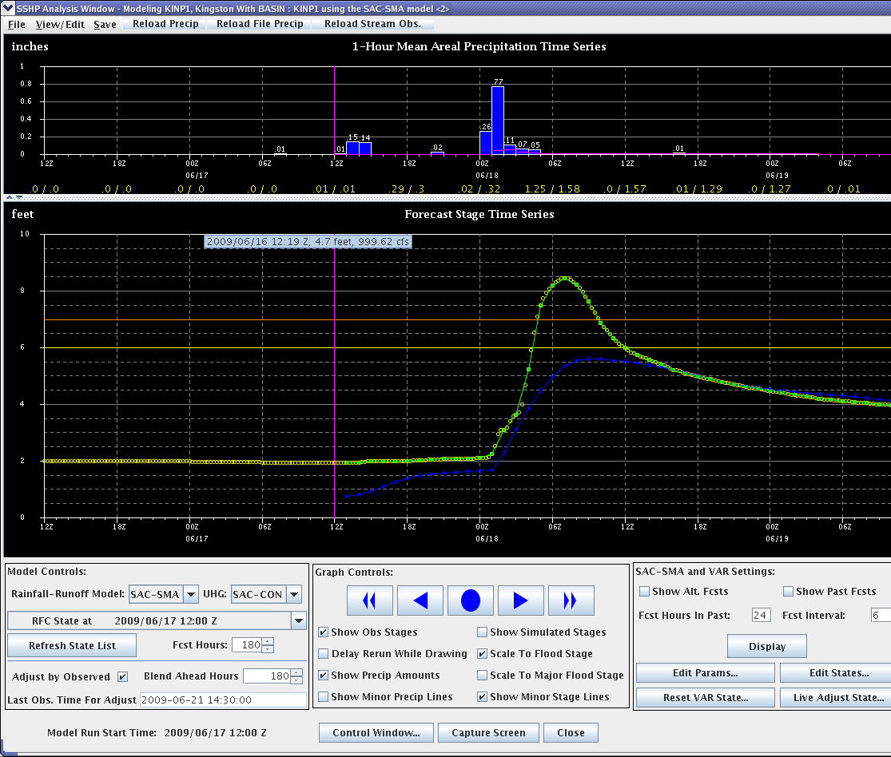
SSHP Forecast Comparisons using MPE Radar Data
(Basin average rain 1.58”)
Kingston, PA (KINP1) -- June 18, 2009
SAC-SMA (Stratiform) Unit Hydrograph
SAC-CON (Convective) Unit Hydrograph
5.4’
Forecast crest
5.6’
8.5’
Actual crest
8.5’
Forecast crest 9 hours late
Forecast crest 2 hours late

Slide 21
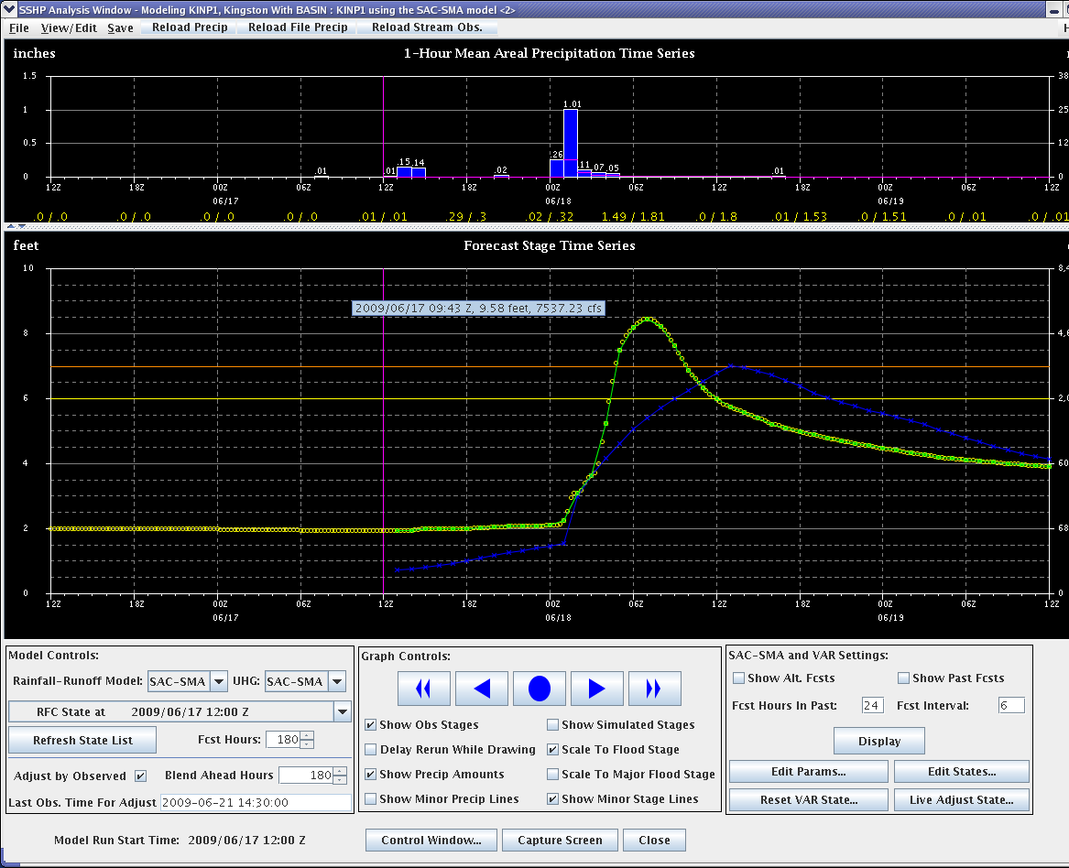
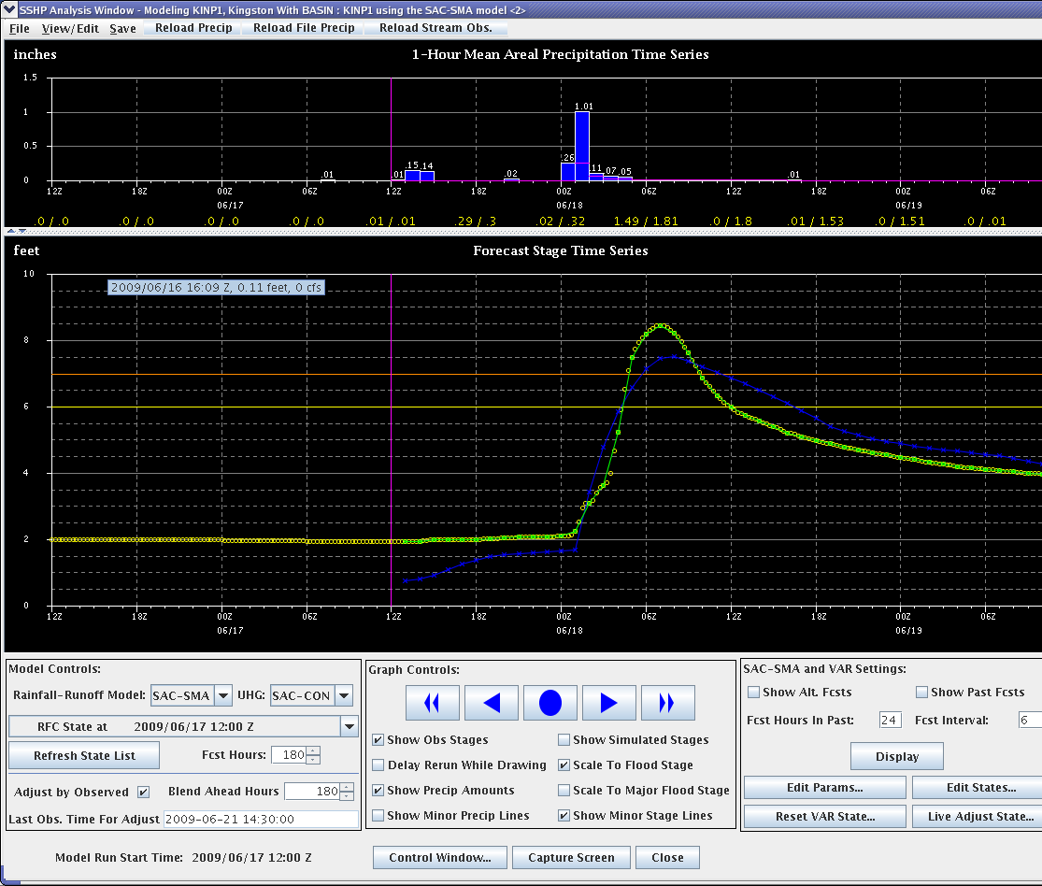
SSHP Forecast Comparisons using Final XMRG Quality Controlled MPE Data
(Basin average rain 1.81”)
Kingston, PA (KINP1) -- June 18, 2009
SAC-SMA (Stratiform) Unit Hydrograph
SAC-CON (Convective) Unit Hydrograph
7.0’
Forecast crest
7.5’
8.5’
Actual crest
8.5’
Forecast crest 7 hours late
Forecast crest 1 hour late

Slide 22
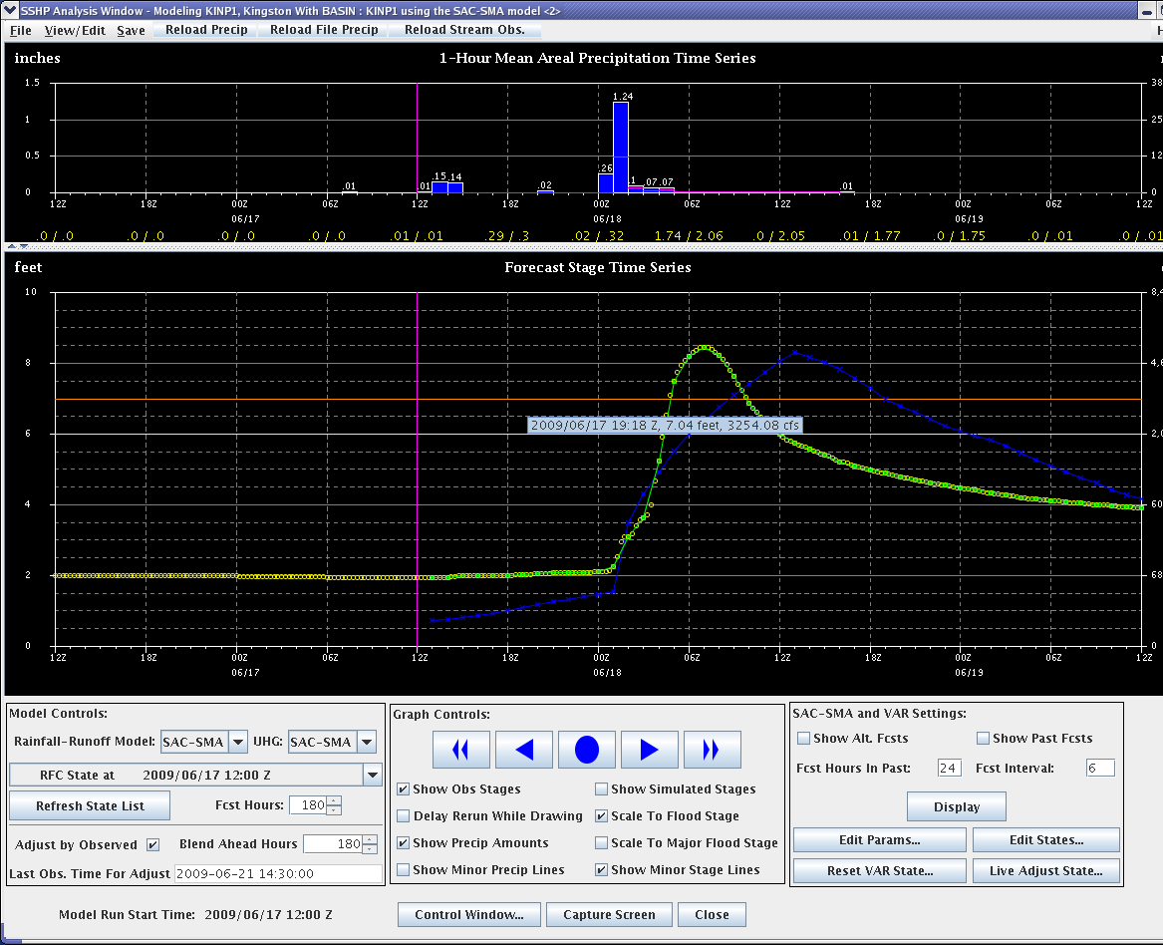
SSHP Forecast Comparisons using QPE (Q2) Raw Data
(Basin average rain 2.06”)
Kingston, PA (KINP1) -- June 18, 2009
SAC-SMA (Stratiform) Unit Hydrograph
SAC-CON (Convective) Unit Hydrograph
8.3’
Forecast crest
9.0’
8.5’
Actual crest
8.5’
Forecast crest 6 hours late
Forecast crest 1 hour late

Slide 23
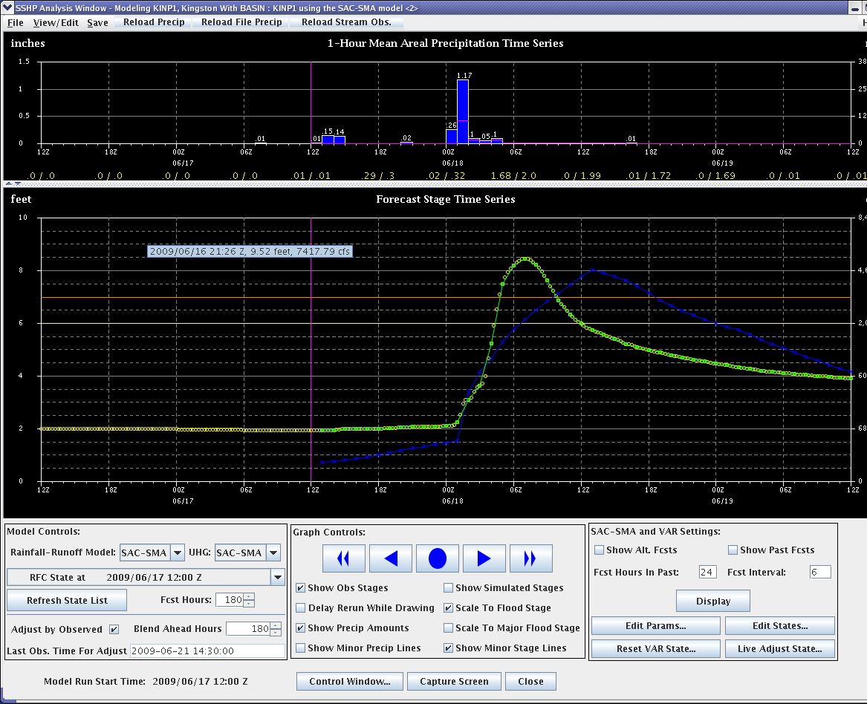
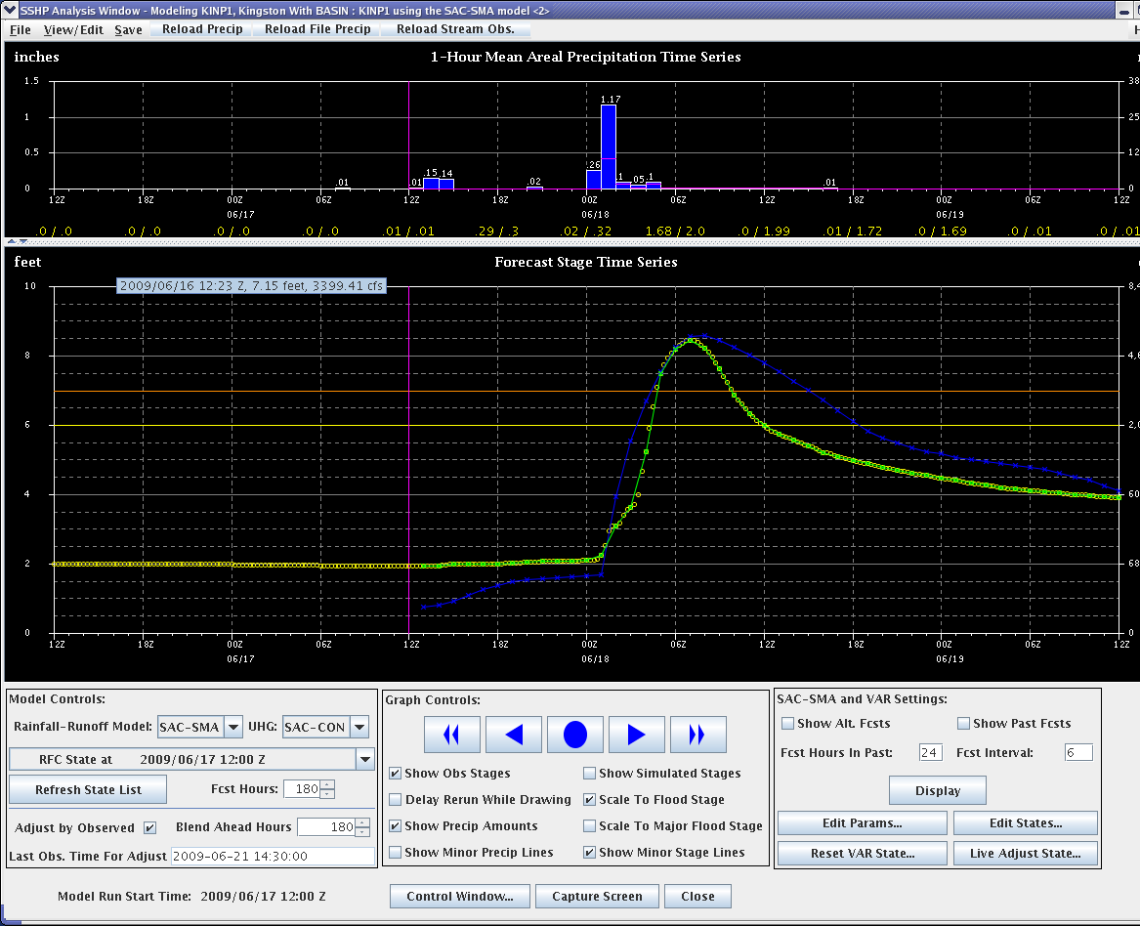
SSHP Forecast Comparisons using QPE (Q2) Gage Adjusted Data
(Basin average rain 2.00”)
Kingston, PA (KINP1) -- June 18, 2009
SAC-SMA (Stratiform) Unit Hydrograph
SAC-CON (Convective) Unit Hydrograph
8.0’
Forecast crest
8.5’
8.5’
Actual crest
8.5’
Forecast crest 6 hours late
Forecast crest 1 hour late

Slide 24
MPE comparisons
West Union, OH (WUNO1)
April 4, 2008
XMRG quality controlled
Radar only
Q2
1.52”
2.05”
2.34”

Slide 25
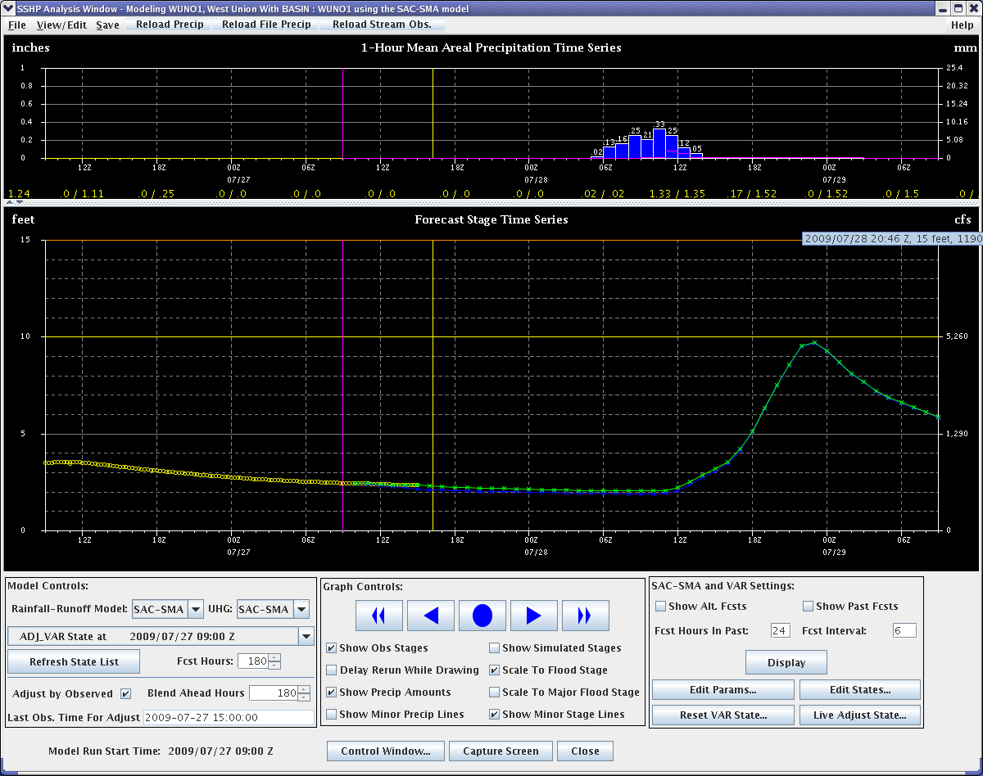
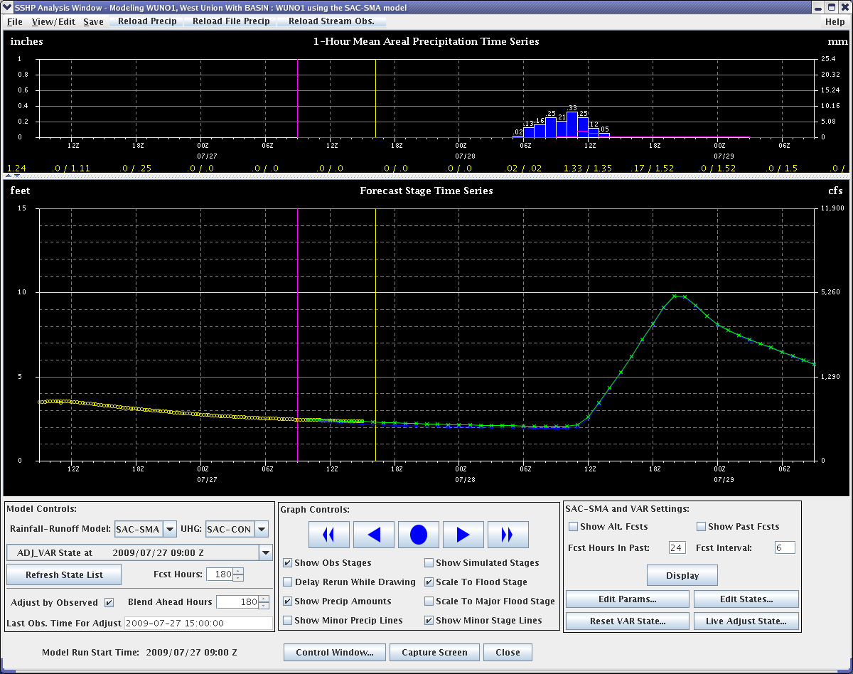
SSHP Forecast Comparisons using MPE Radar Data
(Basin average rain 1.52”)
West Union, OH (WUNO1) – April 4, 2008
SAC-SMA (Stratiform) Unit Hydrograph
SAC-CON (Convective) Unit Hydrograph
14.9’
Forecast crest
14.9’
18.7’
Actual crest
18.7’
Forecast crest 3 hours late
Forecast crest 1 hour late

Slide 26
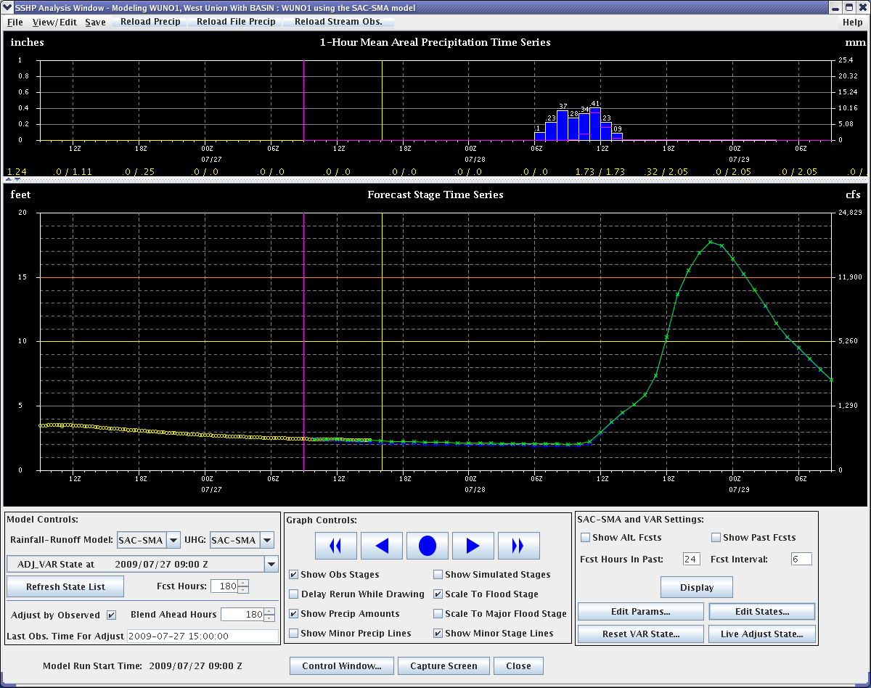
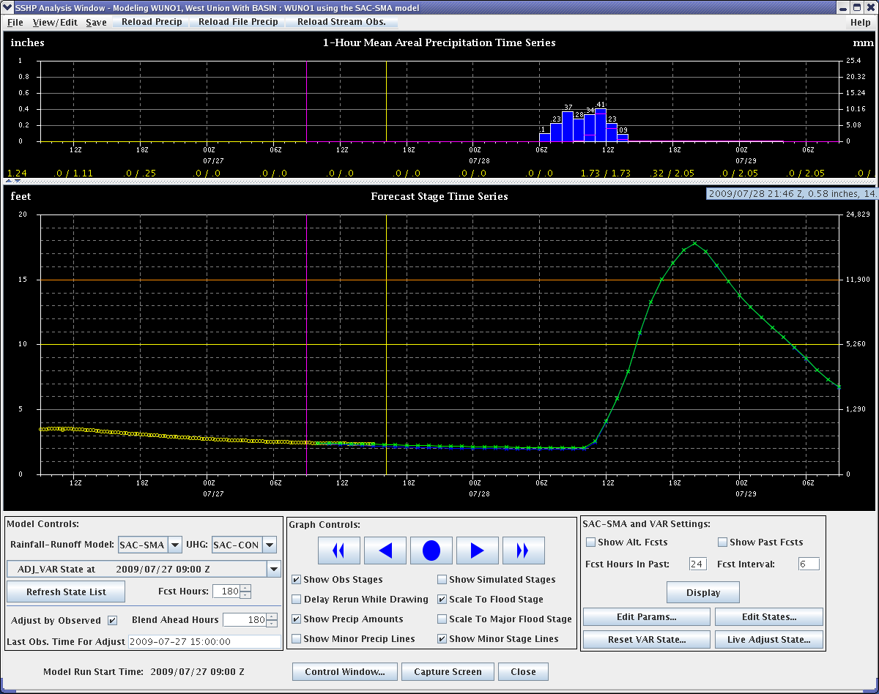
SSHP Forecast Comparisons using Final XMRG Quality Controlled MPE Data
(Basin average rain 2.05”)
West Union, OH (WUNO1) – April 4, 2008
SAC-SMA (Stratiform) Unit Hydrograph
SAC-CON (Convective) Unit Hydrograph
17.9’
Forecast crest
17.9’
18.7’
Actual crest
18.7’
Forecast crest 3 hours late
Forecast crest 1 hour late

Slide 27
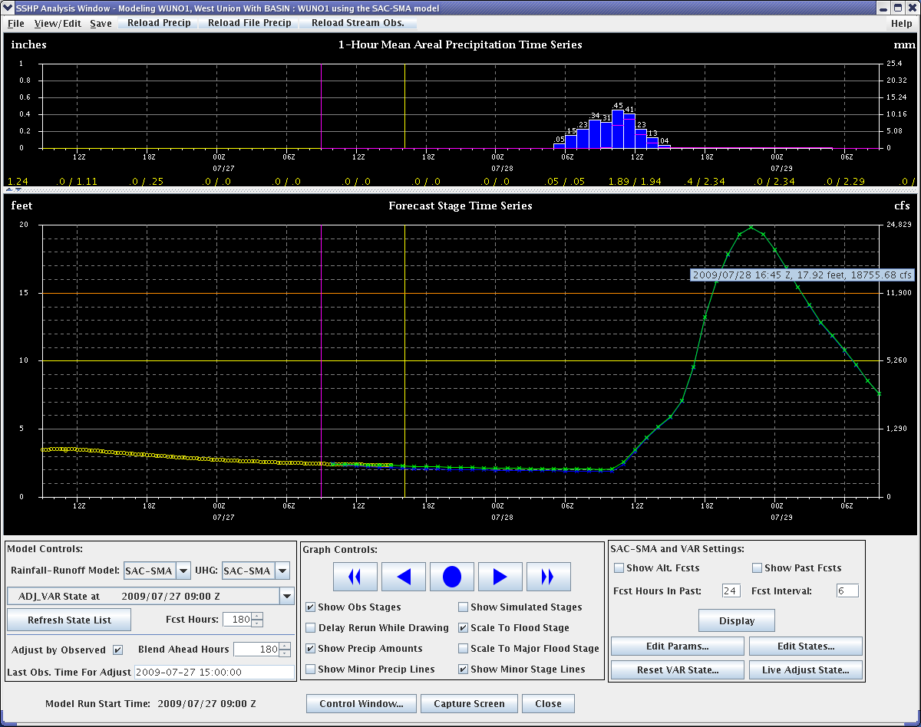
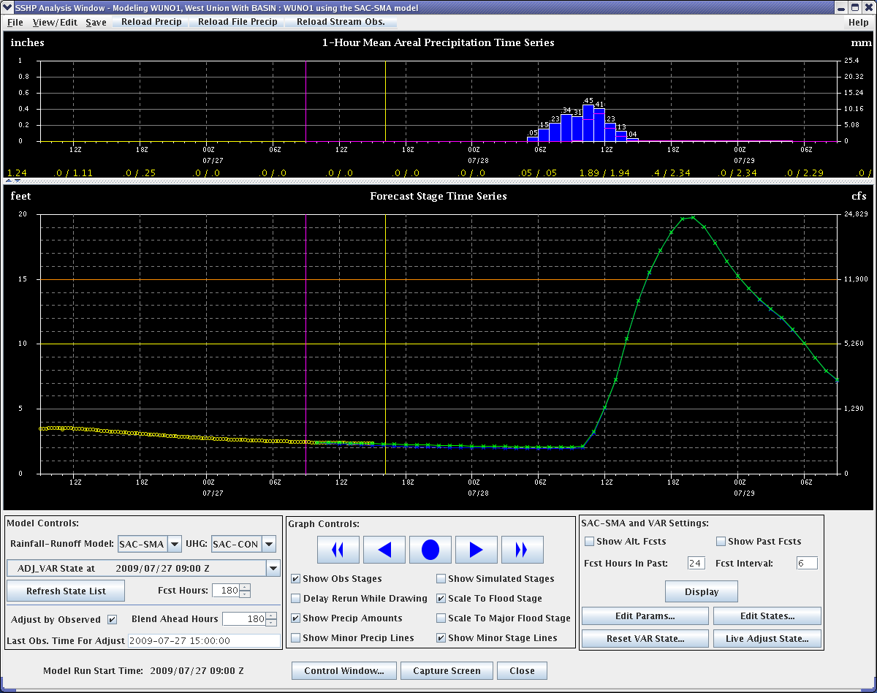
SSHP Forecast Comparisons using QPE (Q2) Raw Data
(Basin average rain 2.34”)
West Union, OH (WUNO1) – April 4, 2008
SAC-SMA (Stratiform) Unit Hydrograph
SAC-CON (Convective) Unit Hydrograph
19.8’
Forecast crest
19.8’
18.7’
Actual crest
18.7’
Forecast crest 3 hours late
Forecast crest 1 hour late

Slide 28
Summary
Q2 offers a good first guess in many cases when WFOs are busy for use in SSHP
Q2 attempts at simulating the Z/R relationship closer to the real world by allow for Z/R changes over small distances than a radar umbrella and over smaller time-scales, hourly for RFC Q2, than the current occasional changes at the WFO for the DPA product.
WFOs should still take a look at rain gages to make sure they are comfortable with the Q2 estimate used in SSHP
It is important to know the type of event affecting the basin
A non-uniform and more showery or convective event usually favors use of the SAC-CON unit hydrograph
A cool season and/or steady and uniform moderate to heavy rain event usually favors use of the SAC-SMA unit hydrograph

Slide 29
Summary
SSHP running in the background now allows forecasters to see future possibilities in RiverMonitor. Great Situational Awareness Tool!
VAR is a great tool for converging toward the real solution
OHRFC worked with OHD to add additional tools for not only the SAC-SMA but also the API-MKC that would make the SSHP a better tool to use. The 1, 3 and 6 hour Gridded Flash Flood Guidance was added so forecasts could choose a more representative value for a storm event
The technology is there and rather powerful in SSHP to advance the hydrologic science. It is now time for us to take advantage of it! It can be used as a situational awareness tool to assist in Flood Watches, Areal Flood Warnings and evening Site Specific Flood/Flash Flood Warnings
These forecasts can be pushed to AHPS to offer more detailed forecasts to customers

Slide 30
Summary
Questions:
James.Noel@noaa.gov
Or
Jeffrey.Myers@noaa.gov

