Slide 1
Best Practices of NWS Blacksburg, VA as demonstrated during the
15 May 2009 Christiansburg, VA Flash Flood
Anita Silverman & Peter Corrigan
NWS Blacksburg VA
Notes:
Created for the Eastern Region Flash Flood Conference
Wilkes-Barre, PA
1

Slide 2
Best Practices - Outline
Case overview
Pre-storm environment
Flash Flood decision tools
Pictures

Slide 3
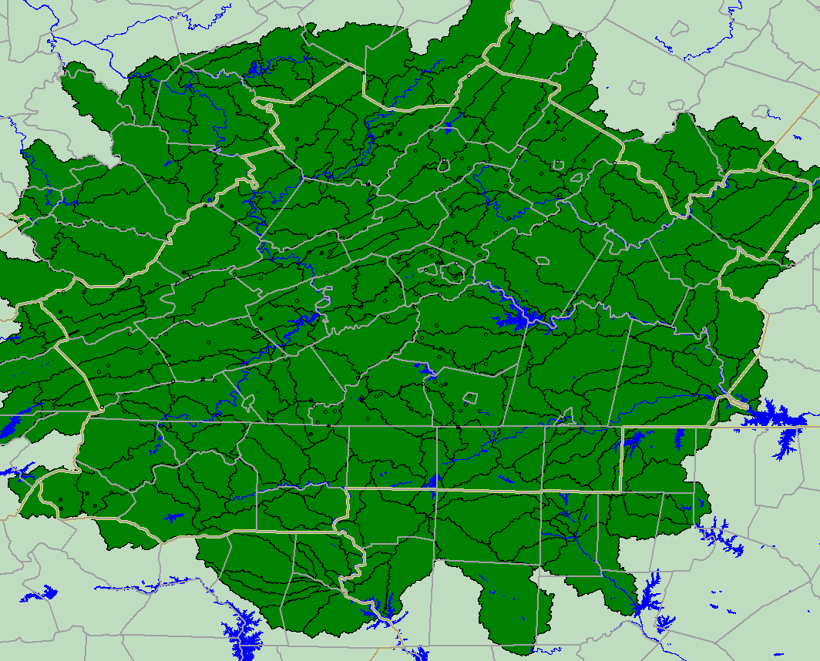
Best Practices - Background
  SW Virginia, NW North Carolina, SE West Virginia
  4 RFCs
Notes:
Hydrologic Service Area of Blacksburg, VA WFO. Yellow star is located over Christiansburg, VA.

Slide 4
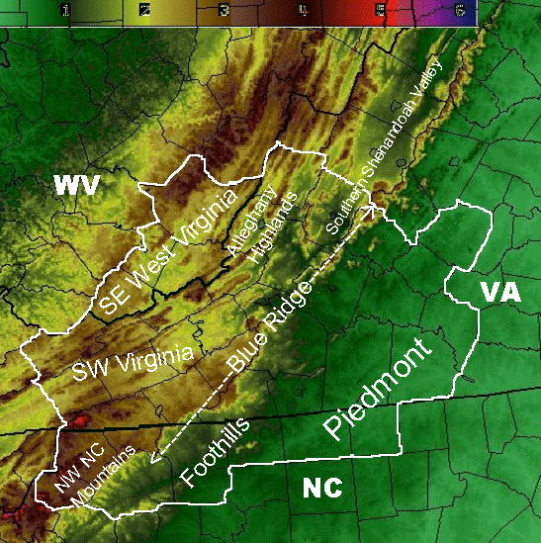
Topography
Notes:
Topography of WFO Blacksburg County Warning Area. The Blue Ridge Mountains bisect the forecast area from northeast to southwest. Elevation changes from just under 500 feet in the far southeast counties to just over 5000 feet at the top of Mt. Rogers (highest point in VA) in the southwest CWA. The yellow star marks the location of Christiansburg, VA.

Slide 5
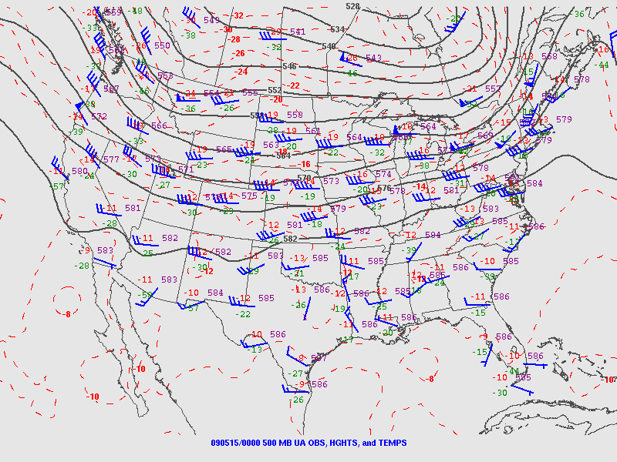
May 15 2009 – 00UTC 500 mb
Notes:
Zonal flow at 500 mb. Weak upper ridging over the far southeast US.
At 300mb(not shown) RRQ of upper jet over eastern Great Lakes. Upper diffluence over the mid Atlantic region.
Black lines are height. Red dashed contours are temperatures.

Slide 6
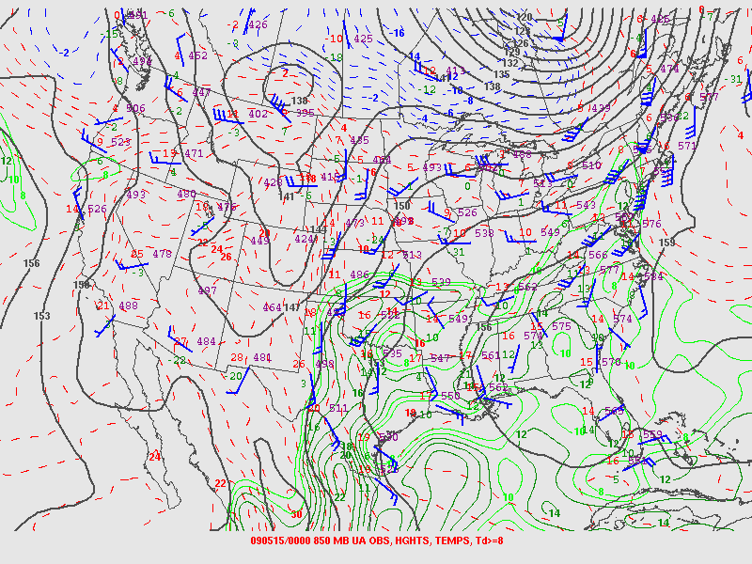
May 15 2009 – 00UTC 850 mb
Notes:
High 850 mb and 700 mb (not shown) dew points. Neutral temperature advection.
Black lines are height. Green contours are dew point. Red dashed line is temperature.
6

Slide 7
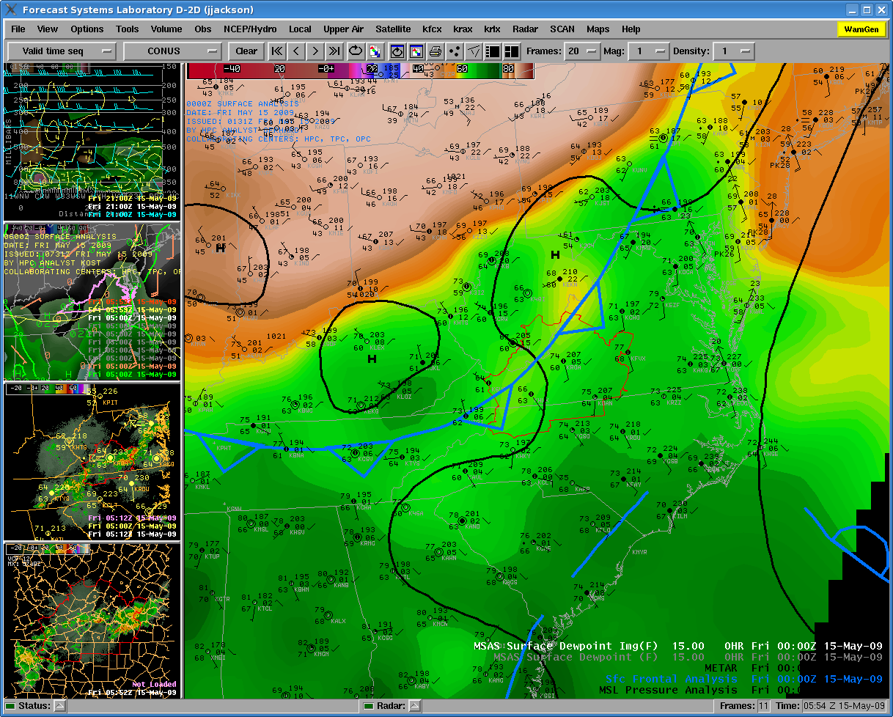
MSAS Sfc Td/HPC fronts – 00UTC
Frontal boundary into NW HSA
Weak SE flow ahead
Sfc Tds – low/mid 60s
Notes:
Presence of slow-moving, weak boundary with convergent flow likely an important focusing and lift mechanism. Additional lift provided by SE flow in to higher terrain over central HSA.
Approaching the month (June) with the highest number of flash flood events, (187), representing nearly 25% of the total flash flood events.
Surface dew point is shaded from low (browns) to high (dark green) on the large pane.

Slide 8
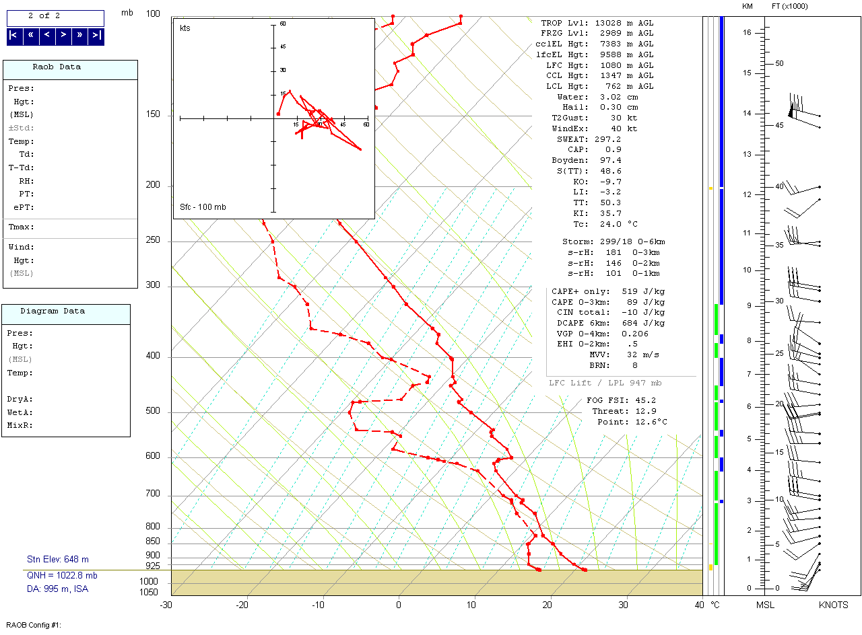
May 15 2009 – 00UTC RNK
PW = 1.19 in
CAPE = 519 J/kg
Notes:
00UTC sounding was in very close proximity to location of flash flooding, within 10 nm. Convective Available Potential Energy (CAPE) was 519 J/kg. The precipitable water value was 1.19 inches.

Slide 9
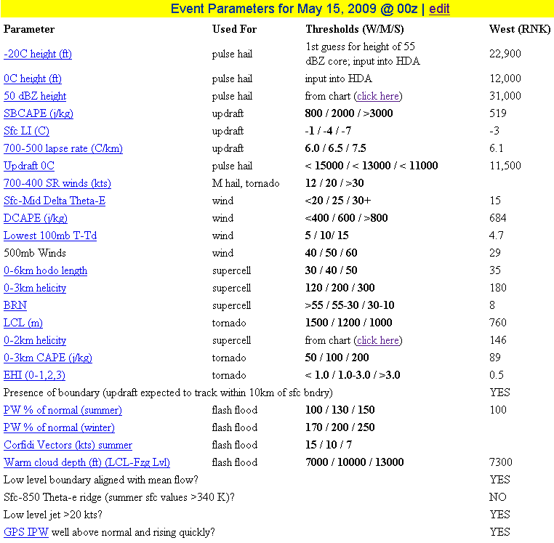
Checklist for May 15 2009 00UTC
Wet bulb zero height was low
LCL below 800 m
DCAPE >680 J/kg
Increasing PW
Notes:
This checklist is filled out whenever there is a threat of severe weather or flash flooding using a RAOB sounding (usually modified if based on the 12UTC release), BUFKIT or the SPC upper air analysis.
This checklist is on the intranet and has links for almost each parameter giving more detail. Each checklist is archived after completed for later case studies, event reviews and other research. In most cases the RNK is representative of the area along and west of the Blue Ridge mountains. GSO is used for the southeast half of the CWA.
Checklist was created for us by Matt Bunkers from WFO Sioux Falls.
Parameters, including precipitable water rising quickly just before the event, show the chance for severe thunderstorms and flash flooding.

Slide 10
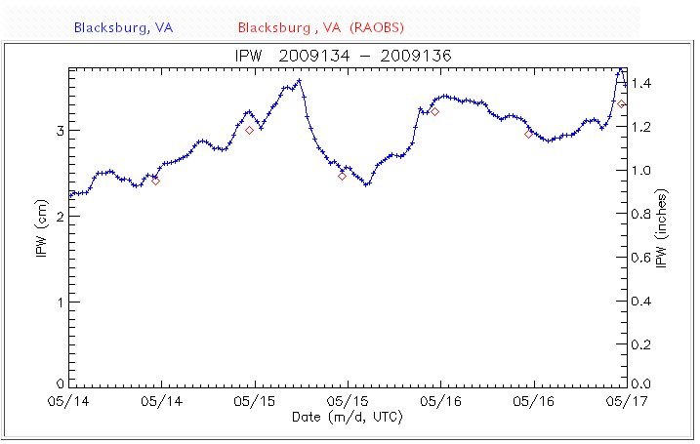
Precipitable Water
Notes:
Precipitable water as measured by the vertical profiler ESRL/IPW sensor at the BCB airport (next to the RNK upper air launch site).
Blue line is profiler data. Red diamonds are precipitable water values from the radiosounde.
Graph covers 00UTC May 14th through 00UTC May 17^{th.} The black arrow marks 00UTC on May 15.
This is the same profiler data and network that goes into the total precipitable water products.

Slide 11
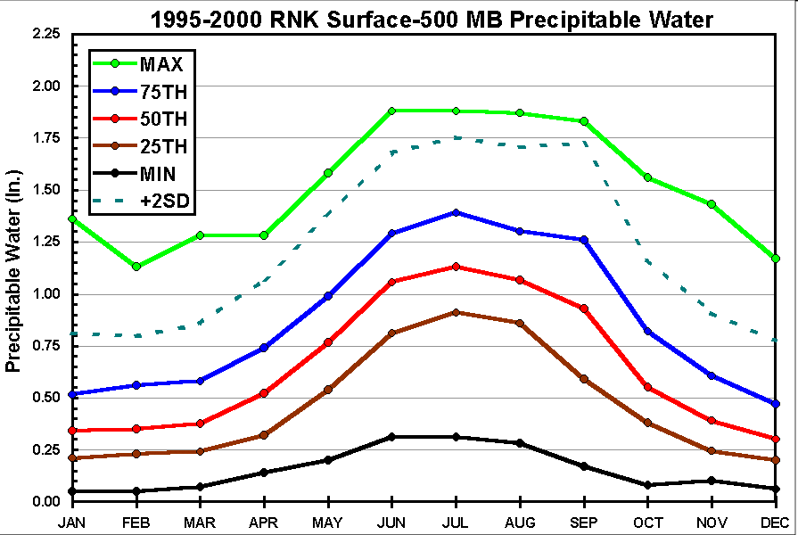
Monthly PW Climatology
Notes:
From the research done for The Use of GPS Integrated Precipitable Water Measurements to Supplement WSR-88D Parameters in Determining the Potential for Flash Flood Producing Rainfall. This was a cooperative project between WFO
Blacksburg, VA and VA Tech.
On May 15, 2009 at 00UTC the precipitable water was around 1.2 inches (at tip of black arrow). This near the 75th percentile for this date. In other words, close to average for mid May.

Slide 12
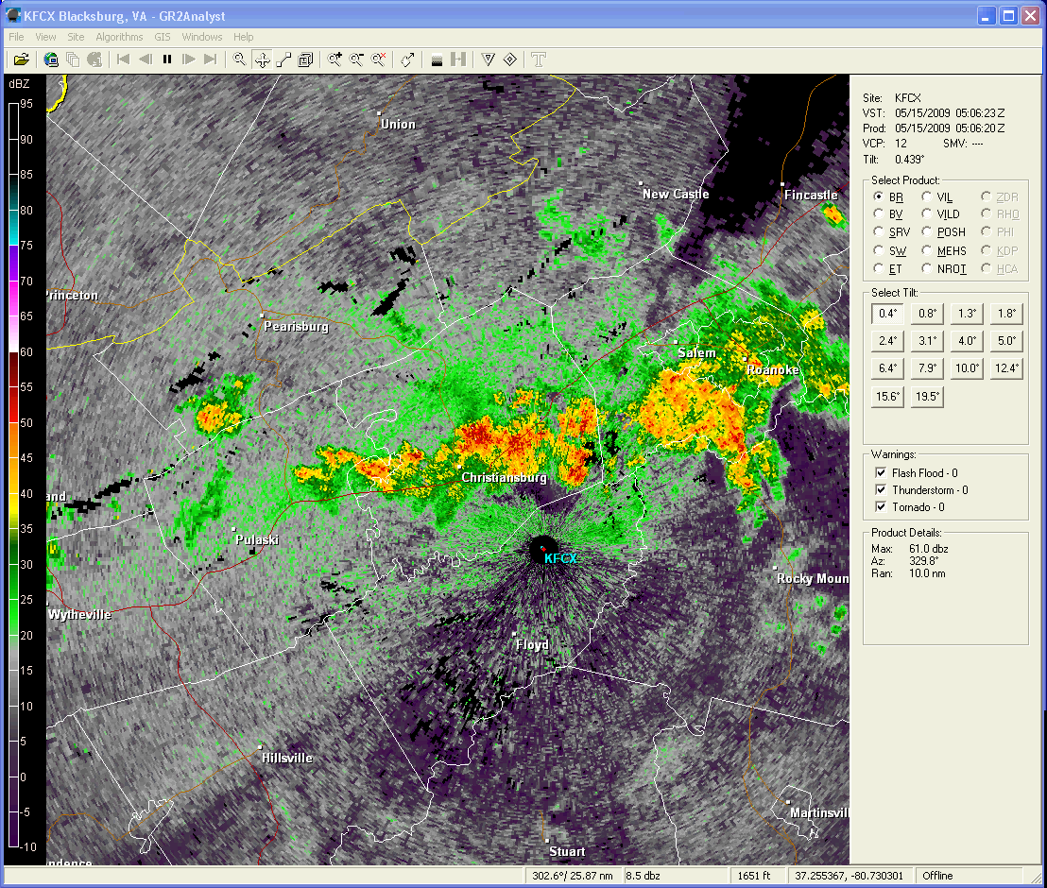
Base Reflectivity 05 – 08 UTC
Notes:
Loop of base reflectivity showing development of storms from east-northeast to west-southwest, with cells toward the end of the loop training west to east. Storms were not deep with most of the cores below the freezing level.

Slide 13
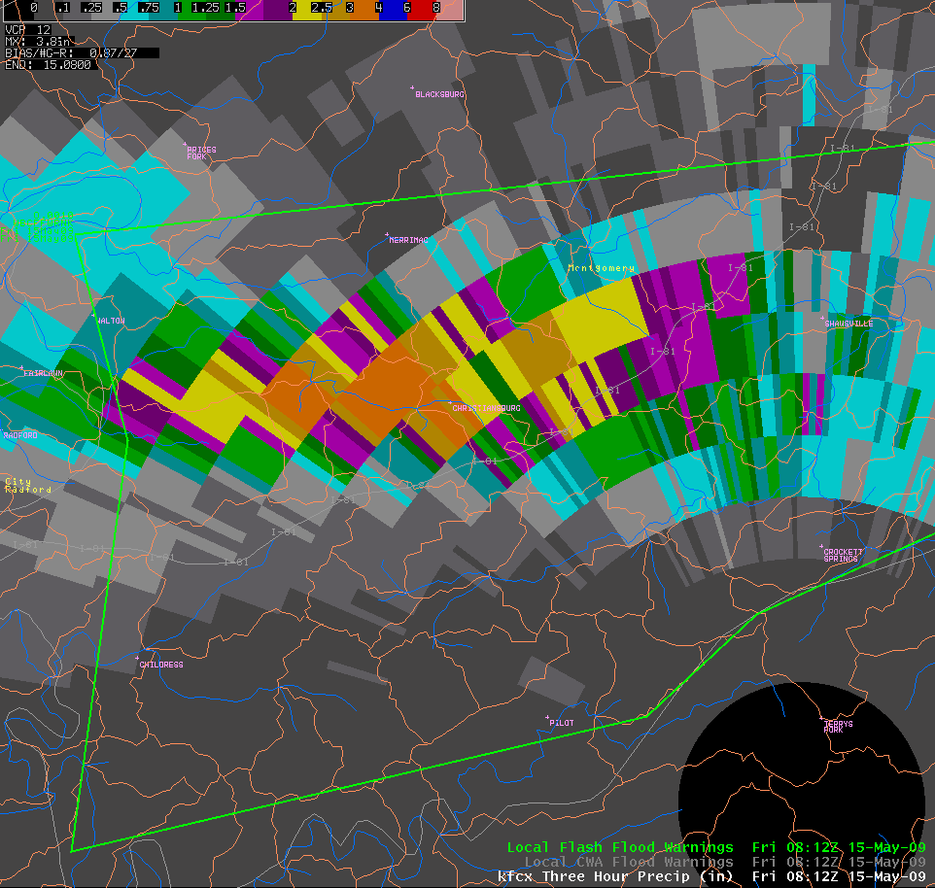
May 15 2009
KFCX THP at 0812Z
Max 3.8 inches just west of Christiansburg
Christiansburg, VA
Notes:
Green outline is the Flash Flood Warning.
Notice heavy rain was in between stations. Bias was close to 1.0 through this event. In this area the radar matched closely to observed precipitation reports. To the east, radar rainfall estimates were about ½ of the amounts being reported. The close range to the radar of these storms contributed to the better estimates. Radar was not overshooting the storms in this area.
Yellow arrow points to Crab Creek in Christiansburg, VA.

Slide 14
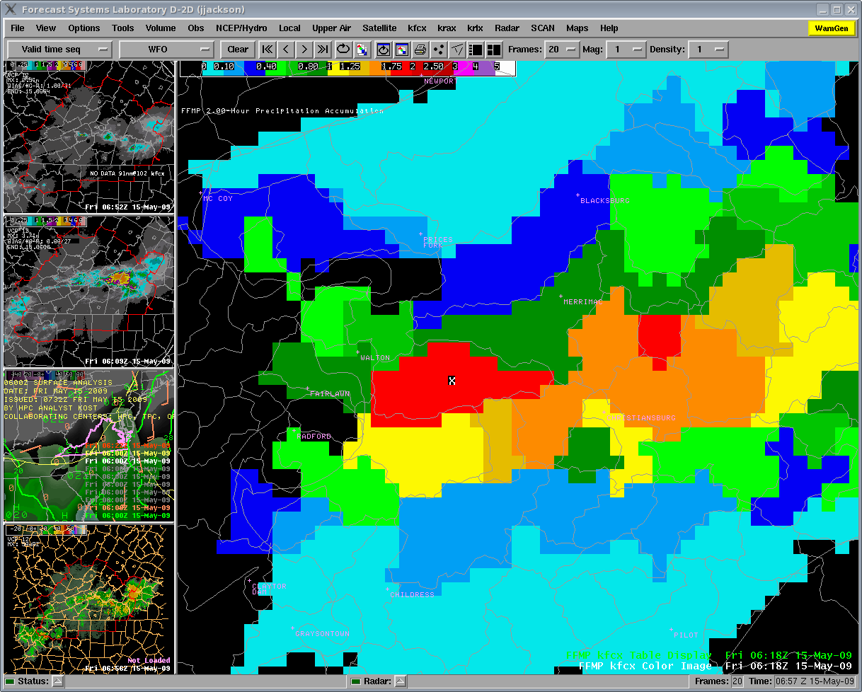
FFMP - Crab Creek basin
2-hr basin amounts
1.75 to 2.00” basin MAP
Notes:
One hour basin amounts (not shown) were 1-1.25” basin MAP
More impressive accumulations at 2-hours…Red color is 1.75” to 2.00”.
Note the fairly isolated nature of the heavier rainfall accumulations. If heavy rain falls one ‘row’ of small basins further south it will be in heavily forested terrain with little ‘significant’ flash flooding likely.
Crab Creek basin is marked with the X.

Slide 15
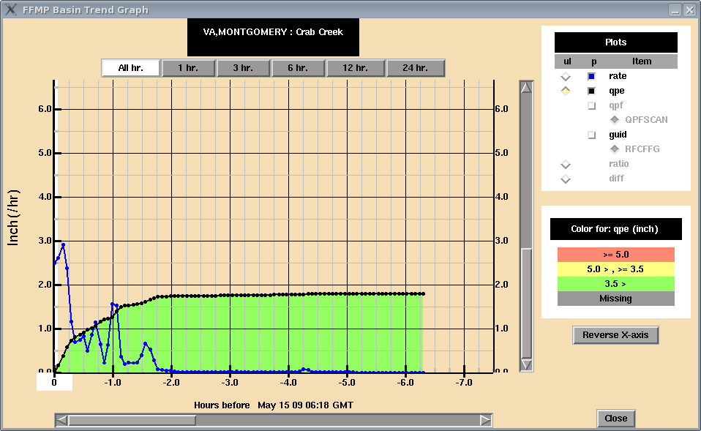
FFMP - Crab Creek basin – 0618 UTC
Rainfall rate jump at ~06Z (20 min prior)
Rates are average value across the basin
Notes:
Note moderate rainfall rates (mostly <1”/hr) between ~0415 (-2 hr) and ~0600
And sudden jump in last 15 minutes up to almost 3”/hr. Urban flooding first reported ~20 minutes after this image.
The 4 basins that cover the Town of Christiansburg flow into 2 different river systems. The Crab Creek and Slate Branch basins flow into the New River and are covered by OHRFC. The North Fork Roanoke River and South Fork Roanoke River flow toward the Atlantic and are covered by SERFC.
Rainfall rates from the KFCX radar were limited to ~4”/hr by hail cap. Radar was set to Convective Z-R 300^{1.4}

Slide 16
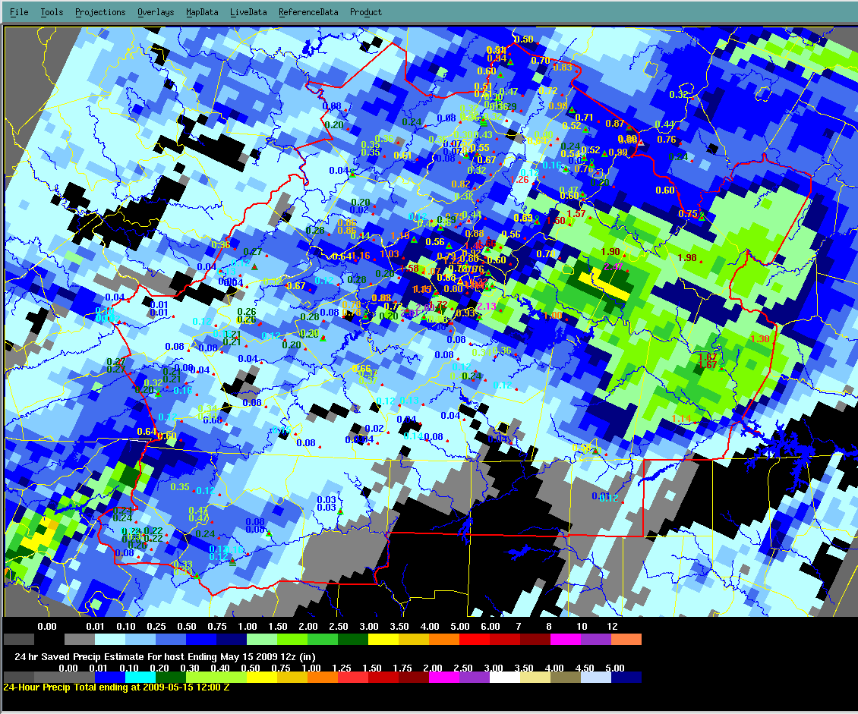
May 15 2009
24 hour MPE
Ending 12z May 15
Notes:
Notice the large area of > 3 inches of rainfall east of Bedford. Other Flash flooding was ongoing when the heavy rainfall developed over Christiansburg.
North Fork of the Roanoke River basin average was 0.75 to 1.00 inches. Maximum rainfall report in the basin was 2.81 at the Shawsville gage. No flooding was reported in this basin. Just to the west gages reported less than 1 inch 24 hour precipitation. In this case network of IFLOWS, USGS and other rain gages did not capture the heaviest rainfall.

Slide 17
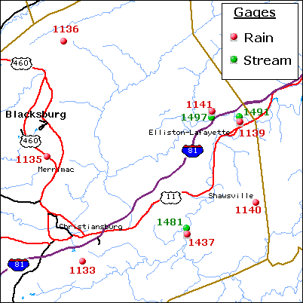
IFLOWS network – Montgomery Co.
Notes:
IFLOWS – part of the Automated Flood Warning System (AFWS)
No IFLOWS gages where heaviest rain fell. No Stream gages along Crab Creek, Town Creek or Wilson Creek.
Gage 1133 had 0.04 inches in 24 hours and gage 1437 had 2.81 inches.
Blue circle is location of flash flooding.

Slide 18
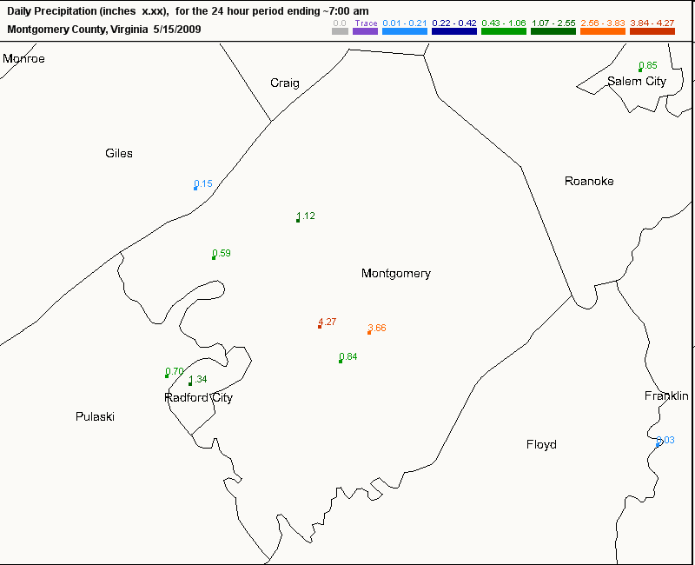
CoCoRaHS
Not in real time
Good for verification and post storm assessment
Confirmed bias calculated by radar was close to 1.0
Notes:
However, the CoCoRaHS reports from later that morning were more revealing. Clearly highlights the very small scale of the heavy rain. 4.27” at house of NWS employee.

Slide 19
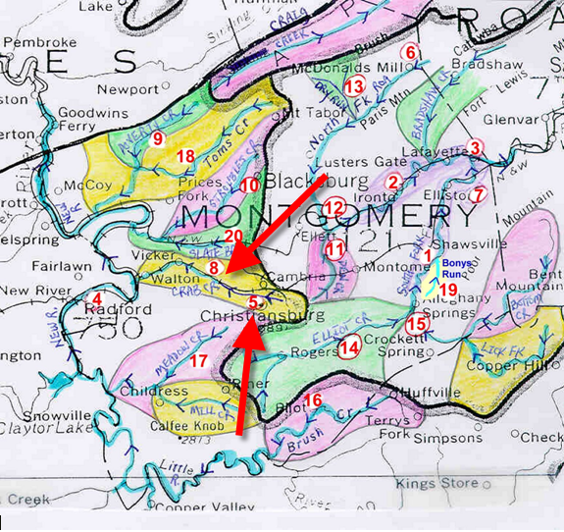
Montgomery Co. Flood prone areas
Montgomery County
Flood Prone Areas
1. Shawsville – Frequent flooding along the South Fork of the Roanoke River (1) in the purple area. (IFLOWS stream gage).
2. Ironto – Frequent flooding along the North Fork of the Roanoke River (2) in the purple area. (IFLOWS stream gage). Tend to flood SR 603 in the Ironto area first. Extreme flooding in the past has closed the northbound lane of I-81.
3. Lafayette – Frequent flooding here at the confluence of the North and South Forks of the Roanoke River (3). (IFLOWS stream gage).
4. Radford – Flooding caused here by the New River. A frequent flood problem in the city is Bissett Park, and also Veterans Field. Both locations are associated with river flooding.
(5) (8) Crab Creek - Floods Water Street in Christiansburg, and State Route 660, Crab Creek Road, near Vicker.
Notes:
Each of our 40 counties have hard copies of basins in each county. Flood prone and past flood areas are labeled with a red number. Creek names are labeled. Impact at each area is listed along with the map. Rainfall totals and flash flood guidance as well as impact are given for each event. This information built up over years of documentation during and after events.

Slide 20
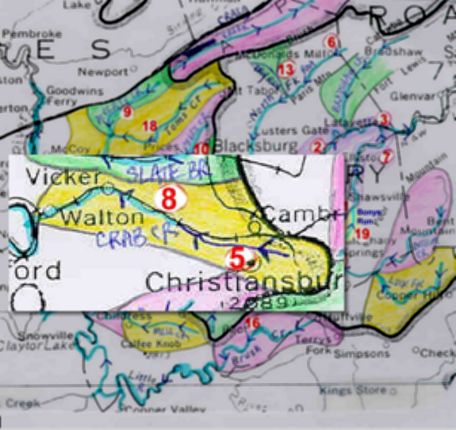
Montgomery Co. Past Flooding
Past Flooding
1/8/98 – 1.25 inches in an hour, and a total of 2.25 inches in 12 hours, caused Crab Creek (or Town Creek), (5) to flood Water St in Christiansburg. 1.5 inches in 3 hours, and 2.5 inches in 12 hours, caused Brush Creek (16), to flood and wash out part of State Rte 612 near Pilot. FFG: 0.7 in 1 hr, 1.2 in 3 hrs, and 1.8 in 12 hrs.
6/19/96 – 3 inches in 1 hour caused small stream flooding – several small bridges underwater along the North Fork of the Roanoke River, (6). FFG: 1.3 inches in 1 hr, and 2.2 inches in 3 hrs.
2/98 – 1.5 inches in 6 to 9 hours caused the South Fork of the Roanoke River (7) to close one lane of US 460 in Elliston. Several small creeks were out of their banks from Elliston to the Roanoke county line. FFG: 0.5 in 1 hr, 0.9 in 3 hrs, 1.0 in 6 hrs, and 1.3 in 12 hrs.
3/20/98 – 1 inch from 900 am to noon, and then 1 to 1.25 from 200 to 400 pm caused the South Fork of the Roanoke River to flood State Rte 637 in Alleghany Springs, (15) and SR 11 between Elliston and Shawsville (7). FFG: 0.5 in 1 hour, 1.0 in 2 hrs, 1.2 in 6 hours, and 1.5 in 12 hrs.
4/19/98 – 1 inch in 3 hours, and a total of 1.5 to 2.0 inches in a 6 hour period caused minor small stream flooding and closed roads along the North Fork of the Roanoke River (6), Poverty Creek (9), and Crab Creek (8) below Christiansburg. FFG: 1.2 in 3 hrs, and 1.5 in 6 hrs.
Notes:
There has been flooding before along Crab Creek in Jan and April of 1998.
Crab Creek also flooded in May 1999 and 2002. These maps, flood prone areas and past flooding are available in the operations area in hard copy, on PC through AMBER, and on AWIPS through AMBER. Impact statements can easily be copied and pasted into flash flood warnings and statements. This is an ongoing project, started in the early 90s by lead forecaster Jan Jackson. The database gets updated with each flash flood event.
During this case the radar estimated 2 to 3 inches of rain in about 2 hours. 1 hr FFG was 1.4 inches, 3hr FFG was 1.8 inches, 6 hr FFG was 2.0 inches

Slide 21
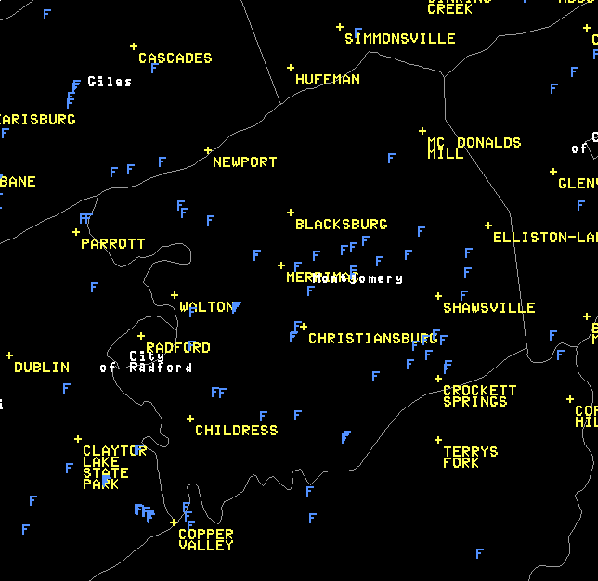
Flood prone locations in AWIPS
Blue F is a location where flash flooding has occurred
Notes:
Have taken the latitude and longitude of each flood prone area and have made these into a Local Map on AWIPS. Each blue F is a location that has had flash flooding.

Slide 22
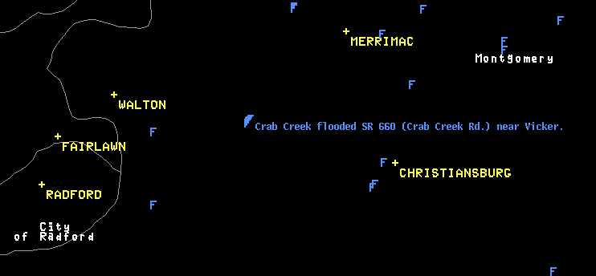
Flood Prone Areas in AWIPS
Mouse over each F to get a summary impact statement
Notes:
Crab Creek flooded State Route 660 ( Crab Creek Road) near Vicker.
In addition, now having the lat/lon for flood prone locations makes it easier to enter into Storm Data.

Slide 23
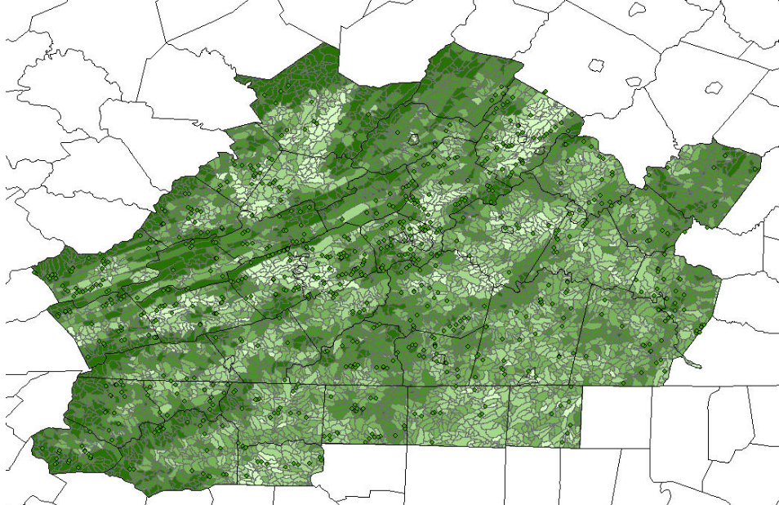
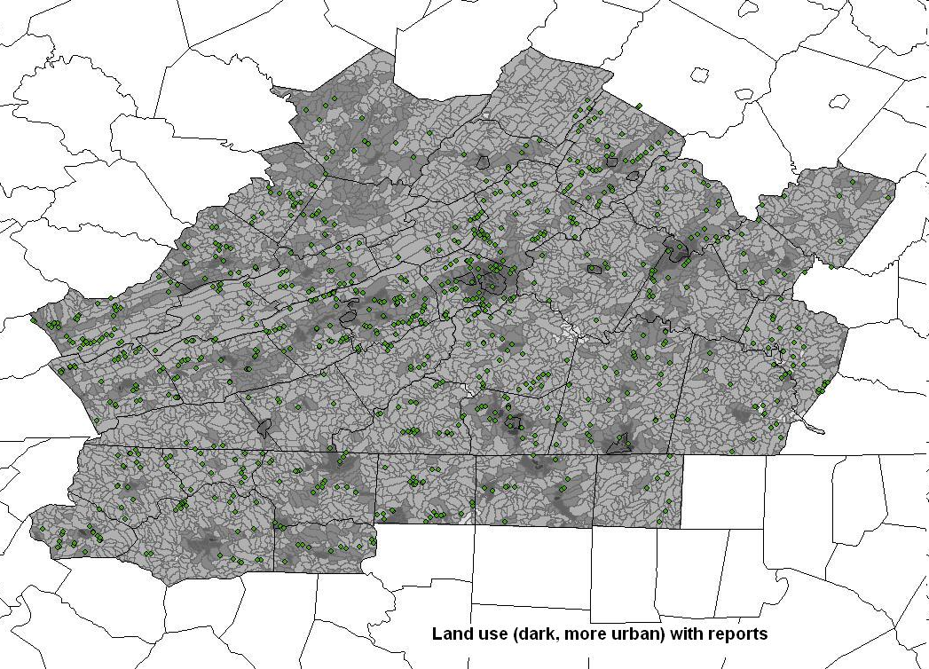
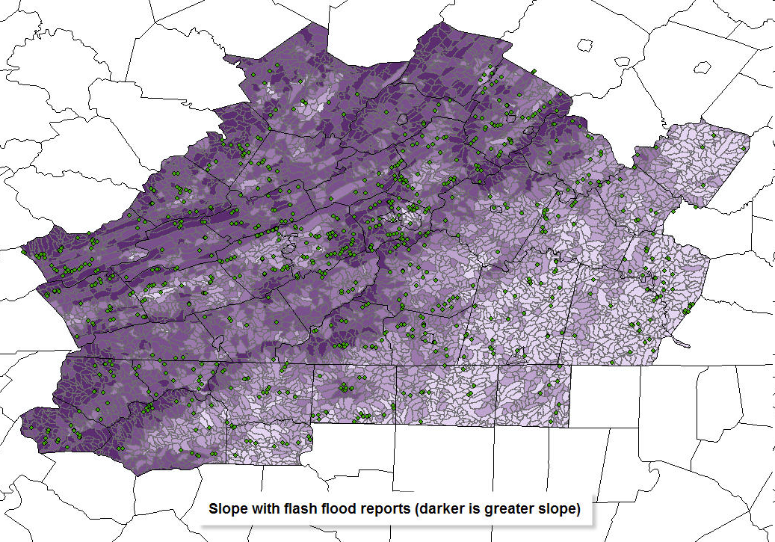
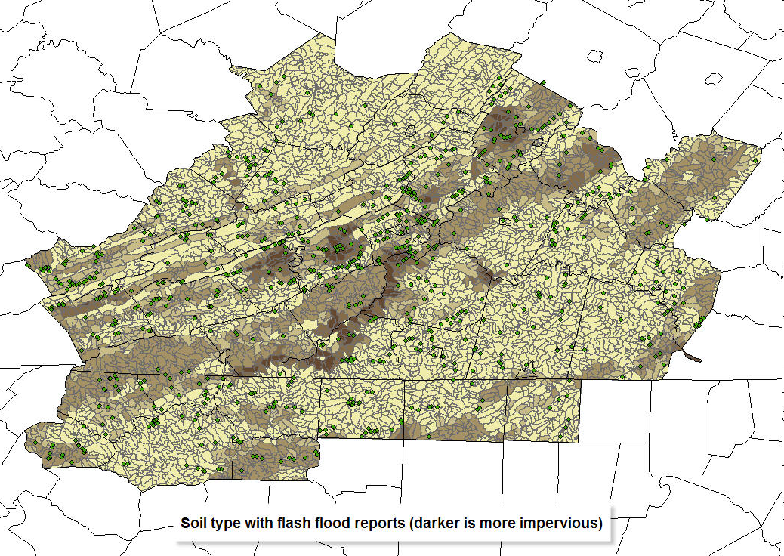
Flash Flood Potential Index (FFPI)
Forestation
Land Use
Slope
Soil Use
Notes:
Four layers of the Flash Flood Potential Index. National and State forest cover parts of the Blue Ridge and western HSA.
A majority of previous flash flood reports have occurred in basins that are more urbanized. Of course, these are the higher population areas and flooding is more likely to be reported or observed. Large parts of the HSA have very low to almost no population.
Looking at slope, there is a gradual rise in the east, then a sharp rise along the Blue Ridge Mountains with mountains and valleys in the west.
Notice the darker soil use areas along the population centers and more impervious soil along the east side of the Blue Ridge Parkway from the Floyd/Franklin County border into southeast Carroll County.
Green dots mark flood prone locations.

Slide 24
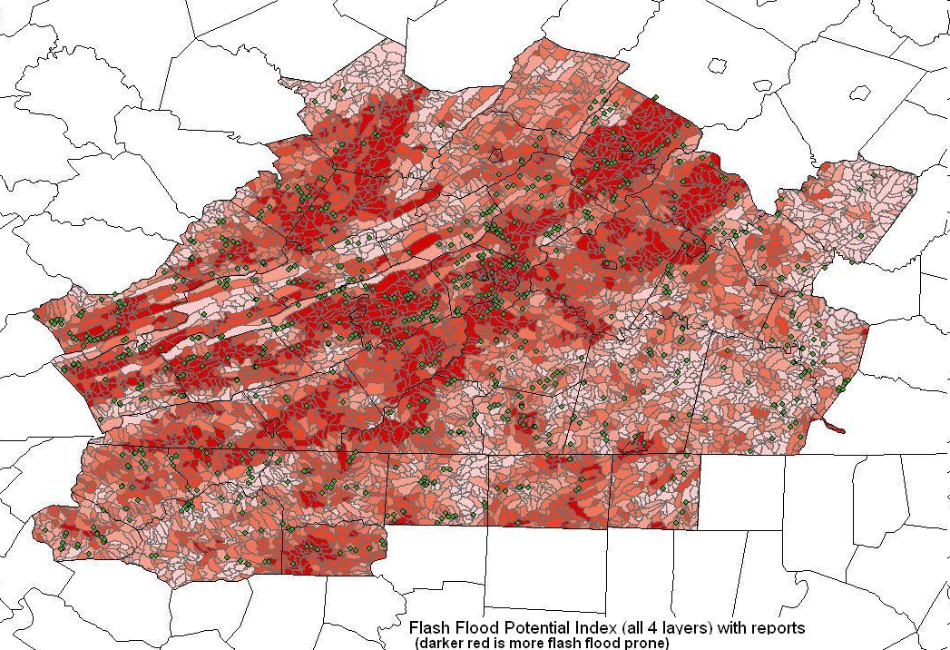
FFPI – all 4 layers
Notes:
All 4 layers of the Flash Flood potential inches combined. We have applied an equal weighting on each layer. Green dots are locations that have had previous flash flooding. This map shows a good correlation between reports of flooding and basins where there is higher flood potential. These maps were created by Greg Smith from the CNRFC (Salt Lake City).
This is not an interactive map yet, but is available to forecasters on the intranet page.

Slide 25
What happened
Flash Flooding along Crab Creek, Town Creek and Wilson Creek
Urban flooding in Christiansburg
Annual percent chance of occurrence (per NOAA Atlas 14) was likely less than 1 percent
Damage > $250K
Notes:
Urban flooding included the main business route (Route 460) through town. From Local Storm Report “NORTH FRANKLIN STREET AT SPRADLIN FARMS CLOSED DUE TO HIGH WATER REACHING A DEPTH OF 3 FEET. ROAD RE-OPENED AROUND 400 AM.”
Local Storm Report of Crab Creek flooding said “CRAB CREEK FLOODING THE BRIDGE ALONG WALTON ROAD, IN THE COMMUNITY OF WALTON. “
Close to a 100 year flood event.

Slide 26
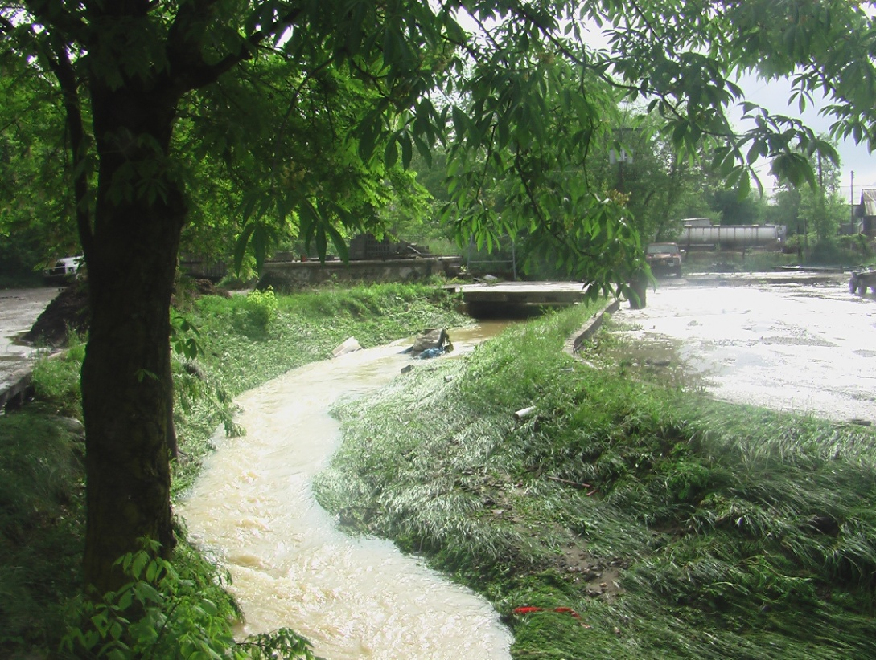
What happened
Crab Creek – near intersection of Acorn & Lucas St. – Upstream view – Dir. ENE. Water was ~3 ft. deep in the parking lot on the right. Stream became at least 40 yards wide through here.

Slide 27
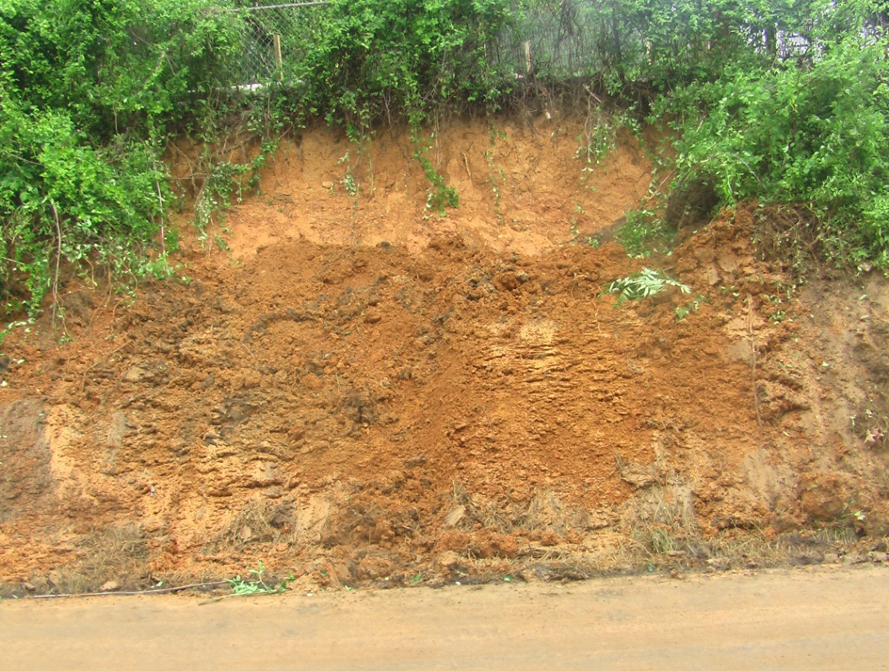
What happened
Debris flow on Ellet Road

Slide 28
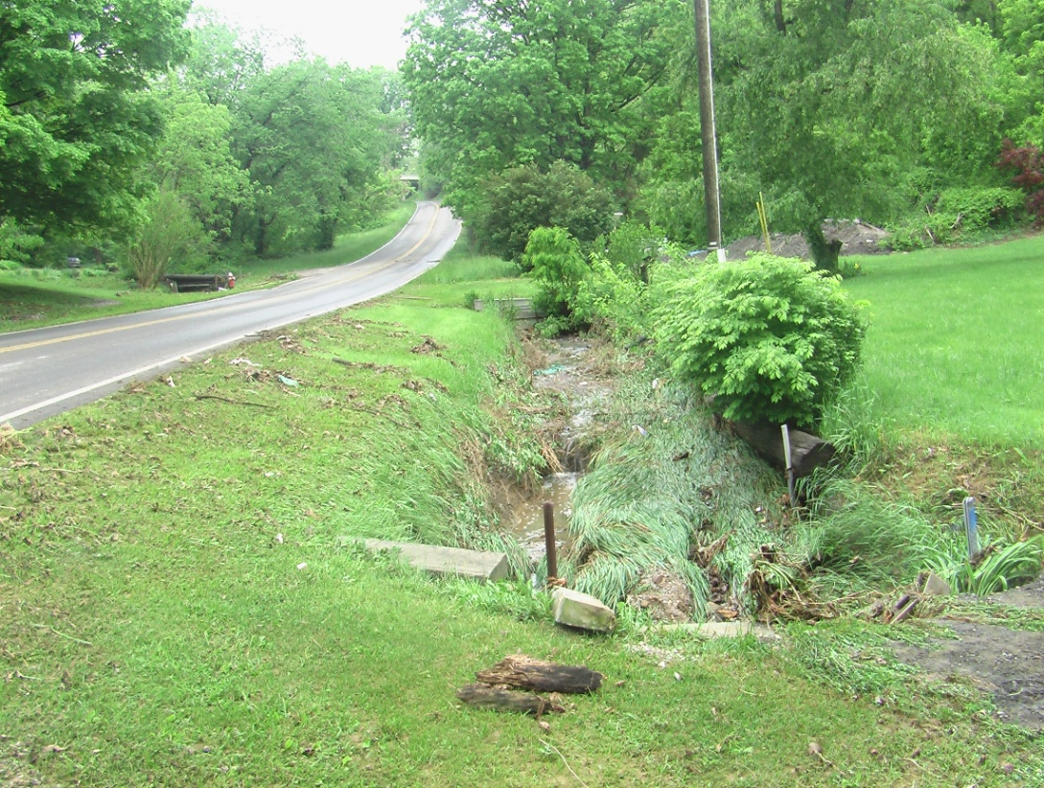
What happened
Water came across Ellet Rd. from upper left to lower right in this picture

Slide 29
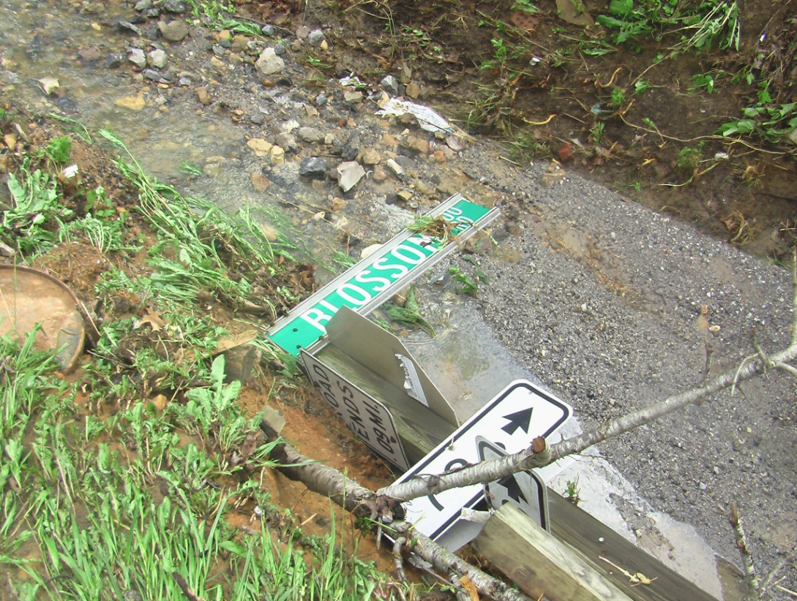
What happened
Sign for Blossom Rd. knocked down

Slide 30
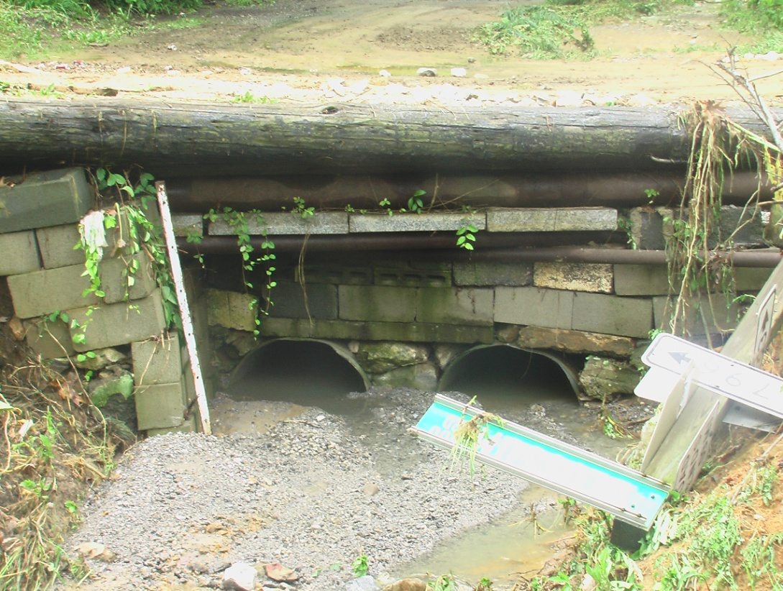
What happened
Downstream side of plugged-up culvert at bottom of Blossom Road

Slide 31
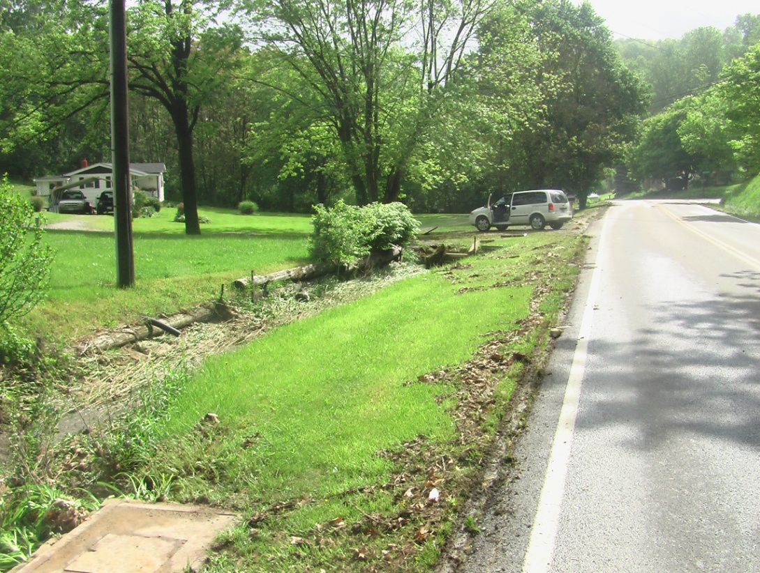
What happened
Looking down Ellet Rd. from near Blossom Rd.
According to man in the white house water reached ½ way up the lawn.
He had 3.75” in a rain gage from this event

Slide 32
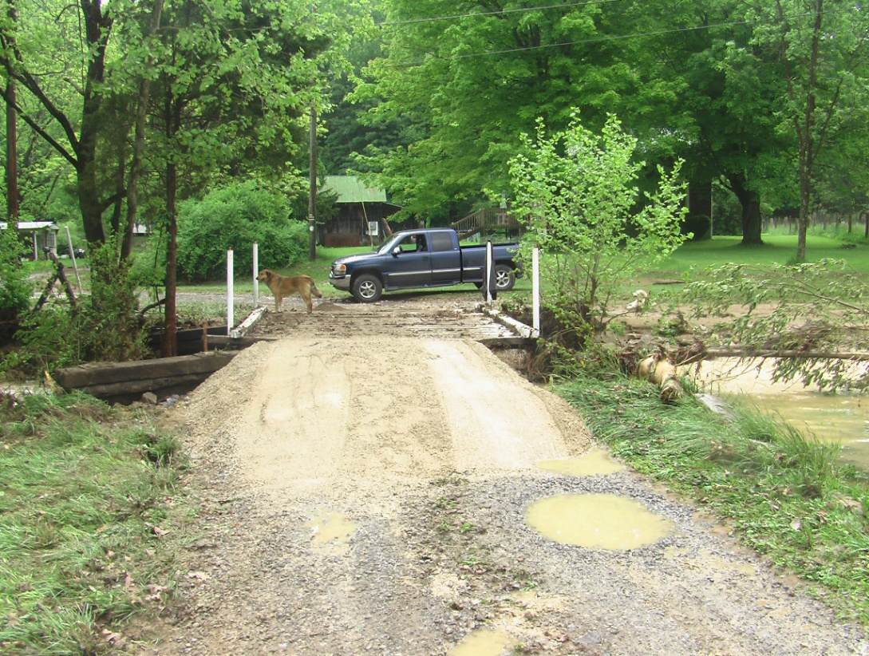
What happened
Small wooden bridge over Wilson Creek. Water was certainly over the top of this bridge.

Slide 33
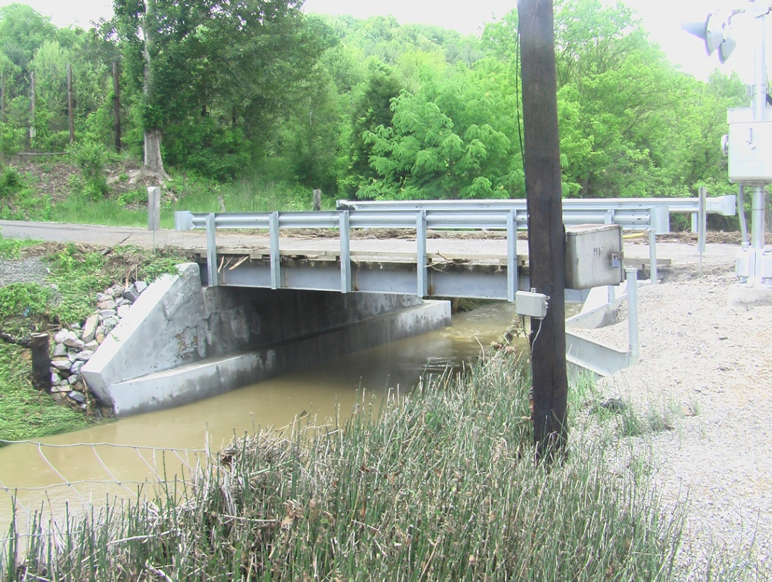
What happened
Water from Crab Creek was also over this bridge by several feet.

Slide 34
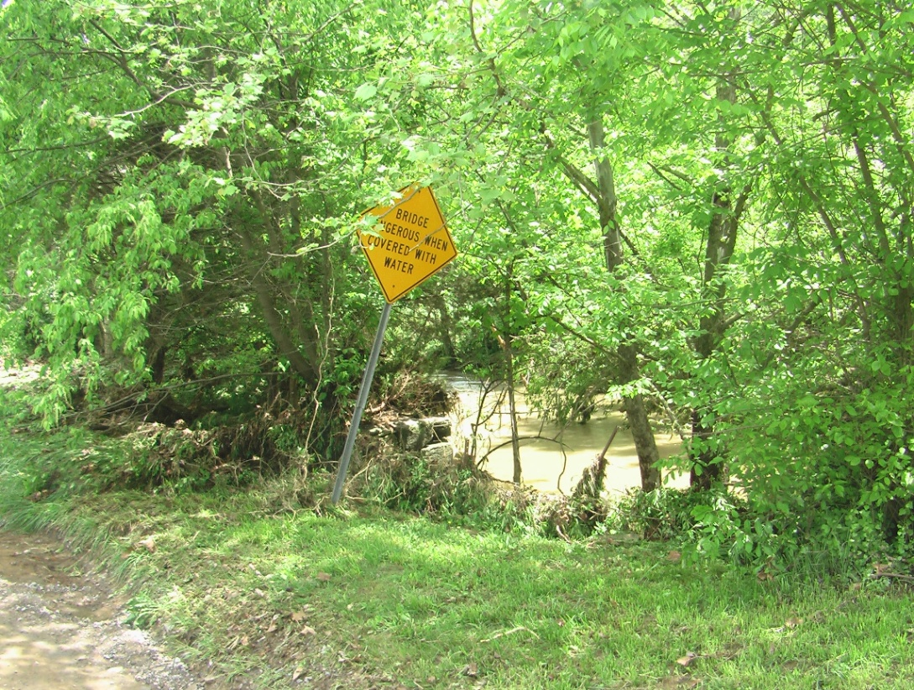
What happened
Informative sign
“BRIDGE DANGEROUS WHEN COVERED WITH WATER”

Slide 35
Best Practices - Conclusion
Unique and challenging event
FFMP/AMBER
Pre-storm environment checklist
Flood prone areas/past flooding by county
Flash Flood Potential Index
IFLOWS and CoCoRAHS for post storm analysis
Notes:
How is this approach working for us? Lead time improved from just over 40 minutes in 2003 to just under 80 min by 2009.
Always room for improvement.
In FY’09 POD was 0.74 (Region 0.90) , FAR was 0.22, CSI was 0.69, LT was 87.7 min (Region 49 min)

