Slide 1
Life on the edge Patterns and Probabilities of heavy rainfall
Richard H. Grumm
National Weather Service Office
State College PA 16803

Slide 2
Introduction
There are known patterns for heavy rainfall
There are known models to predict heavy rainfall
There is uncertainty associated with forecasting heavy rainfall
There are ensembles and probabilities to deal with uncertainty

Slide 3
Sometimes
Your in the sweet spot with a high probability and a good high probability outcome. Life is relatively easy.
Other times, your on the edge, life is tough, you find yourself running from the cops and being chased by thugs, well not exactly but the forecast is tough on the edge.

Slide 4
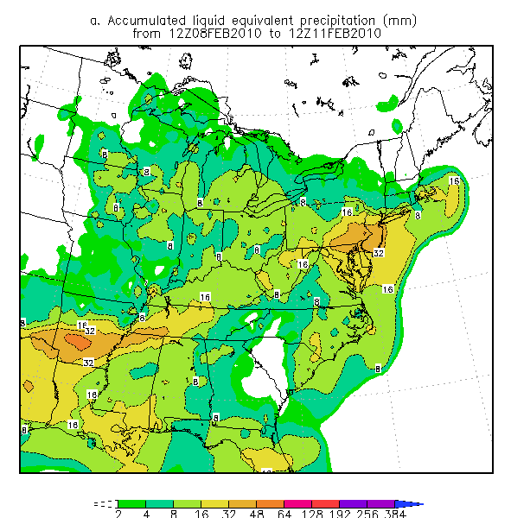
Look at the sharp edge in this precipitation shield

Slide 5
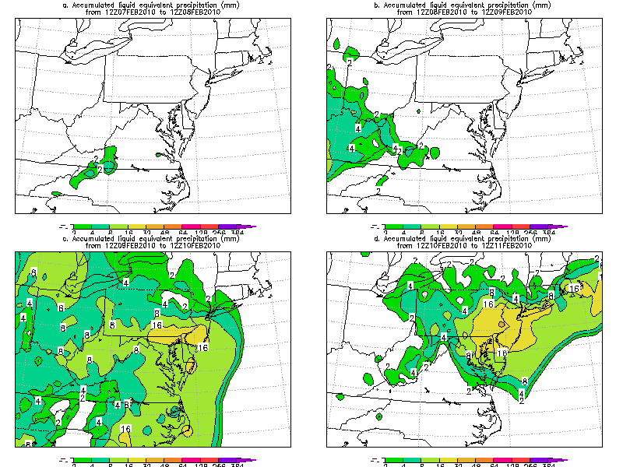
Real edges of precipitation shields can be real tight

Slide 6
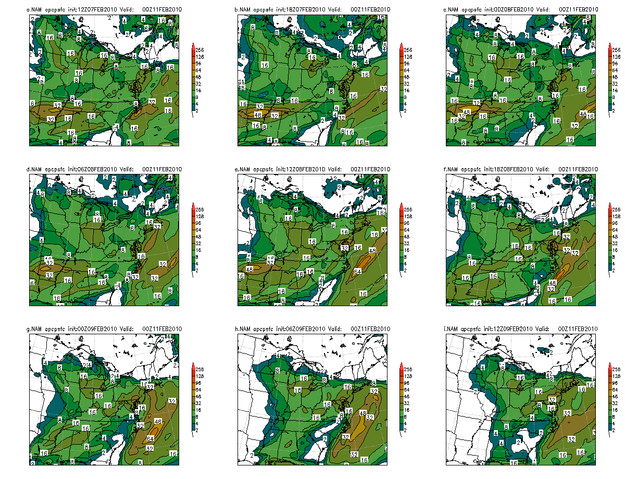
Models often Predicted these edges

Slide 7
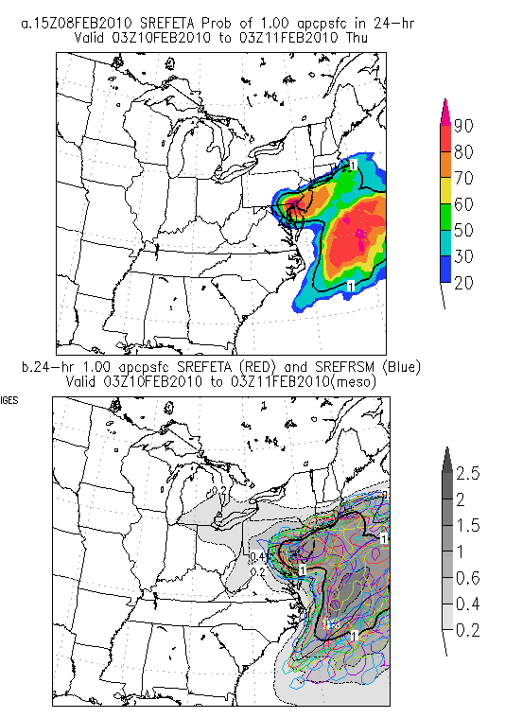
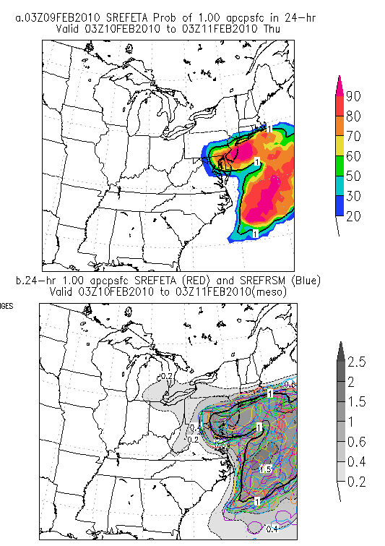
Ensembles Predict sharp edges Why?

Slide 8
Why Sharp Edges?
The real atmosphere has these features they are real.
Our models are getting better
They deal better with hydrometeors so spill out QPF is reduced
They can really predicted the synoptic and finer models, mesoscale features quite well
Finer scale models produce better rain shadow and terrain effects.
Thus they are simulating reality better
The edges vary by cycle→ still uncertainty

Slide 9
A few points about edges
Life is easier inside the edges
More confident in the higher probability outcome
Beware hubris as uncertainty α forecast length
The high probability and edges move about more at longer ranges
Shorter ranges one can get real confident

Slide 10
What is long range or short range? “Luke feel the uncertainty go with the uncertainty”
Good question each system has it’s own unique predictability horizon.
Some events are more predictable than others
Success with one event does NOT translate to success with the next event.
Beware along the edges
Patience is your ally
Never rush to warn on the edge new forecasts will come in with new edges
Remember on the edges → Patience is your ally

Slide 11
Forecasting Heavy Rainfall eastern US bias here
Know the patterns which produce heavy rainfall
Synoptic Type event
Frontal event
And more troublesome mesoscale events.
Match the pattern with the EFS probabilities
The EFS and models should predict the pattern
And produce realistic rainfall patterns
But the location and details will vary and not be correct!
Be mindful of the uncertainty
The details will vary with forecast length and
Model/EFS resolution
More uncertainty the more patience is required

Slide 12
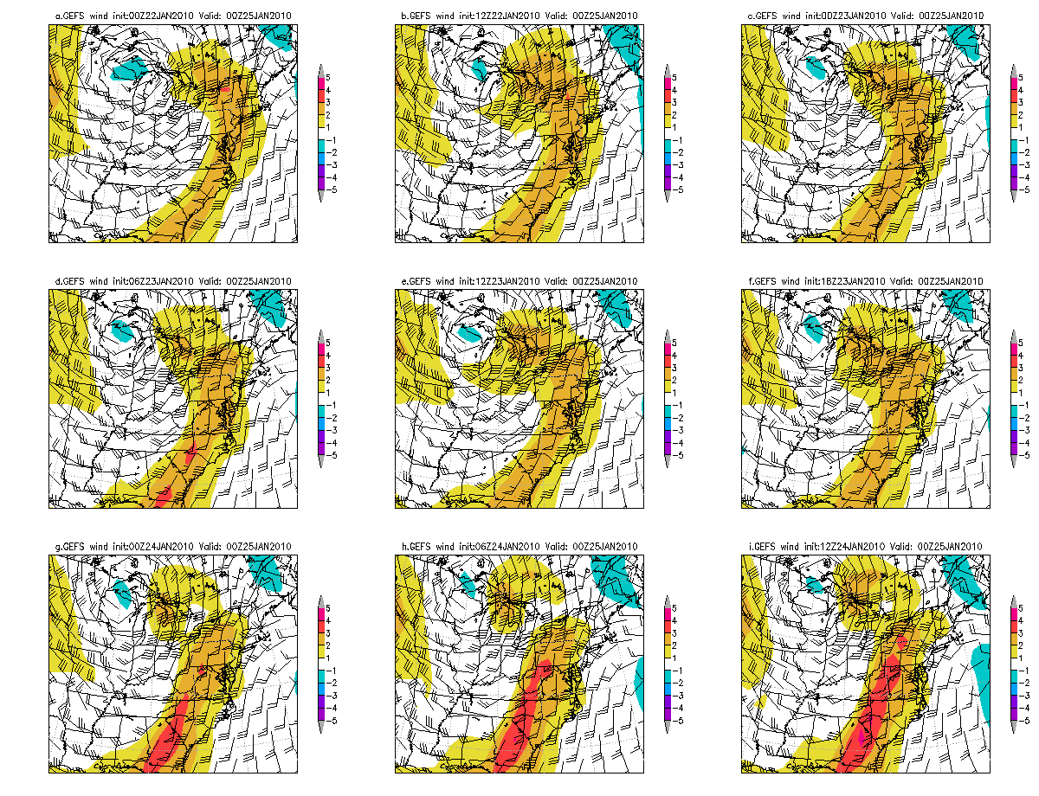
The Synoptic Pattern
A strong southerly flow
V-wind anomalies ahead of a generally N-S frontal zone
Plumes of high PW air in close proximity to the v-wind anomalies
Produce most of the big 4+ inch rainfall events
Well predicted pattern in the NCEP Models
The details may vary see an ensemble near you!

Slide 13
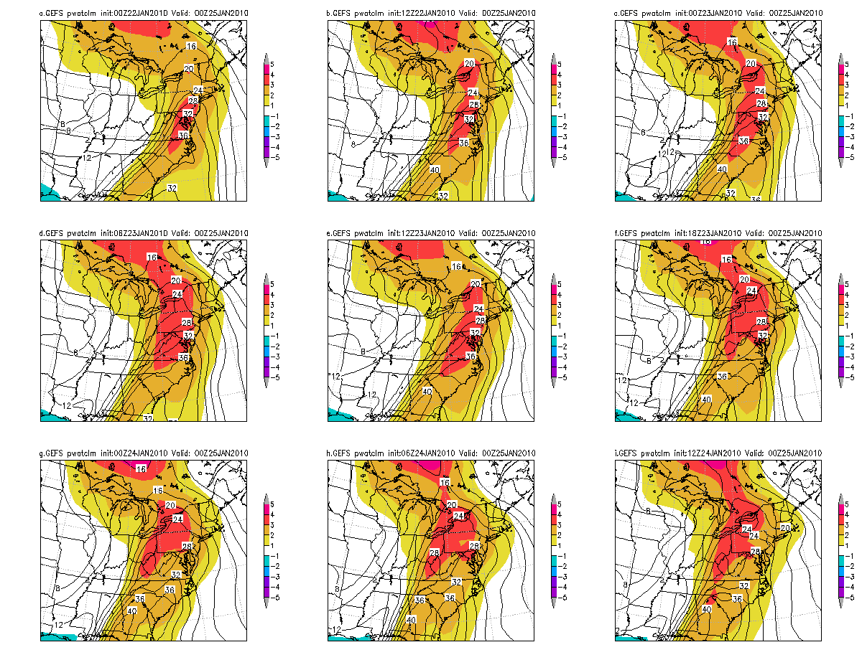
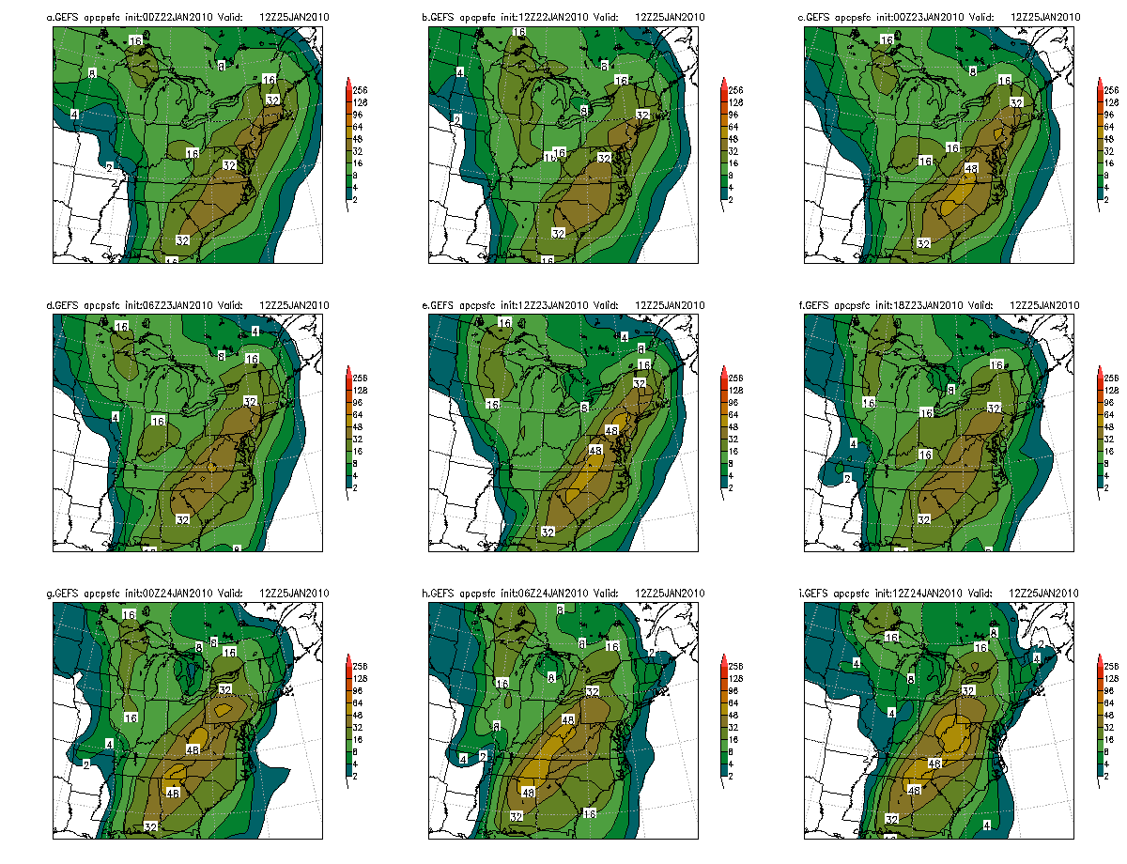

Slide 14
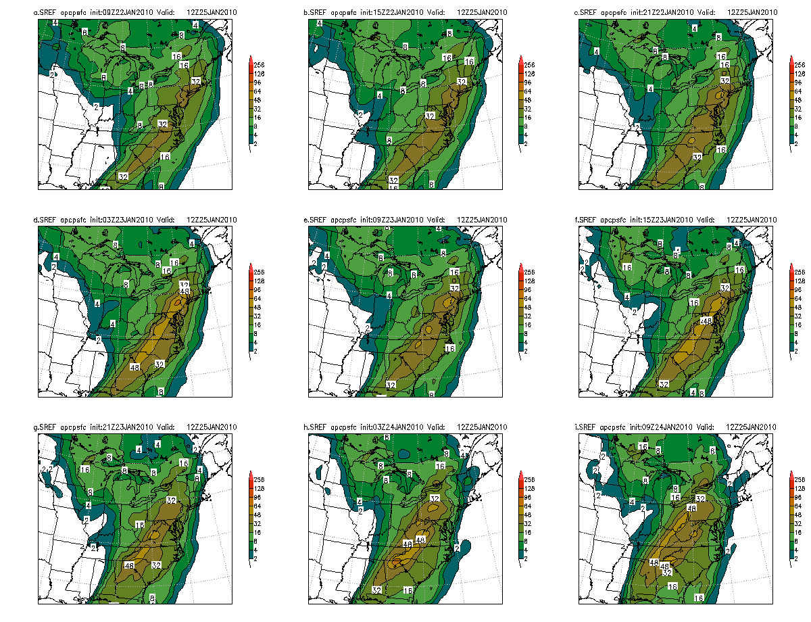
SREF has more details→sharper edges too!

Slide 15
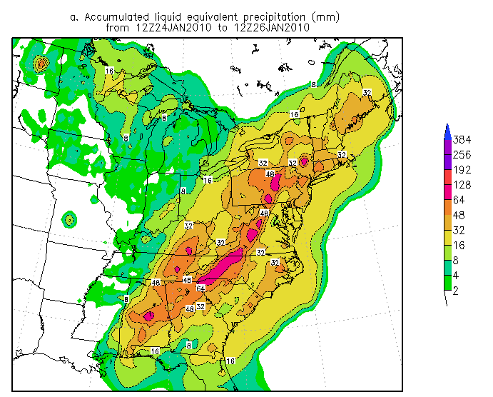
The rainfall Sharp edges for the heavy rainfall

Slide 16
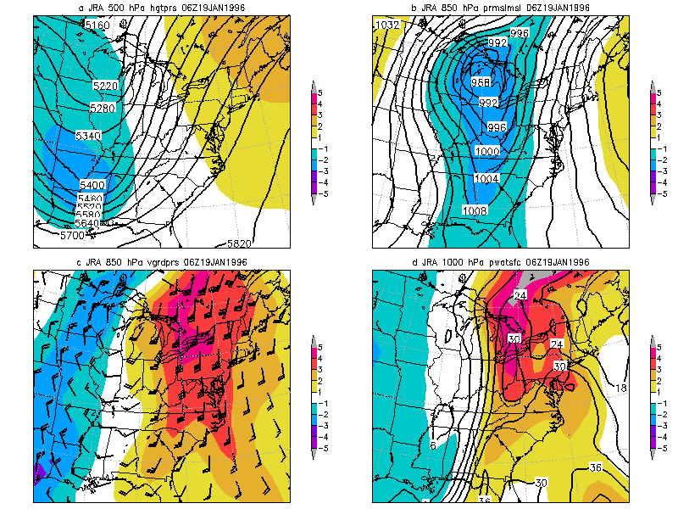
Classic Synoptic Example

Slide 17
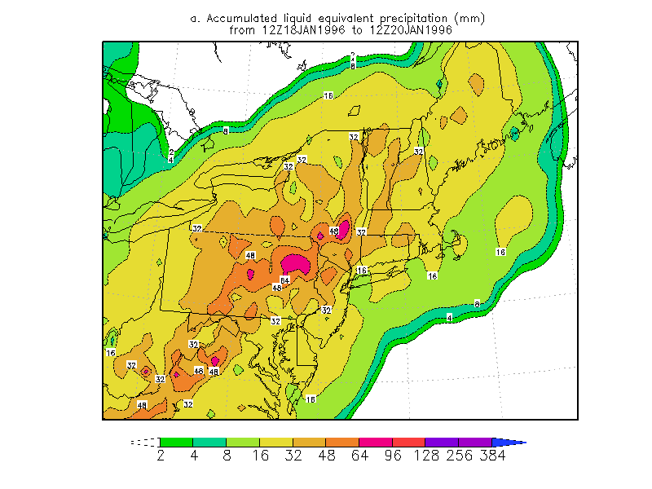
19 January 1996 QPE

Slide 18
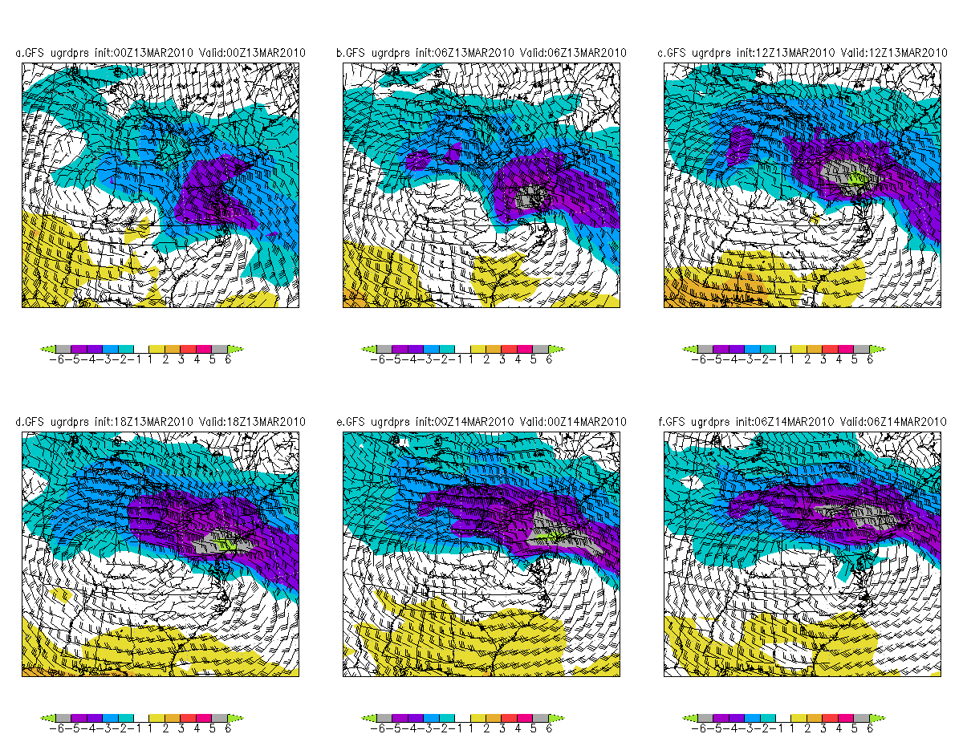
The Frontal Pattern
A strong easterly flow
Negative u-wind anomalies on the cool side of an E-W frontal zone
Plumes of high PW to east
Produce many 1-4 inch rainfall events
Well predicted pattern in the NCEP Models
The details may vary see an ensemble near you!

Slide 19
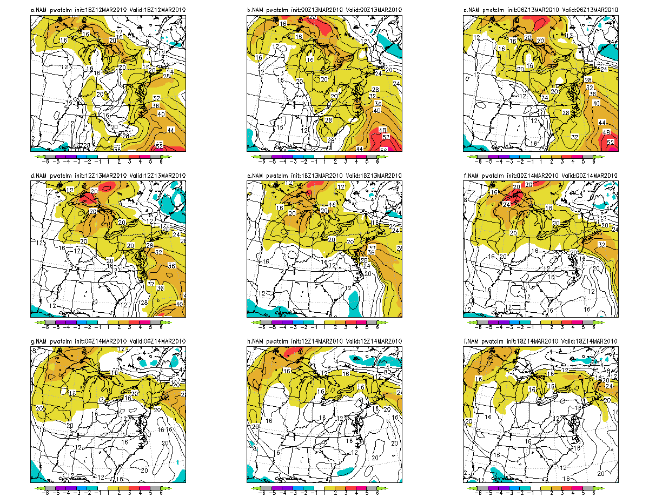

Slide 20
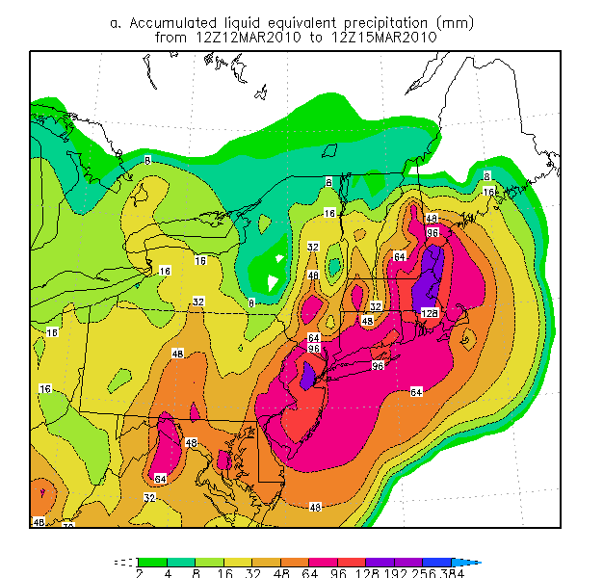
The QPE→ Lots of terrain influenced details

Slide 21
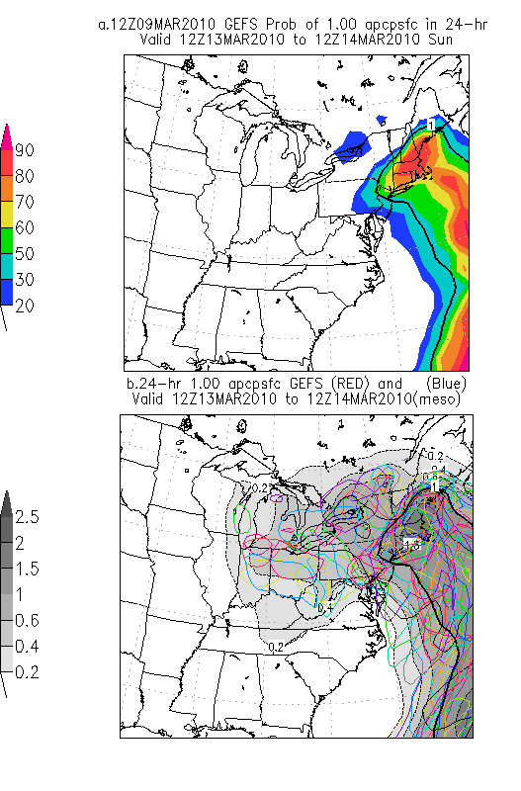
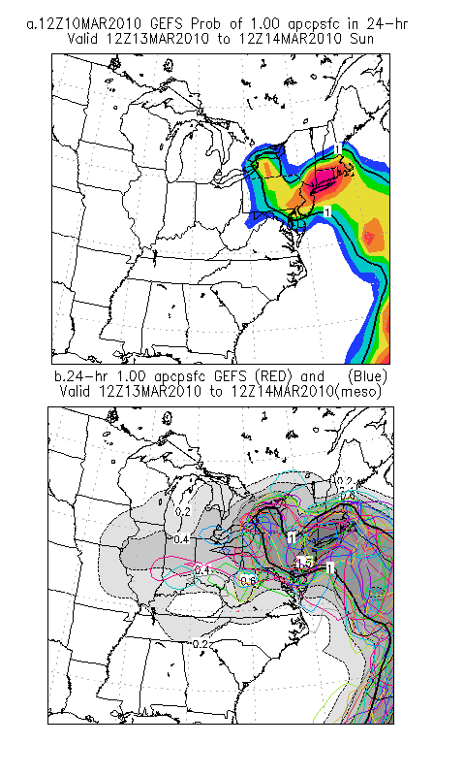
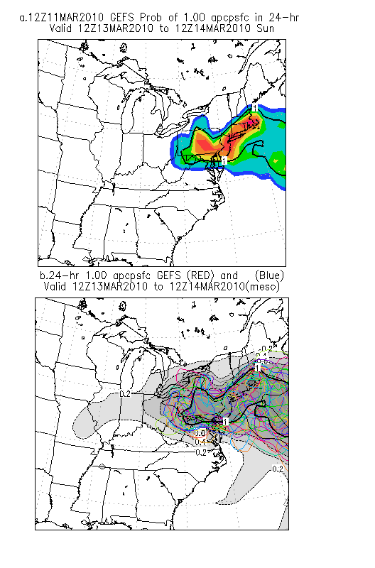
Forecasts had sharp edges

Slide 22
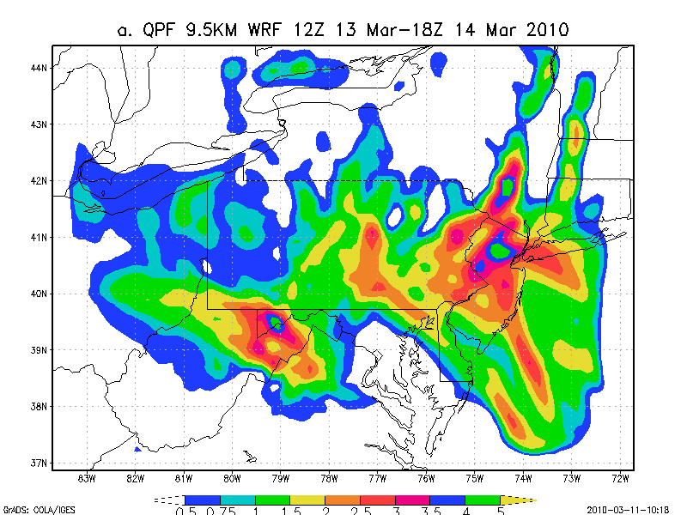
Downscaled model runs showed 00Z 11 March Terrain effects and lots of “edges”

Slide 23
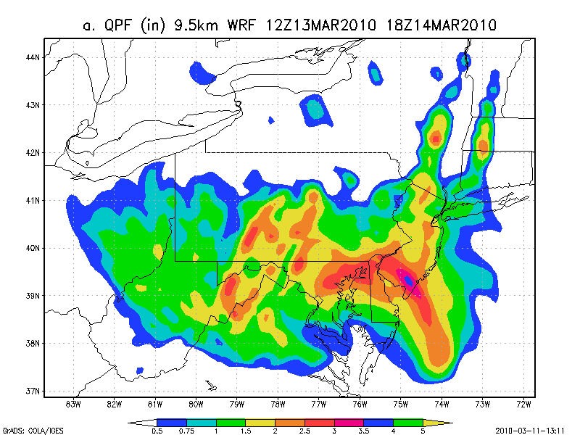
12Z 11 March Downscaled GFS details changed

Slide 24
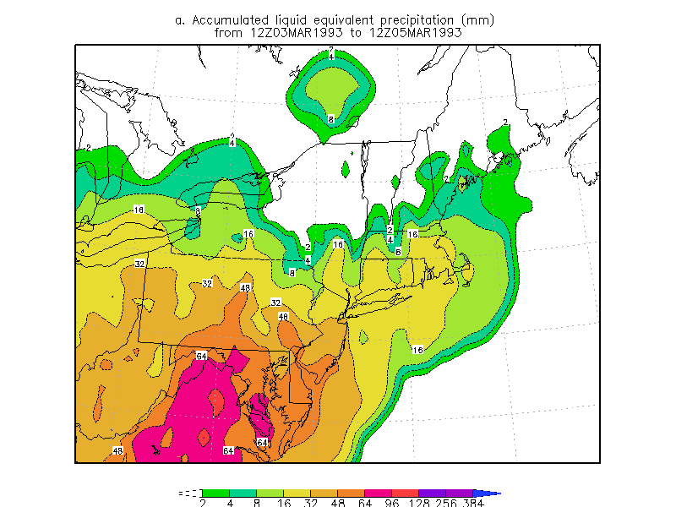
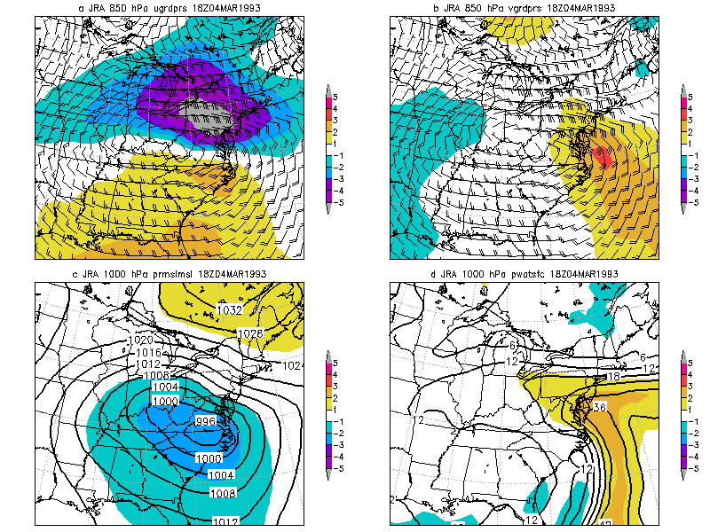
Big Event from the Past sharp edges too!

Slide 25
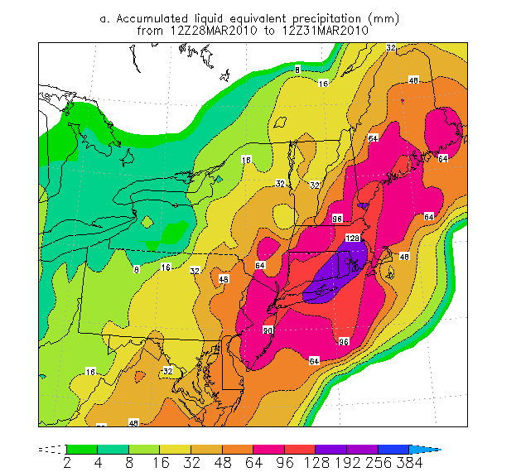
The worse case events
A synoptic that transitions to a frontal event
You can get really big rainfall amounts
29-30 March 2010
The synoptic with Tropical wave
Deadly rainfall amounts
Think June 2006!

Slide 26
Those Pesky edges Try Wisk the edge remover
All these events had sharp edges
So did the forecasts
Life along the edges is hard
Easy in the high probability areas
Heard on the edges→ shorter forecast ranges give better probabilities and confidence

Slide 27
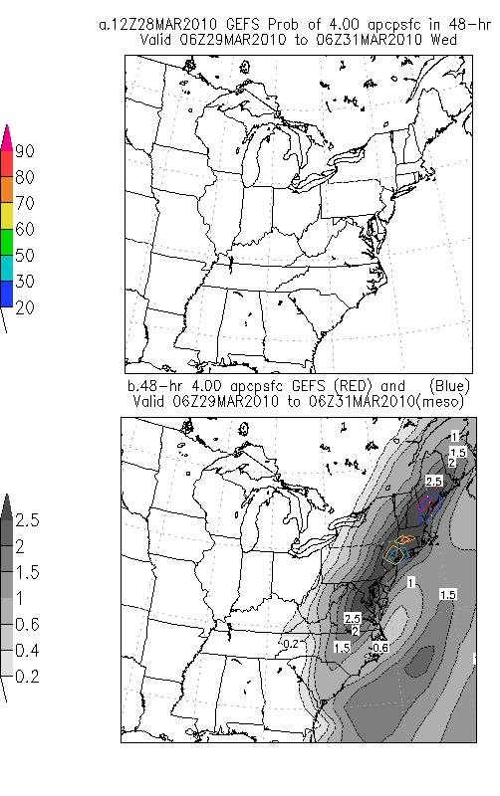
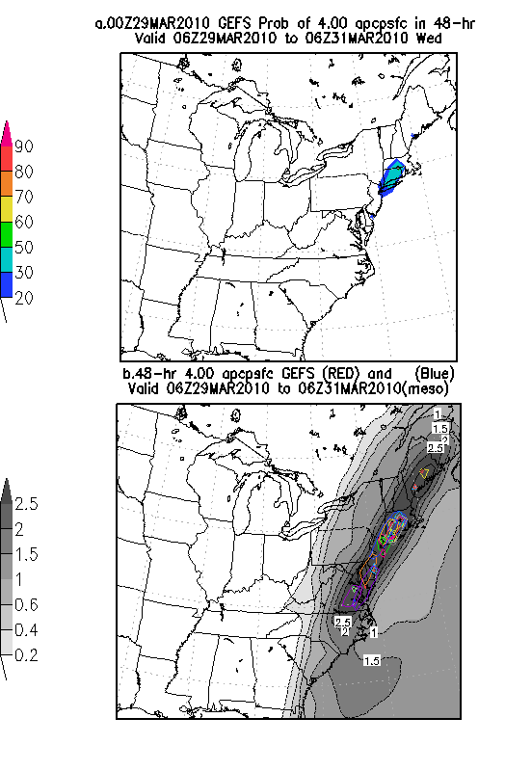
More Pesky edges for a record event

Slide 28
Review “embrace the uncertainty and patience is your ally”
There is uncertainty associated with ALL forecasting
Heavy rainfall
Heavy snow
Severe weather you name it….
The models and EFS can predict the patterns for event types
But the details are elusive often elusive
There is uncertainty and there will always be uncertainty
The patterns produce high probability areas→ confident forecasts
The patterns can produce sharp edges→ uncertain forecasts
Embrace the uncertainty along the edge → be patient
Shorter lead-time warnings take patience and courage
Avoid hubris and avoid that Titanic unsinkable sense of being.

