Slide 1
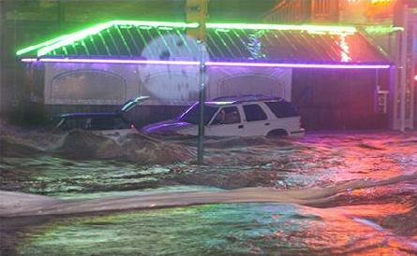
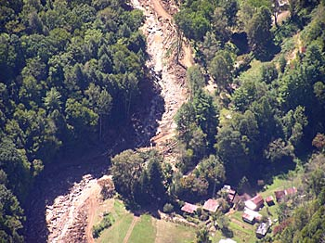
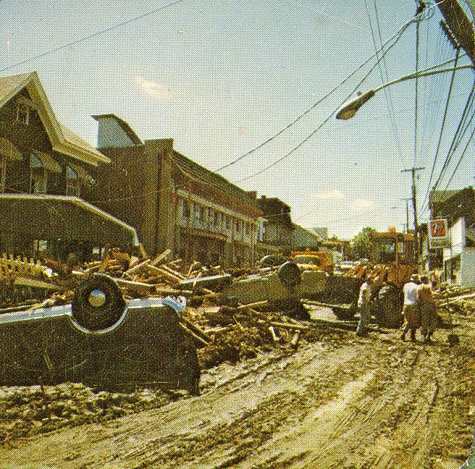
Flash Flood Forecasting
What is a Realistic Expectation for Warnings?
Peeks Creek, NC, 2004
Richmond, VA, 2004
Matt Kelsch, Hydrometeorologist
UCAR/COMET, Boulder, Colorado
NWS Eastern Region Flash Flood Conference 03 June 2010
Johnstown, PA, 1977

Slide 2
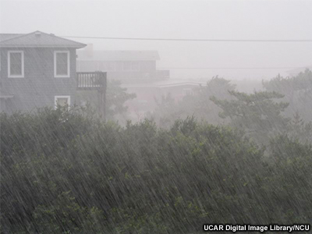
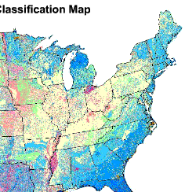
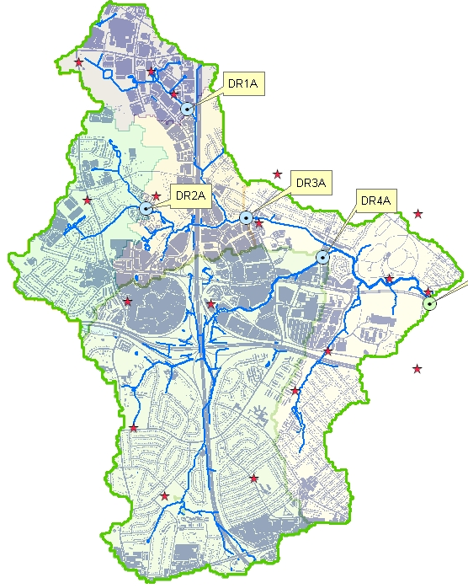
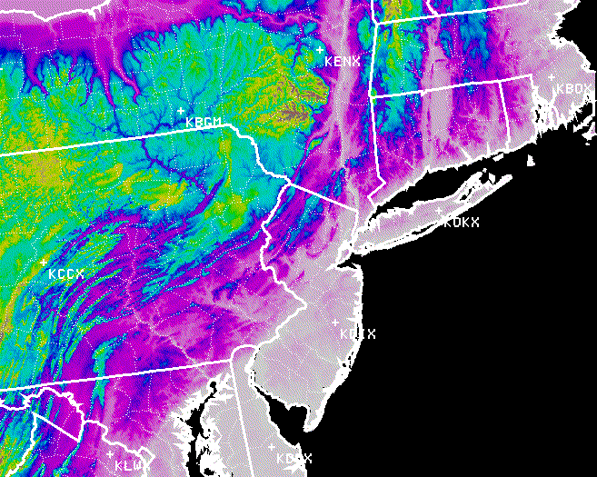
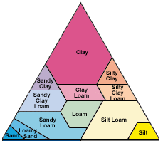
Flash Flood Forecasting
The Operational Challenge
A flood where the causative rainfall and the runoff occur on the same time and space scales.
Intense rainfall
Hydrologically sensitive basin
  Urban/altered
  Low infiltration (surface conditions)
  Steep
Soil Classification
To issue effective area- and time-specific warnings:
Accurately forecast rainfall intensity, timing, & coverage
Anticipate runoff complexity (variable runoff efficiency, structural failures, debris)

Slide 3
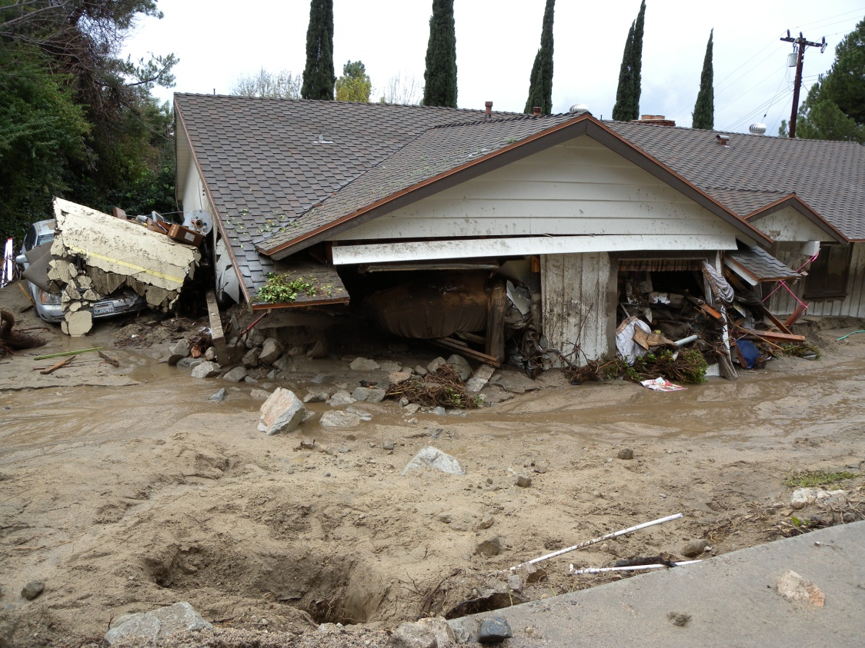
Flash Flood Forecasting
What is a Realistic Expectation for Warnings?
Is our best guidance an enhanced watch phase?
Ready-Set-Go:
Ready (general watch, counties)
Set (more specific watch, groups of basins, and/or more specific timing, anticipated structural failure)
Go (warning- based on observations, basin specific)
Provided by WFO Oxnard, CA
Southern California flash flood/mudflow
6 Feb 2010

Slide 4
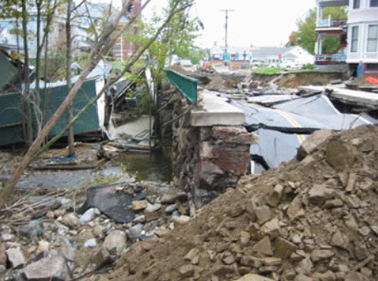
Flash Flood Forecasting
What’s Needed for Improved Warnings
Meso-β scale rainfall,
and,
High-resolution, accurate & detailed runoff information, and,
Good, well-planned interagency communication
Hinsdale, NH, 9 Oct 2005

Slide 5
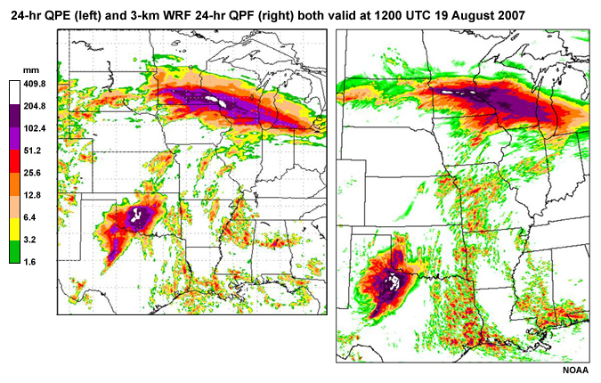
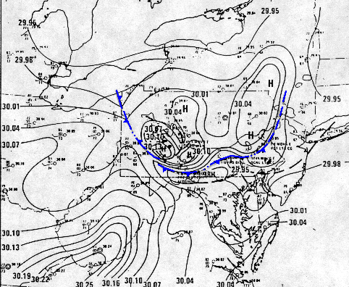
Flash Flood Forecasting
Are QPFs up to the Task?
MOISTURE AND LIFT
Concentration of a large amount of MOISTURE into a localized area of LIFT
Anomalous moisture
Moisture replenishment
Tropical maritime connection
Focus area of lift
Do our NWP models provide guidance that is representative of the flash flood scale?
Steering flow
Cells dissipate
⬇
Johnstown
cool
dome
Convective cells repeatedly grow and mature on cool side of boundary ➔
Warm moist
Moisture ➔ focus into boundary

Slide 6
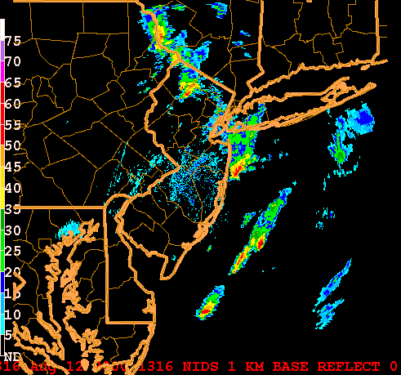
Flash Flood Forecasting
A Good Analysis of Data is the Place to Start
Convective cells repeatedly grow and mature along terrain
Cells dissipate
⬇
Steering flow
Madison County, VA, June 1995
Hurricane Fran, Sep 1996
Sparta, NJ, Aug 2000
Peeks Creek, NC, Sep 2004
Moisture focus into boundary

Slide 7
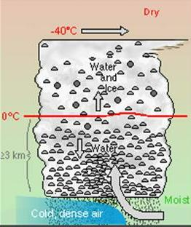
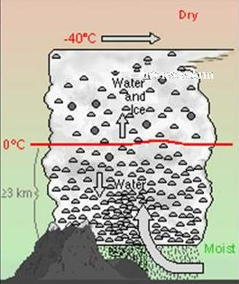
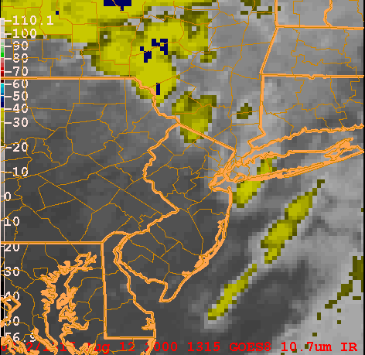
Flash Flood Forecasting
Recognize Scenarios for Enhanced Rainrates
Warm Rain Process
Deep warm layer (> 3 km)
Anomalous moisture
Rapid moisture replenishment
Enhanced Low level lift

Slide 8
Flash Flood Forecasting
Small Basin with Respect to Wet Footprint
⇐ Minimal flash flood threat
Increased flash flood risk for small basins completely covered by intense precip area ⇒
Provided by Bob Davis

Slide 9
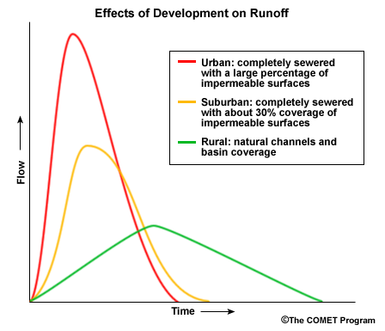
Flash Flood Forecasting
Flash Floods and Urbanization
Urbanization: the two biggies…
More Runoff: Increased coverage of impermeable surfaces
More Rapid Runoff: helped by storm drain systems, the road grid, stream channelization
Flood stage

Slide 10
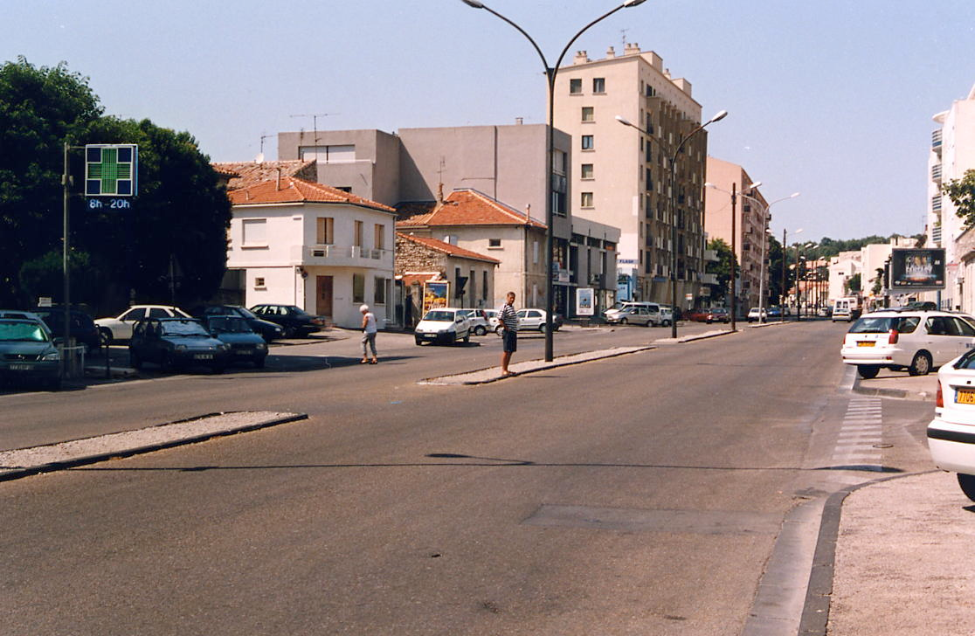
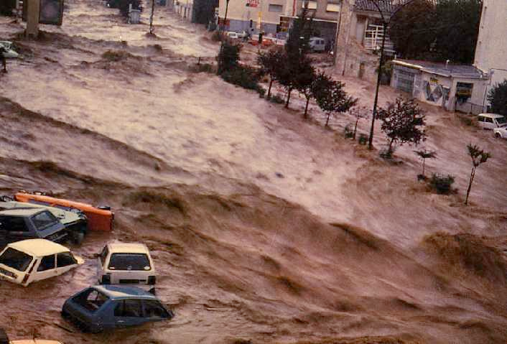
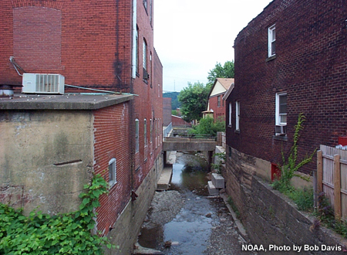
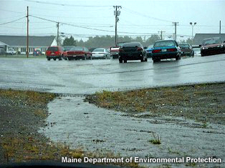
Flash Flood Forecasting
Flash Floods and Urbanization
Decrease roughness
Decrease infiltration
Increase stream density
  Roads, stormwater infrastructure
Increase slope
  Remove meanders

Slide 11
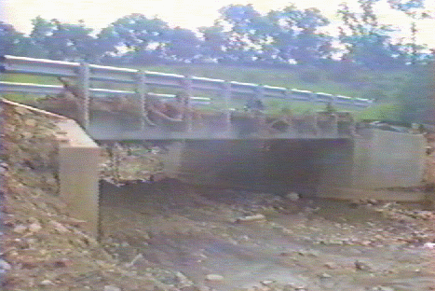
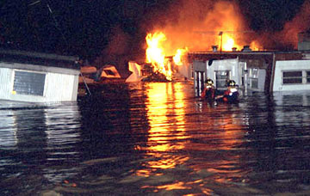
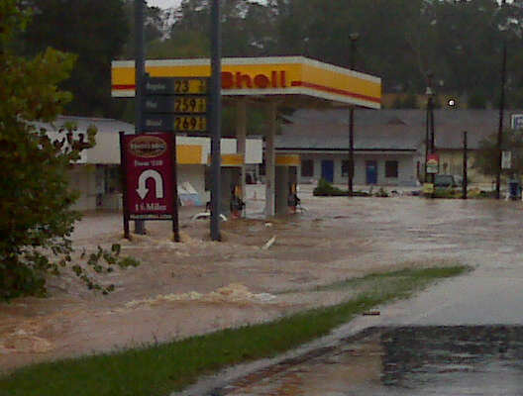
Flash Flood Forecasting
Flash Floods and Urbanization
Other factors:
Debris clogs
Altered/redirected channels
Hazardous material
Fort Collins
28 July 1997
Rapidan River, VA, Jun 1995
Cheyenne WY, 1 Aug 1985
Atlanta Metro, 21 Sep 2009
Provided by WFO Peach Tree City , GA

Slide 12
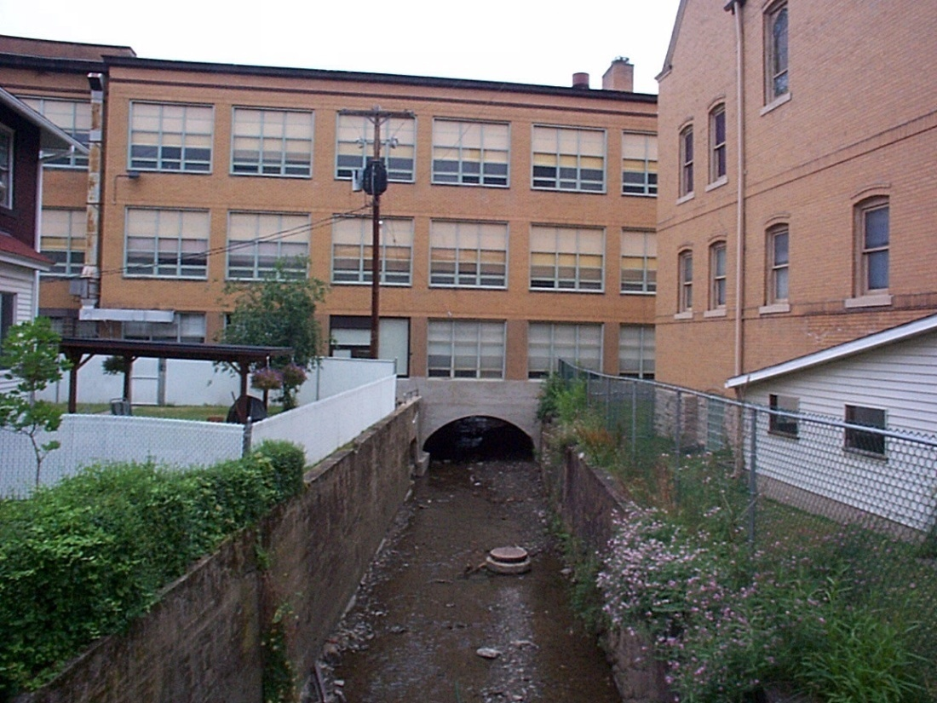
Flash Flood Forecasting
Urbanization Impact on Flash Flood Frequency
Urban streams often need to hold 2-3X pre-urban volume
Many urban streams are not permitted to become wider/deeper
Flash floods at lower precip threshold
More frequent flash floods
Photo by Bob Davis, Pittsburgh

Slide 13
Flash Flood Forecasting
The Baltimore Study (Princeton University)
Moore’s Run: 9 sq km
Surface stream channel mostly replaced by storm sewer network
⬅ Flood inundation in lower Moores Run on 13 June 2003
Dr. James Smith, Princeton University

Slide 14
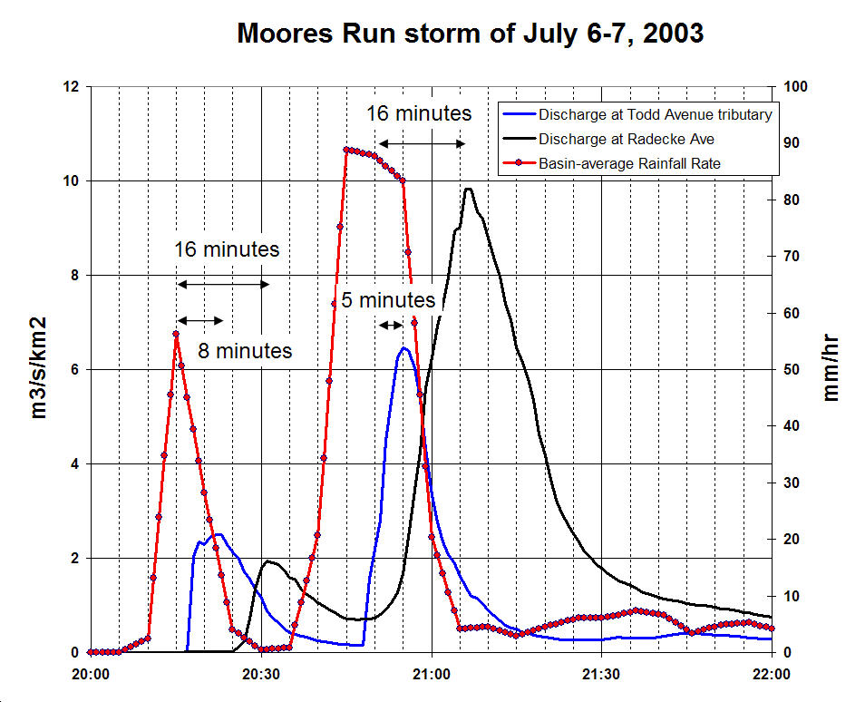
Moores Run Rainfall and Discharge 13 June 2003
Rain = 42 mm
Runoff = 17 mm
Do we really have the information to issue flash flood warnings in very fast-response basins?
Obtained from Dr. James Smith, Princeton University

Slide 15
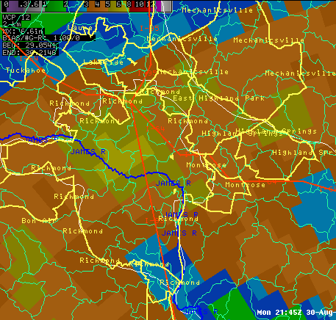
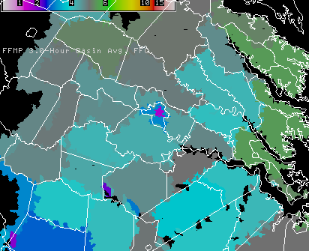
Flash Flood Forecasting
Richmond, 30 August 2004
Up 12 inches of rain in 8 hr, about half in 3 hr
Shockoe experienced 8000 cfs (return period >500 yr)
Altered 3h FFG for City of Richmond

Slide 16
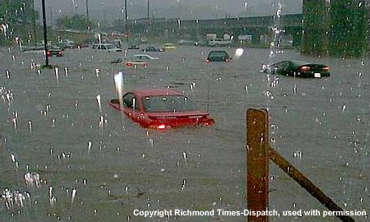
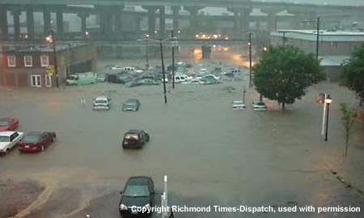
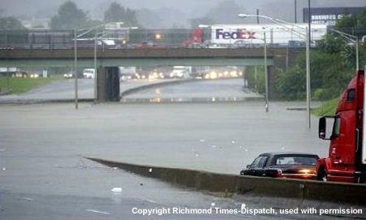
Flash Flood Forecasting
Richmond, 30 August 2004
Turn around don’t drown doesn’t work if you’re stuck in traffic as the water rises
The forecast “goal” is to provide information
that encourages people to avoid an area

Slide 17
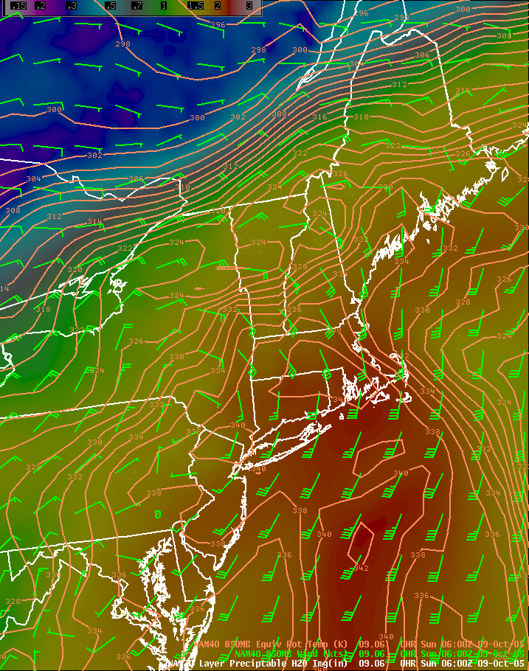
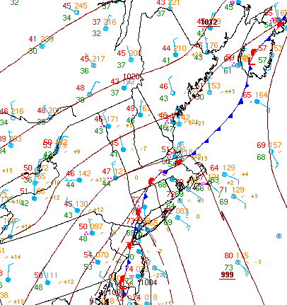
Flash Flood Forecasting
Larger Scale Events: Area Flood or Flash Flood?
PW (image)
850 wind
850 Theta-e
Steering flow
Convective cells repeatedly grow and mature on cool side of boundary ➔
Moisture ➔ focus into boundary

Slide 18
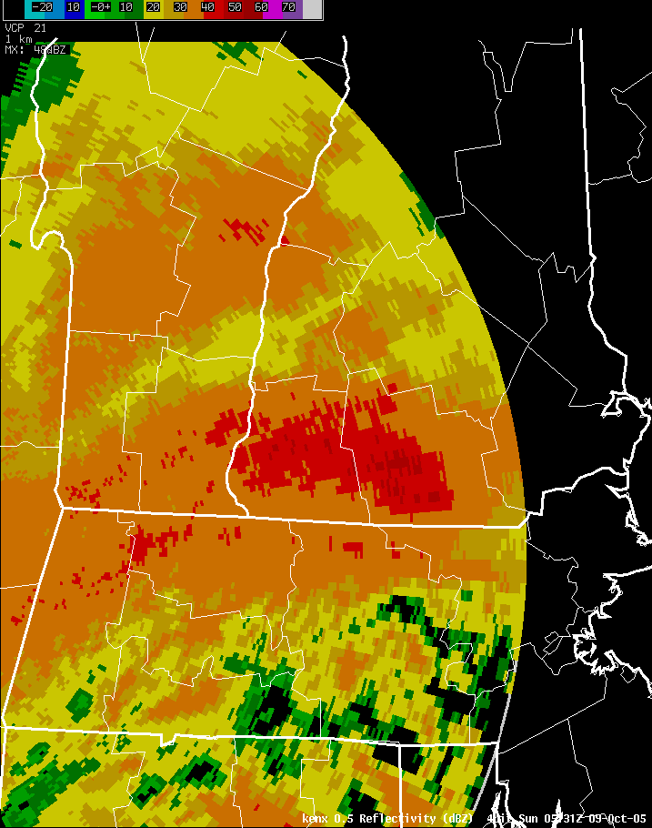
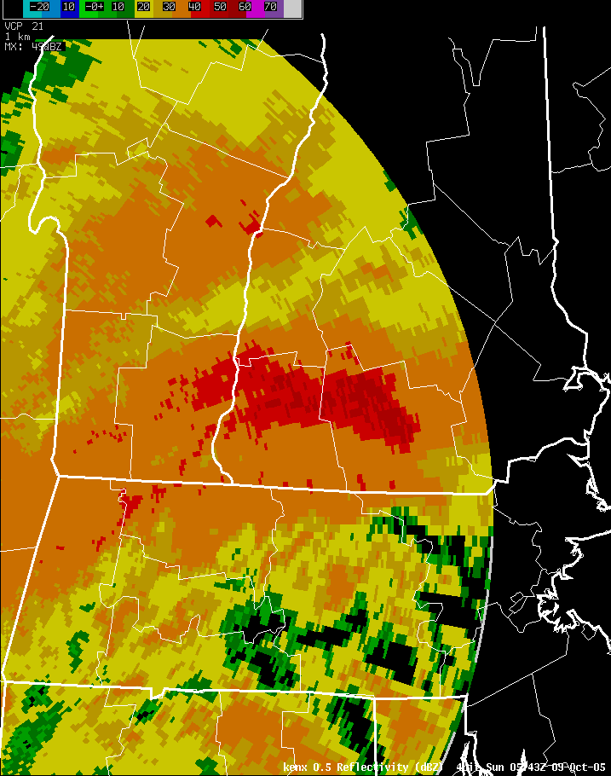
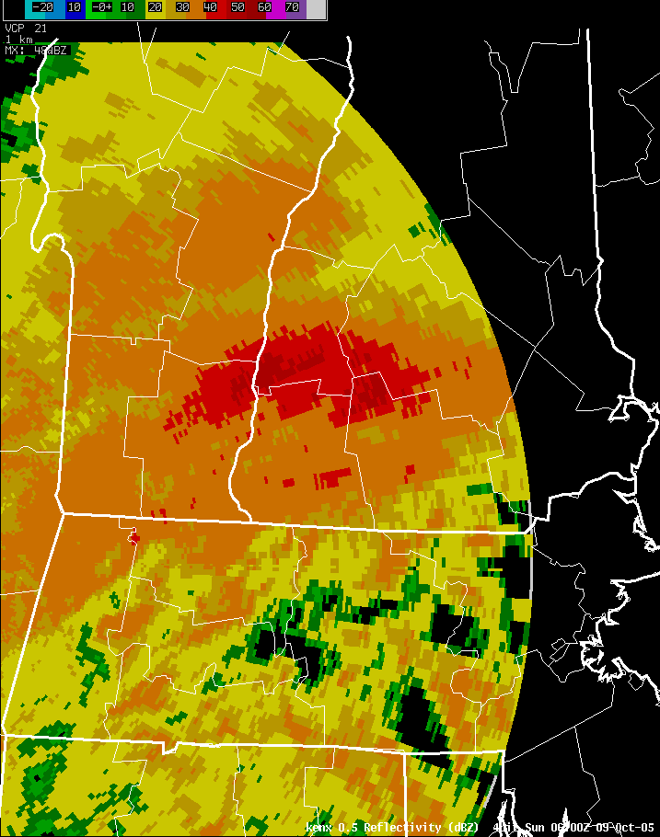
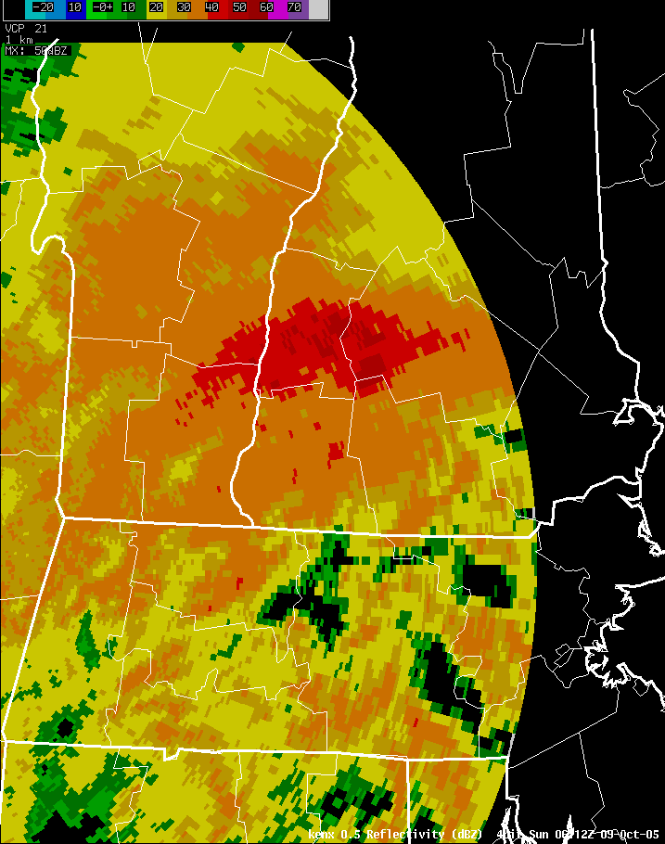
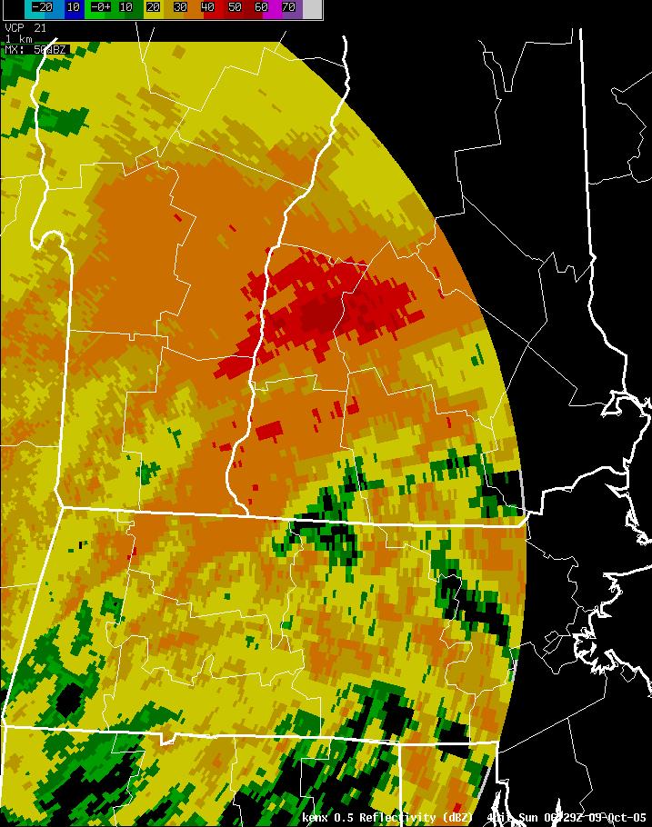
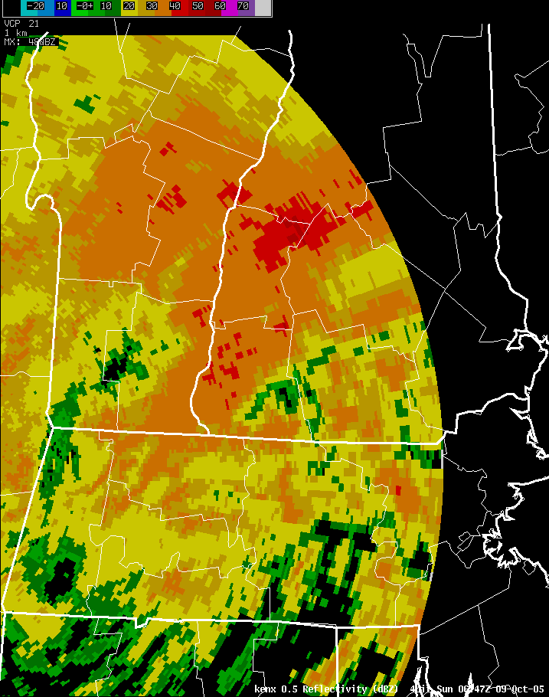
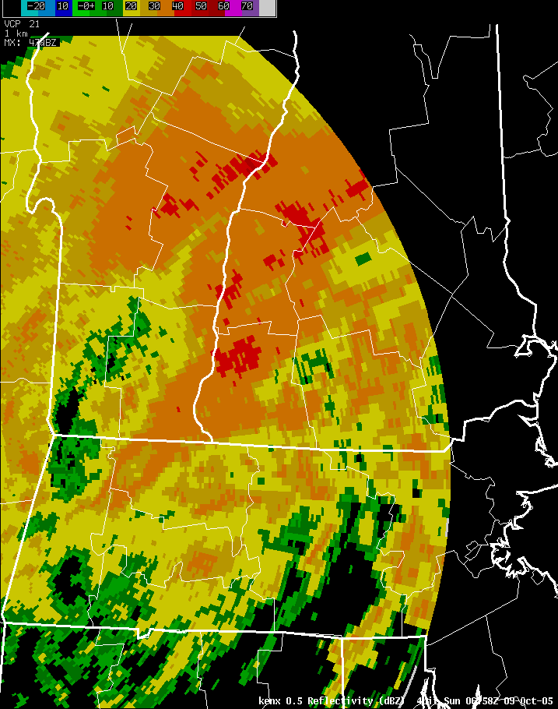
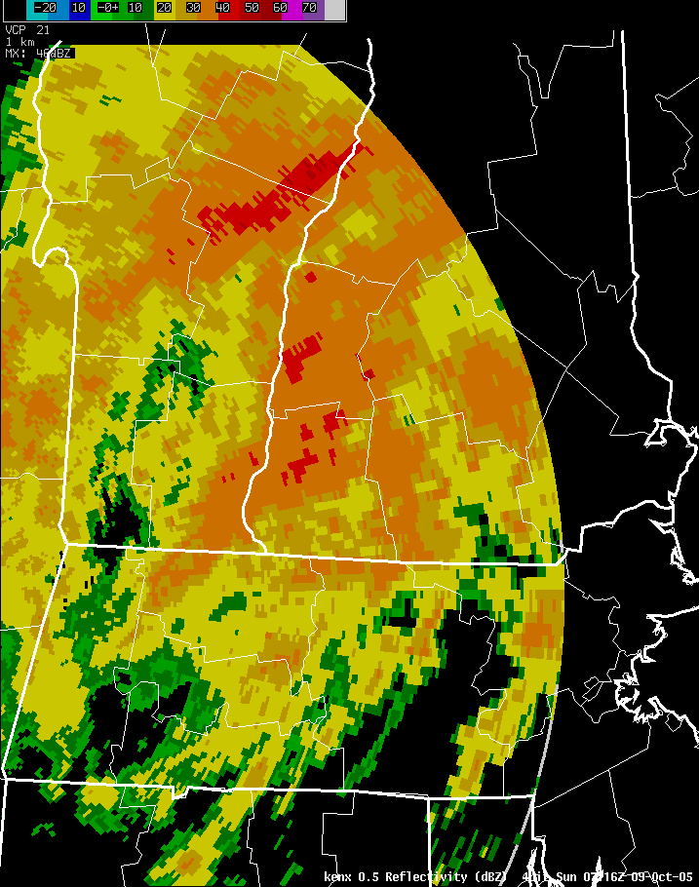
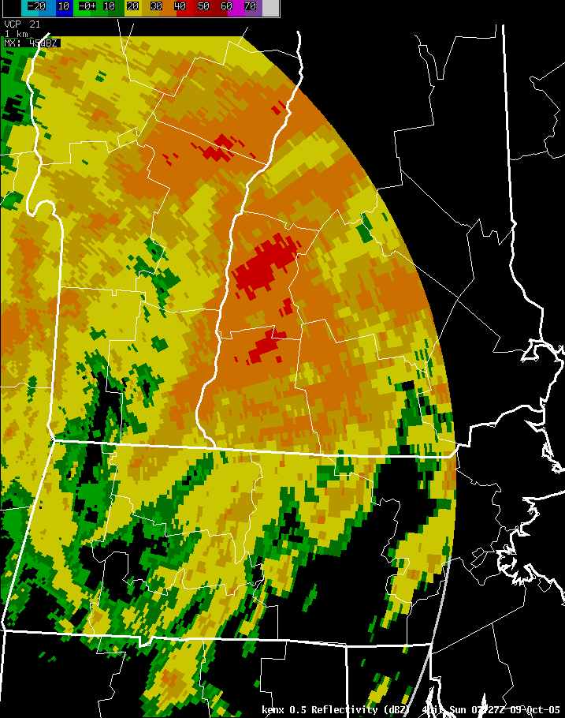
Cheshire County, NH
9 Oct 2005
Albany, NY, WSR-88D
Steering flow
Moisture ➔ focus into boundary

Slide 19
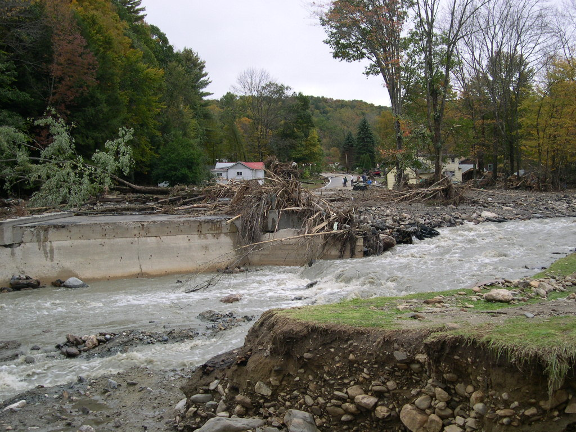
Cheshire County, NH, 9 Oct 2005
In large-area intense rains, structural failures are sometimes the cause of severe local flash flooding
Provided by WFO Taunton, MA

Slide 20
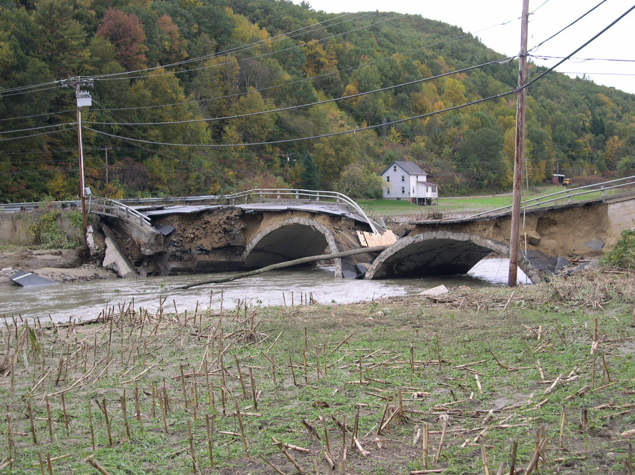
Cheshire County, NH, 9 Oct 2005
Provided by WFO Taunton, MA

Slide 21
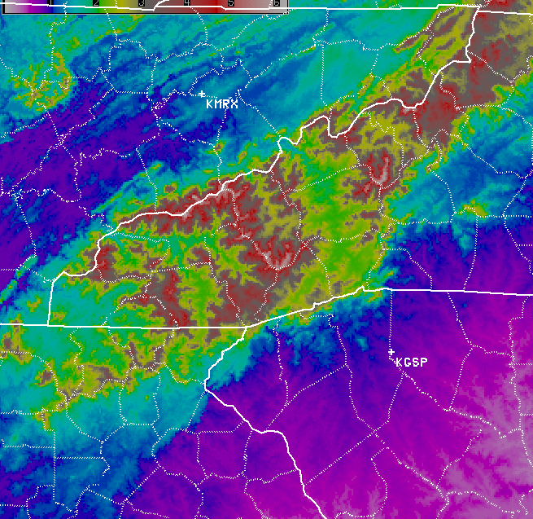
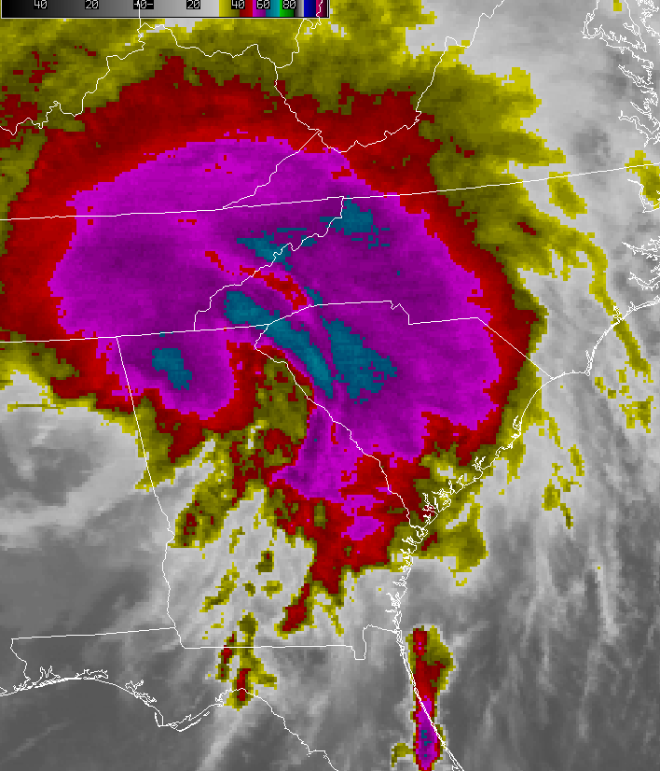
Flash Flood Forecasting
Hurricane Ivan Event, 16-18 Sep 2004
Tropical moisture advected into area as the circulation of Hurricane Ivan moves northward to the west of North Carolina
Orographic lift enhances precip
Previously wet soils increase runoff and potential for slope failures

Slide 22
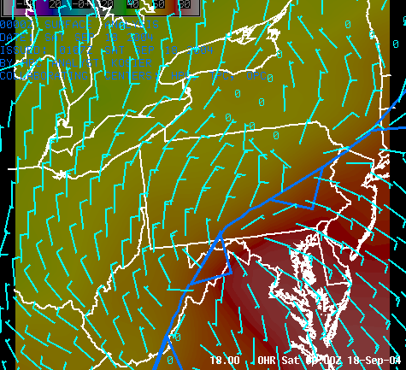
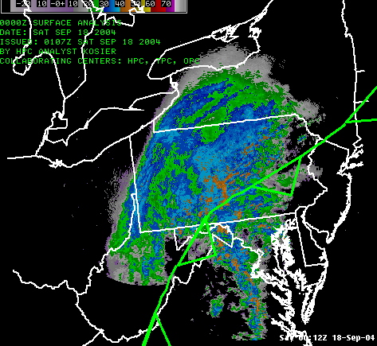
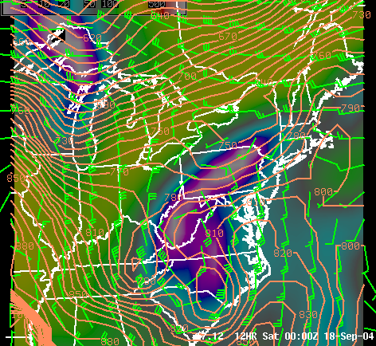
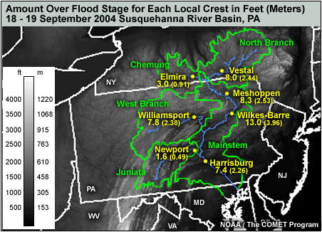
Flash Flood Forecasting
Hurricane Ivan Event, 16-18 Sep 2004
305K sfc:
Pressure
wind
Cond. Press. deficit
Remnants of Ivan continue north in middle Atlantic.
Strong frontogenesis combined with tropical moisture result in large area of excessive rainfall on cool side of the front.
Previously wet soils increase runoff coefficients.
Flash floods are followed by major river floods.
Sfc wind and Td

Slide 23
For COMET Training: http://www.meted.ucar.edu/
Flash Flood Forecasting
Effective time- and area-specific warnings require:
  Accurate convective-scale QPF (not quite there yet)
  Accurate QPE (better, still some problem areas)
  Detailed and accurate runoff modeling (distributed models still evolving)
  Well-developed interagency communications
  Public education
  Special attention to sensitive, fast-response basins
    Deforestation
    Urbanization
Do we really have the ability to issue warnings with adequate lead time for all situations?
  Enhanced Watch phase?
  Warnings with guidance about confidence in timing/location
In regionwide flooding with local flash flooding, what do you issue?
Provided by WFO Taunton, MA

Slide 24

COMET training: http://www.meted.ucar.edu/
Flash Flood Forecasting
Peeks Creek, NC, 2004
Photo by Bob Davis, Pittsburgh
Richmond, VA, 2004
Matt Kelsch, Hydrometeorologist
UCAR/COMET, Boulder, Colorado
kelsch@comet,ucar.edu
NWS Eastern Region Flash Flood Conference 03 June 2010
Johnstown, PA, 1977

