Slide 1
Reconstruction of flood magnitude, inundation extent and flow patterns in an urban flood
Andrew J. Miller, University of Maryland, Baltimore County
James A. Smith, Princeton University
Mary Lynn Baeck, Princeton University
Paul Bates, University of Bristol
Tim Fewtrell, University of Bristol
Jeffrey Neal, University of Bristol
Katherine L. Meierdiercks, Siena College

Slide 2
Acknowledgements
National Science Foundation EAR-0208269
UMBC Center for Urban Environmental Research and Education (CUERE)
Institute of Ecosystem Studies (IES) and Baltimore Ecosystem Study (BES)
Maryland Department of Environment/FEMA
USGS/MD-DE-DC Water Science Center
Willis Research Network
Peter Nelson, Eliot Holland, Mike McGuire, Matt Ballantine, Jane Diehl, Tamara Newcomer, Peggy Preston, Craig Nelson, Andy Brett, Andy Lapetina, Alex Lester, Mike McNey, Alex Ntelekos, Garth Lindner, Matt Baker

Slide 3
Flash flood hazards in the Baltimore metropolitan area
Boy, workers swept to deaths as storm tears across state 3rd man missing, feared dead as rising water hits crew in Woodlawn culvert
Published on: November 20, 2003
Frank D. Roylance
An 11-year-old North Baltimore boy died in a stream while walking home from school and three workers were swept away by floodwaters at a culvert repair site in Woodlawn yesterday as heavy rains and thunderstorms turned urban streams into raging torrents.
The child, identified by police as Darryl McTier Jr. of the 6000 block of The Alameda, was walking home from school when he was caught in swollen Chinquapin Run. Firefighters found his body wedged in rocks about 300 feet south of Woodbourne
Water in culvert rose from inches to feet in a flash, police report Workers say two men were swept out by swift current that barred rescue
Published on: November 22, 2003
Laura Barnhardt and Sara Neufeld
The water flowing through the culvert under Interstate 70 where three construction workers were making repairs Wednesday was only 2 inches deep at first. About 2:30 p.m., as the rain started falling harder, the water rose to about 4 inches.
Within a minute, the project foreman told Baltimore County police, the pipe, which measures 8 feet in diameter, was three-fourths full.
The workers were still inside.
In a flash, the first worker was swept out. It looked as if he was swimming with
Articles from the Baltimore Sun, November 2003

Slide 4
Older urban watershed with buried streams and storm drains
Drainage area = 9.1 km²

Slide 5
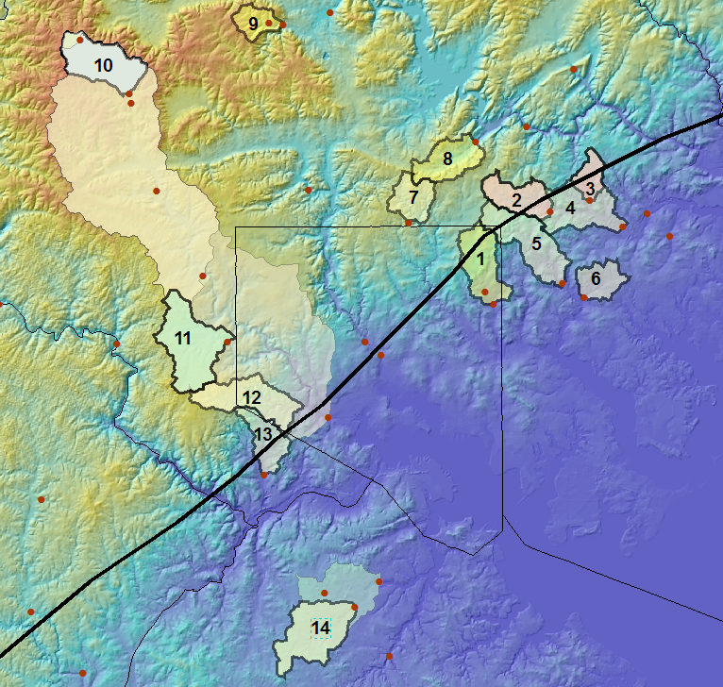
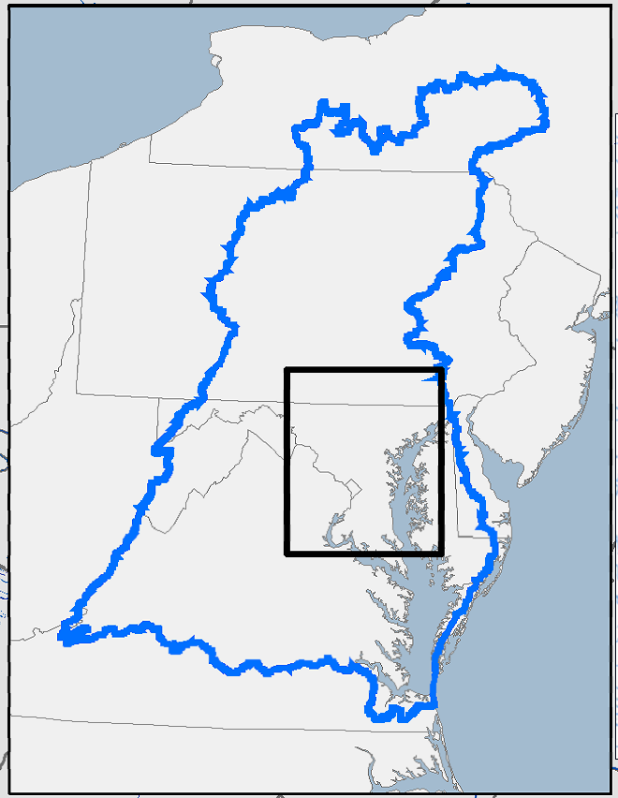
Baltimore area watersheds of
drainage area 3 to 20 km² with USGS stream gage records
Gwynns
Falls
Gwynns Falls at Delight
Dead Run
Moores Run
Fall Line

Slide 6
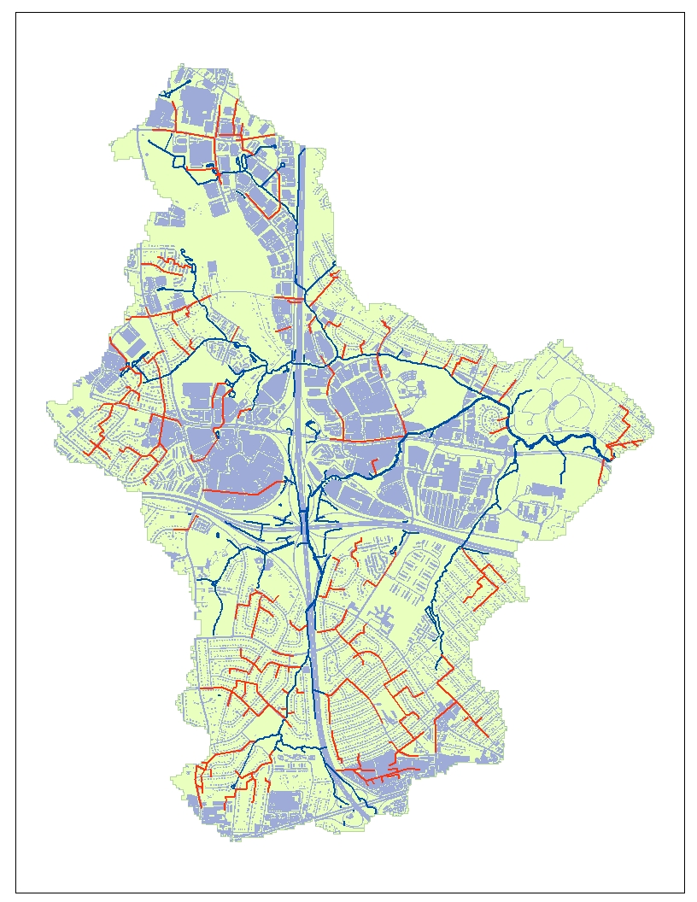
Blue – Surface drainage
Orange – Storm Drain
Dead Run watershed
Natural and artificial
drainage networks
Watershed hydrologic response is enhanced by impervious cover and a dense network of storm drains

Slide 7
1950’s-era suburban development with high impervious cover and limited stormwater management
Drainage area = 14.3 km²

Slide 8
Research on flood dynamics
Problem: Need for improved forecasts of flood-wave propagation, inundation extent, flood probabilities – especially in urban watersheds
Research tools and methods:
Rainfall fields (high-resolution weather radar, corrected using point measurements)
Observational analysis and mesocale modeling (WRF model) of warm-season thunderstorms
High-resolution topographic data to characterize channels and flood-prone areas
Field surveys of high-water marks and inundated area after floods
2-d hydraulic modeling to match observations and make predictions

Slide 9
Storm and flood of July 7, 2004
Dead Run
watershed

Slide 10
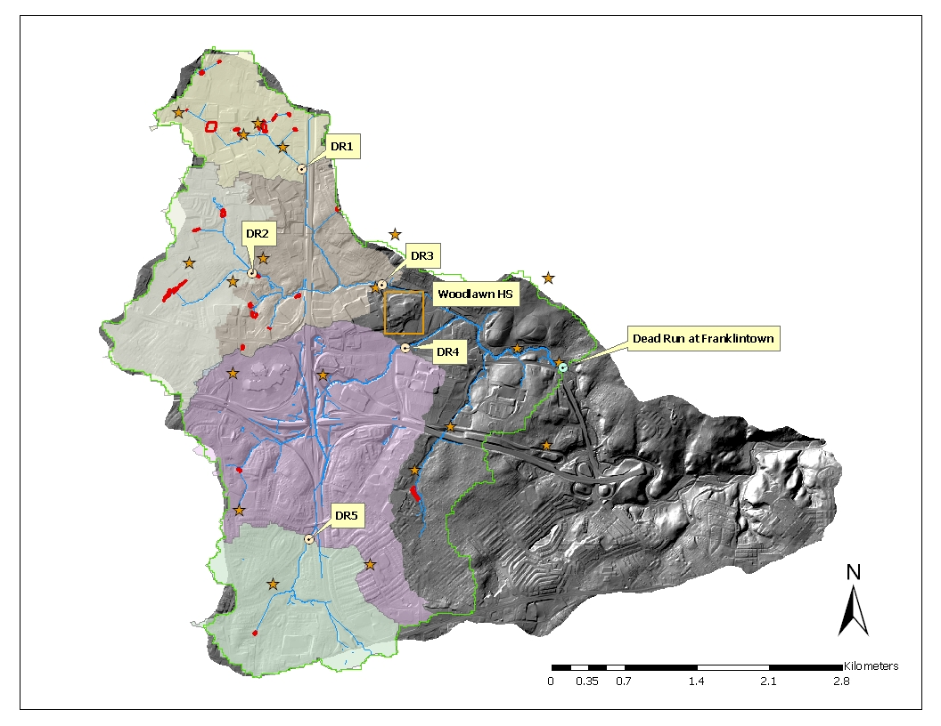
Dead Run Watershed

Slide 11
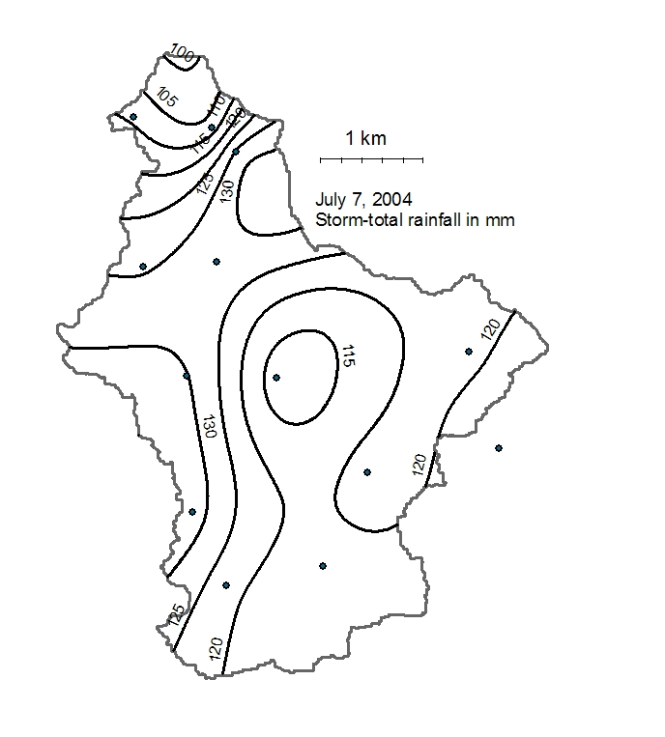
Contours based on storm-total rainfall at rain-gage network
Point totals used in bias-correction of WSR-88D record with 6-minute time intervals

Slide 12
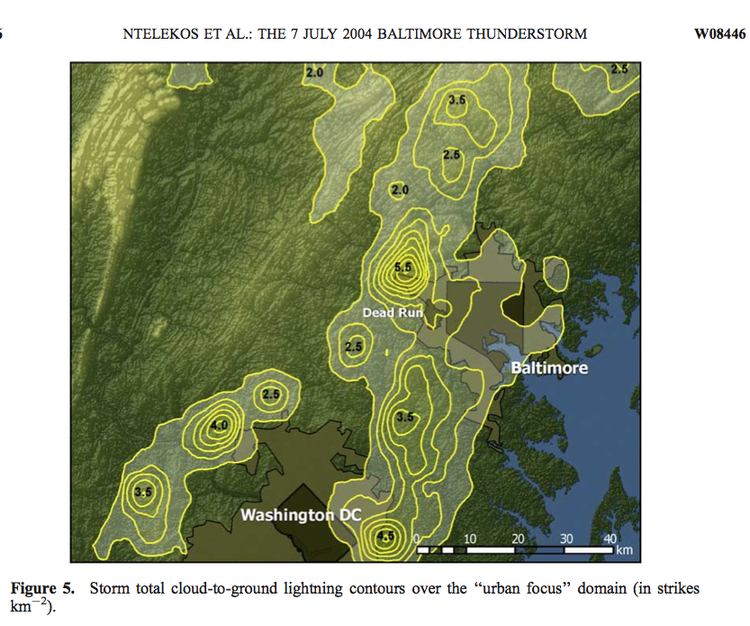
WATER RESOURCES RESEARCH, VOL. 44, W08446, doi:10.1029/2007WR006346

Slide 13
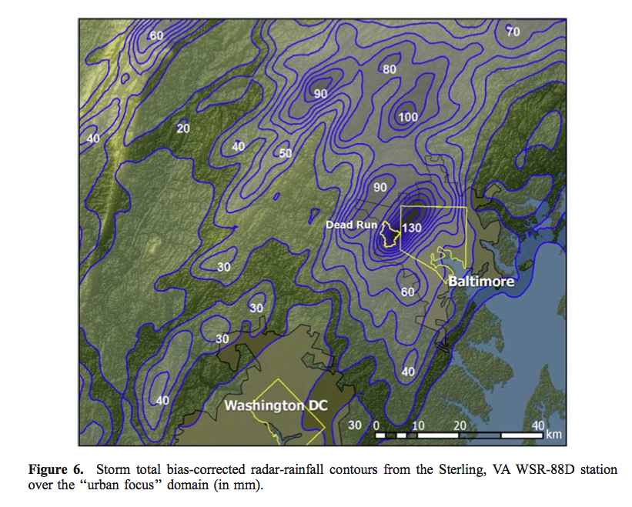
From Ntelekos et al., 2008, WATER RESOURCES RESEARCH, VOL. 44, W08446, doi:10.1029/2007WR006346

Slide 16
Maximum precipitation accumulation and recurrence intervals Dead Run Watershed, July 7, 2004
Duration | Maximum accumulation | Recurrence interval
(minutes) | (mm) | (years)
15 | 27.9 | 10
30 | 49.8 | 37.5
60 | 79.4 | 108
120 | 120.9 | 384
Dead Run at Franklintown stream gauge characteristic hydrograph response to a rainfall pulse is 60-75 minutes
Suggests that flood peak most likely responds to the 60-minute maximum accumulation and may have comparable recurrence interval

Slide 18
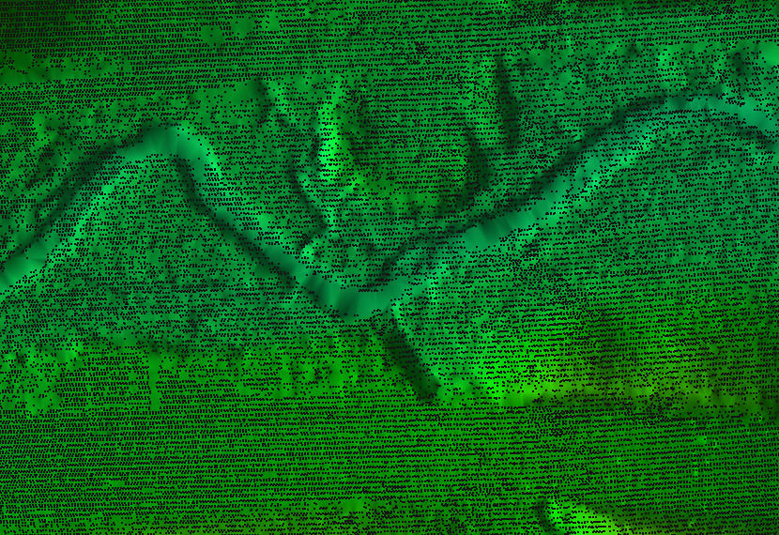
To model flood hydraulics, we need detailed topography. Coverage of LiDAR points along Dead Run – note prominent gaps in the channel…

Slide 19
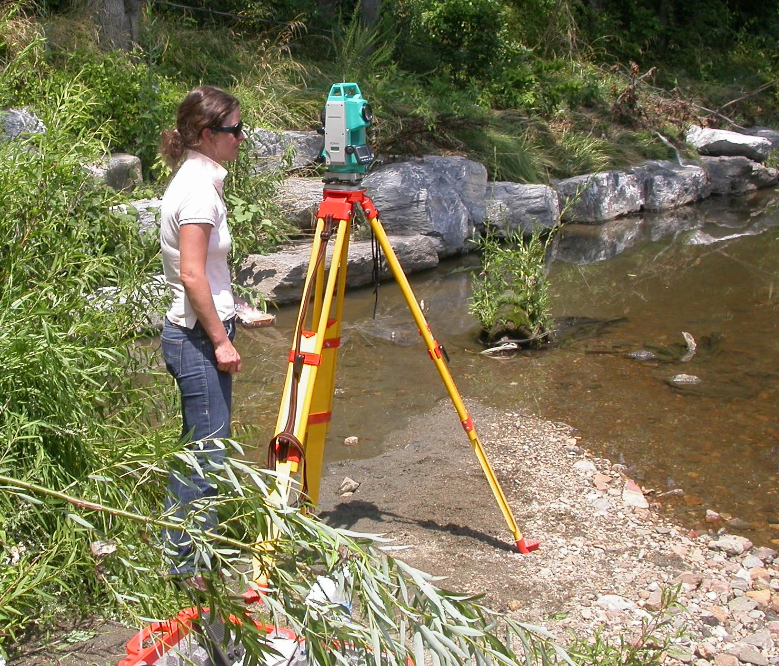
…which we fill by conducting field surveys with a total station.

Slide 20
Dead Run upstream of Franklintown gage
Channel data = field survey + LiDAR
Bank/floodplain data = LiDAR

Slide 21
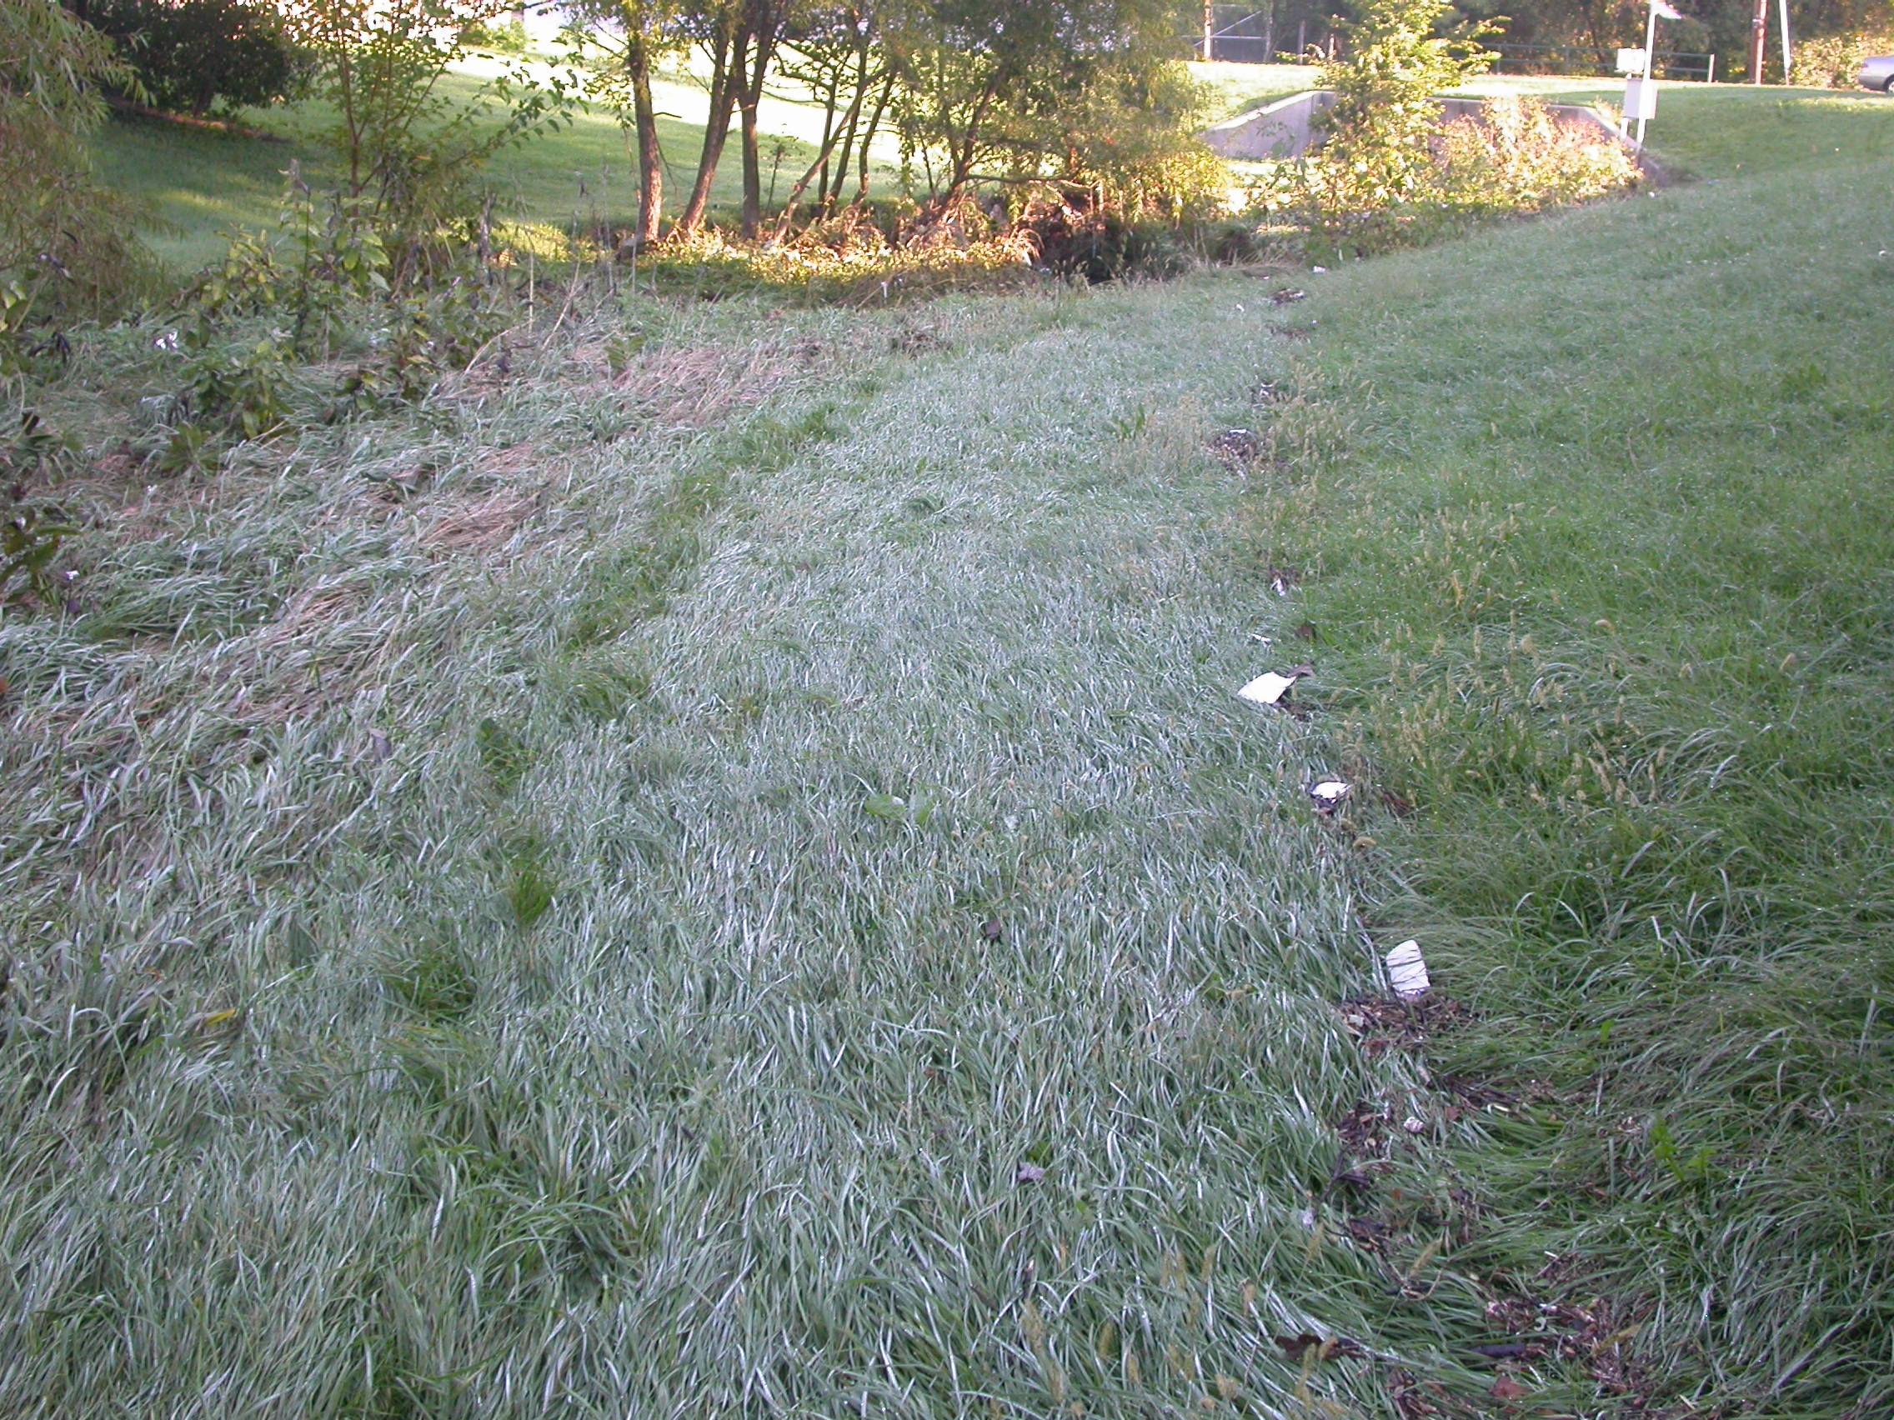
We then identify and survey high-water marks in the field
DR5 gage – high water line
Flood of 9-27-08

Slide 22
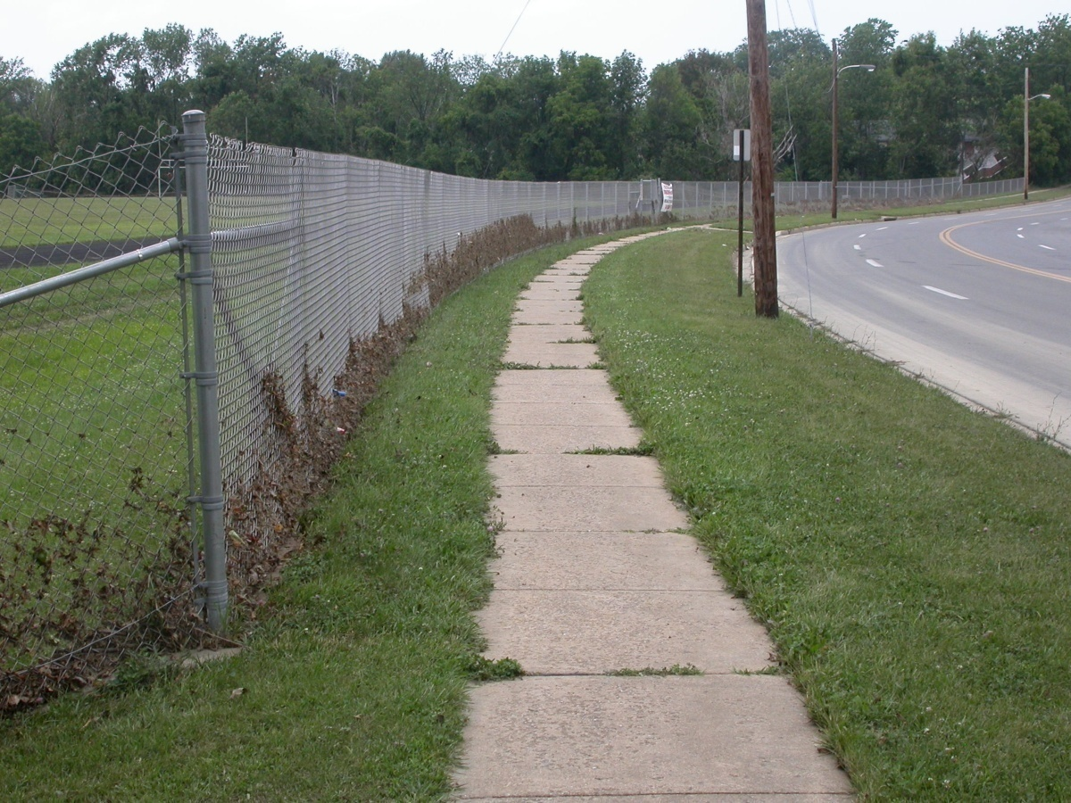
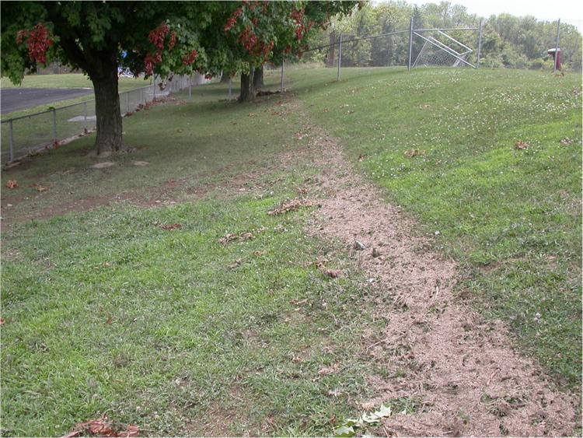
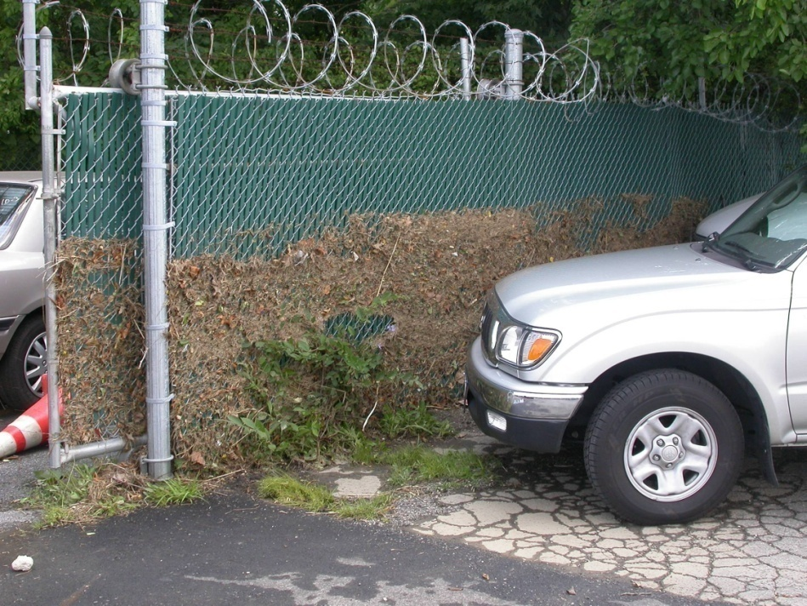
Flood of
July 7, 2004

Slide 23
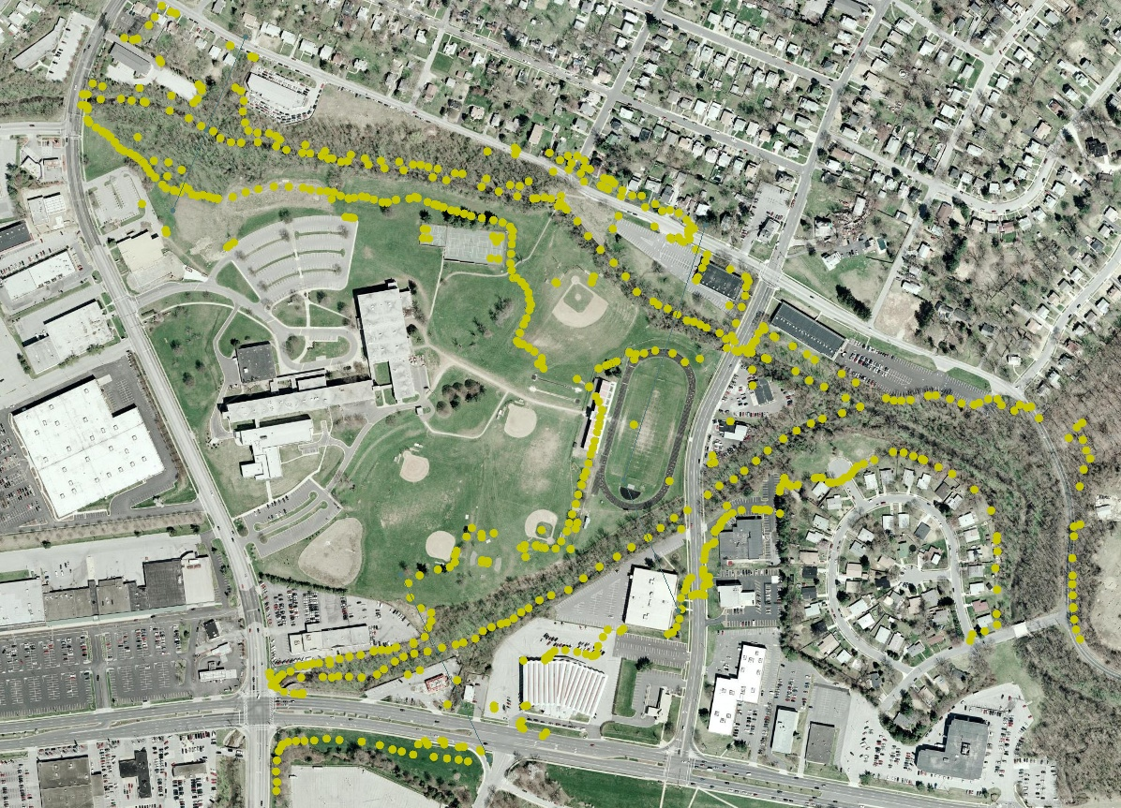
We georeference them to photo image points and LiDAR elevations

Slide 24
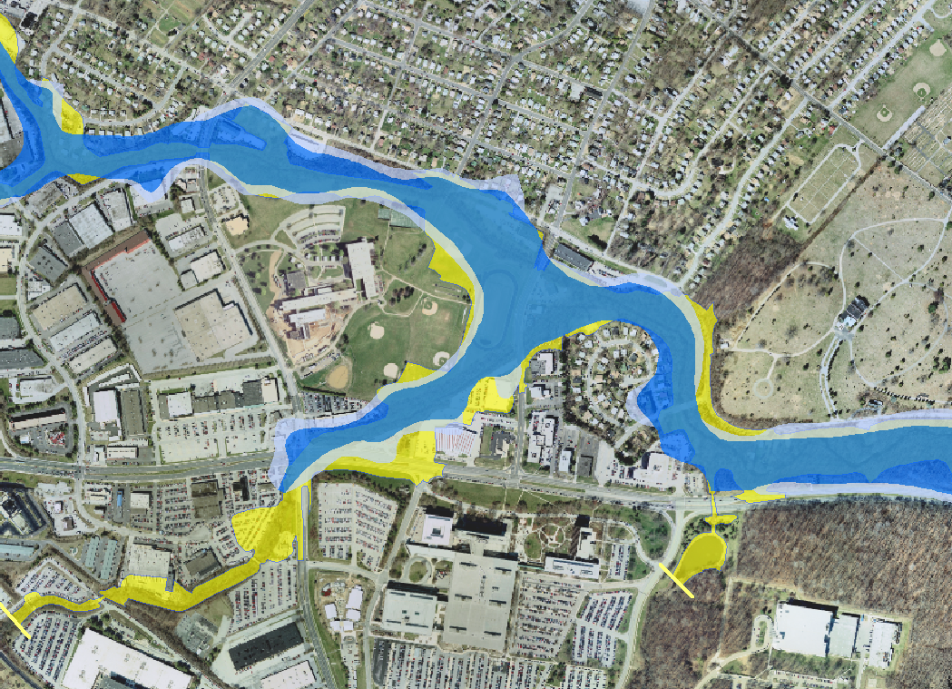
Yellow – July 7 Inundation Area
Light blue – FEMA 500-yr Floodplain
Dark blue – FEMA 100-yr Floodplain

Slide 25
TELEMAC-2D¹
Numerical solution of 2- dimensional depth-averaged form of the Navier-Stokes continuity and momentum equations
Finite-element mesh
Specify topography and boundary conditions, including inflow hydrograph
Model predicts inundated area, depth and velocity vectors for each node for each time step
¹ Hervouet, J-M., 2007. Hydrodynamics of free-surface flows: modelling with the finite element method. Wiley, 341 pp.

Slide 26
Dead Run Watershed

Slide 27
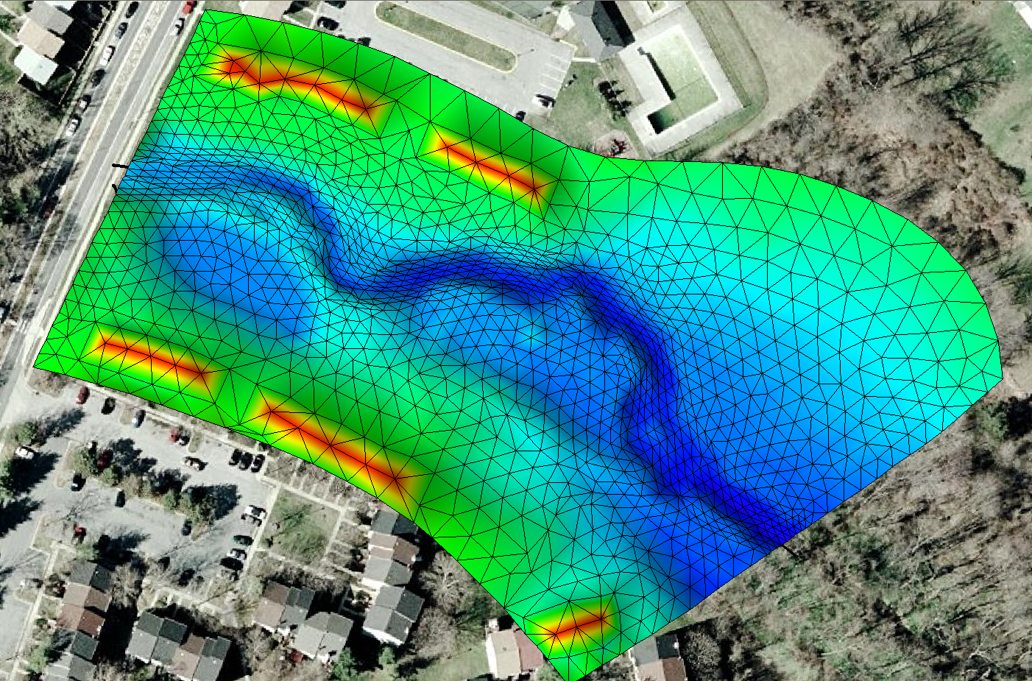
DR2 Gauge

Slide 28
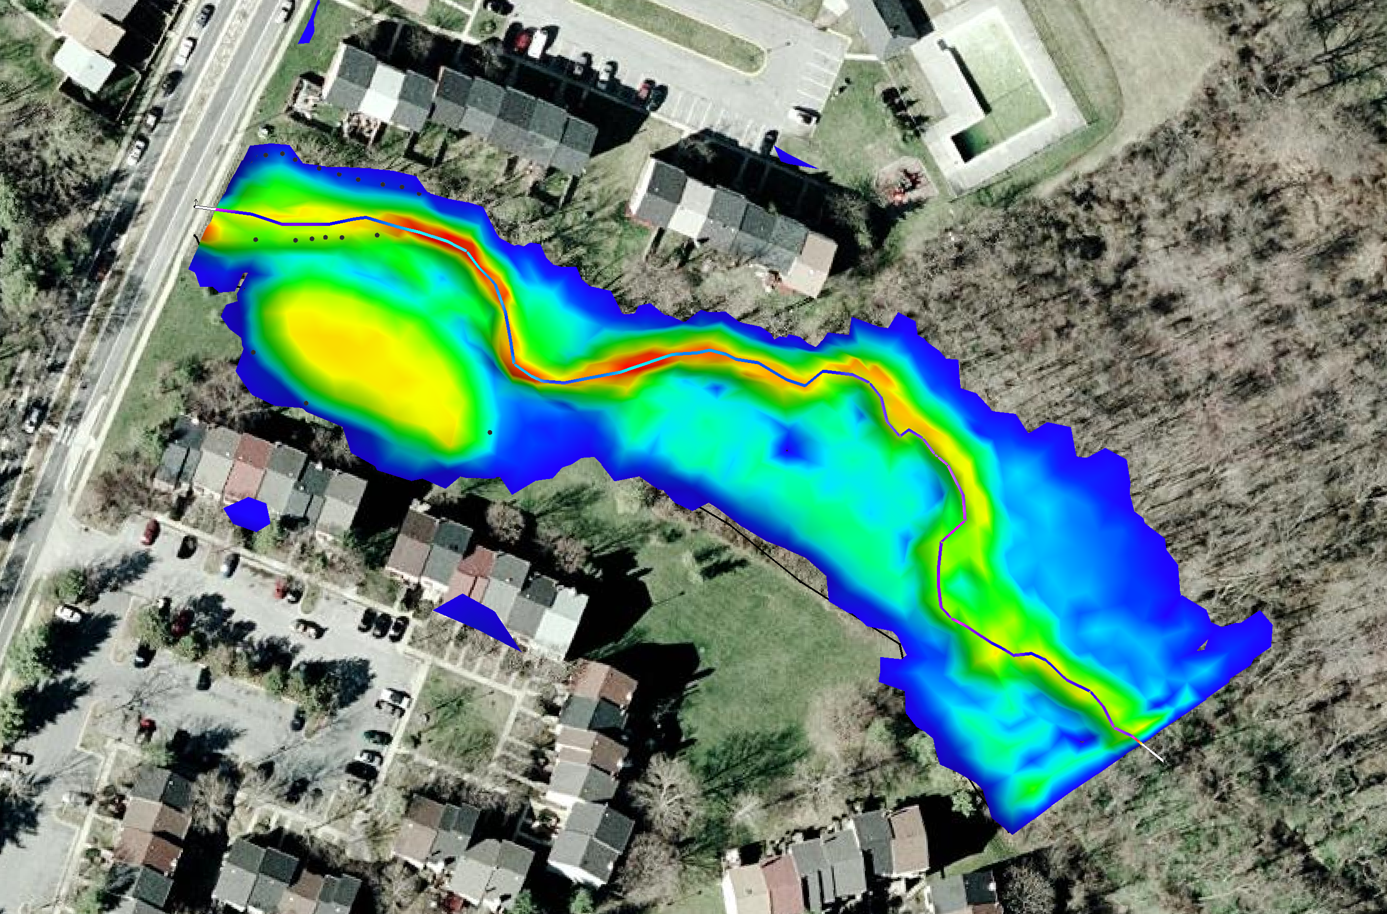
DR2 Gauge
Comparison of surveyed and modeled inundation areas

Slide 33
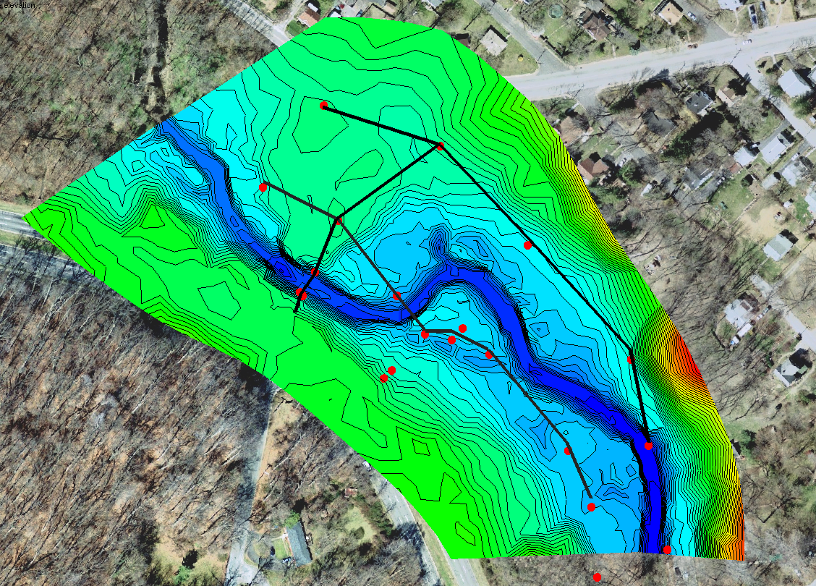
At the Dead Run at Franklintown USGS gauge, the July 7, 2004 event was the flood of record and exceeded the flood peak during Tropical Storm Agnes in 1972
The gauge was inundated during the flood and stopped recording for 95 minutes when the flood was at its peak. High-water marks were surveyed by USGS and used in the official indirect estimate of peak flow. (8700 cfs or 246 m³/s).
Flow
Franklintown Gauge

Slide 34
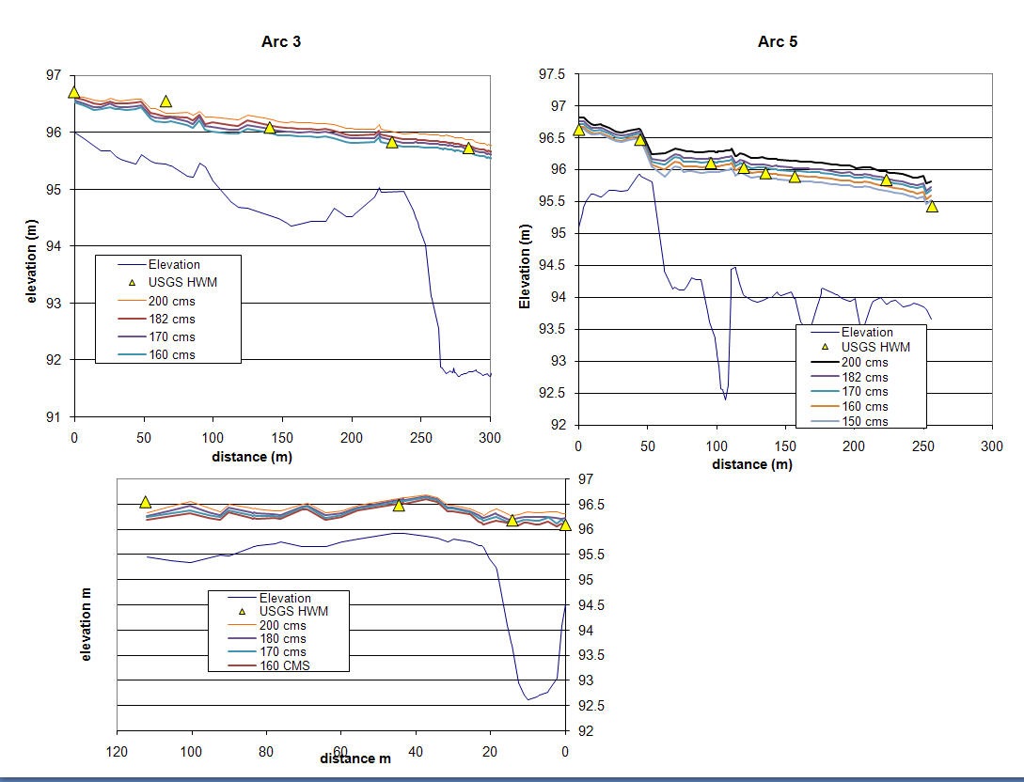
We used TELEMAC to estimate the peak flow with the best match to the ensemble of USGS high-water marks (5650 cfs or 160 m³/s)
We also estimated the timing and shape of the missing portion of the hydrograph

Slide 37
Bulletin 17B Log Pearson III Flood frequency analysis
Dead Run at Franklintown official peak flow record
Recurrence interval of July 7 flood: ~68 years
95% confidence interval: 30 – 180 years

Slide 38
Bulletin 17B Log Pearson III Flood frequency analysis
Dead Run at Franklintown adjusted peak flow record
Recurrence interval of July 7 flood: ~46 years
95% confidence interval: 21 – 109 years

Slide 39
Franklintown gauge results
Uncertainty in peak flow estimation and flood frequency analysis
Sensitivity of hazard assessment to uncertainty in estimates for even a single event
In urban watersheds, “ordinary” storms may generate big floods; but floods generated by rare events may not be as rare as the storms themselves
Importance of models as tools for investigating uncertainty and filling gaps in observation

Slide 40
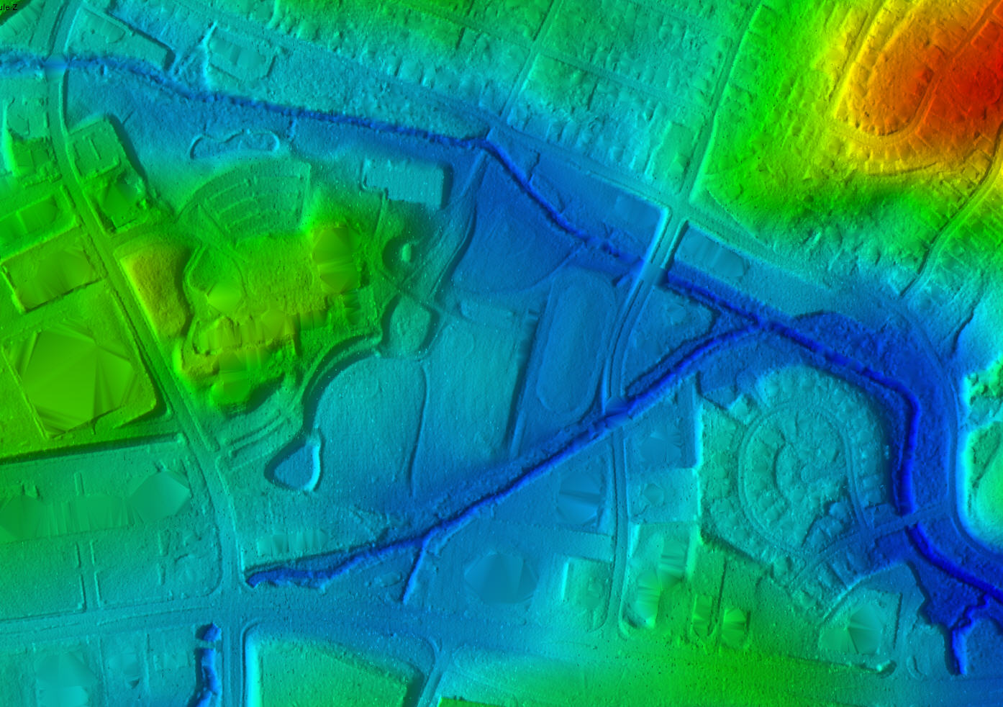

Slide 41
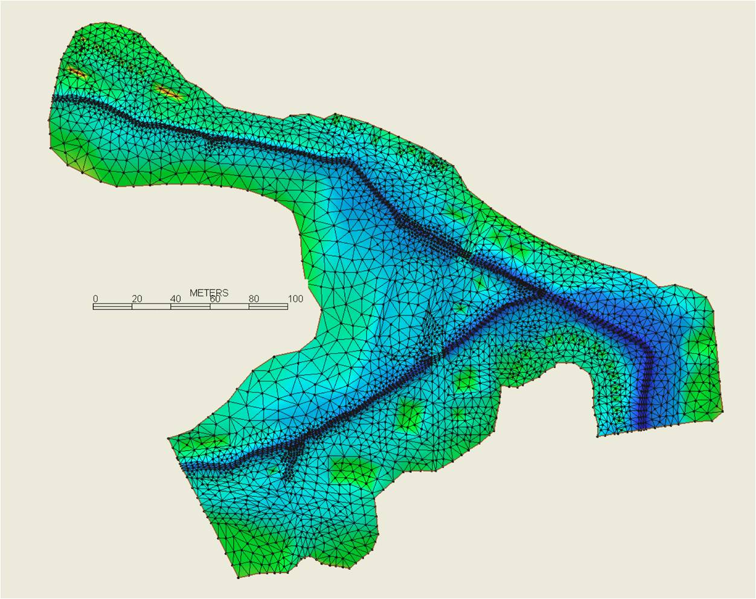
DR3
DR4

Slide 45
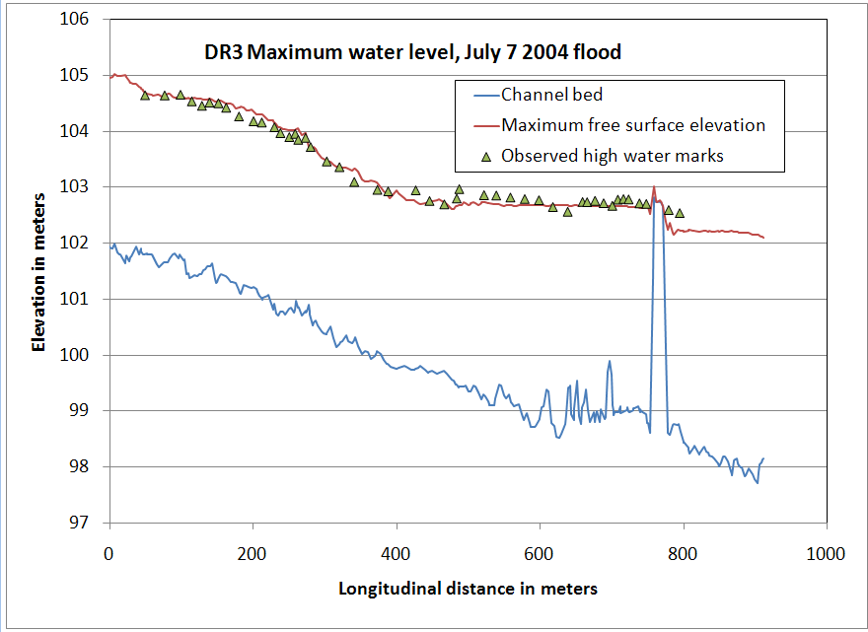
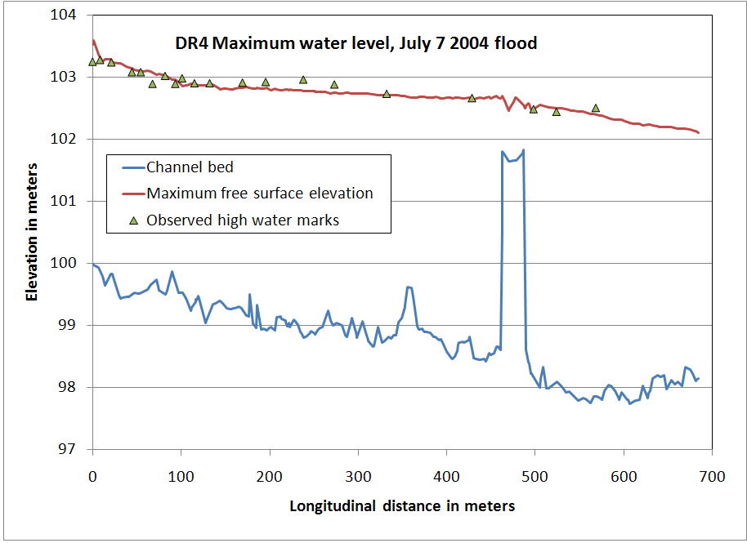
Ponding at high stage extends
300-400 m upstream of bridges
and road embankments
Simulated vs observed
thalweg flood profiles
July 7, 2004

Slide 48
Comparison of LISFLOOD-FP¹ 1D/2D hydraulic model with TELEMAC-2D for the July 7, 2004 flood
Dr. Timothy Fewtrell¹, Dr. Jeff Neal² and Prof. Paul Bates²
¹ Willis Research Network, University of Bristol, University Road, Bristol, BS8 1SS, UK
² University of Bristol, University Road, Bristol, BS8 1SS, UK
Channel is approximated as 1D and rectangular and solved by the diffusive wave equation
Floodplain flow is calculated in 2D using the continuity and momentum equations
LISFLOOD is orders of magnitude more efficient than standard 2d hydraulics models
¹ Bates, P.D., M.S. Horritt, and T.J. Fewtrell, 2010. A simple inertial formulation of the shallow water equations for efficient two dimensional flood inundation modelling. Journal of Hydrology doi:10.1016/j.jhydrol.2010.03.027

Slide 49
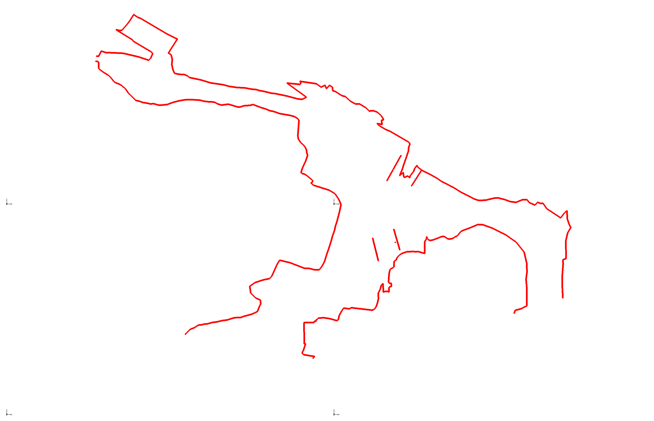
Comparison of surveyed inundation lines with LISFLOOD-FP results based on Miller input hydrographs for DR3/DR4 site

Slide 50
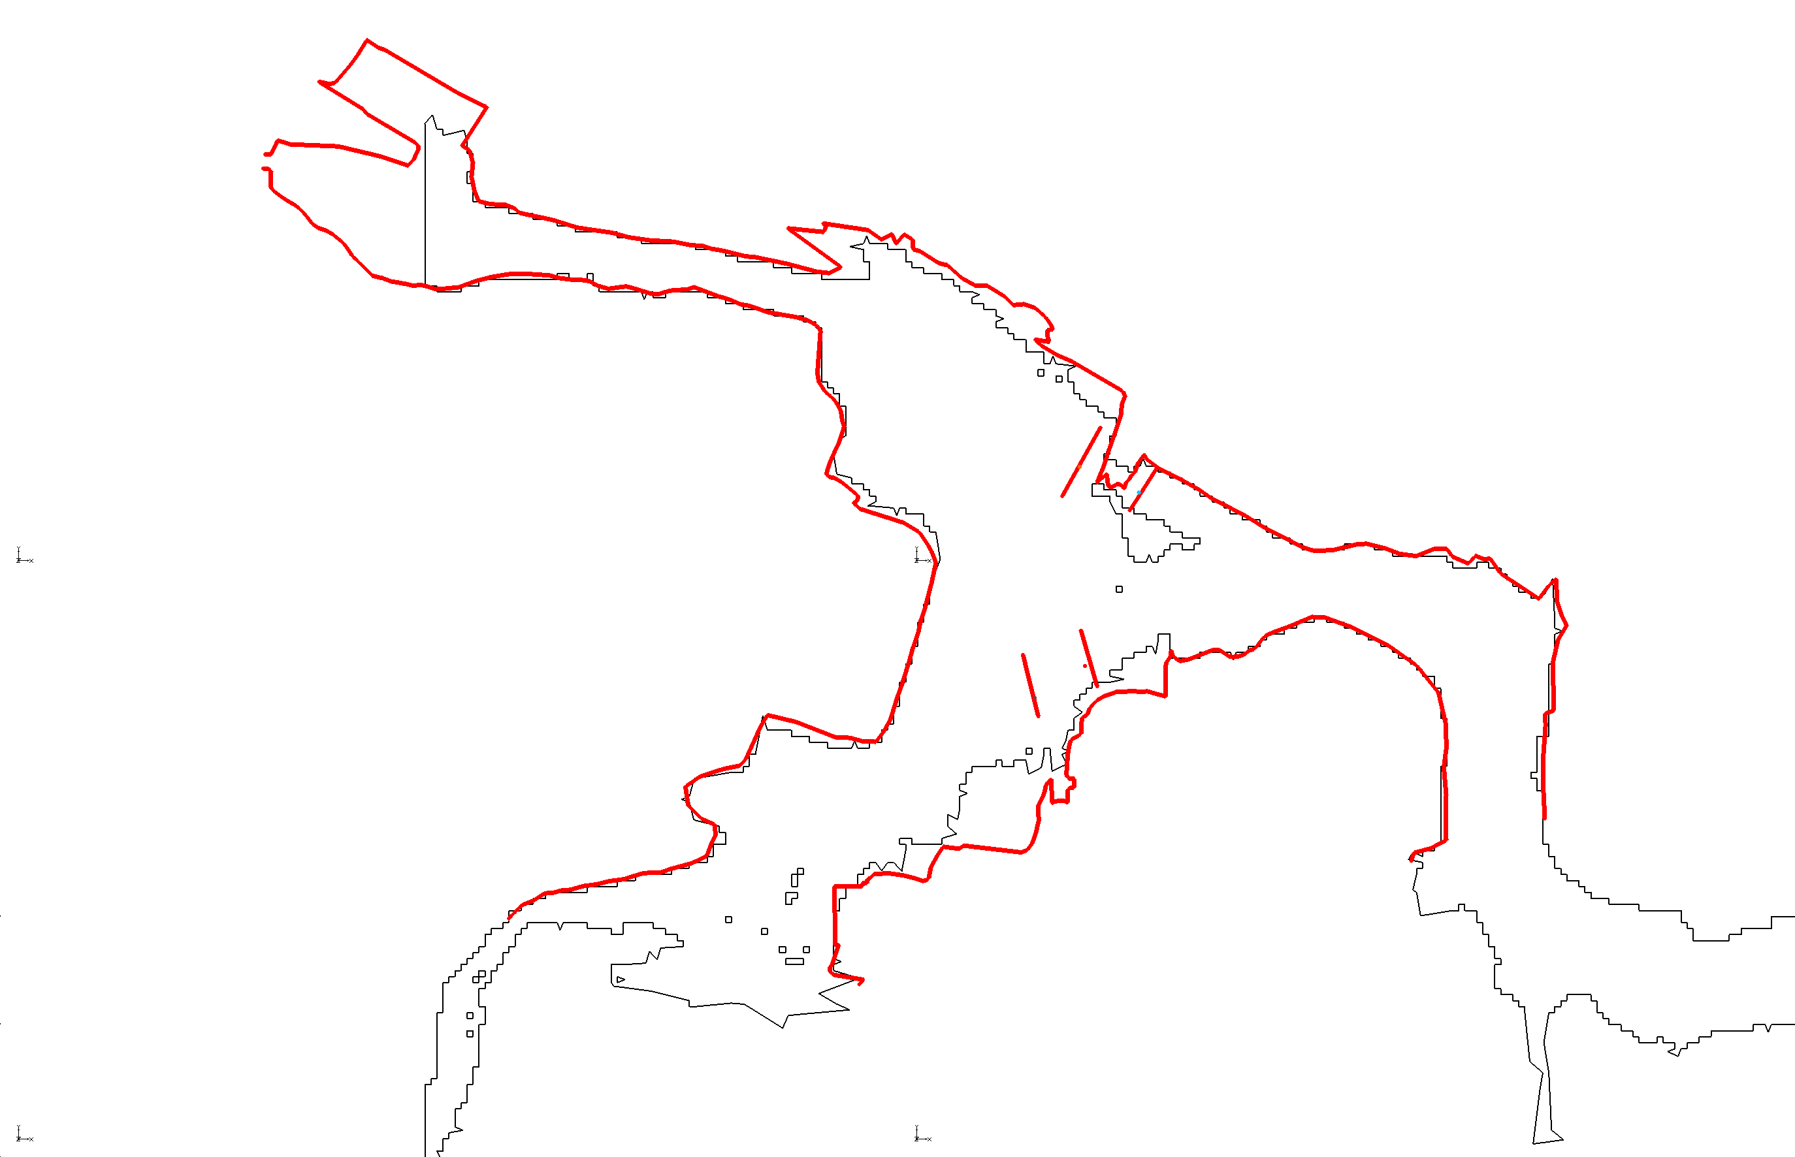
Comparison of surveyed inundation lines with LISFLOOD-FP results based on Miller input hydrographs for DR3/DR4 site

Slide 51
Comparison of surveyed inundation lines with LISFLOOD-FP and TELEMAC model results based on Miller input hydrographs for DR3/DR4 site

Slide 54
Comparison of TELEMAC-2D and LISFLOOD-FP
Both are computationally stable
Both provide good match to mapped flood inundation area (assumes a good topographic base)
LISFLOOD-FP missed backwater effects of infrastructure; but these were not built into the model
LISFLOOD does well with high-water marks outside of backwater zone
LISFLOOD can run this extreme-flood scenario in minutes rather than hours
If a model can be set up in advance, might allow real-time prediction of flood inundation for given hydrologic inputs

Slide 55
Conclusions
The July 7, 2004 Dead Run flood is a valuable case study for application of new tools and methods for flash floods
The flood was comparable to the most extreme floods measured at comparable drainage areas in the mid-Atlantic region
2-d hydraulic models can generate results that closely match high-water marks, inundation extent, and water-level records
Modeling results highlight uncertainty in flood-frequency analysis and sensitivity to the accuracy of estimation of the largest events
Urban infrastructure exerts a controlling influence on flood hydraulics and needs to be accounted for in modeling studies
With proper advance preparation, LISFLOOD-FP has the potential to be used in real-time prediction of flood inundation extent

