Slide 1
The Future of Hydrologic Modeling
Dave Radell
Scientific Services Division
Eastern Region Headquarters

Slide 2
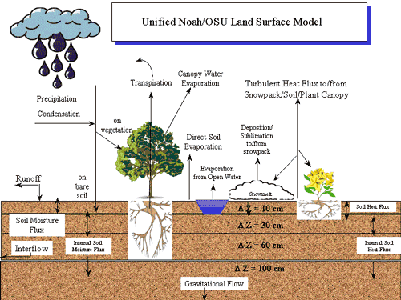
Current Research Thrusts
  Distributed Models
  Data Assimilation
  Ensemble Forecasts
  Verification
Courtesy NCAR

Slide 3
How advances in predictability science transition to improved operations…
Adapted from: NRC 2002

Slide 4
Hydrologic Models
Continued research and development on physically based models offers the potential for:
    More accurate forecasts in ungauged and poorly gauged basins;
    More accurate forecasts after changes in land use and land cover, such as forest fires and other large-scale disturbances to soil and vegetation;
    More accurate forecasts under non-stationary climate conditions;
    Modeling of interior states and fluxes, which are critical for forecasts of water quality, soil moisture, land slides, groundwater levels, low flows, etc.; and
    The ability to merge hydrologic forecasting models with those for weather and climate forecasting.
Notes:
Lumped versus distributed; physical versus conceptual.

Slide 5
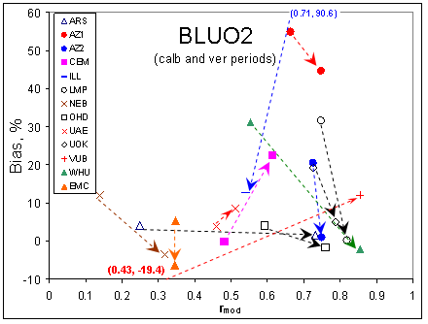
Distributed Model Intercomparison Project-2
Basin 1
Basin 2
Take away: Distributed models do not consistently outperform!
Notes:
Two basins, many dist. Models. Streamflow is the forecast variable. Arrows show before and after model calibration. The main focus here is to hammer the point that with the increased complexity, distributed models do not consistently outperform lumped counterparts. Note here as well, that even with calibration there is often a degredation in the bias or Rmod. This is a problem, in an operational setting.

Slide 6
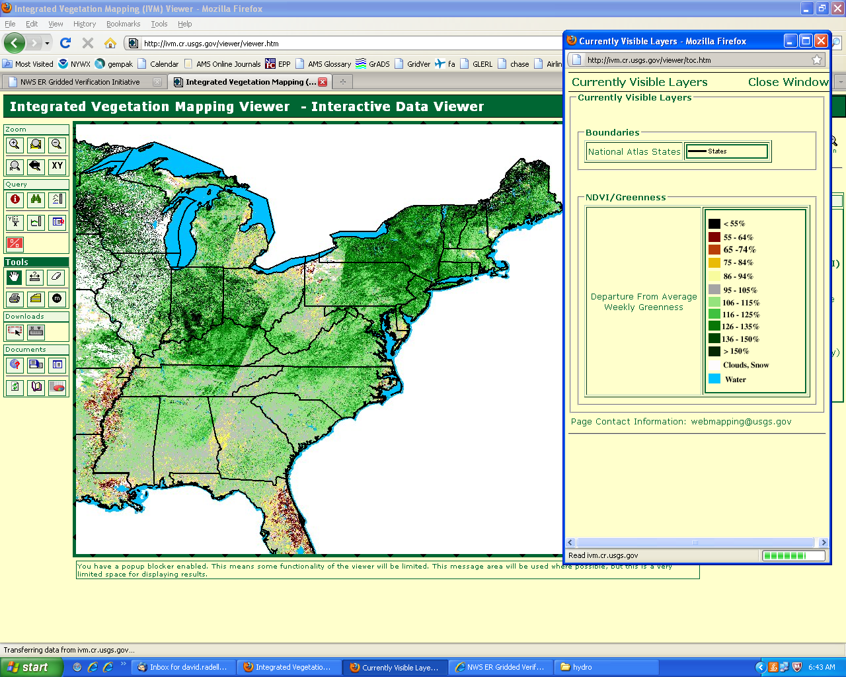
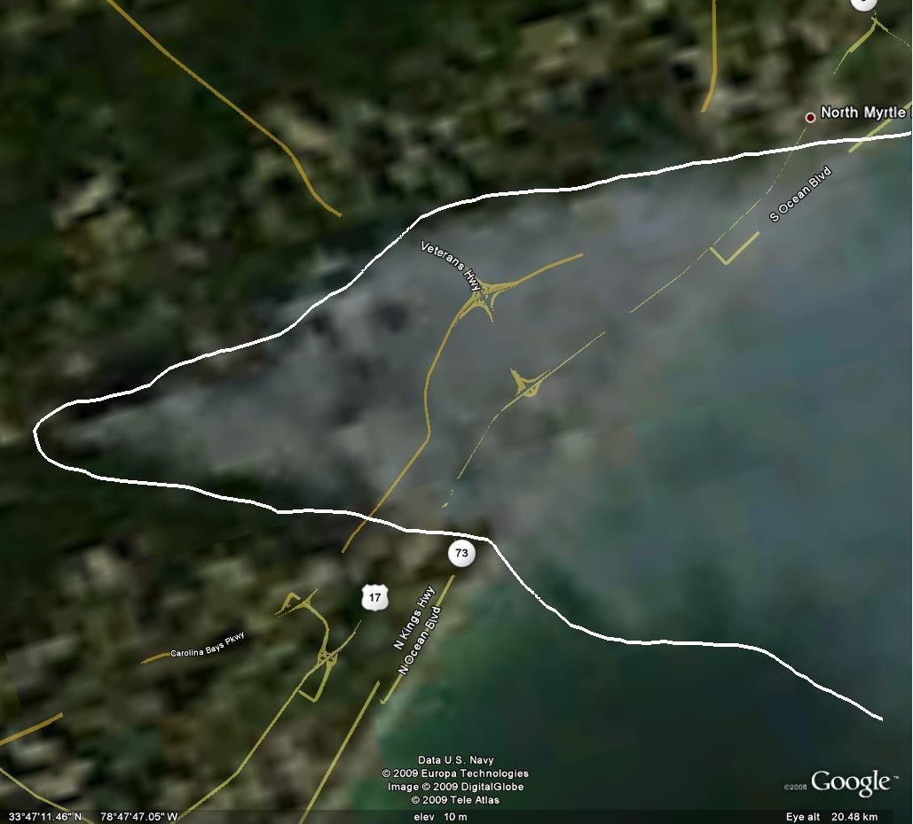
Hydrologic Models
April 2010: Early Greenup!
Fire Burn Areas
Courtesy USDA
Time scales of interest: Minutes - Years
Notes:
For operational use, distributed models must be flexible in space in time. Think about changing land surfaces due to a fire, the impact of irrigation on a field, or vegetation. Currently, most operational guidance uses climatological values of some sort to derive vegetation parameters (LAI, greenup), which don’t work as well for years like 2010. That impacts the transpiration part of ET! The spatial variability of these parameters is also important over small basins. MODIS, GOES-R, NPOESS, microwave sensors will help with this.

Slide 7
Hydrologic Models
    Physically-based, distributive hydrologic modeling will play a role in the NWS “Integrated Water Resources Science/Service Initiative”. Also, these parameters become important at small time/space scales (flash flooding).
    *Inclusion of groundwater-surface water interaction (GSFLOW or NOAH).
    *More Robust Potential Evapotranspiration (ET) estimates.
    Higher resolution (space and time) ET estimates (basin-scale, soil moisture controlled)
    Coupled water-energy budget modeling…physically based.
Notes:
The move from calibration to physically observed parameter estimation. With focus on shorter time/space scales, need to keep with evolving state of the land surface.

Slide 8
Challenges to Hydrologic Modeling
  Current Shortfalls of Physically Based Hydrologic Models
    The models are typically based on small-scale hydrologic theory and thereby fail to account for larger-scale processes such as preferential flow paths;
    The data necessary to estimate parameter values are not available at high enough resolution, certainty, or both;
    The data necessary to drive the models are not available at high enough resolution, certainty or both; and
    Despite the rapid increase in computer power and decrease in hardware costs, the computational demands are still a barrier, particularly for performing data assimilation and ensemble modeling in real-time.
Notes:
To some degree, this is a data assimilation problem. Leads into the next slide(s) nicely.

Slide 9
Operational Hydrologic Data Assimilation
MODIS-derived snow cover
Atmospheric forcing
In-situ snow water equivalent (SWE)
AMSR-derived SWE¹
Snow models
SNODAS SWE
Snowmelt
CPPA external (Clark et al.)
MODIS-derived surface temperature
Potential evap. (PE)
Precipitation
MODIS-derived cloud cover
Soil moisture accounting models
In-situ soil moisture (SM)
AMSR-derived SM¹
NASA-NWS (Restrepo (PI) Peters-Lidard (Co-PI) and Limaye (Co-PI) et al.)
Runoff
Hydrologic routing models
Streamflow or stage
Flow
CPPA Core, AHPS, Water Resources (Seo et al.)
Satellite altimetry
Hydraulic routing models
River flow or stage
Flow
¹ pending assessment
reservoir, etc., models
Notes:
Large number of data sets, physical processes over many time scales. Difficult in operations. Decompose the DA problem into smaller ones to phase in over time. Note the difference in the colored boxes….yellow would indicate snow related parms, green remote sensing, pink the surface layer etc.

Slide 10
Operational Hydrologic Data Assimilation
Atmospheric forcing
Snow models
Snow/Frozen
Remote Sensing/Satellite
Precipitation
Soil moisture accounting models
Soil Moisture
Runoff
Hydrologic routing models
Flow
Hydraulic routing models
River flow or stage
Flow
reservoir, etc., models
Notes:
Large number of data sets, physical processes over many time scales. Difficult in operations. Decompose the DA problem into smaller ones to phase in over time. Note the difference in the colored boxes….yellow would indicate snow related parms, green remote sensing, pink the surface layer etc.

Slide 11
From Seo et al. JHM 2003
Notes:
Example of streamflow simulation before (top) and after (bottom) VAR assimilation (climo PET and hourly precipitation). The SAC model was used here. Some improvement in peak flow.

Slide 12
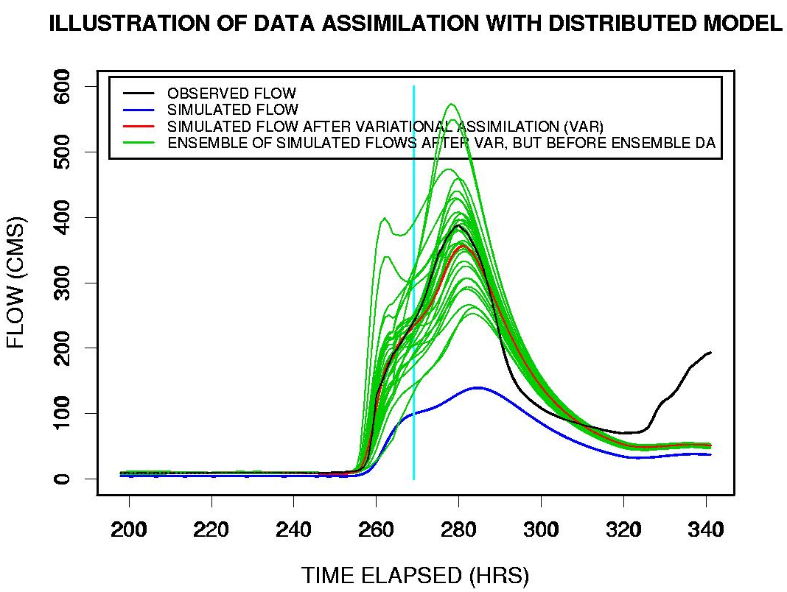
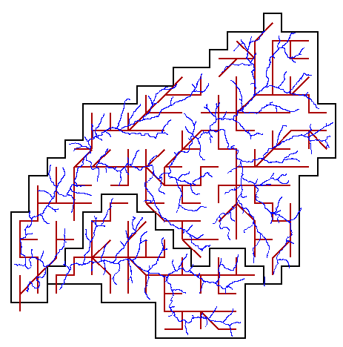
Data Assimilation
WTTO2 Channel Network
ABRFC / WTTO2
Notes:
Streamflow versus time showing the impact of data assimilation . Black is observed flow, blue without DA, red with DA (ensemble). Green are individual ensembles.

Slide 13
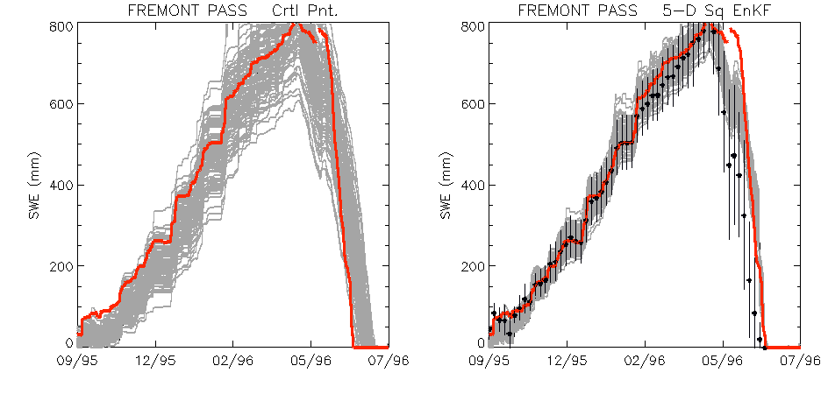
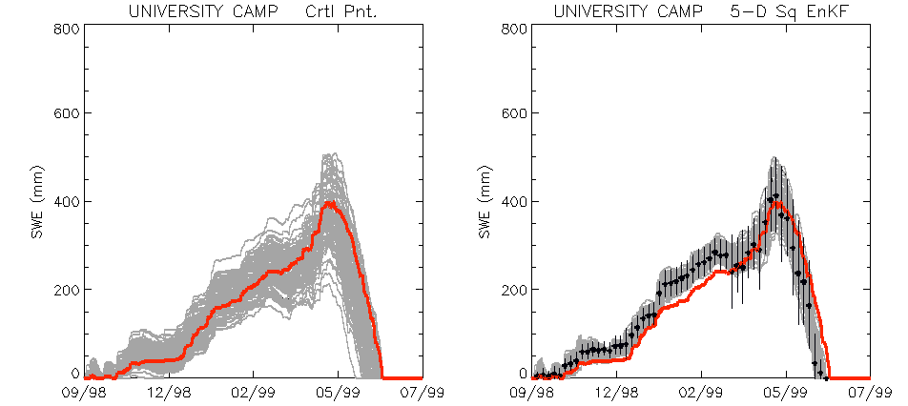


Ensemble Kalman Filter
Assimilation of SWE
Interpolated SWE Mean & Std. Dev
Model
Truth
Slater & Clark, 2006
CIRES University of Colorado
Notes:
Talking points: Freemont pass, better skill, less spread. Univ. Camp. Degredation of skill. Note the decrease in the spread/variability of the ensembles due to the DA. Don’t want to constrain the envelope of solutions too much.
Using our PQPE estimates and similarly derived temperature estimates, we forced NWS-RFS SNOW-17 and applied an ensemble kalman filter for data assimilation purposes. “Observed SWE” is gained by the same methods as the PQPE from surrounding stations, with data from the experimental site withheld for validation purposes. Left panels show “raw” simulations using our PQPE and temperature ensembles. Right panels show the impact of applying the ensemble kalman filter. Red line is the “truth” that was withheld in each experiment. We see consistently better performance, but on occasion the ensemble spread decreases too much.

Slide 14
Soil Moisture Observations
  What for?
    Model Calibration
    Model Verification
    Data Assimilation both for floods and drought forecasts
    Water balance estimation in irrigated areas
  Problems:
    Current space-based techniques only sample the very top layer of the soil
    Would a combination of remote-sensed information and models will be able to tell us the soil moisture profile and assess irrigation amounts?
  New Techniques to be researched:
    Cosmic rays
    Broadcast radio
    GRACE in combination with other techniques?
    GPS reflectivity
*Soil Moisture is #2 to QPF… and, uncertainty in soil moisture initial conditions is a large source of error!
Notes:
SM is second to QPF in terms of errors in initial conditions for hydro models. In-situ obs. are sparse, remotely sensed obs./satellites only capture skin SM value. Space-based techniques (cosmic rays) seem promising.

Slide 15
Ensemble Forecasting –
Where we are
  Until now, operational ensemble forecast has been limited to Ensemble Streamflow Prediction (ESP) runs, essentially a long-range probabilistic forecast.
  Since AHPS, NWS is committed to generate streamflow forecasts at all time scales: customers and partners clearly indicate a need for short-term forecasts.
    Ensemble pre-processor, to generate QPF and QTF short-term ensembles from single-value weather forecasts.
    Ensemble post-processor to account for hydrologic uncertainty and river regulation
    Hydrologic Ensemble Hindcaster, to support large-sample verification of streamflow ensembles
    Ensemble Verification System for verification of precipitation, temperature and streamflow ensembles
  Partners: NCEP, HEPEX, Universities, RFCs, NASA Goddard, etc.
Notes:
Shift from long term probabilistic forecasts to shorter term (customer driven). Application to FF guidance. End user interpretation is a challenge.

Slide 16
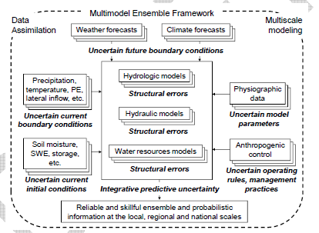
Multi-Model Ensembles: Uncertainty Considerations
Notes:
Highlights: This depicts the major sources of uncertainty associated with each step of the multi-model ensemble framework. Space-time scale issue. Must allow flexibility to incorporate all relavent space/time scales but be dynamically and statistically consistent. Initial model states, calibration (parameters), rating curves, forecast and analysis uncertainties should all be considered. Forecaster should have influence on the meteorological input…..weighting of atmospheric ENS members for example.

Slide 17
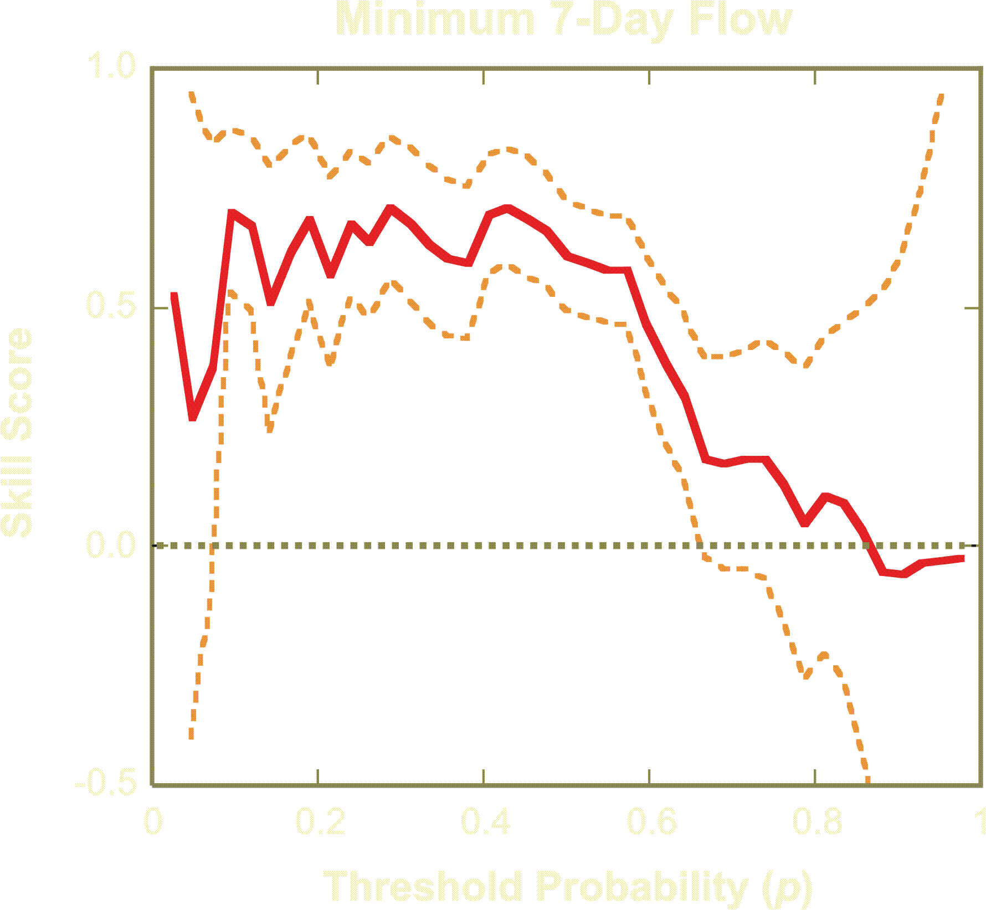

Ensemble Forecast Skill- Iowa Institute of Hydraulic Research
Skill depends on the threshold
Uncertainty is greater for extremes
Summary measures describe attributes of the function
Skill
Standard
Errors
April 1st Forecasts
Notes:
Ensemble probabilistic forecast skill as a function of flow threshold (index by the flow’s nonexceedance probability p) for 7-minimum flow forecasts over a 90-day time horizon issued on April 1st for the Des Moines River at Stratford.
Probability forecast skill (i.e., the skill of probability forecasts for event below/above the flow threshold) depends on the threshold --- In this case, the skill is much higher for low flow thresholds; the skill of forecasting high flow events is poor. [Note: The low skill at high thresholds is probably not a concern here for users, as they are most interested in the probability of an unusually low 7-day minimum flow (droughts)].
One can interpret some simpler (univariate) summary measures as summarizing attributes on the skill function shown above (see next slide for an example).
Using sampling theory, exact or approximate standard error estimators have been developed for distributions-oriented (DO) forecast quality measures. These estimators can be computed based only on sample moments of the forecasts and observations (that is, Monte Carlo simulation is not needed). Therefore, estimates of uncertainty in the forecast measures can be routinely computed along with the measures themselves.
The plot above shows the estimated skill for AHPS forecasts of 7-day minimum flow over a 90-day forecast horizon, for a Raccoon River tributary (part of the Des Moines AHPS). The skill is computed for various flow thresholds, which are indexed above using the nonexceedance probability (p) of the flow thresholds. Also plotted are the standard errors for each skill estimate.
Some observations:
Skill estimates for flow extremes (low or high flow thresholds) have much higher uncertainties, as these events rarely occur in the verification sample.
Uncertainties also depend on the magnitude of the skill. When the skill estimate is near zero, its uncertainty is much higher and when the forecast has significant skill (e.g., for p in the range from 0.1 to about 0.6).
Despite the high uncertainties in the forecast quality estimates, overall attributes of ensemble forecasts (and their significance) are apparent. For example, probabilistic forecasts for AHPS 7-day minimum flows have significant skill for lower flow thresholds (e.g., probability of dry conditions).

Slide 18
Ensembles- Where we want to be
Notes:
Summary of future of ensemble use in hydro forecasting. Note new forecast fields/grids. New data sets and role of distributed models are KEY to this progress.

Slide 19
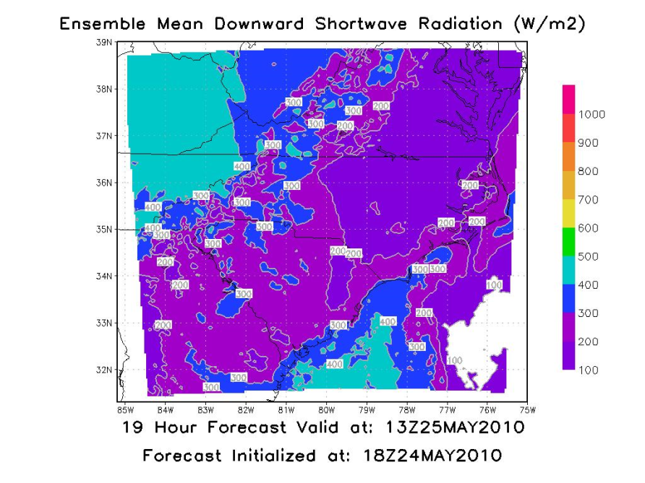
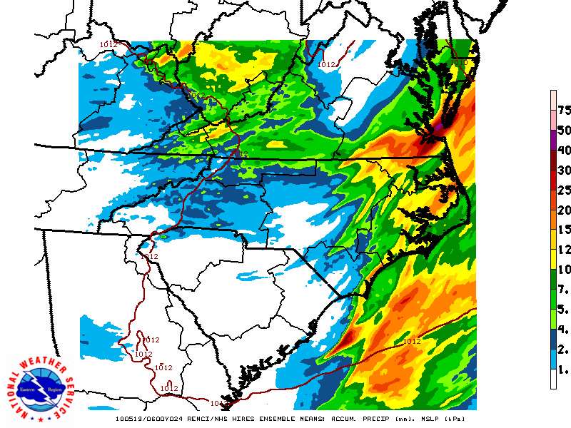
RENCI/NWS Oper. Ensemble
Eastern Region Example: Short Range T, QPF
*Southeast WFOs, RENCI, others. 21 members in total.
*Hourly mean, min, max, etc. QPF ,T, SW.
*4-km grid spacing, combination of WRF, RAMS etc. 1-hour forecasts to 30 hrs.
*Skill? QPF verification plans in the future.
Notes:
Highlights: Regional or locally run NWP models can provide the IC/BCs to help drive the next generation of hydro models. Think QPF and QPT. Also some energy budget output as well.

Slide 20
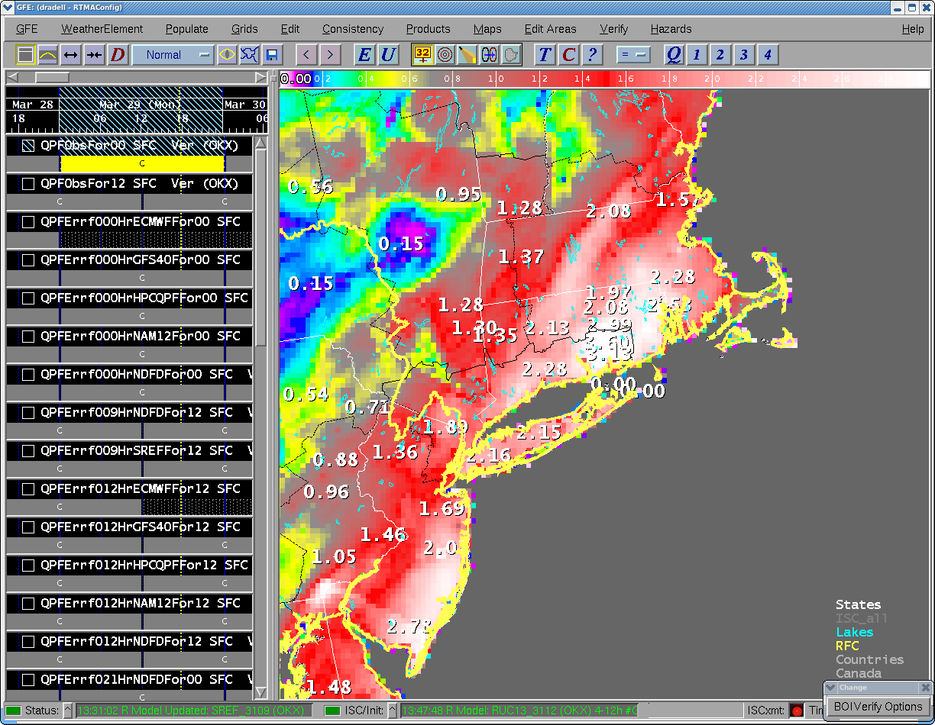
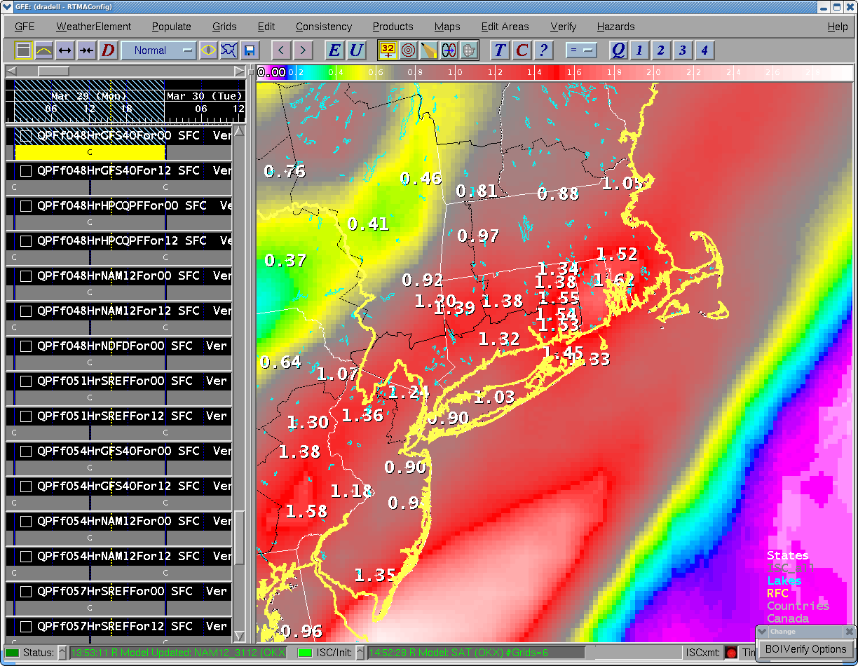
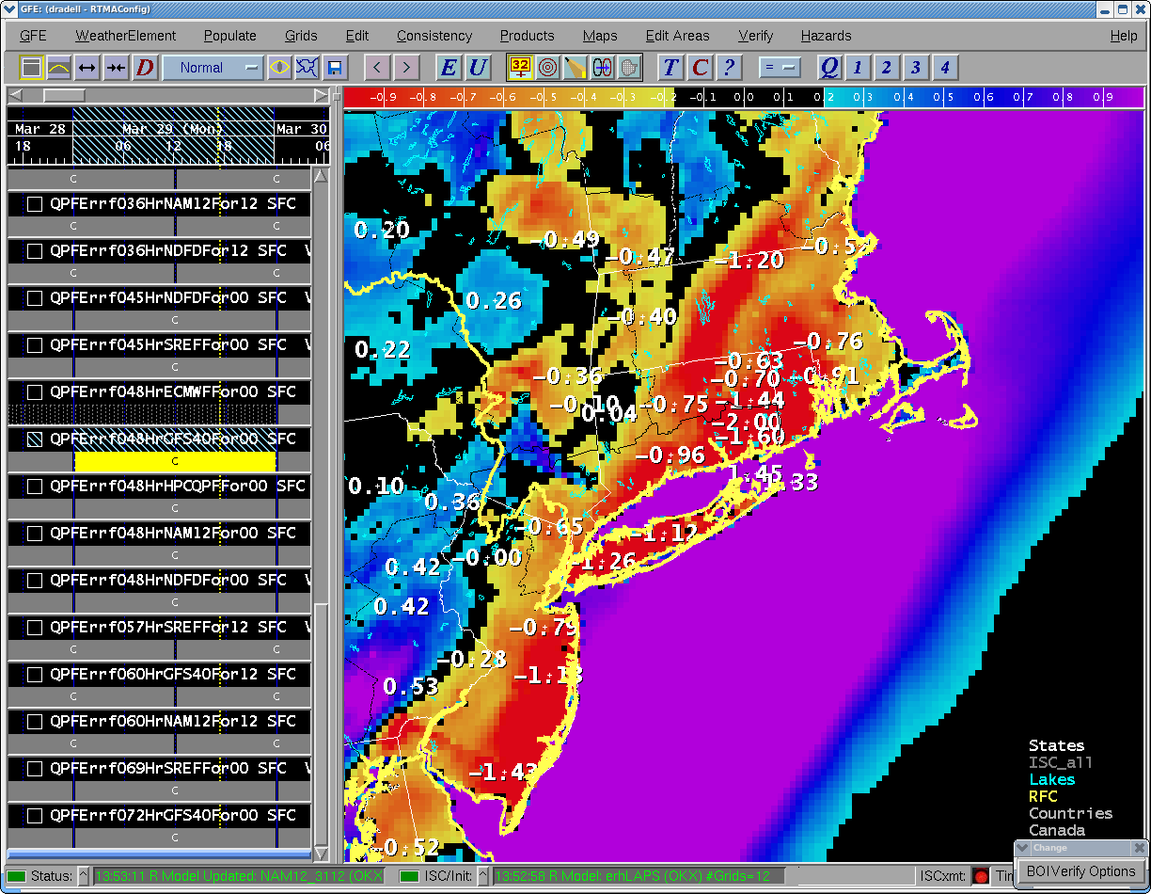
Deterministic Verification
Emphasis should be on the QPE/QPF and soil mositure used in initial/boundary conditions. “Verify-on-the-fly” concept. Incorporation of “uncertainty”?
Notes:
20
Deterministic verification is happening to some extent within the region now….focus should be on QPF and soil moisture.

Slide 21
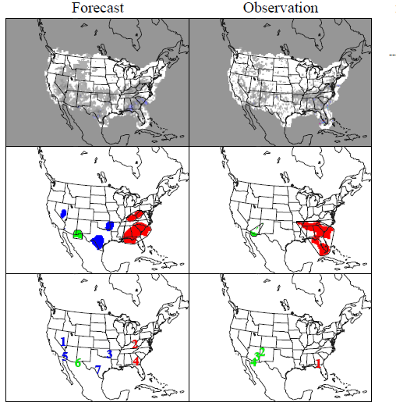
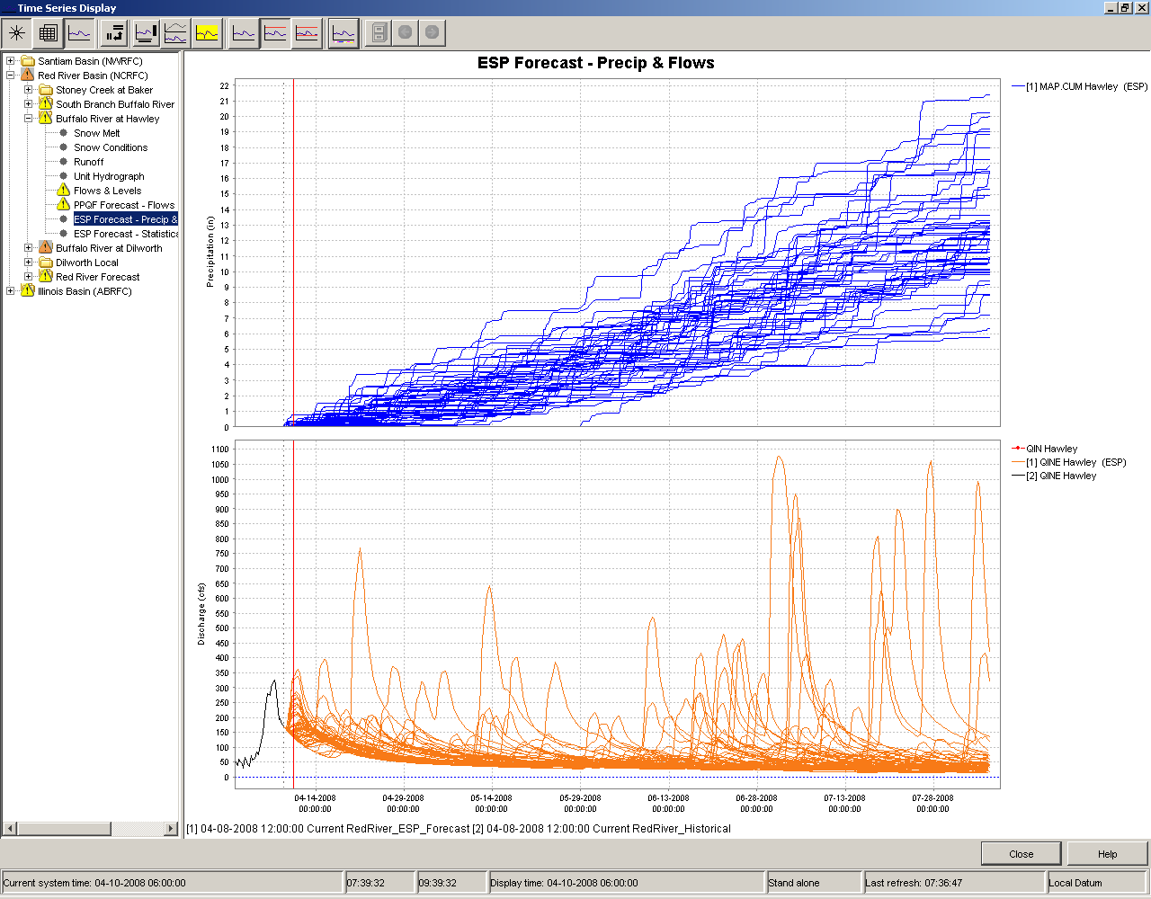
Ensemble Verification
MET/MODE (DTC)
Ensemble: EVS, XEFS, CHPS
Notes:
21
Question: How to use verification feedback in an operational setting in a meaningful way? What metrics are most useful to answer questions like: “How good was the forecast”? “How can the forecast improve”?

Slide 22
The Future of Hydrologic Forecasting at the NWS
Goal: Hydro. forecasts that are more accurate, with improved lead time!
Emphasis on models with physically observable parameters.
Enhanced use of remotely sensed information on a wide range of atmospheric and land-surface characteristics, from both active and passive satellite-based and/or airborne sensors.
Higher-resolution models (space and time).

Slide 23
The Future of Hydrologic Forecasting at the NWS
Explicit consideration of the uncertainty in the forcings (observations and forecasts).
Multi-model ensembles to address the problem of uncertainty in the forecasts arising from structural errors in the models.
Data assimilation of in-situ and remote-sensed state variables.
Verification of single-value (deterministic) and ensemble (probabilistic) forecasts.

Slide 24
Thank You!
david.radell@noaa.gov

Slide 25
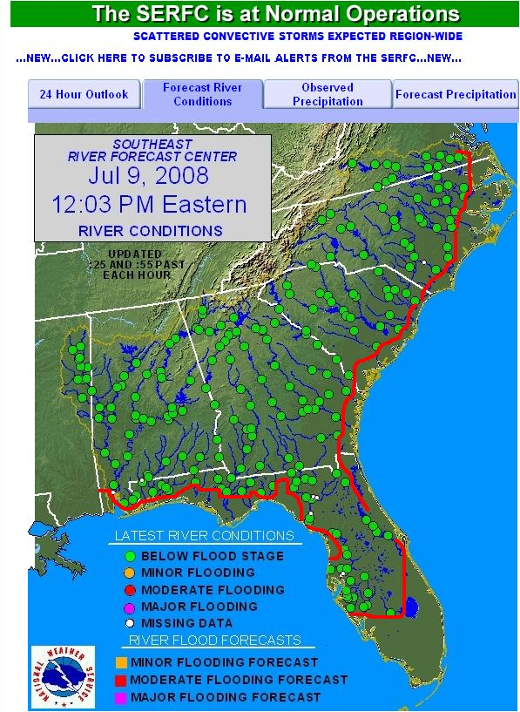
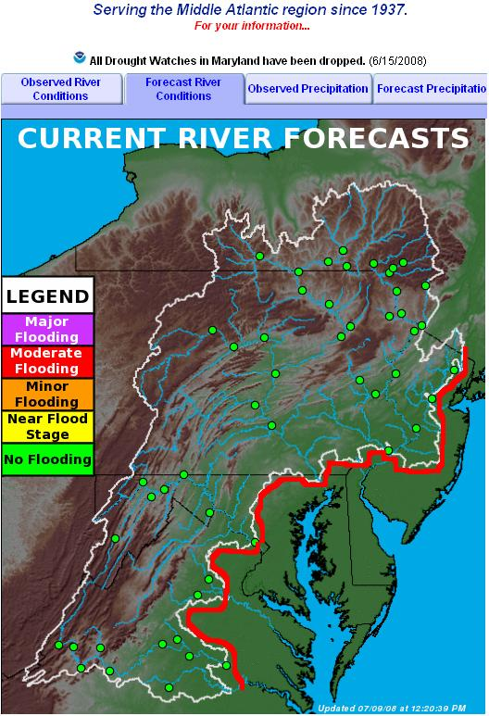
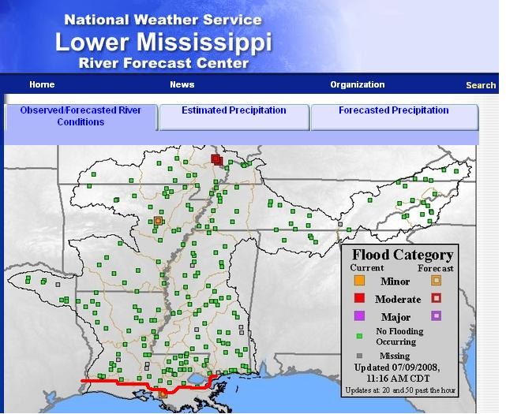
Hydrologic Forecasting in the Coastal Zone
MARFC
SERFC
Coastal Areas Outside
the Forecast Zones
LMRFC

