Slide 1
The U. S. Geological Survey Streamgaging Network
Supporting Society’s
Water-Resource Decisions
Presented by:
Bob Hainly, Assistant Director
USGS-PA Water Science Center
June 4, 2010

Slide 2
The U. S. Geological Survey
Streamgaging Network
Supporting Society’s
Water-Resource Decisions
What we’ll cover today:
National, regional, and local streamgaging networks
Streamgage evolution and operations
Uses of streamflow data to benefit society
Examples of societal benefits
Issues with managing and funding a cooperative network

Slide 3
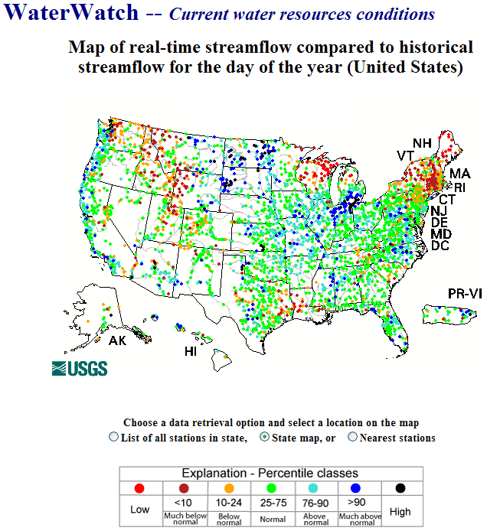
National Streamgaging Network
First streamgage established in 1889
Currently includes 7,400 streamgages
Annual funding to operate this network is approaching 150 million dollars
http://waterwatch.usgs.gov/
Notes:
The U.S. Geological Survey (USGS) established its first streamgage in 1889 on the Rio Grande River at Embudo, N.M. As the need for stream-flow information increased, the USGS streamgaging network expanded to its current size of approximately 7,400 streamgages nationwide.
Streamgaging generally involves (1) obtaining a continuous record of stage (height of water), (2) obtaining periodic measurements of discharge, (3) defining the relation between the stage and the discharge, (4) using the stage-discharge relation to convert the continuous record of stage into a record of discharge, and (5) disseminating the streamflow information to a multitude of users, including water managers, scientists, engineers, and the general public.

Slide 4
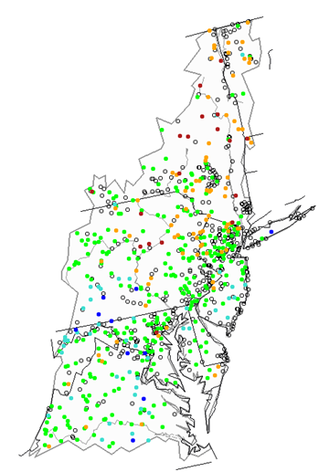
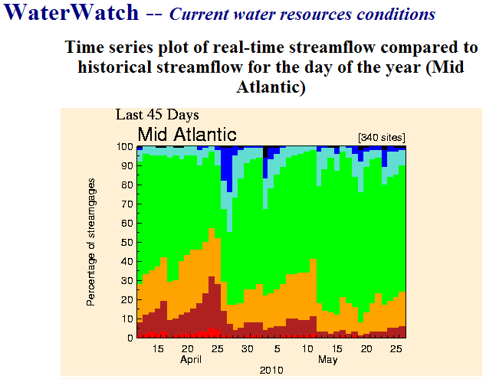
Mid-Atlantic Network
http://waterwatch.usgs.gov/
Notes:
The USGS Water Watch web page allows display of streamgages in regional settings. This image of streamgages shows the Mid-Atlantic Region. Additional data displays are available to summarize hydrologic conditions over various periods of time. This particular graph shows the percentage of streamgages in the region that were categorized as below and above normal on a daily basis during the last two months.

Slide 5
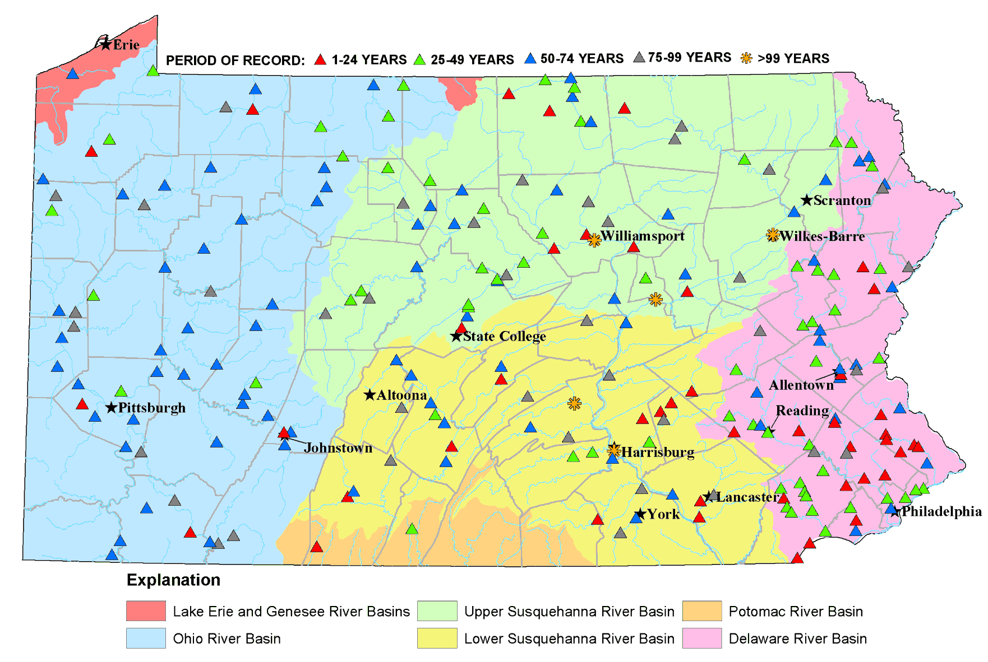
Pennsylvania Network
Over 40 partners contribute financially to the statewide network
Major partners are: USACE, PA-DEP, NWS, SRBC, and the USGS
http://waterdata.usgs.gov/pa/nwis/current/?type=intro
Notes:
The cooperative streamflow monitoring network operated by the USGS in Pennsylvania includes about 300 real-time stations.
Pennsylvania has a long history of water-resources data collection. Five stations within the Susquehanna River basin have over 100 years of continuous record. The oldest site is located on the Susquehanna River at Harrisburg, where data collection was begun in 1890. The streamgage on the Susquehanna River right here in Wilkes-Barre has been in operation since 1899.
Data from the streamgages are used in various ways. Flood-forecasting is one of the more critical uses of the data.
The USGS National Streamflow Information Program has designated the data from nearly half of the 300 streamgages statewide, as critical to flood-forecasting.

Slide 6
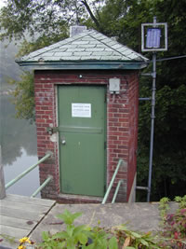
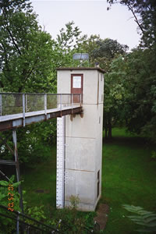
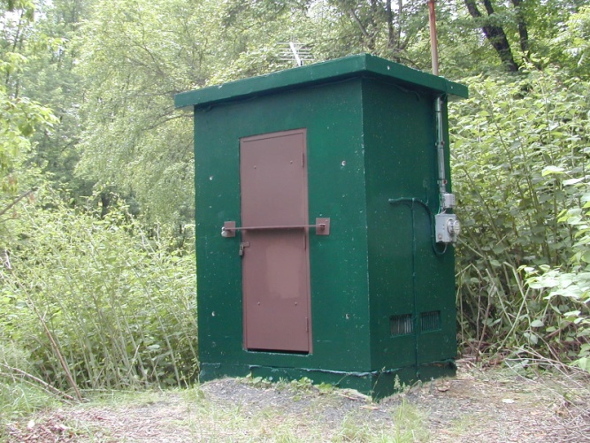
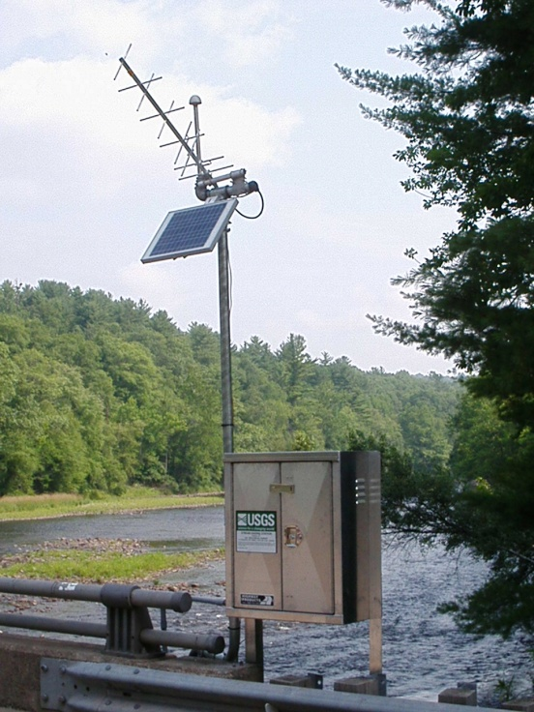
Streamgage Evolution
Notes:
Streamgage structures and the type of equipment we use has changed dramatically over the years—mostly in the last 20 years of our century of streamflow data collection. Modern streamgages are much more compact. Stilling wells are no longer being used and the structure now houses electronic rather than mechanical recording and sensing equipment.

Slide 7
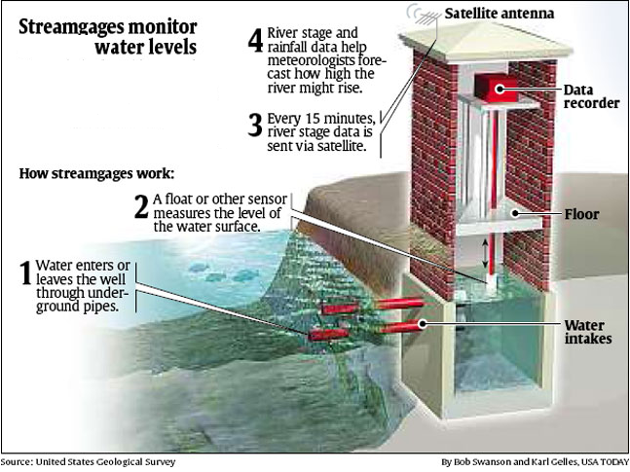
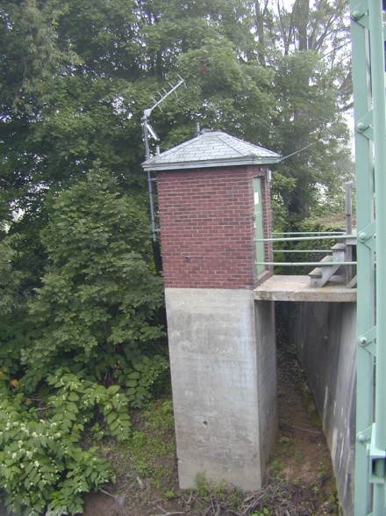
Streamgage Operations
Notes:
Stilling wells are relatively simple structures that use mechanical means and water’s need to balance its surface level to replicate and sense the water level in the stream. A float on the surface of the water in the stilling well is connected to a pulley wheel mounted on the shelf near the top of the streamgage. The movement of that wheel is transmitted to a recording device and a radio transmitter in order to provide the data that are displayed on the web.

Slide 8
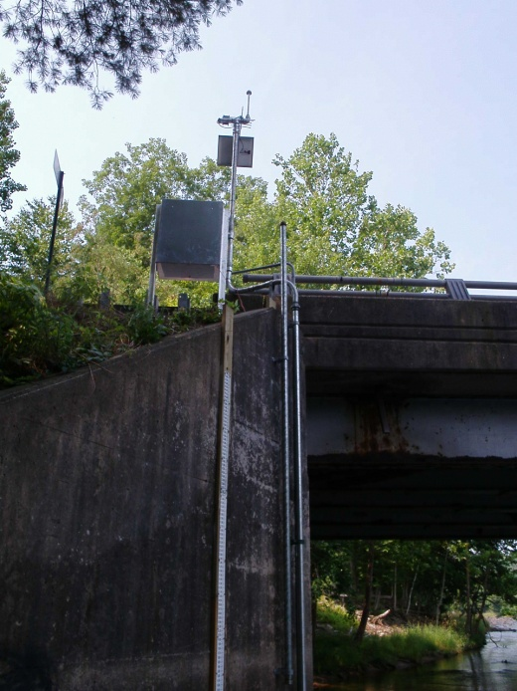
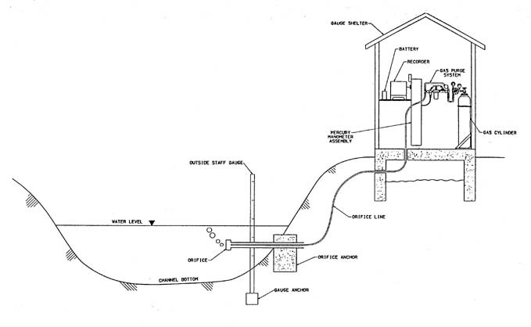

Streamgage Operations
Notes:
Most streamgages built and installed in the last ten years use a pressure-sensing system rather than a stilling well. This is partly as a result of the safety issues involved with the confined space of a stilling well and, also as a result of technological advances that provide more reliable stage data. A pressure system senses the weight of the water or pressure exerted on the open-ended orifice of a small-diameter tube that is closed at its terminus in the streamgage structure. The change in pressure as a result of the change in depth of water over the orifice is measured by equipment in the streamgage and transferred to the same recording and transmitting equipment used in a stilling well.

Slide 9
Supporting Society’s
Water Resource Decisions
USGS streamflow data enable informed decisions about:
  Management and allocation of water resources,
  Prediction of and reaction to floods,
  Design and operation of engineering structures,
  Scientific research,
  Operation of locks and dams, and
  Recreational safety
Notes:
In the United States, there is an important resource which aids in preventing loss of life, saves one billion dollars a year in property losses, and allows bridges to be properly designed and drinking water allocated. Yet, it is a resource that the general public knows very little about. This resource is the USGS stream-gaging network.
This network provides the hydrologic information needed to aid in defining, using, and managing our country's invaluable surface water resources. The stream-gaging network provides a continuous source of well-archived, well-documented, and unbiased water data that are used in countless ways by governmental and private industries alike. The water data are put to work for everyone, every single day.

Slide 10
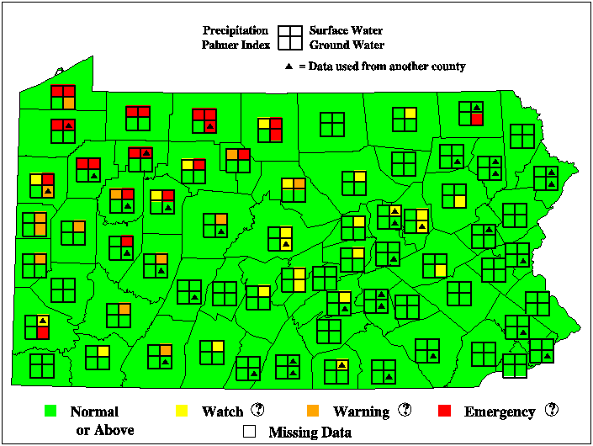
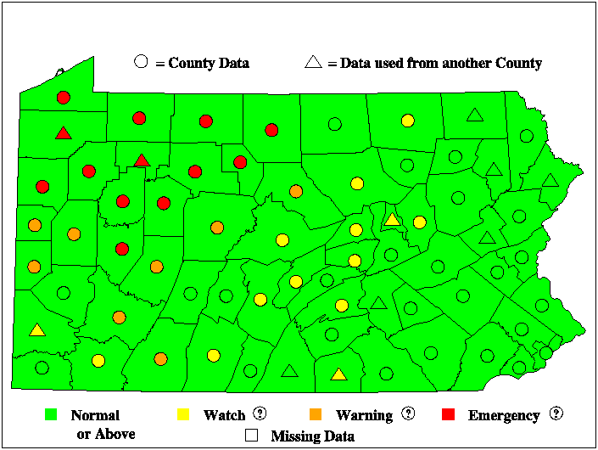
Supporting Society’s
Water Resource Decisions
Management and allocation of water resources
  Drought management
http://pa.water.usgs.gov/monitor/
Notes:
Streamflow data assist water managers in making daily operational decisions for dealing with water requirements for municipal, industrial, and agricultural purposes, as well as demands for hydroelectric power generation and space for flood control in reservoirs.
Availability of long-term streamflow is important for wastewater treatment facilities. These facilities need to have estimates of streamflow available to allow for the proper dilution of treated wastewater releases. Data are needed to determine facility-management actions both real-time and to plan operations in the next few days to weeks ahead. In addition, the ability of municipalities and industries to withdraw water from rivers and streams is limited by the availability during low-flow periods. Drought monitoring benefits both of these major water users and, in turn, impacts society’s ability to use an existing infrastructure that is sometimes taken for granted.
A streamflow monitoring effort for drought-management purposes in PA in cooperation with PA DEP and the State drought Coordinator enables that agency to proactively manage industrial, municipal, and public water use during climate-induced low flow conditions. These two images show overall hydrologic conditions and streamflow conditions near the end of April 2010. The visible trend of low-water conditions across the state from northwest to southeast increased the State Coordinator’s attention to drought conditions. These data along with others are used to develop recommendations to the Secretary of PaDEP and the Governor in regards to drought declarations.

Slide 11
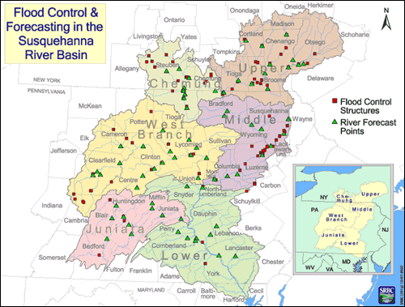
Supporting Society’s
Water Resource Decisions
Prediction of and reaction to floods
  Flood forecasting
60 streamgages and 55 rain gages in PA and NY support the system
Stream stage and flow are data are critical to developing forecasts and real-time monitoring
Notes:
This type of forecasting is a joint effort of several federal, state, and local agencies. Flood forecasting allows for timely warnings that save lives and decrease property damage. A reliable flood forecast, and its subsequent warning, depend on having a reliable and current source of depth and flow data, as well as precipitation data. Flood forecasts are based upon river models that provide estimates of how a river will respond to rainfall. River discharge and stage data provided by streamgages are essential components of river models and flood forecasts. Although the NWS uses many sources of data to develop flood forecasts, the USGS streamgaging network is the principal source of data on river depth and flow.
The flood-forecasting system in the Susquehanna River Basin was developed over 20 years ago and has evolved to a national model of agency cooperation and system usefulness. It actively involves a subset of streamgages located within the basin in NY, PA, and MD. The benefit:cost ratio of the system has been estimated to be 13:1. As a result, the system benefits society not only by reducing property damages and saving lives but, in the long run, it saves money that society can put towards other resources.

Slide 12
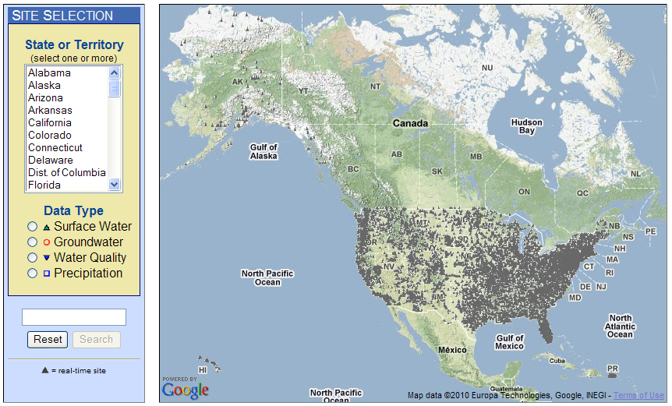
Supporting Society’s
Water Resource Decisions
Prediction of and reaction to floods
  Development of publicly available tools
USGS WaterAlert
http://water.usgs.gov/wateralert/
Sends e-mail or text messages when user-selected parameters exceed user-definable thresholds
Notes:
The U.S. Geological Survey WaterAlert service sends e-mail or text messages when certain parameters measured by a USGS data-collection station exceed user-definable thresholds. The development and maintenance of the WaterAlert system is supported through the USGS Cooperative Water Program, the USGS National Streamflow Information Program, and by USGS data-collection partners, including numerous federal, state, and local agencies. All WaterAlert data are made available from the National Water Information System.
Real-time data from USGS gages are transmitted via satellite or other telemetry to USGS offices at various intervals; in most cases, once every 1 or 4 hours. Emergency transmissions, such as during floods, may be more frequent. Notifications will be based on the data received at these site-dependent intervals.

Slide 13
Society’s Impact on
Water Resources Programs
Funding and funding stability impact USGS’s ability to meet society’s needs
A good example - Funding for the Susquehanna River Basin System streamgages is fairly well balanced among four agencies
The USGS is more than willing to work with any group that is interested in stabilizing and/or enhancing the network
Susquehanna River Basin
Flood Forecasting System Gage Funding
Notes:
Reductions in funding impact the Flood Warning Program directly, but have less effect on the Statewide network because of the diversity of funding sources.
The dedicated funding for the Flood-Forecasting network from the National Weather Service covers slightly less than 25 percent of the funding required to operate and maintain all the stream gages in the Basin’s Warning System network, but only about 10 percent of the statewide network.
The remaining funding comes from various sources—mainly the Pennsylvania Department of Environmental Protection, the U.S. Army Corps of Engineers, and the USGS Cooperative and National Streamflow Information Programs.
As the manager of the multi-agency cooperative streamgaging network, the USGS attempts to include as many funding partners as possible so that temporary or long-term budget shortfalls do not seriously impact the stability of the network. We are always willing to talk to others about how they might contribute to the success of the network’s data-delivery system and assure that the appropriate stream stage and flow data are available when needed to meet a variety of water-management and emergency-management issues.

Slide 14
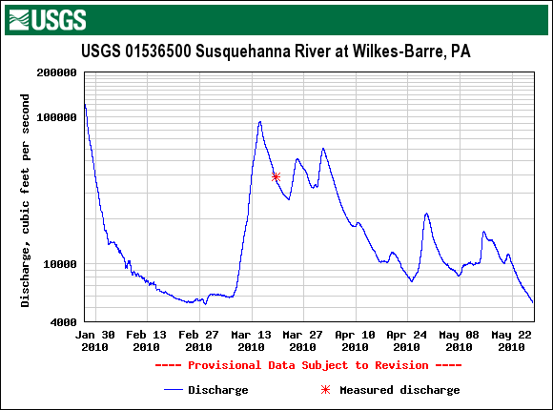
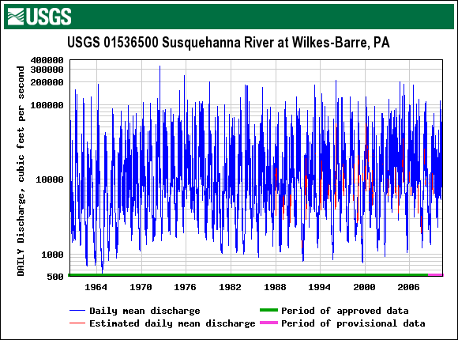
The U. S. Geological Survey
Streamgaging Network
Supporting Society’s
Water-Resource Decisions
Any questions?

