Slide 1
Wilkes-Barre and Agnes, Then and Now
David J. Nicosia
Warning Coordination Meteorologist
NOAA’s National Weather Service
Binghamton NY

Slide 2
Hurricane Agnes Facts
June 14-25, 1972
130 deaths, 122 in the United States.
  24 in New York
  50 in Pennsylvania
15.6 billion dollars (2010 dollars)
7th costliest in United States History
Category 1 Storm
  Maximum sustained winds of 85 mph.
Up to 19 inches of rain fell in the Middle Atlantic States.

Slide 3
Tuesday June 20th, 1972

Slide 4
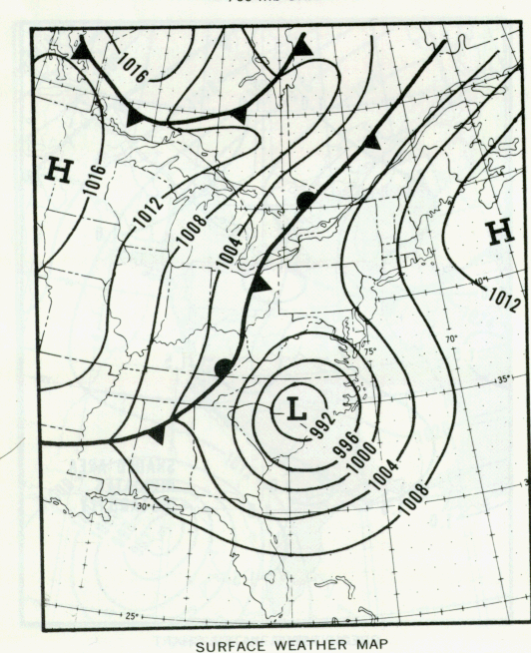
Wednesday June 21st, 1972

Slide 5
Thursday June 22nd, 1972

Slide 6
Friday June 23rd, 1972

Slide 7
Saturday June 24th, 1972

Slide 8
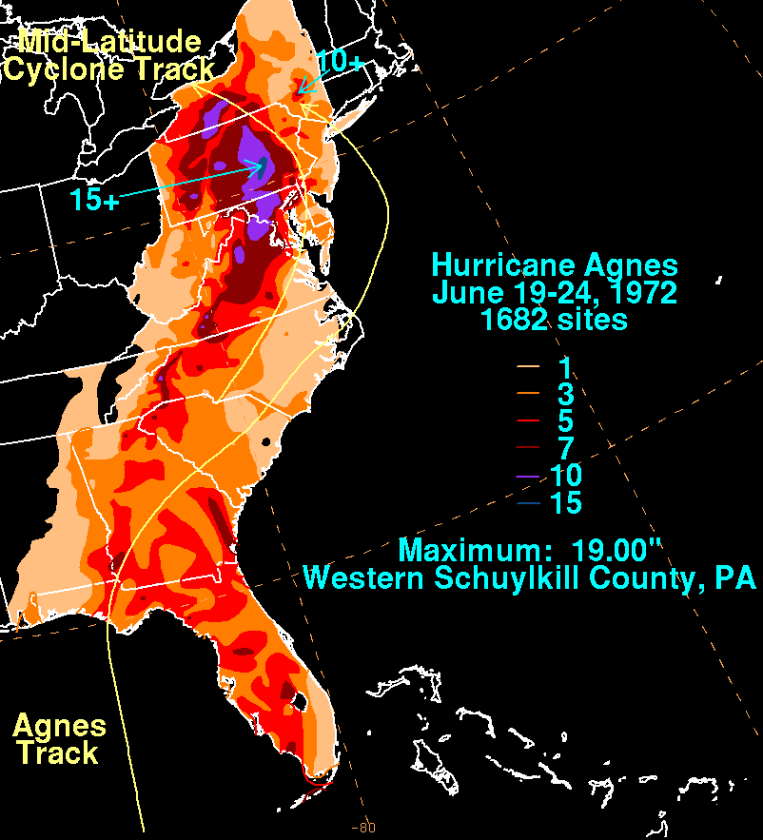
Agnes Rainfall

Slide 9
River Crests Susquehanna Basin
Location Max previously known Agnes Max
Year Height Flow(cfs) Height Flow(cfs)
------------------------------------------------------------------------
Susquehanna River
Towanda, PA 1946 25.08 191,000 33.43 320,000
Wilkes-Barre, PA 1936 33.07 232,000 40.91 345,000
Danville, PA 1936 27.4 250,000 32.16 363,000
Sunbury, PA 1936 34.65 556,000 35.80 620,000
Harrisburg, PA 1936 29.23 740,000 32.57 1,020,000
Marietta, PA 1936 60.73 787,000 64.54 1,080,000
West Branch Susquehanna River
Williamsport, PA 1936 33.57 264,000 34.75 279,000
Chemung River
Chemung, NY 1946 23.97 132,000 31.62 189,000
Corning, NY 1946 37.74 40.71 228,000
Elmira, NY 1946 21.20 25.20

Slide 10
Wilkes-Barre Impacts
Heavy rains begin on Wednesday the 21st and last until Friday the 23rd.
Susquehanna River came over the levee around 1130 am in Wilkes-Barre, Friday June 23rd, 1972.
River crested at 40.91 feet Saturday June 24th, 1972.
  Previous record was 33.07 feet.
  Levee height was close to 37 feet.
Almost entire city was flooded.
  Hundreds of homes and businesses.
One of the hardest hit areas from Agnes.

Slide 11
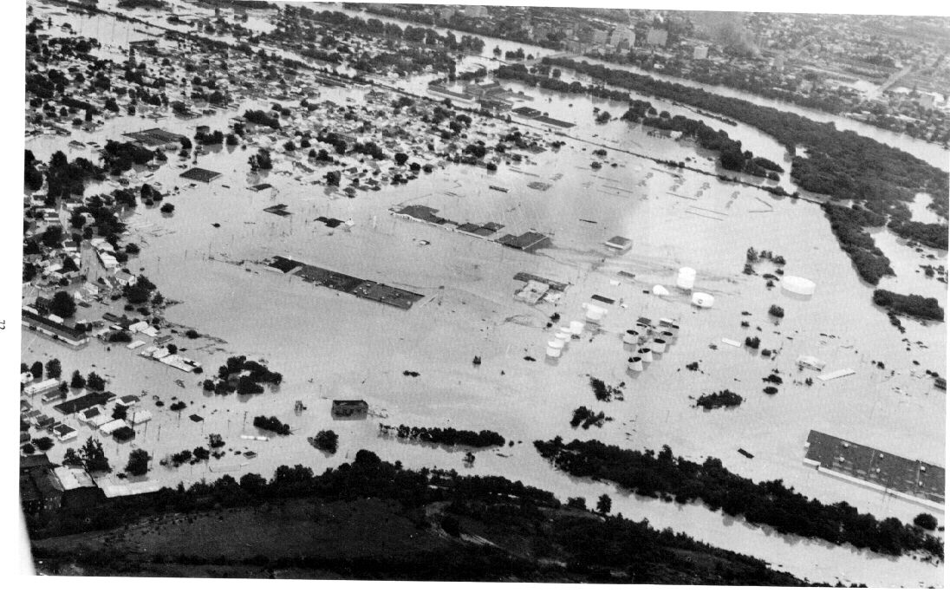
Wyoming Valley Northeast Pennsylvania

Slide 12
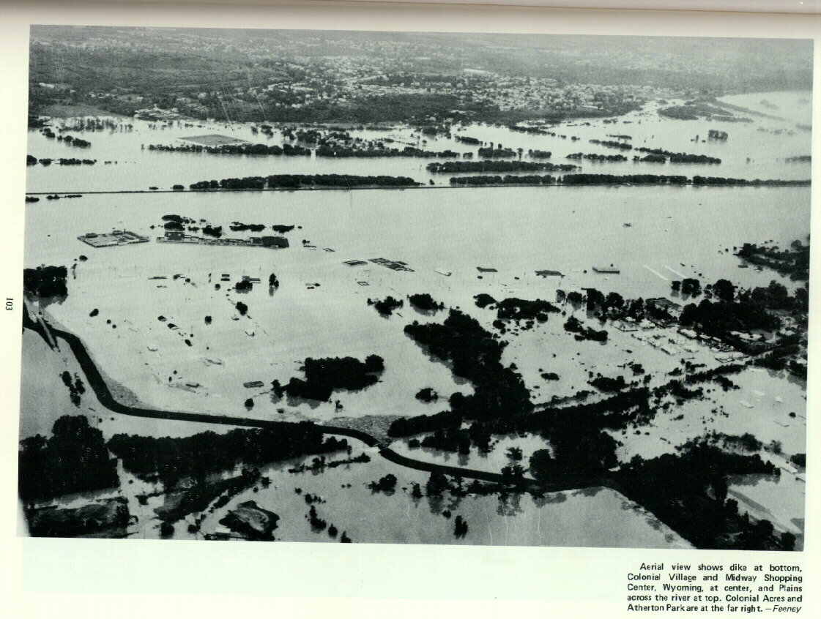
Wilkes-Barre, PA

Slide 13
Wilkes-Barre, PA

Slide 14
Wilkes-Barre, PA

Slide 15
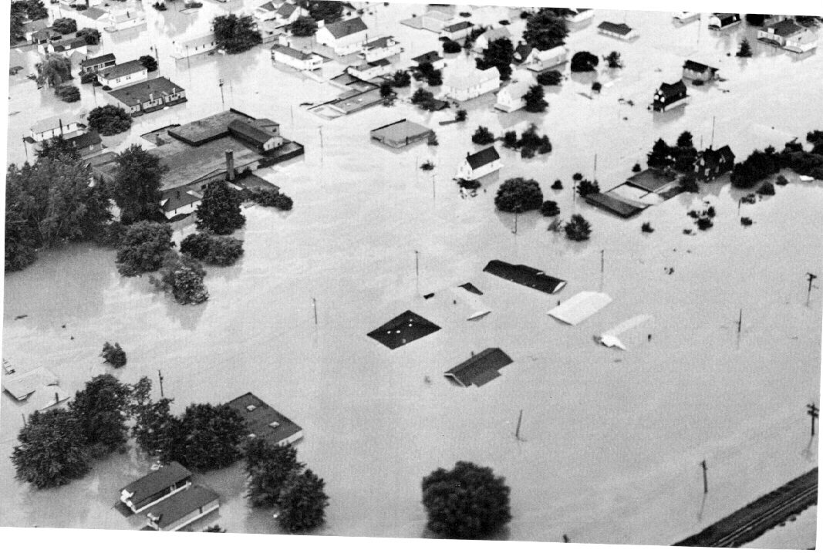
Wilkes-Barre, PA

Slide 16
Wilkes-Barre, PA

Slide 17
Wilkes-Barre, PA

Slide 18
Bloomsburg, PA

Slide 19

Impacts

Slide 20
Destruction

Slide 21
Ground not stable many places

Slide 23
Thousands of Homes damaged

Slide 24
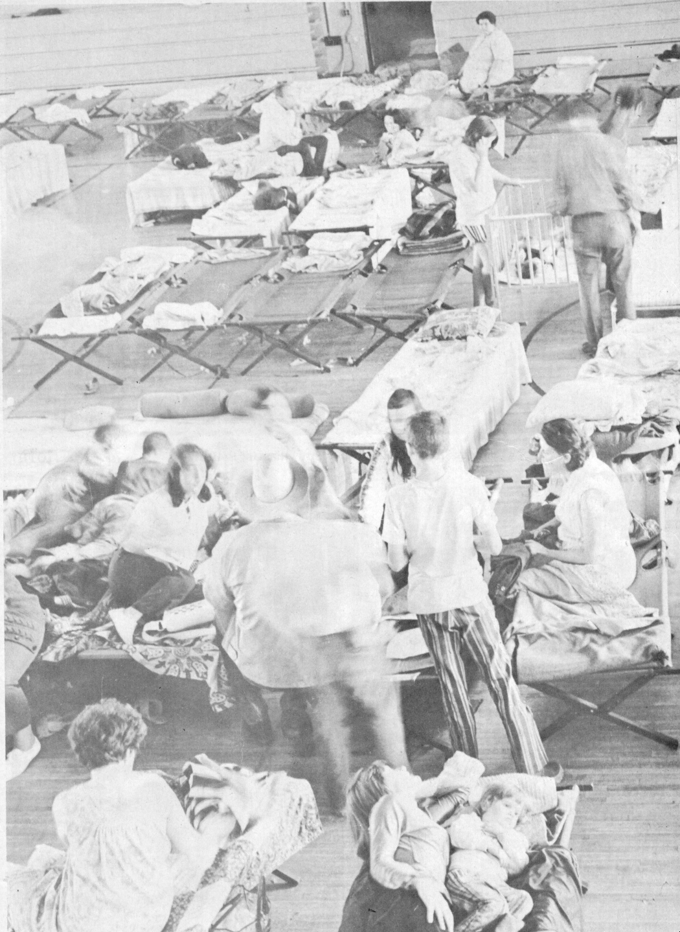
Thousands Displaced

Slide 25
National Guard

Slide 26
Cemetery

Slide 27
Mud

Slide 28
More Mud!

Slide 29
Dust

Slide 30
Dead Fish

Slide 31
Major Business Losses!!

Slide 32
Donations

Slide 33
Could This Happen Again?
Agnes was about a 300 year
flood.
1- in-300 chance every year.
Are we prepared?
How have things changed?

Slide 34
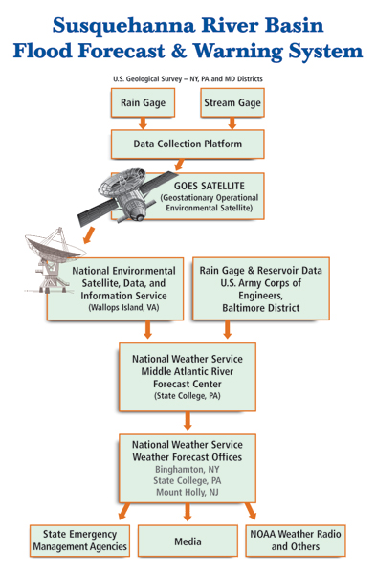

Slide 35
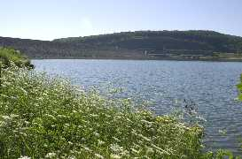
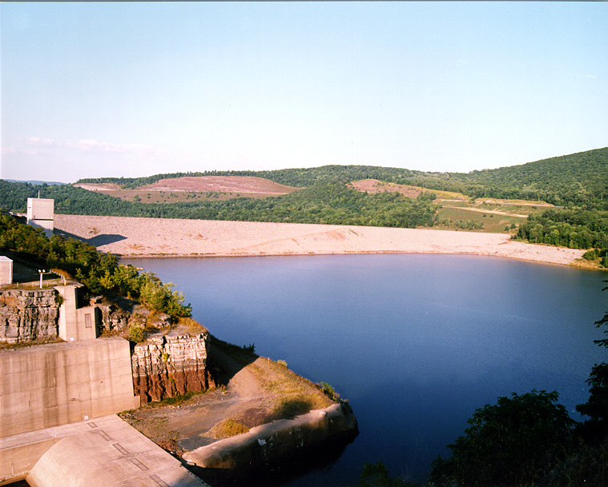
Flood Control Dams
Cowanesque Dam
Reduced flood crests by several feet.
Reduce impact of flooding.
Tioga-Hammond Dam

Slide 36
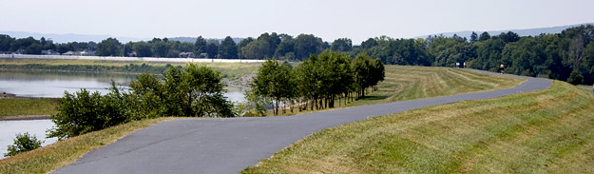
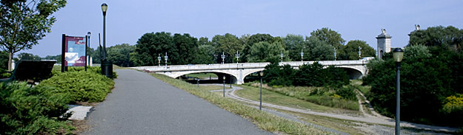
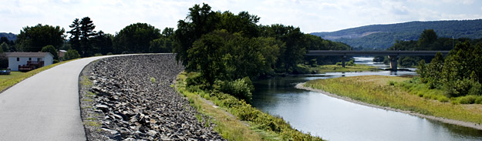
Levees

Slide 37
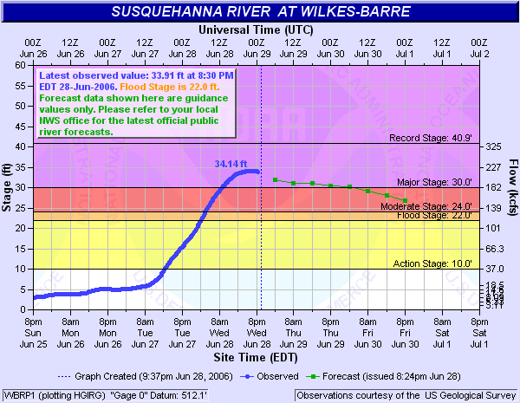
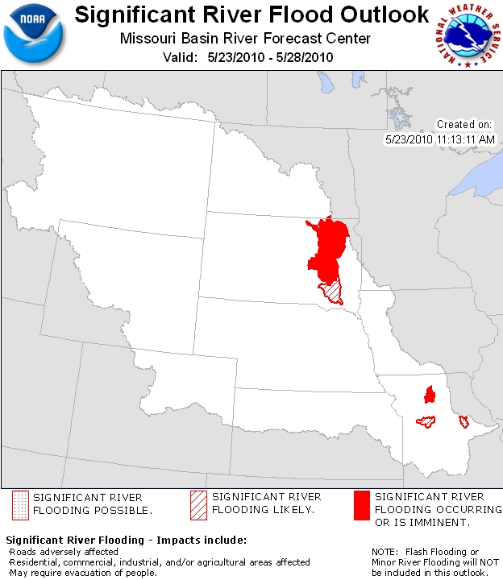
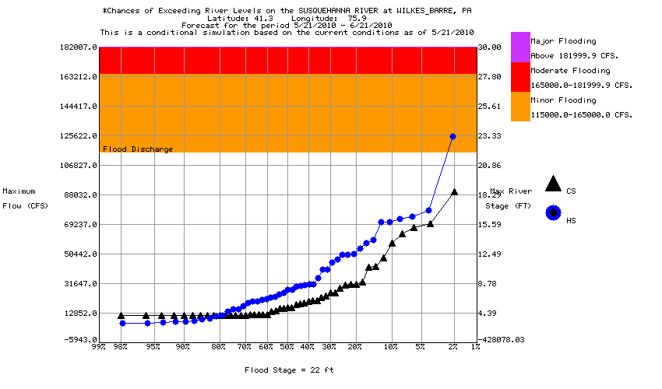
Better River Forecasts and Warnings

Slide 38
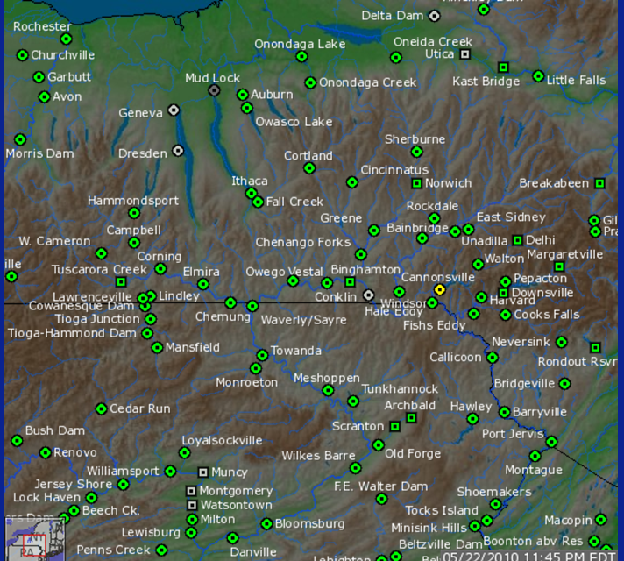
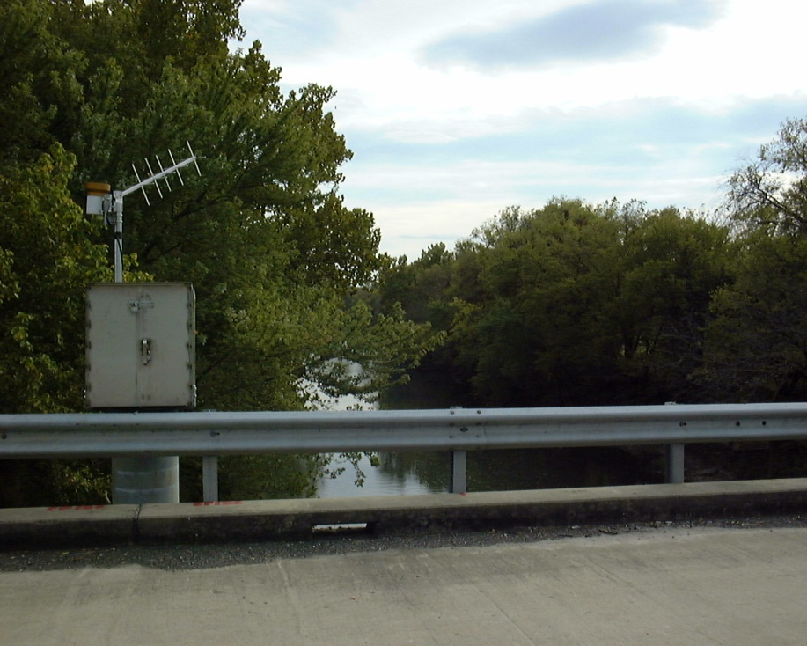
More River Gages
Data every 15 minutes
More accurate river forecasts

Slide 39
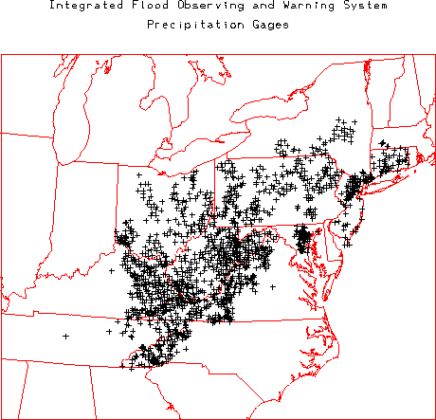
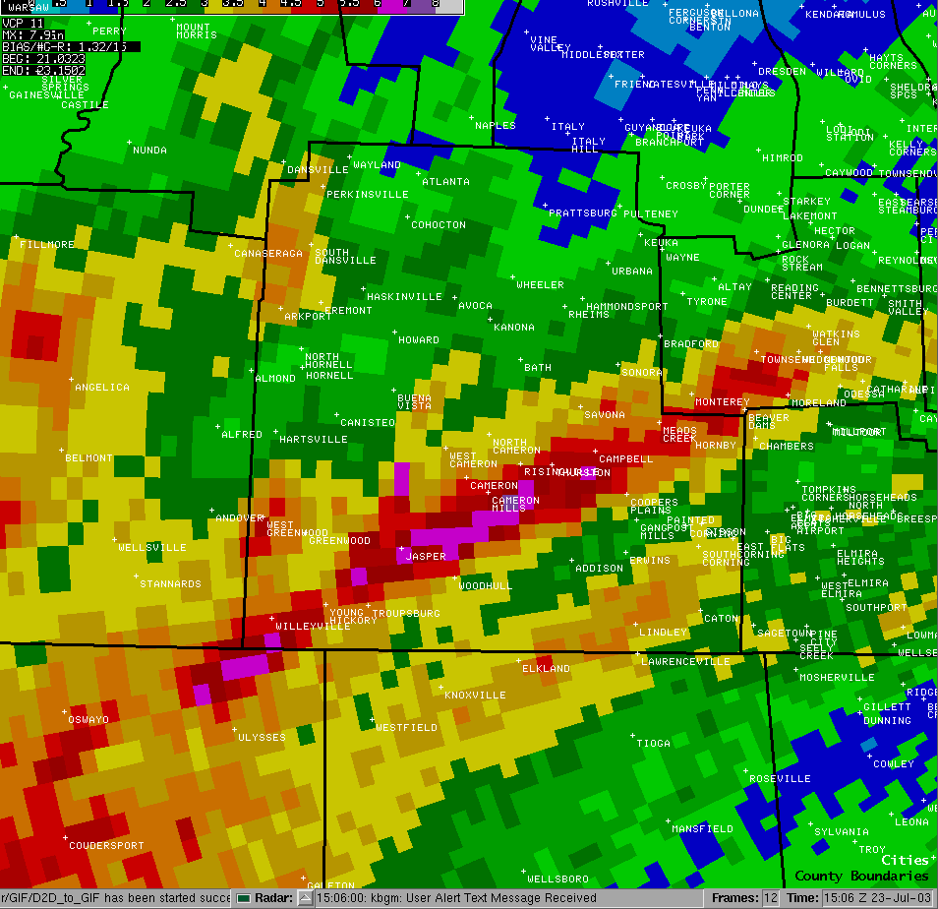
Better Precipitation Data
IFLOWS.
COCORAHS.
Radar rainfall estimation.
Improved mean areal precipitation.
Result: Improved river forecasts.

Slide 40
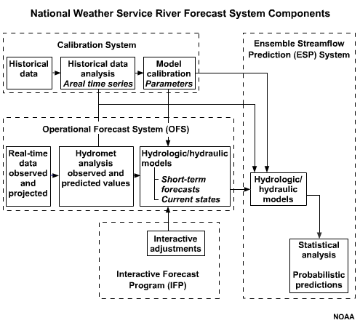
Better River Models
Improved calibration.
More river gauges thus more data points.
Better snowmelt capabilities.
Better rainfall forecasts.
More river forecast points available for longer forecast time periods.
More lead time for major floods.
Better Decision Support

Slide 41


Getting the Word Out

Slide 42
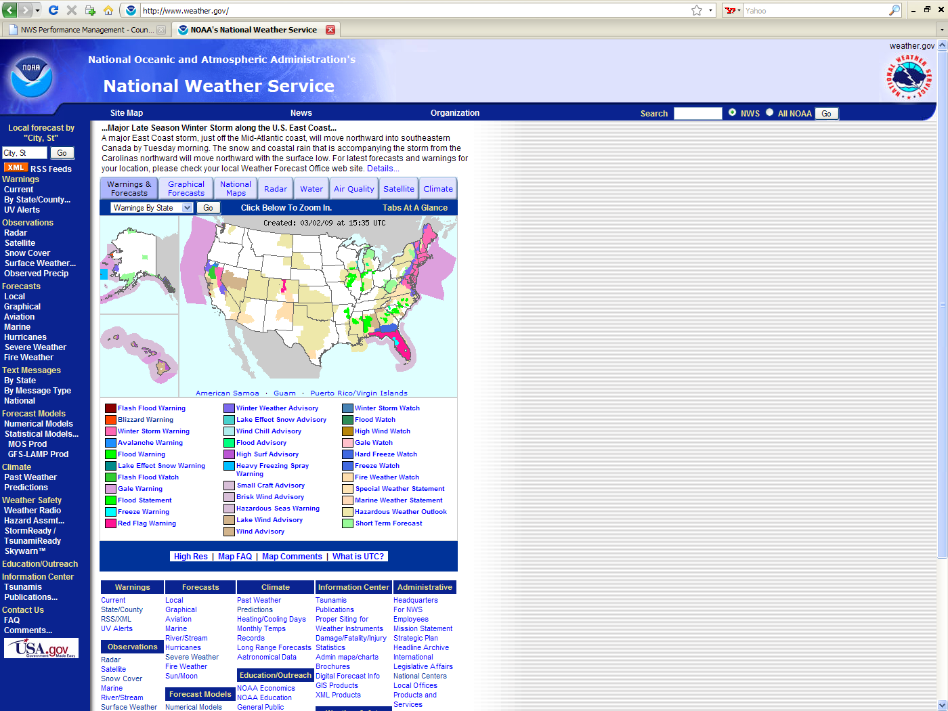
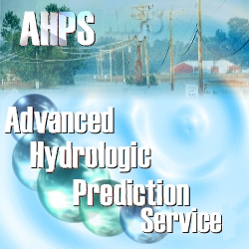
Internet
http://weather.gov

Slide 43

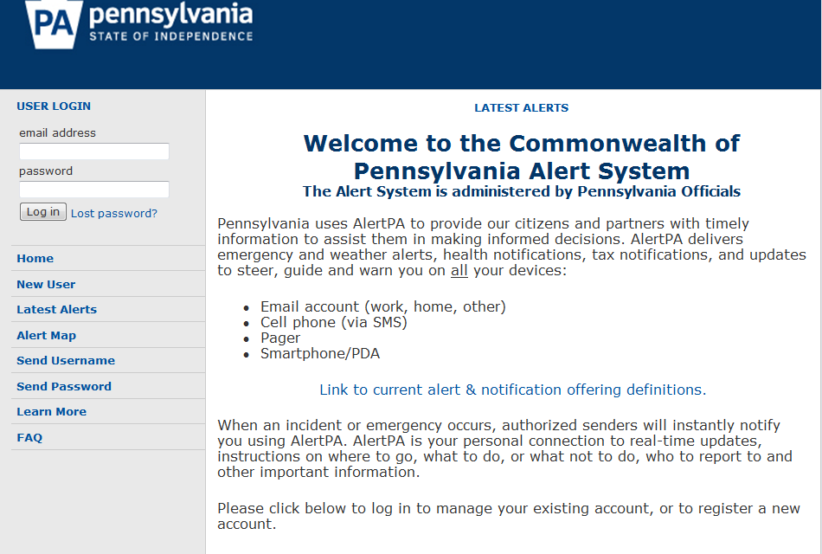
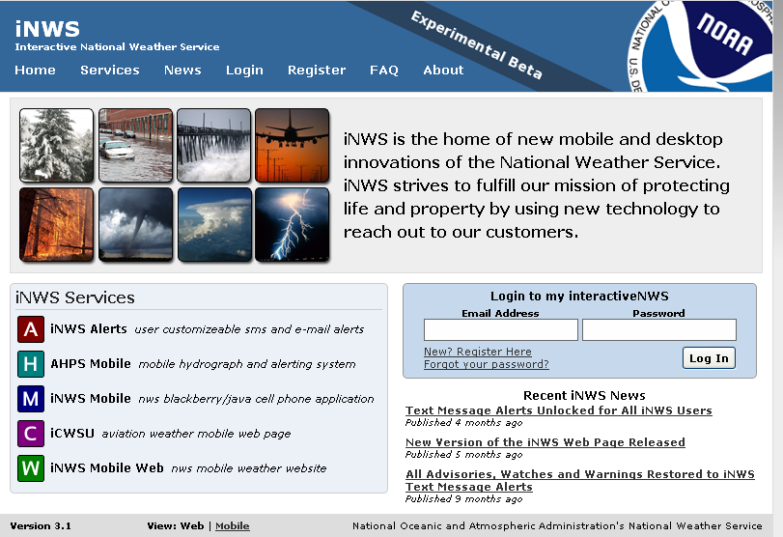
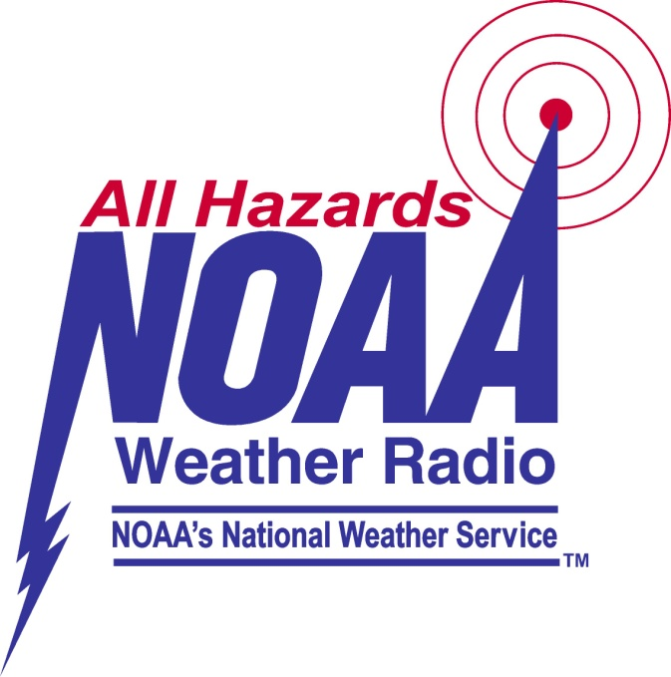


Slide 44
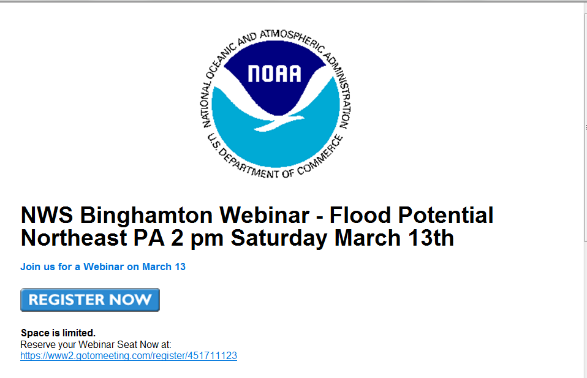
National Weather Service Briefings

Slide 45






Coordination and Partnerships
Local community groups.
  Chemung Basin’s flood warning services
  IFLOWS network.
  CoCoRAHS network.
  SKYWARN.
Emergency management
  StormReady.
Decision Support Services
  Extensive customer briefings days in advance of a potential flood.
  Began customer briefings 5 days in advance before the June 2006 flood.
NWS, DRBC and SRBC are involved in local flood task forces, hazard mitigation workshops, water resources associations, soil and water conservation and other groups.
Strong working relationship with local media.
Research with academic community

Slide 46
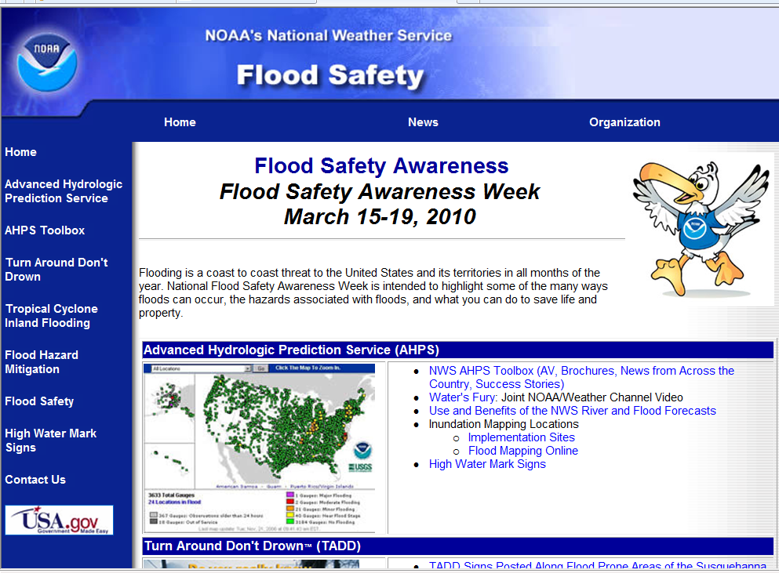
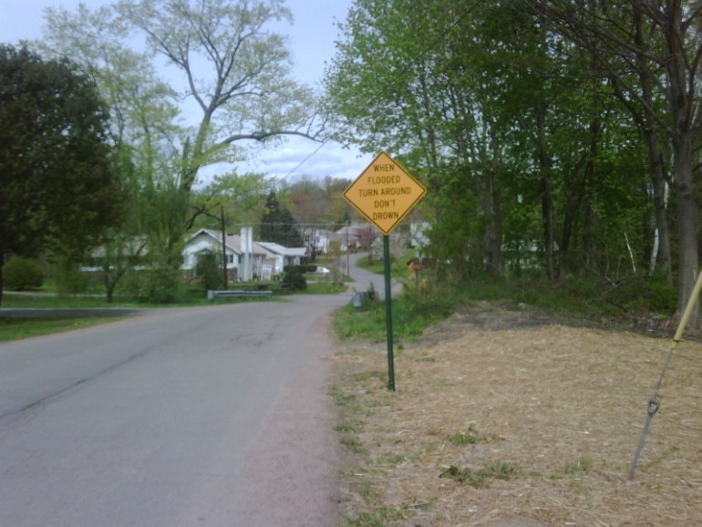
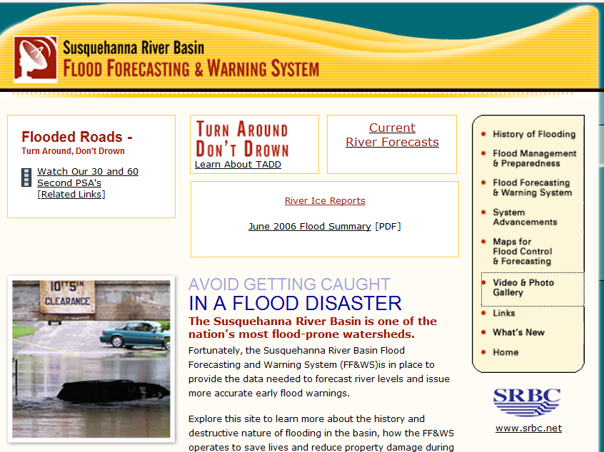

Outreach
SRBC provided funds for over 50 “Turn Around Don’t Drown” Signs for Flood-Prone Roads in Three Southern Tier NY and Two Northern Tier PA Counties

Slide 47
The Future

Slide 48
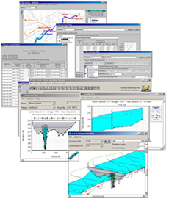

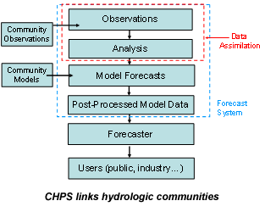
Community Hydrologic Prediction Service (CHPS)

Slide 49
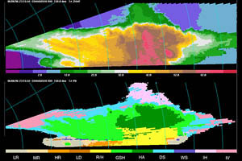
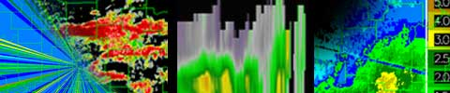
Radar Dual-Polarization
Improved precipitation estimation.
Will improve mean areal precipitation that is used in river forecasts.
Will increase accuracy of flash flood warnings.

Slide 50
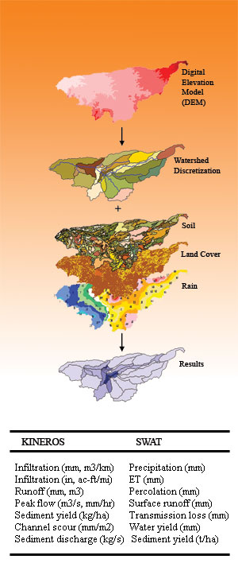
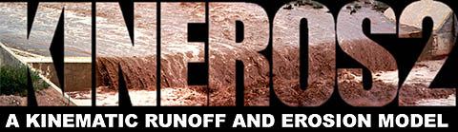
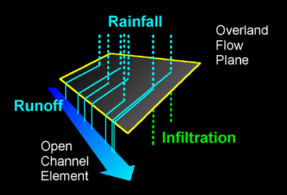
KINEROS and Local River Modeling
More local models to forecast smaller streams and rivers.
Improve flash flood and smaller river forecasts and warnings.

Slide 51

Societal Impacts and River Forecasts
Communicating river and flood information to the public.
Sociology becoming more and more important for effective warnings.
People need to take appropriate actions during floods.

Slide 52
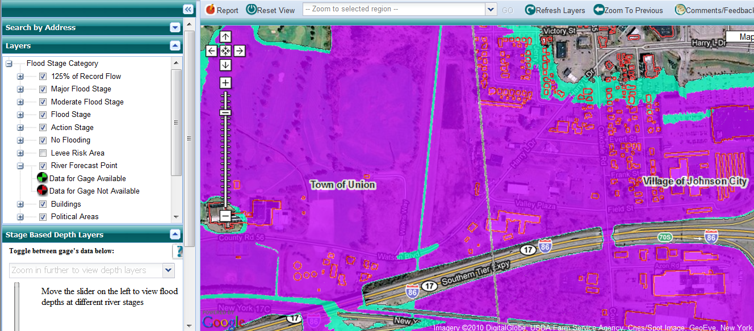
Inundation Mapping
Visualizing flood forecasts.
What does a 37 feet river stage mean at Vestal, NY?
Inundation mapping can tell you.

Slide 53
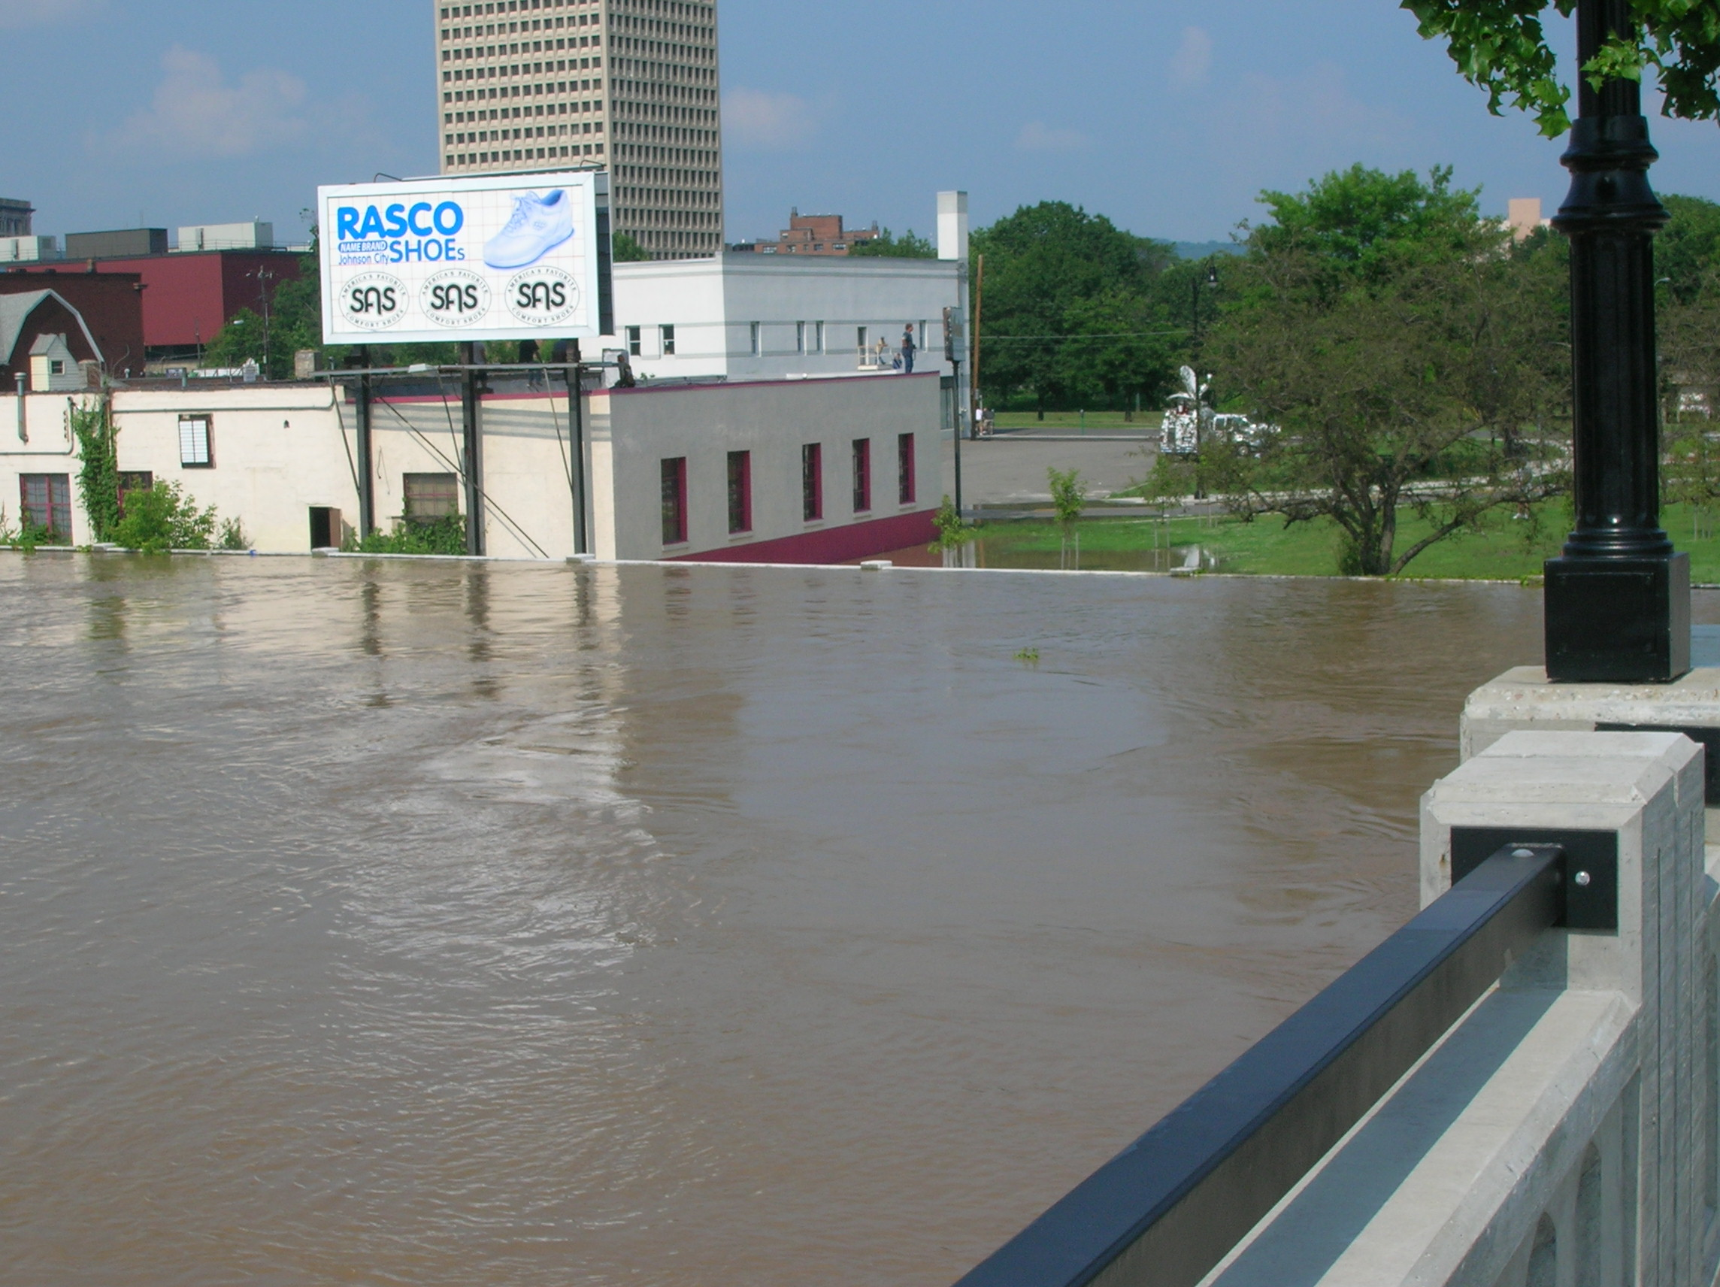
Summary: are we ready for the next big flood?
Binghamton Flood Wall June 2006
The June 2006 flood was a
testament to our increasing state of preparedness
  13 lives lost June 2006
  flood vs. 74 with the Agnes flood in Pennsylvania and New York.
  Still have more work to do!!
The goal of the conference today is to highlight our flood forecast and
warning services, look into future services and most importantly, hear from you,
our stakeholders. Are we meeting your customer needs? How can we serve you better? How can we make our warnings and forecasts more effective?

Slide 54
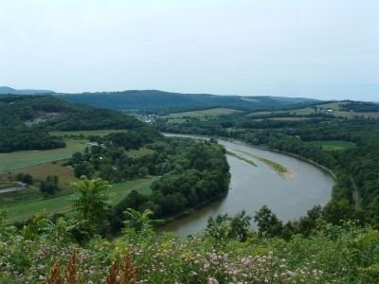
Thanks!!
Susquehanna River near Wyalusing, PA

