Slide 1
Examining Rainfall forecast uncertainty and its impact on river forecasts
David R. Vallee Hydrologist-in-Charge
NOAA/NWS/Northeast River Forecast Center
Eastern Region Flash Flood Conference

Slide 2
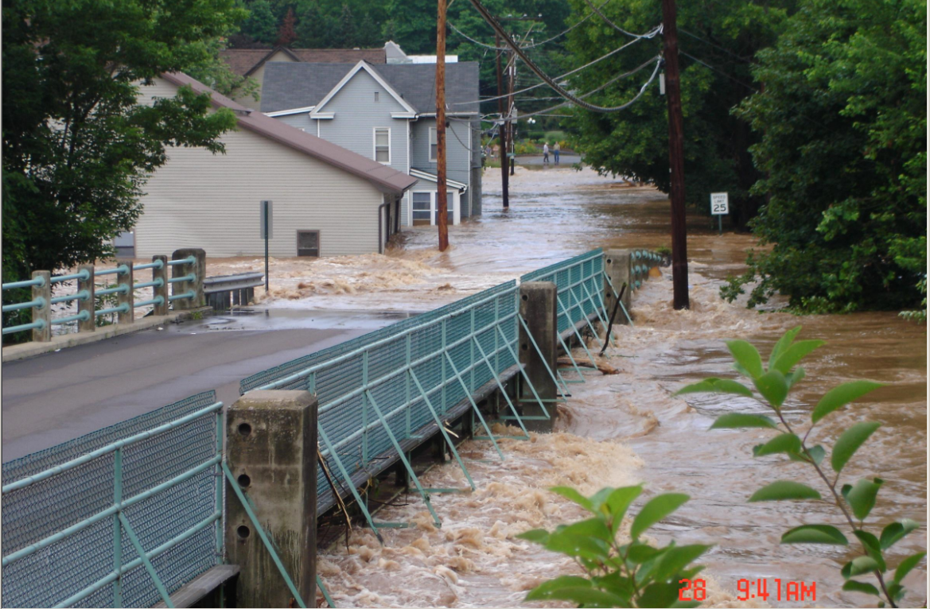
Objectives
Rainfall forecasting for Rivers – Purpose and expectations
Uncertainty – its origins and meaning
A few examples
New/experimental approach to address the uncertainty as it relates to the river forecasting process
Fishing Creek, Fernville, PA, June 28, 2006
Picture courtesy of http://news.webshots.com

Slide 3
Rainfall Forecasting - Purpose
Quantitative Precipitation Forecast which is:
A 24-48 hour forecast representing the expected basin average rainfall in any particular area in discrete 6 hour time steps
Produced through forecaster analysis of the atmosphere, Numerical Model guidance interpretation, and Hydromet Prediction Center (HPC) forecasts
It is a key driver/forcing for our river forecasts
Routine verification conducted

Slide 4
Rainfall Forecasting - Goal
Produce the most accurate QPF to provide the most accurate river forecast
But issues include:
Nature doesn’t operate on our nice and neat 6 hour time steps
By its nature – the art/science of rainfall forecasting remains one of our greatest challenges
By its nature – it is often the greatest source of both river forecast error and uncertainty
At Woonsocket, RI on the Blackstone River a 20 mile displacement on the axis of 4 inch rains = a 4 foot “Over-forecast”!

Slide 5
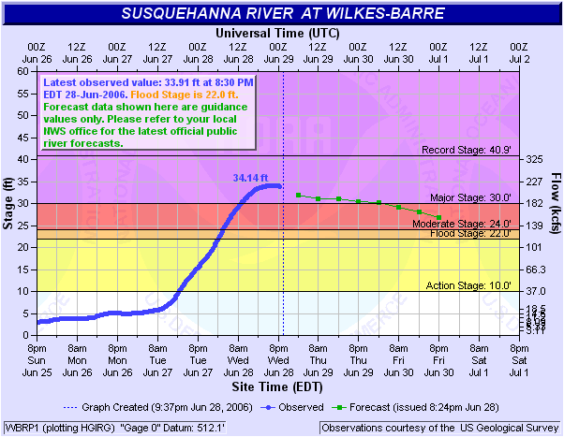
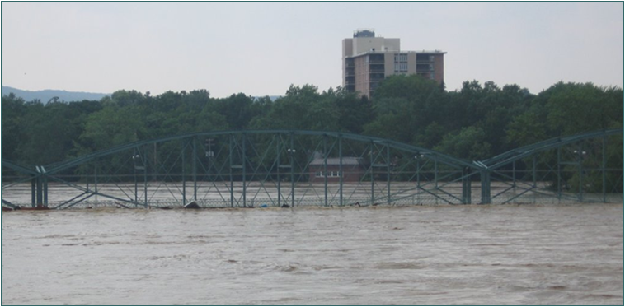
Uncertainty - Its origins and meaning
Arises from different places
Forecaster expertise & experience
Errors in observations
Meteorologic and Hydrologic Modeling Systems
Various resolutions, modeling schemes, antecedent conditions
Basic nature of the weather system
Nor’easters & Tropical Cyclones vs. Convection
The way the rain falls over a basin
What we are trying to accomplish:
Nail the rainfall over the right basin, at the right time step, at the right intensity out to 48 hours!!
The devil is in the almighty details!

Slide 6
Just how uncertain?
Nature provided a small scale example of this over central New York; May 13-14, 2010
Illustrates several key points;
No one model will always have the correct answer
Convective based systems are often the least predictable “until the system ignites”
For Decision Support – our goal is to give you our best forecast but convey the uncertainty and reasons for it; to couch expectations
Resist the urge to focus on every tenth of a foot in our stage forecasts at longer lead times!

Slide 7
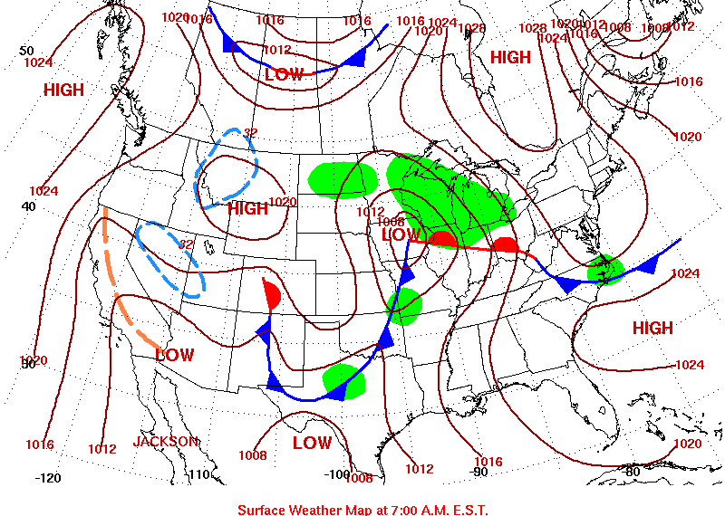
The Potential Event

Slide 8
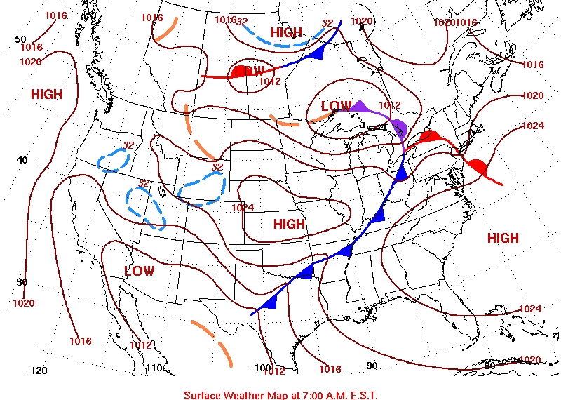
The Potential Event

Slide 9
So where is the axis of 0.1-2.0 inch rains going to fall?
Global Forecast System (GFS)
North American Model (NAM)
Rainfall Forecast for 6 hour period ending 2 am Fri, May 14th

Slide 10
So where is the axis of 1-2 inch rains going to fall?
European Forecast Model (ECMWF)
Canadian Forecast Model (GEM)
Rainfall Forecast for 6 hour period ending 2 am Fri, May 14th

Slide 11
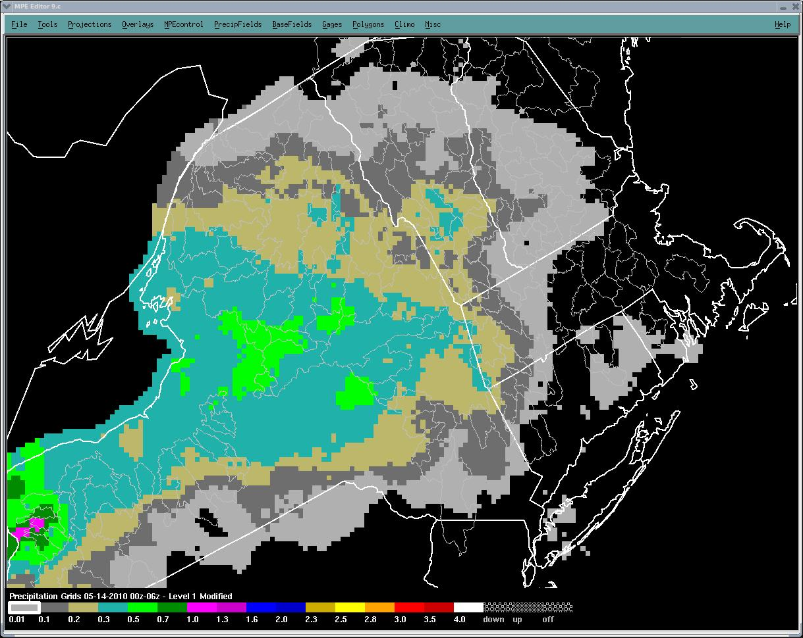
So where is the axis of 1-2 inch rains going to fall?
Northeast River Forecast Center Forecast
Observed rainfall ending 2 am 5/14
Rainfall Forecast for 6 hour period ending 2 am Fri, May 14th

Slide 12
Lets take a far more significant event June 22-30, 2006 Heavy Rains and Flooding
Excellent extended lead time to heavy rainfall potential: 4-7 inches forecast
Highly predictable pattern and flood potential was recognized days in advance
But the devilish details:
Narrow axis of intense rains positioned east of earlier forecasts
Overforecast of rainfall to the west
Communicating this is a challenge!
National Center’s 5 day rainfall forecast

Slide 13
A Different Approach; NCEP s Confidence Forecasts
6 hour forecast – period ending 2 am Fri, May 14
Method objectively quantifies the level of confidence in a given HPC forecast
In general, the larger the spread the greater the uncertainty and thus the lower the confidence
RFCs along the Mississippi are producing river forecasts with each of these forecasts
http://www.hpc.ncep.noaa.gov/qpfci/qpfci.shtml

Slide 14
A new experimental approach Met-member based ensemble forecasts
Method developed by the Ohio, Mid-Atlantic and Northeast RFCs
Suite of hydrologic forecasts are produced using the Rainfall and Temperature forecasts from two numerical prediction systems

Slide 15
Uses similar approach to the 30-90 day Ensemble Streamflow Prediction Technique
The Difference:
These experimental streamflow and melt scenarios are driven by unbiased model forecasts of rainfall and temperature

Slide 16
Rainfall uncertainty and its impact on River Forecasts

Slide 17
Don’t forget snowmelt contributions!

Slide 18
Our Ultimate Goal:

Slide 19
Examining QPF uncertainty and its impact on river forecasts Questions?
David R. Vallee Hydrologist-in-Charge
NOAA/NWS/Northeast River Forecast Center
Eastern Region Flash Flood Conference

